Slide 1
Chapter 6 power series

Slide 2
Working with Taylor Series
Section 6.4

Slide 3
Notes:
The expressions on the right-hand side are known as binomial expansions and the coefficients are known as binomial coefficients.

Slide 4
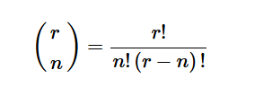
Binomial Coefficient

Slide 7
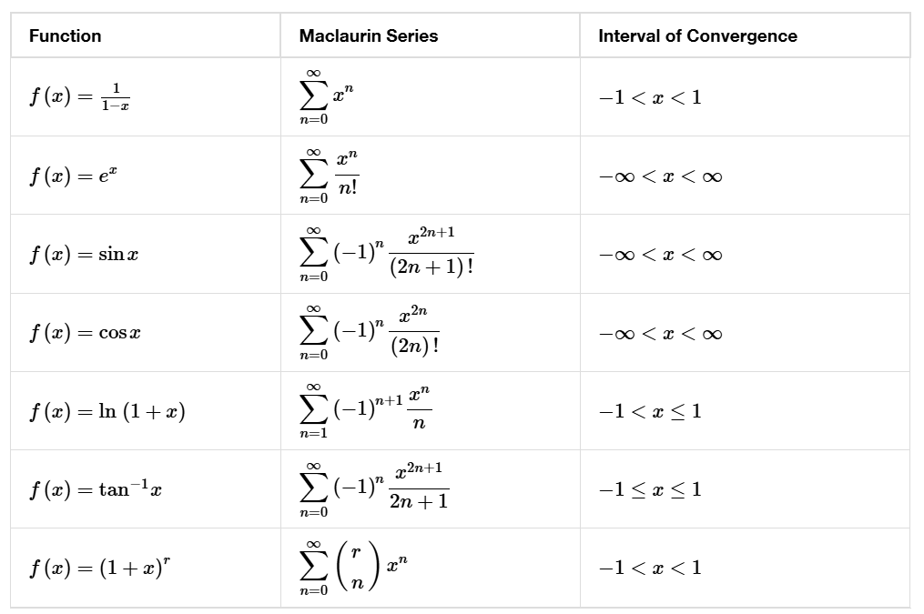

Slide 15
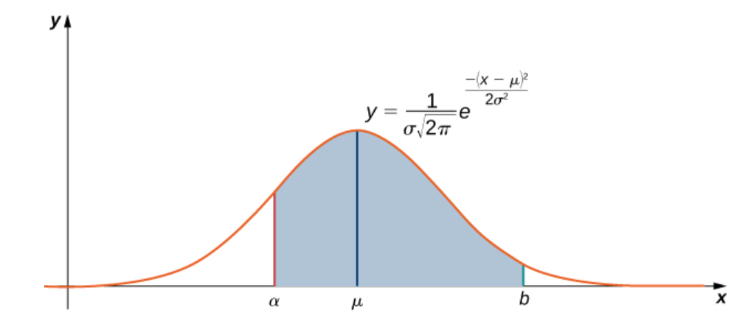
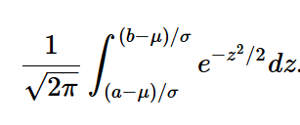
Notes:
In the next example, we will use this integral to calculate a probability.

Slide 18
Parametric equations
Section 7.1
Notes:
In this section we examine parametric equations and their graphs. In the two-dimensional coordinate system, parametric equations are useful for describing curves that are not necessarily functions. The parameter is an independent variable that both x and y depend on, and as the parameter increases, the values of x and y trace out a path along a plane curve. For example, if the parameter is t (a common choice), then t might represent time. Then x and y are defined as functions of time, and ( x(t), y(t) ) can describe the position in the plane of a given object as it moves along a curved path.

Slide 21
Notes:
To better understand the graph of a curve represented parametrically, it is useful to rewrite the two equations as a single equation relating the variables x and y.

Slide 22
Notes:
So far we have seen the method of eliminating the parameter, assuming we know a set of parametric equations that describe a plane curve. What if we would like to start with the equation of a curve and determine a pair of parametric equations for that curve? This is certainly possible, and in fact it is possible to do so in many different ways for a given curve. The process is known as parameterization of a curve.

Slide 24
Applets for Cycloids
https://www.geogebra.org/m/QeQ9aA5e
https://www.desmos.com/calculator/3qsidj1kq5

Slide 25
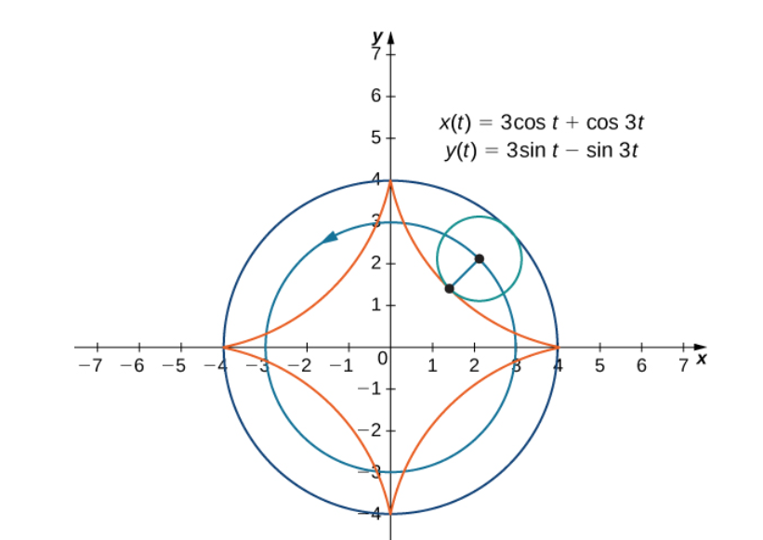

Slide 26
Applets for Hypocycloids
https://www.geogebra.org/m/hbkcjbmh
https://www.desmos.com/calculator/p6o4wxfgsz

Slide 27
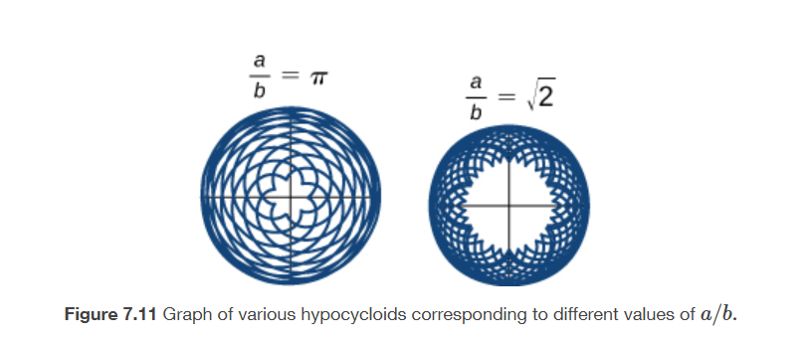

Slide 28
Calculus of Parametric Curves
Section 7.2
Notes:
Now that we have introduced the concept of a parameterized curve, our next step is to learn how to work with this concept in the context of calculus. For example, if we know a parameterization of a given curve, is it possible to calculate the slope of a tangent line to the curve? How about the arc length of the curve? Or the area under the curve?

Slide 30
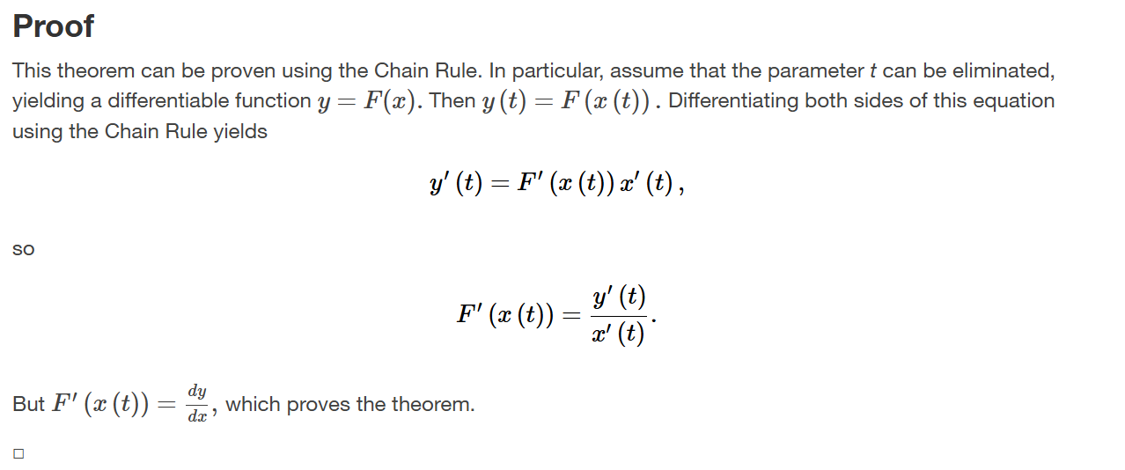

Slide 35
Area
Arc Length
Surface Area

Slide 42
Area
Arc Length
Surface Area

