Slide 1
Chapter 7 Parametric Equations and Polar Coordinates

Slide 2
Polar Coordinates
Section 7.3

Slide 3
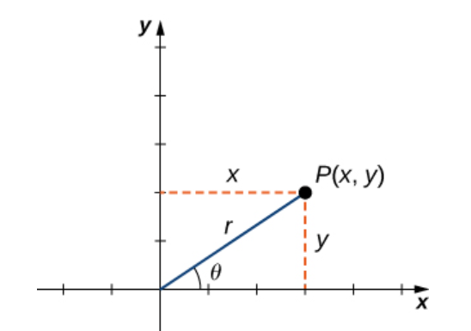
Notes:
Each point (x,y) in the Cartesian coordinate system can therefore be represented as an ordered pair (r,θ) in the polar coordinate system. The first coordinate is called the radial coordinate and the second coordinate is called the angular coordinate. Every point in the plane can be represented in this form.

Slide 4
Notes:
Every point in the plane has an infinite number of representations in polar coordinates. However, each point in the plane has only one representation in the rectangular coordinate system.
Note that the polar representation of a point in the plane also has a visual interpretation. In particular, r is the directed distance that the point lies from the origin, and θ measures the angle that the line segment from the origin to the point makes with the positive x-axis. Positive angles are measured in a counterclockwise direction and negative angles are measured in a clockwise direction.

Slide 6
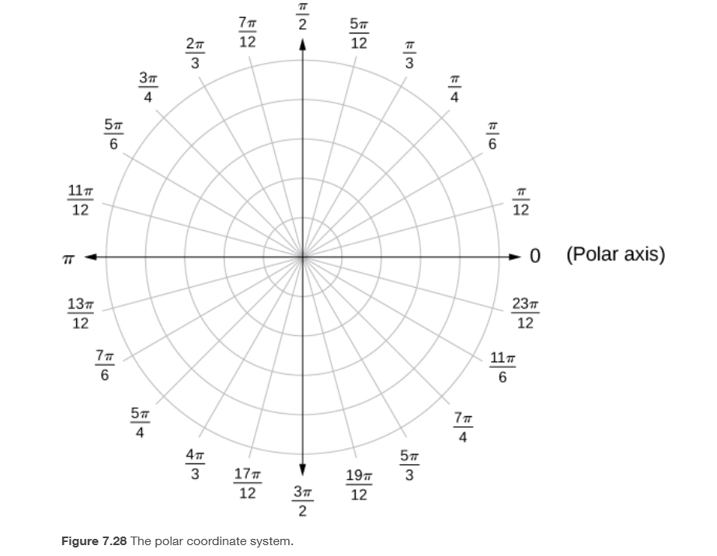
Notes:
The line segment starting from the center of the graph going to the right (called the positive x-axis in the Cartesian system) is the polar axis. The center point is the pole, or origin, of the coordinate system, and corresponds to r=0. The innermost circle shown in Figure 7.28 contains all points a distance of 1 unit from the pole, and is represented by the equation r=1. Then r=2 is the set of points 2 units from the pole, and so on. The line segments emanating from the pole correspond to fixed angles. To plot a point in the polar coordinate system, start with the angle. If the angle is positive, then measure the angle from the polar axis in a counterclockwise direction. If it is negative, then measure it clockwise. If the value of r is positive, move that distance along the terminal ray of the angle. If it is negative, move along the ray that is opposite the terminal ray of the given angle.

Slide 8
Notes:
The general idea behind graphing a function in polar coordinates is the same as graphing a function in rectangular coordinates. Start with a list of values for the independent variable (θ in this case) and calculate the corresponding values of the dependent variable r. This process generates a list of ordered pairs, which can be plotted in the polar coordinate system. Finally, connect the points, and take advantage of any patterns that may appear. The function may be periodic, for example, which indicates that only a limited number of values for the independent variable are needed.

Slide 10
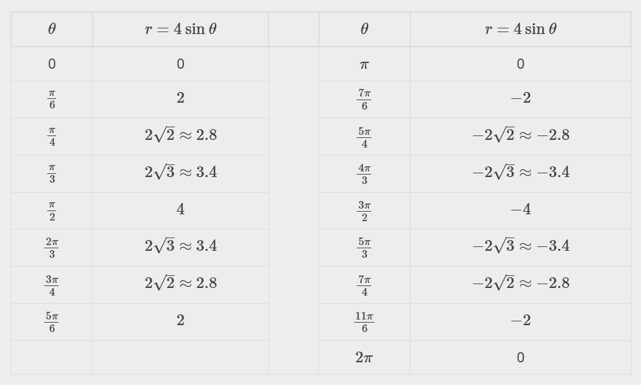
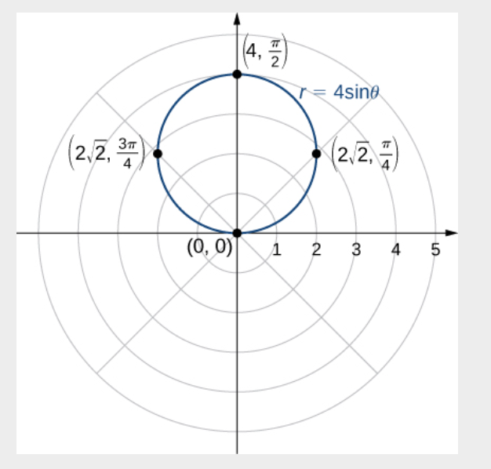
Notes:
Also graph using a tool such as desmos.com.

Slide 11
Hint: Multiply both sides of the equation by $r$, then use the equation to express the equation in terms of $x$ and $y$.
Notes:
Also graph using a tool such as desmos.com.

Slide 12
Notes:
A polar equation is an equation with r and θ.

Slide 13
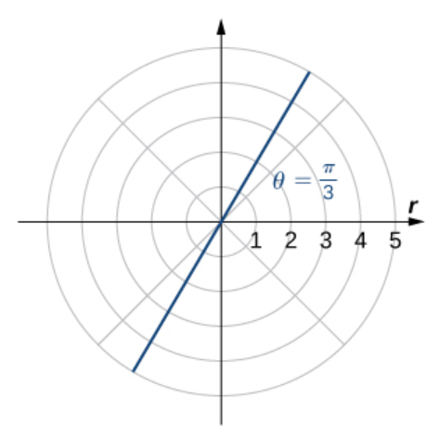
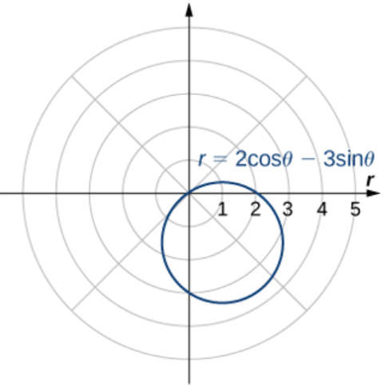
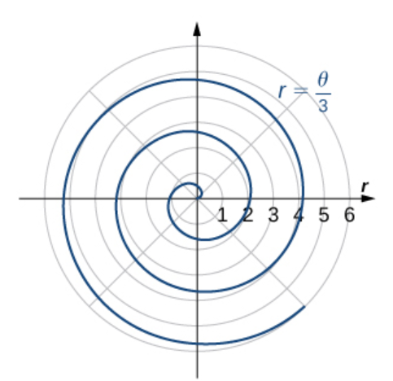
Common Polar Curves
Description | Polar Equation | Example

Slide 14
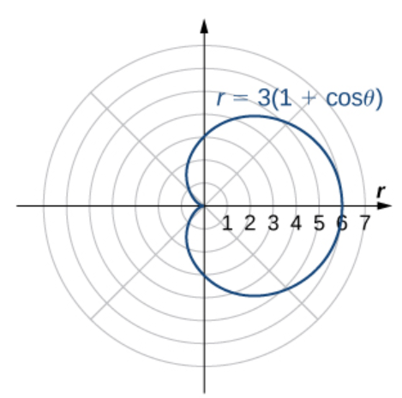
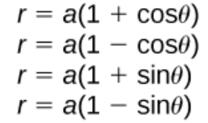
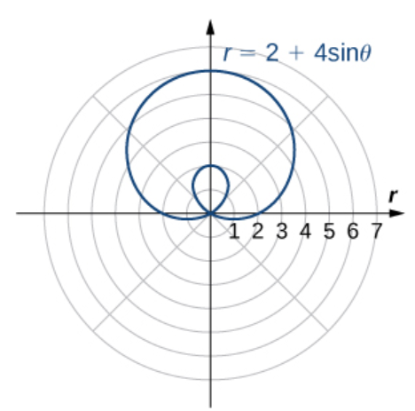
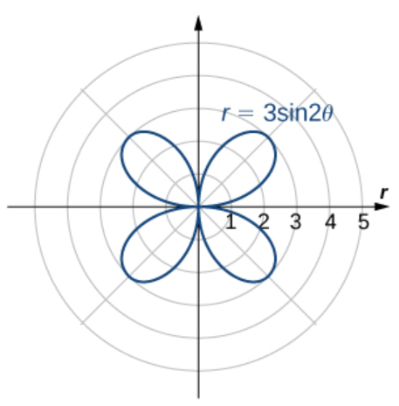
Common Polar Curves
Description | Polar Equation | Example

Slide 17
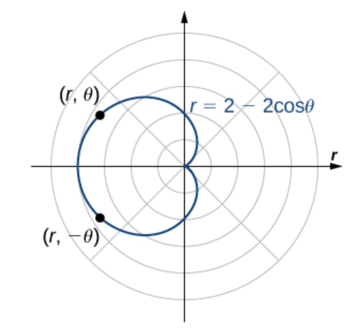
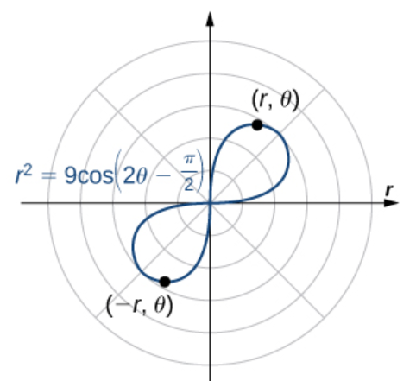
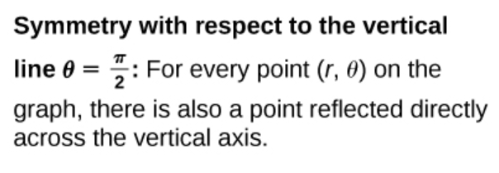
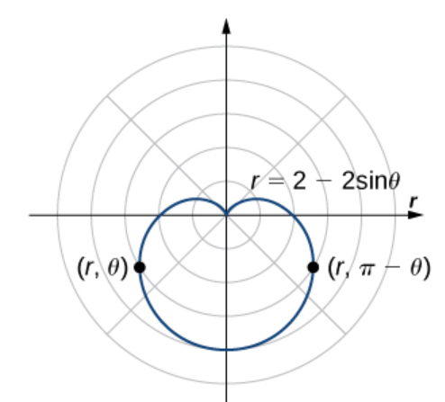

Slide 19
Area and Arc Length in Polar Coordinates
Section 7.4

Slide 20
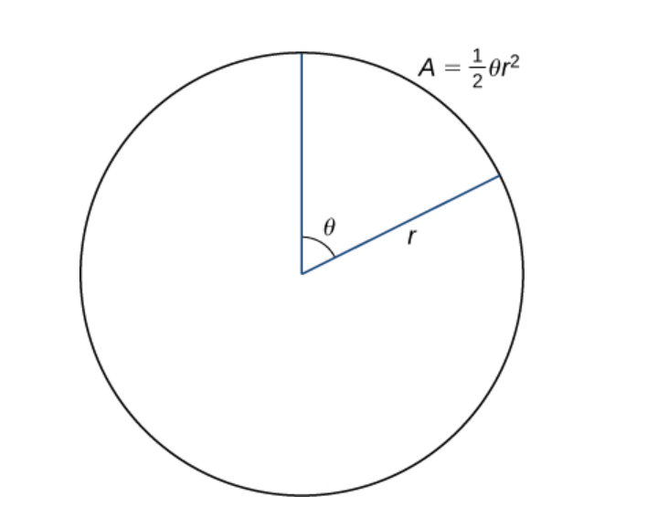

Slide 21
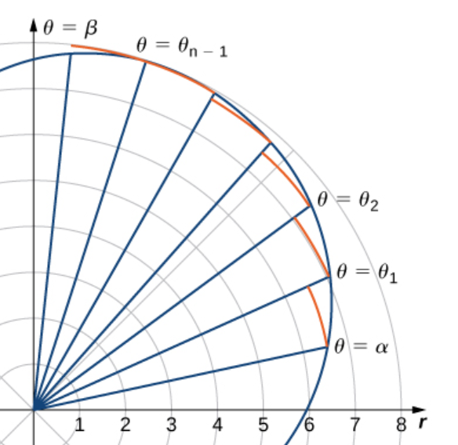
Notes:
The line segments are connected by arcs of constant radius. This defines sectors whose areas can be calculated by using a geometric formula. The area of each sector is then used to approximate the area between successive line segments. We then sum the areas of the sectors to approximate the total area. This approach gives a Riemann sum approximation for the total area.

Slide 24
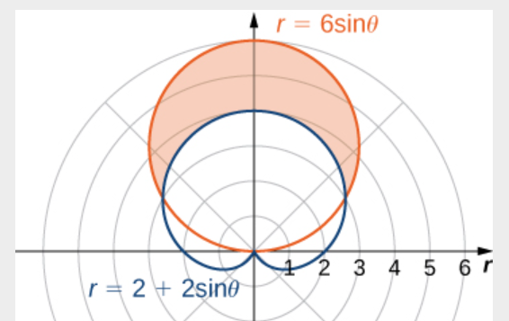
Notes:
In the previous example, we found the area inside one curve. We can also find the area between two polar curves. However, we often need to find the points of intersection of the curves and determine which function defines the outer curve or the inner curve between these two points.

Slide 25
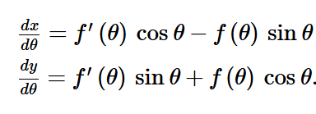

Slide 28
Conic Sections
Section 7.4

Slide 29
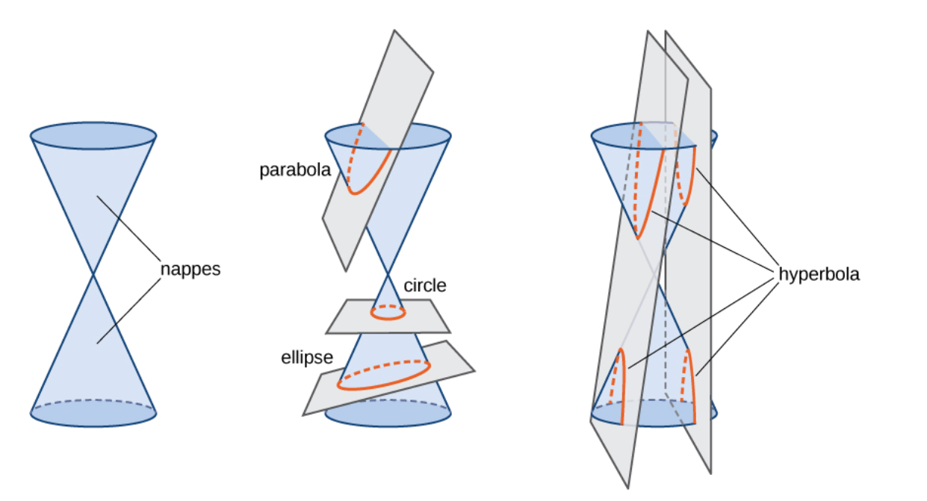
Conic Sections
Notes:
Conic sections are generated by intersecting a plane with a cone. A cone has two identically shaped parts called nappes. One nappe is what most people mean by “cone,” having the shape of a party hat. A right circular cone can be generated by revolving a line passing through the origin around the y-axis. If the plane is parallel to the generating line, the conic section is a parabola. If the plane is perpendicular to the axis of revolution, the conic section is a circle. If the plane intersects one nappe at an angle to the axis (other than 90°),90°), then the conic section is an ellipse. If the plane intersects both nappes, then the conic section is a hyperbola.

Slide 30
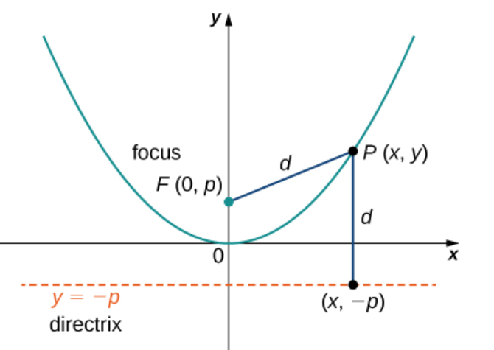

Slide 32
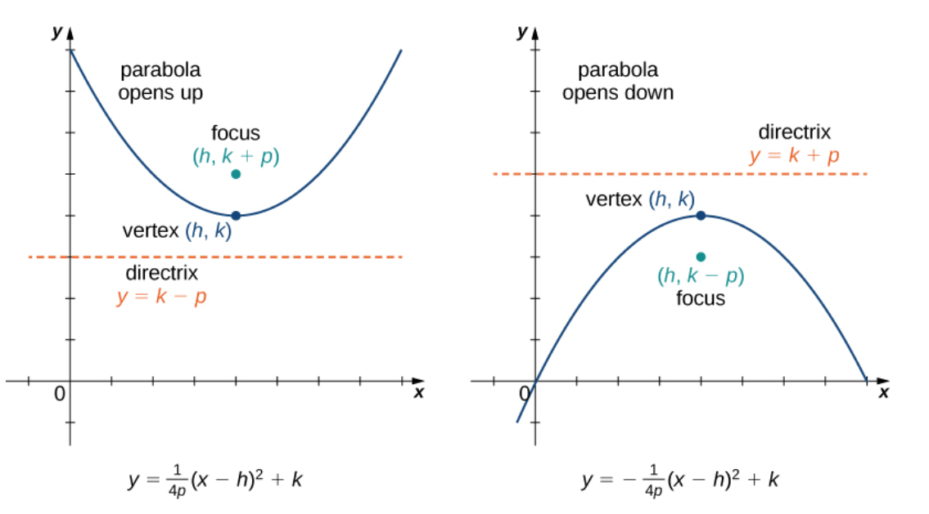

Slide 33
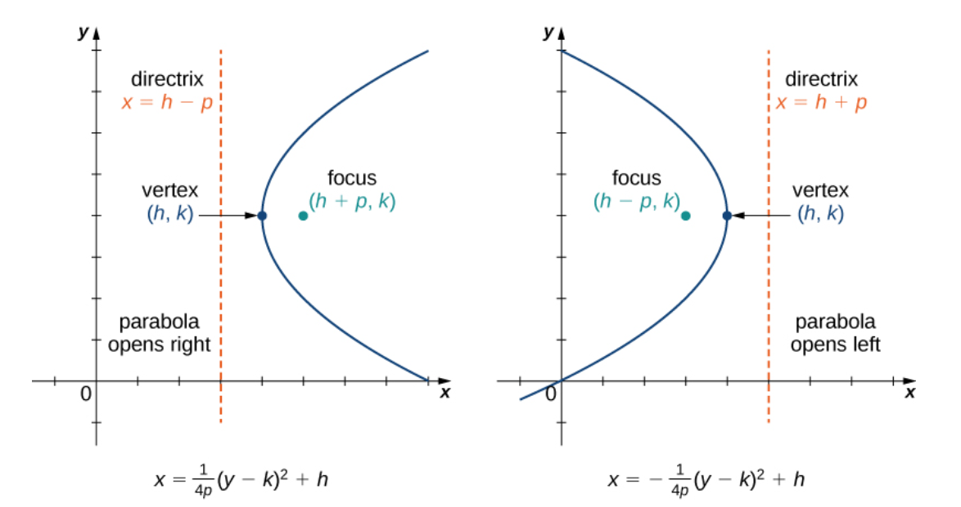

Slide 36
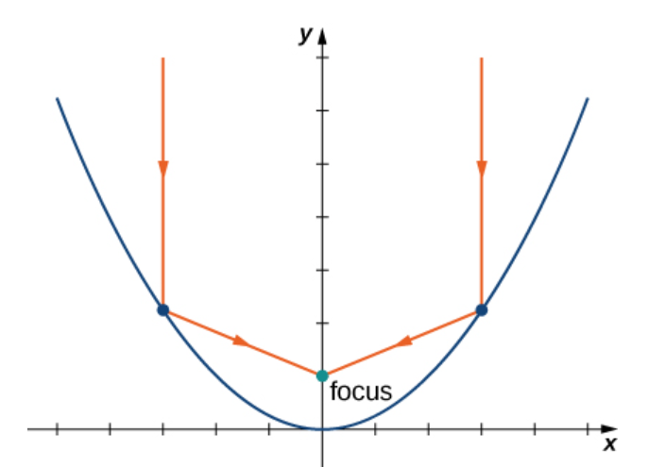
Notes:
The axis of symmetry of a vertical (opening up or down) parabola is a vertical line passing through the vertex. The parabola has an interesting reflective property. Suppose we have a satellite dish with a parabolic cross section. If a beam of electromagnetic waves, such as light or radio waves, comes into the dish in a straight line from a satellite (parallel to the axis of symmetry), then the waves reflect off the dish and collect at the focus of the parabola as shown. Flashlights and headlights in a car work on the same principle, but in reverse: the source of the light (that is, the light bulb) is located at the focus and the reflecting surface on the parabolic mirror focuses the beam straight ahead. This allows a small light bulb to illuminate a wide angle of space in front of the flashlight or car.

Slide 37
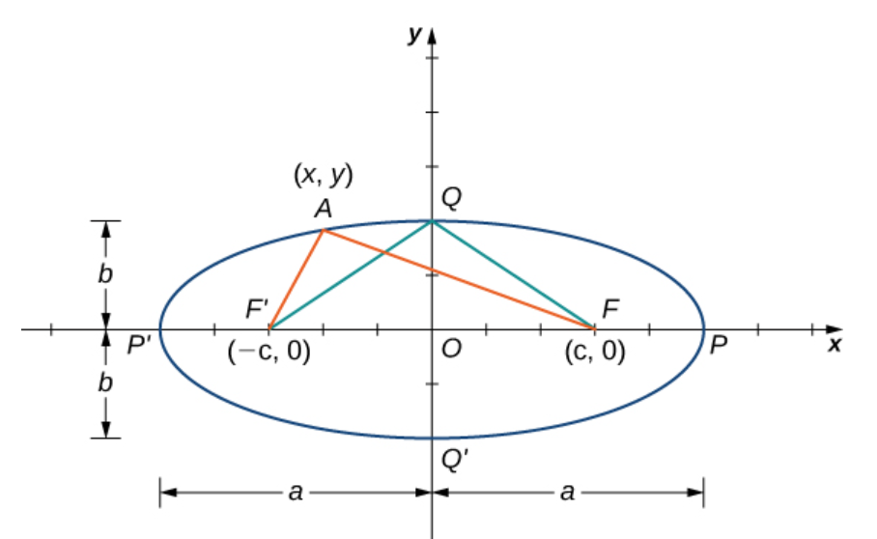
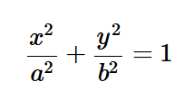

Slide 41
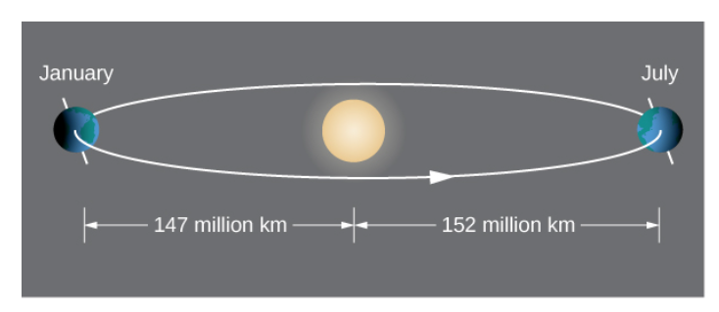
Notes:
According to Kepler’s first law of planetary motion, the orbit of a planet around the Sun is an ellipse with the Sun at one of the foci as shown in Figure 7.50(a). Because Earth’s orbit is an ellipse, the distance from the Sun varies throughout the year. A commonly held misconception is that Earth is closer to the Sun in the summer. In fact, in summer for the northern hemisphere, Earth is farther from the Sun than during winter. The difference in season is caused by the tilt of Earth’s axis in the orbital plane. Comets that orbit the Sun, such as Halley’s Comet, also have elliptical orbits, as do moons orbiting the planets and satellites orbiting Earth.

Slide 42
Notes:
Ellipses also have interesting reflective properties: A light ray emanating from one focus passes through the other focus after mirror reflection in the ellipse. The same thing occurs with a sound wave as well. The National Statuary Hall in the U.S. Capitol in Washington, DC, is a famous room in an elliptical shape as shown in Figure 7.50(b). This hall served as the meeting place for the U.S. House of Representatives for almost fifty years. The location of the two foci of this semi-elliptical room are clearly identified by marks on the floor, and even if the room is full of visitors, when two people stand on these spots and speak to each other, they can hear each other much more clearly than they can hear someone standing close by.

Slide 43
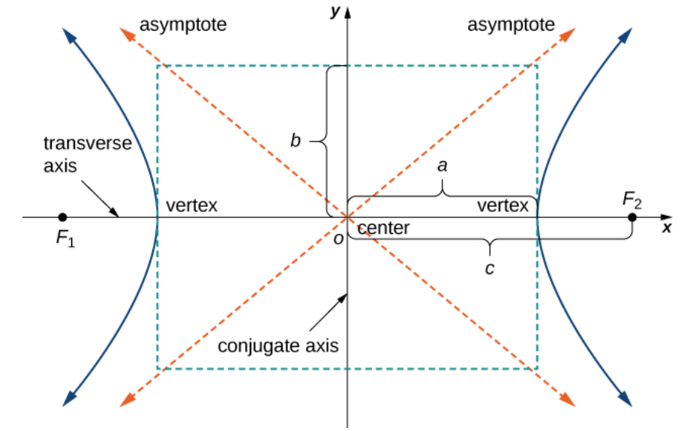

Slide 48
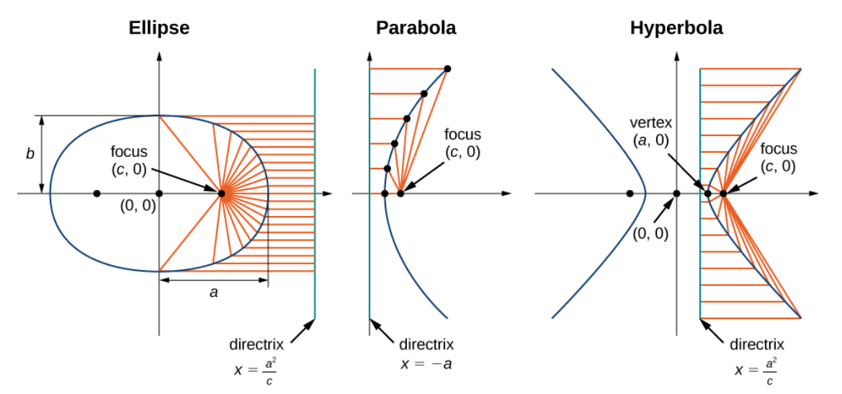
Notes:
Compare the distances a and c.

Slide 50
Notes:
Using the definitions of the focal parameter and eccentricity of the conic section, we can derive an equation for any conic section in polar coordinates. In particular, we assume that one of the foci of a given conic section lies at the pole. Then using the definition of the various conic sections in terms of distances, it is possible to prove the following theorem.

Slide 51
Notes:
Note again, that we assume that one of the foci of a given conic section lies at the pole.

Slide 53
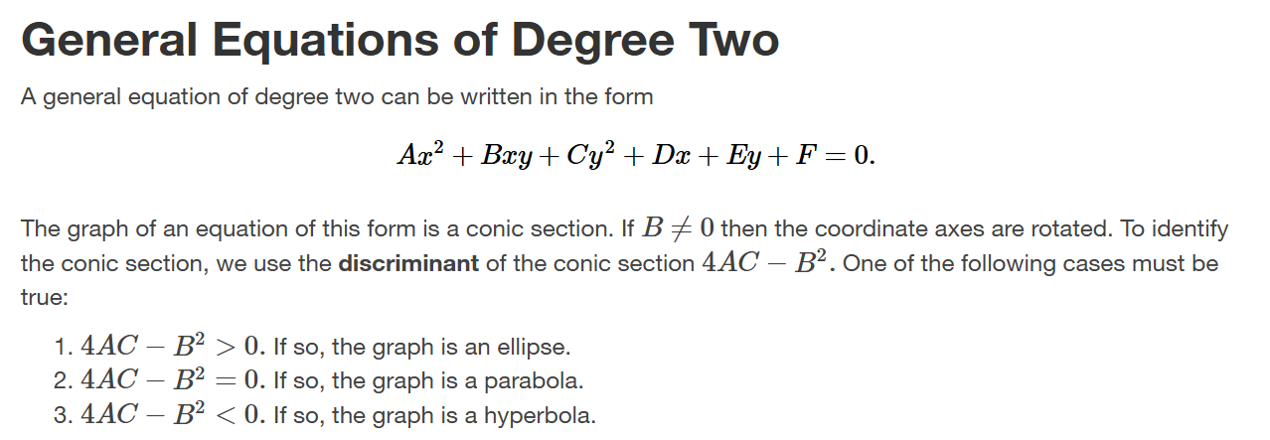

Slide 55
