Slide 1
Chapter 6 power series

Slide 2
Power series and functions
Section 6.1
Notes:
In this section we define power series and show how to determine when a power series converges and when it diverges. We also show how to represent certain functions using power series. Power series have applications in a variety of fields, including physics, chemistry, biology, and economics. As we will see in this chapter, representing functions using power series allows us to solve mathematical problems that cannot be solved with other techniques.

Slide 3
Notes:
A power series is a type of series with terms involving a variable. More specifically, if the variable is x, then all the terms of the series involve powers of x. As a result, a power series can be thought of as an infinite polynomial. Power series are used to represent common functions and also to define new functions.

Slide 4
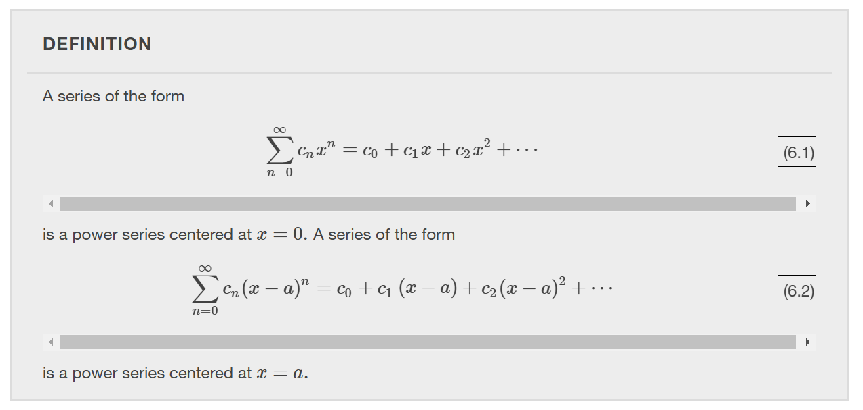

Slide 5
Notes:
Since the terms in a power series involve a variable x, the series may converge for certain values of x and diverge for other values of x. We now summarize the three possibilities for a general power series.

Slide 7
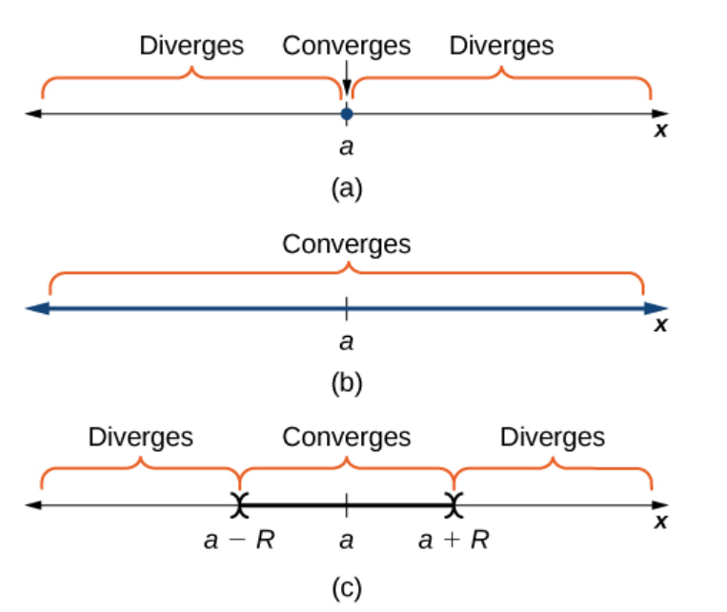

Slide 10
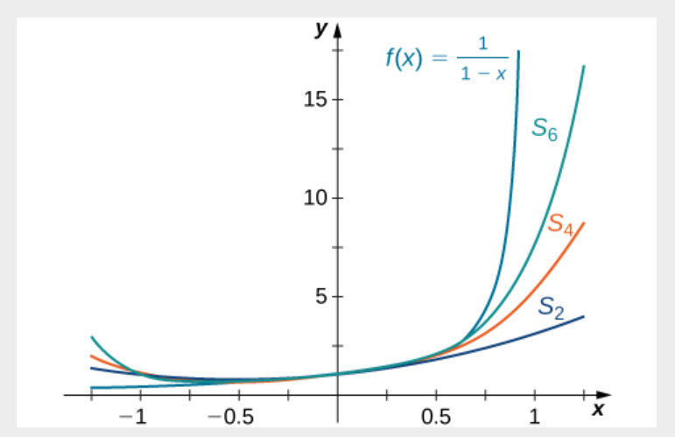

Slide 12
Properties of power series
Section 6.2
Notes:
In the preceding section on power series and functions we showed how to represent certain functions using power series. In this section we discuss how power series can be combined, differentiated, or integrated to create new power series. This capability is particularly useful for a couple of reasons. First, it allows us to find power series representations for certain elementary functions, by writing those functions in terms of functions with known power series. Second, being able to create power series allows us to define new functions that cannot be written in terms of elementary functions. This capability is particularly useful for solving differential equations for which there is no solution in terms of elementary functions.

Slide 17
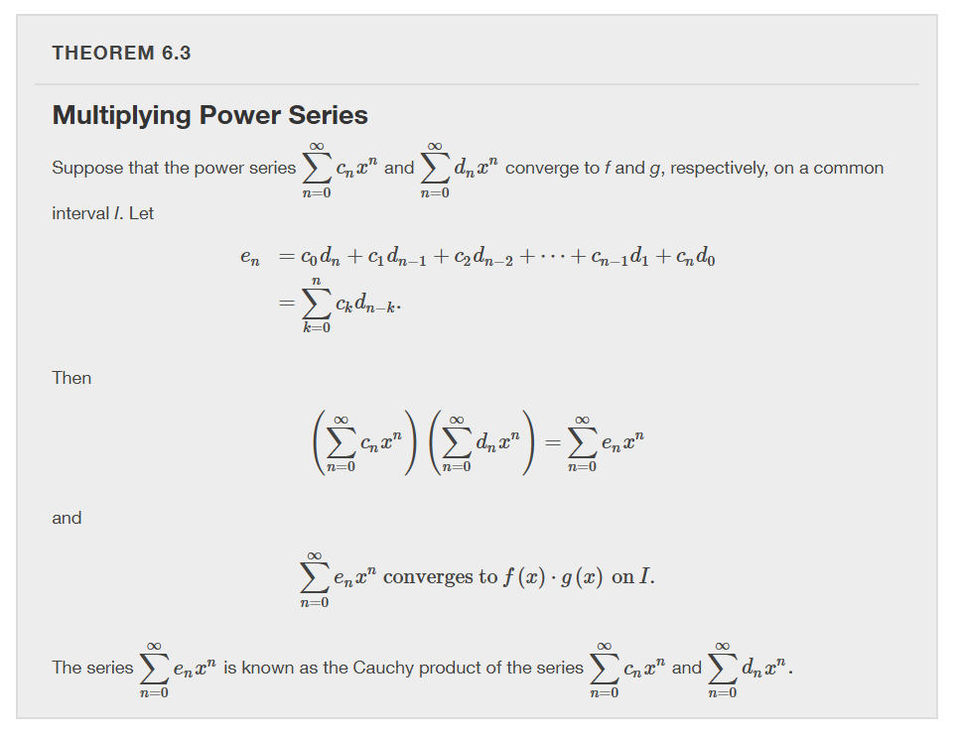

Slide 19
Notes:
The proof of this result is beyond the scope of the text and is omitted.

Slide 20
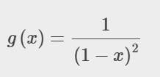

Slide 22
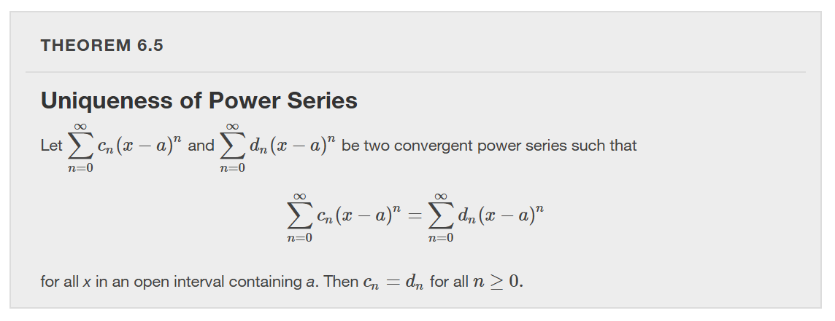
Notes:
In this section we have shown how to find power series representations for certain functions using various algebraic operations, differentiation, or integration. At this point, however, we are still limited as to the functions for which we can find power series representations. Next, we show how to find power series representations for many more functions by introducing Taylor series.

Slide 23
Taylor and Maclaurin Series
Section 6.3
Notes:
In the previous two sections we discussed how to find power series representations for certain types of functions––specifically, functions related to geometric series. Here we discuss power series representations for other types of functions. In particular, we address the following questions: Which functions can be represented by power series and how do we find such representations? If we can find a power series representation for a particular function $f$ and the series converges on some interval, how do we prove that the series actually converges to $f$?

Slide 24
$$= f(x)$$
$$= f(a)$$
$$= f′(a)$$
$$= f′′(a)$$
$$= f′′′(a)$$
Notes:
What should the coefficients be? For now, we ignore issues of convergence, but instead focus on what the series should be, if one exists.
We evaluate the series at $x=a$. We evaluate the derivative, second derivative, and third derivative of the series at $x=a$. We notice the pattern that n! times the nth coefficient should equal the nth derivative evaluated at $x=a$. Using these coefficients we define the Taylor Series.

Slide 26
Notes:
The proof follows directly from Uniqueness of Power Series. To determine if a Taylor series converges, we need to look at its sequence of partial sums. These partial sums are finite polynomials, known as Taylor polynomials.

Slide 30
Notes:
We now state Taylor’s theorem, which provides the formal relationship between a function $f$ and its nth degree Taylor polynomial. This theorem allows us to bound the error when using a Taylor polynomial to approximate a function value, and will be important in proving that a Taylor series for $f$converges to $f$.

