Slide 3
Chapter 5 sequences and series

Slide 4
Comparison tests
Section 5.4
Notes:
In the preceding two sections, we discussed two large classes of series: geometric series and p-series. We know exactly when these series converge and when they diverge. Here we show how to use the convergence or divergence of these series to prove convergence or divergence for other series, using a method called the comparison test. We’ll also discuss the limit comparison test.

Slide 5
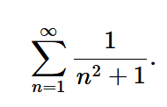
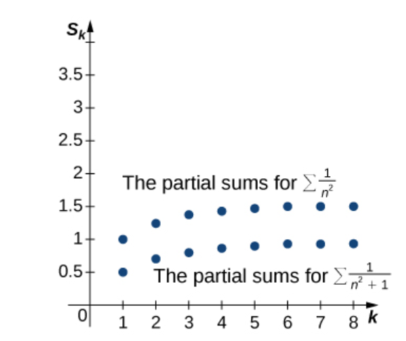
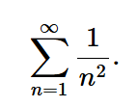
Notes:
Since the series on the right converges, the sequence or partial sums is bounded above. We conclude that the sequence of partial sums is a monotone increasing sequence that is bounded above. Therefore, by the Monotone Convergence Theorem, the sequence of partial sums converges, and thus the series converges.

Slide 6
Notes:
The comparison test works nicely if we can find a comparable series satisfying the hypothesis of the test. However, sometimes finding an appropriate series can be difficult.

Slide 8
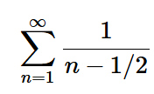
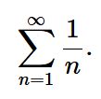
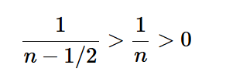
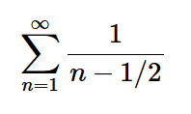
For example, compare
with
Let $N =1$.
Since the Harmonic Series diverges, is also a divergent series by the Comparison Test.

Slide 10
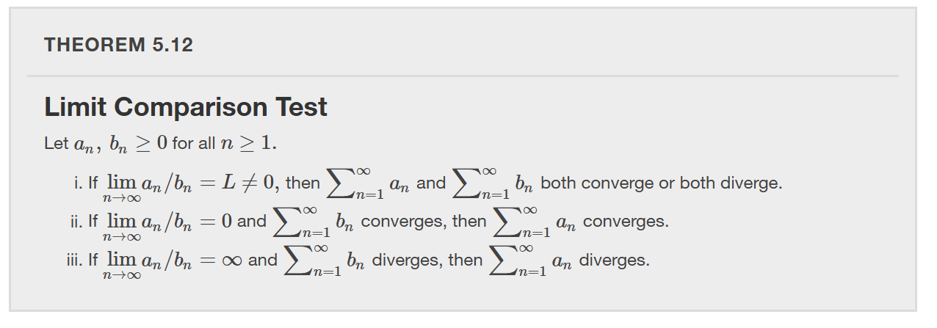

Slide 11
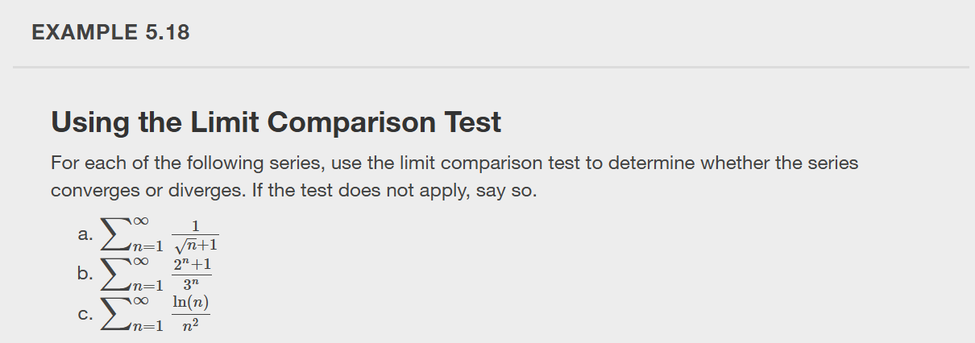
Hint: Use the p-series where $p=\frac{3}{2}$.

Slide 12
Alternating series
Section 5.5

Slide 14
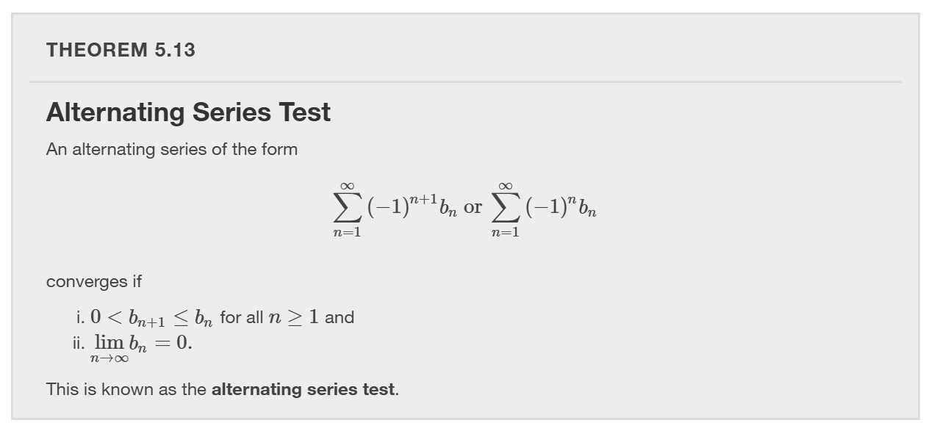

Slide 15
The Alternating Harmonic Series
By the Alternating Series Test, the Alternating Harmonic Series converges.

Slide 19
Notes:
Can you think of an example of conditional convergence? The alternating harmonic series converges and the harmonic series diverges. This means that the alternating harmonic series exhibits conditional convergence, ie. converges conditionally.

Slide 25
Ratio and root tests
Section 5.6
Notes:
In this section, we prove the last two series convergence tests: the ratio test and the root test. These tests are particularly nice because they do not require us to find a comparable series. The ratio test will be especially useful in the discussion of power series in the next chapter. Throughout this chapter, we have seen that no single convergence test works for all series. Therefore, at the end of this section we discuss a strategy for choosing which convergence test to use for a given series.

Slide 26
Notes:
The ratio test provides a way of measuring how fast the terms of a series approach zero. See textbook for proof. The ratio test is particularly useful for series whose terms contain factorials or exponentials, where the ratio of terms simplifies the expression. The ratio test is convenient because it does not require us to find a comparative series. The drawback is that the test sometimes does not provide any information regarding convergence.

Slide 28
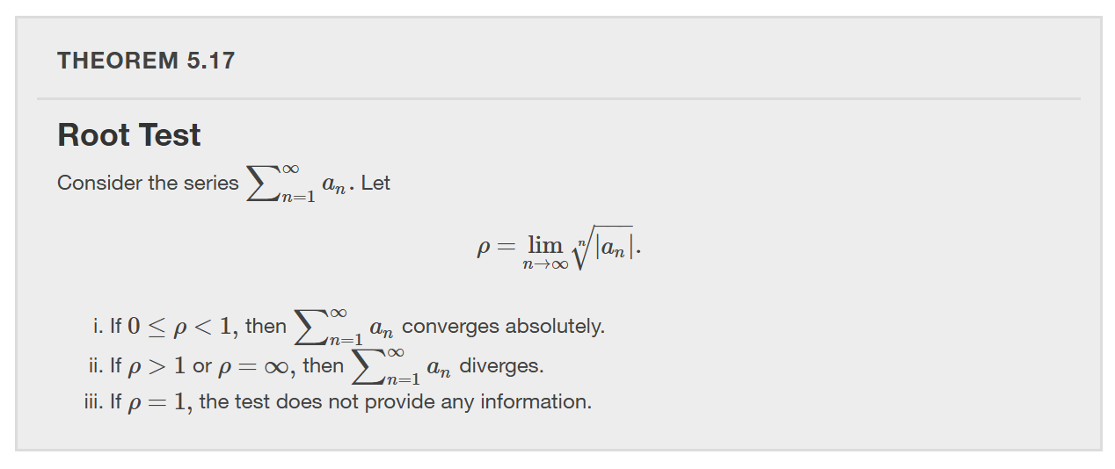
Notes:
The root test is useful for series whose terms involve exponentials.

Slide 32
Summary of Convergence Tests

Slide 33
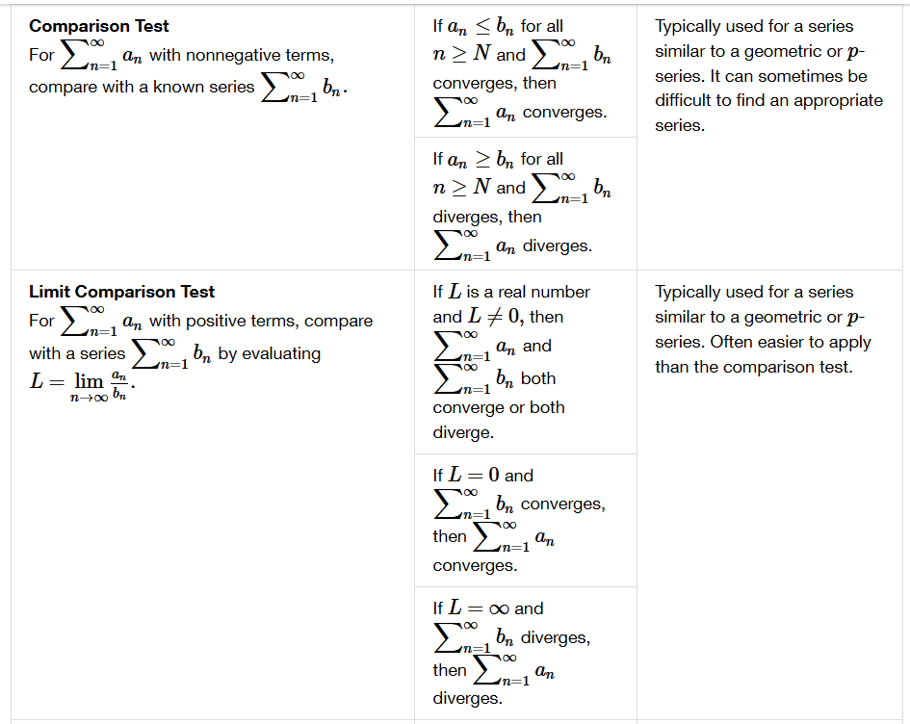

Slide 34
