Slide 2
Chapter 5 sequences and series

Slide 3
Review of Limits
L’Hopital’s Rule

Slide 4
sequences
Section 5.1
Notes:
Associated with the Product Rule for Differentiation

Slide 6
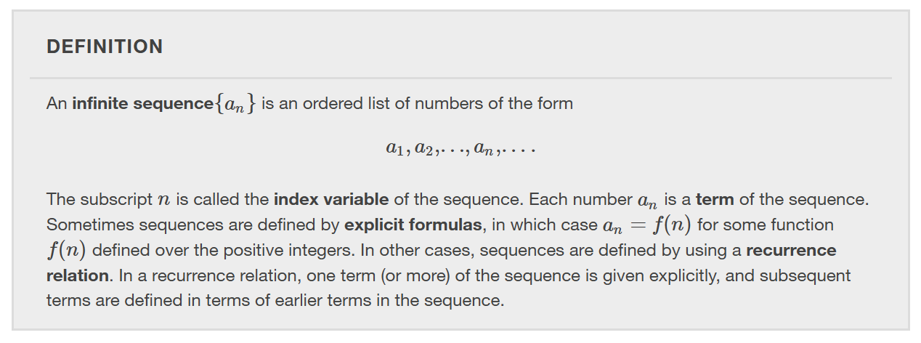

Slide 7
Notes:
Note both types of sequences define the nth term in the sequence as a function of n. We say the sequence is defined explicitly.

Slide 9
Sequences defined recursively
A sequence can be defined recursively by expressing the $n$th term $a_{n}$ in terms of the previous term $a_{n−1}$.

Slide 11
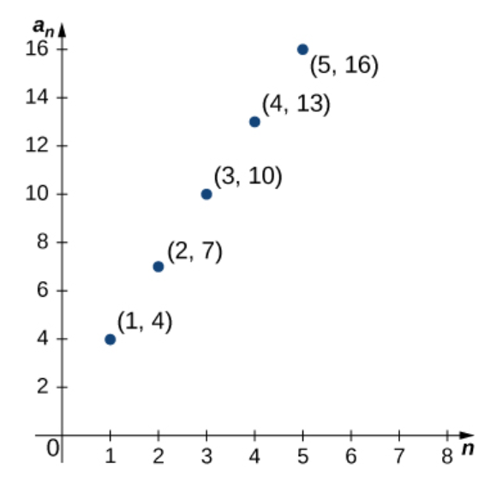

Slide 12
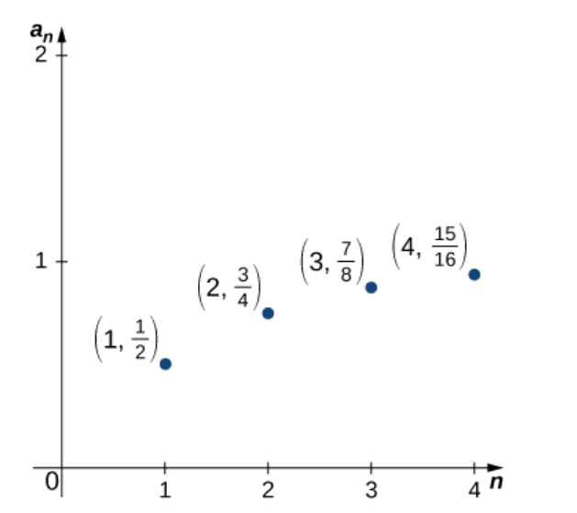

Slide 13
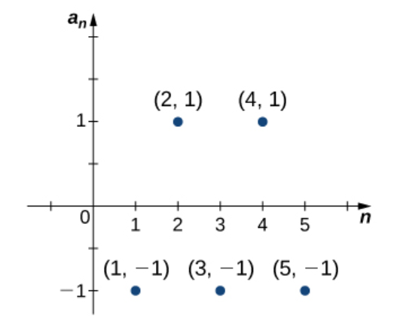

Slide 14
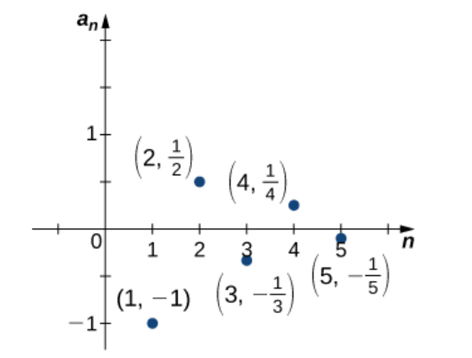

Slide 15
Notes:
In the informal definition for the limit of a sequence, we used the terms “arbitrarily close” and “sufficiently large.” Although these phrases help illustrate the meaning of a converging sequence, they are somewhat vague. To be more precise, we now present the more formal definition of limit for a sequence

Slide 17
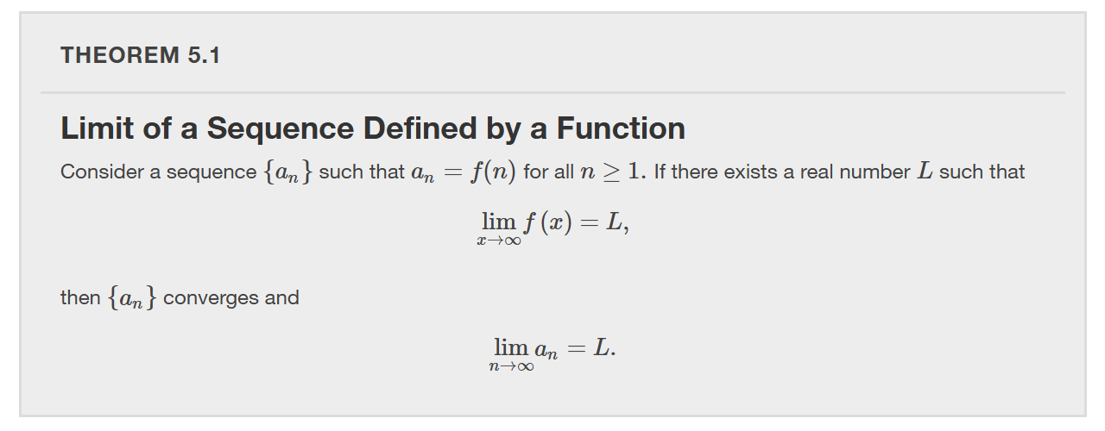

Slide 18
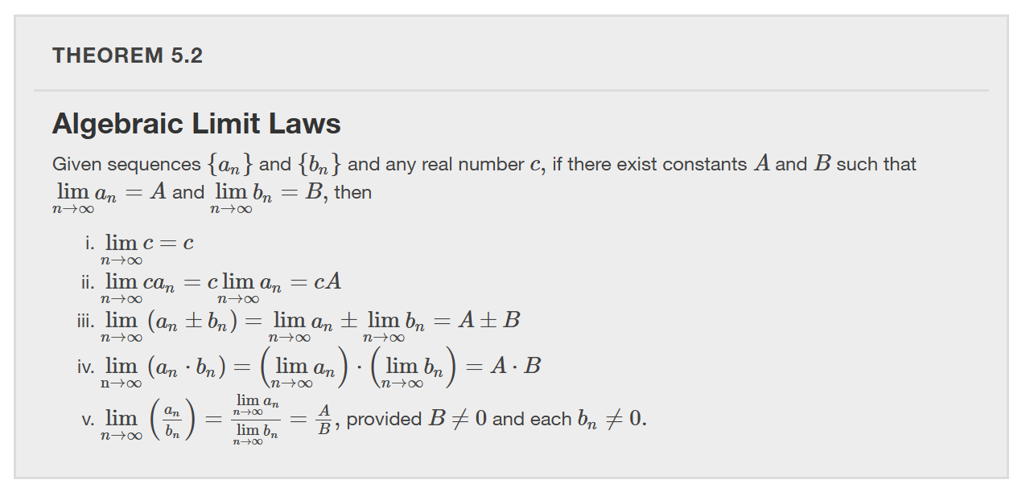

Slide 27
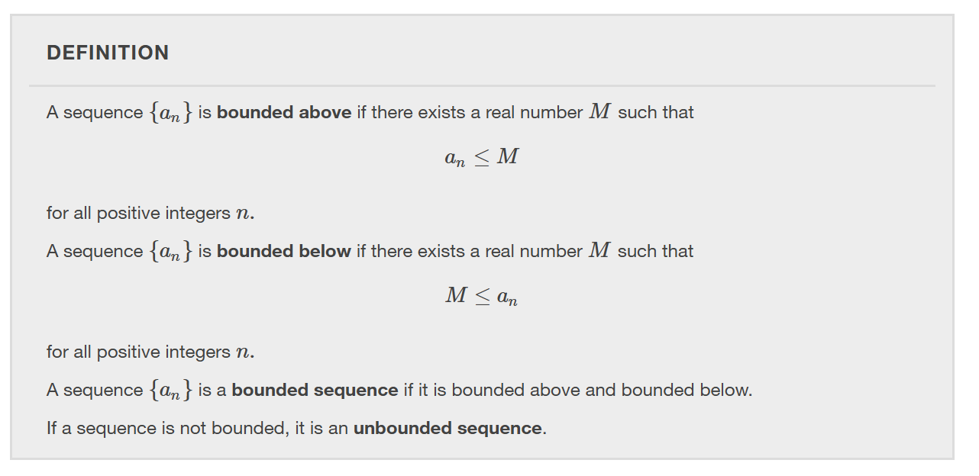

Slide 28
Notes:
Note that a sequence being bounded is not a sufficient condition for a sequence to converge. For example, the sequence {(−1)^n} is bounded, but the sequence diverges because the sequence oscillates between 1 and −1 and never approaches a finite number. We now discuss a sufficient condition for a bounded sequence to converge.

Slide 29
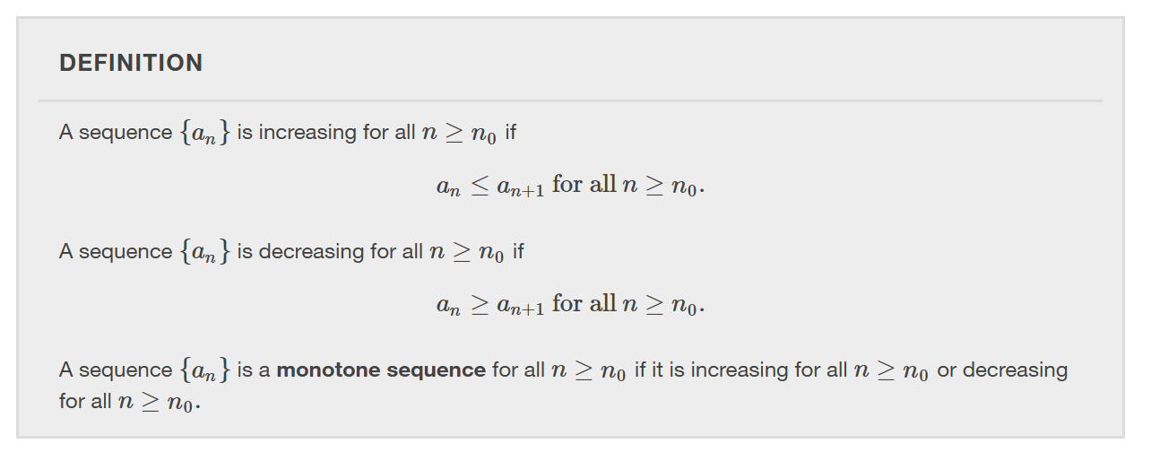

Slide 30
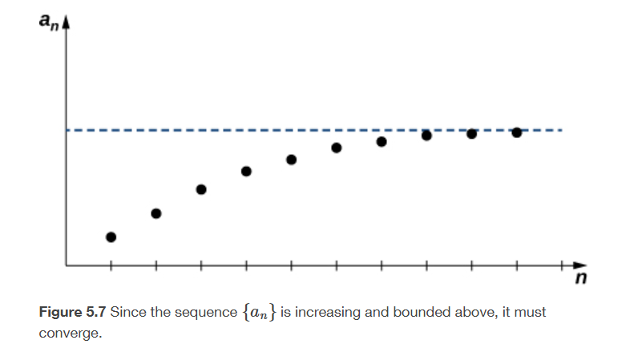

Slide 32
Infinite series
Section 5.2

Slide 33
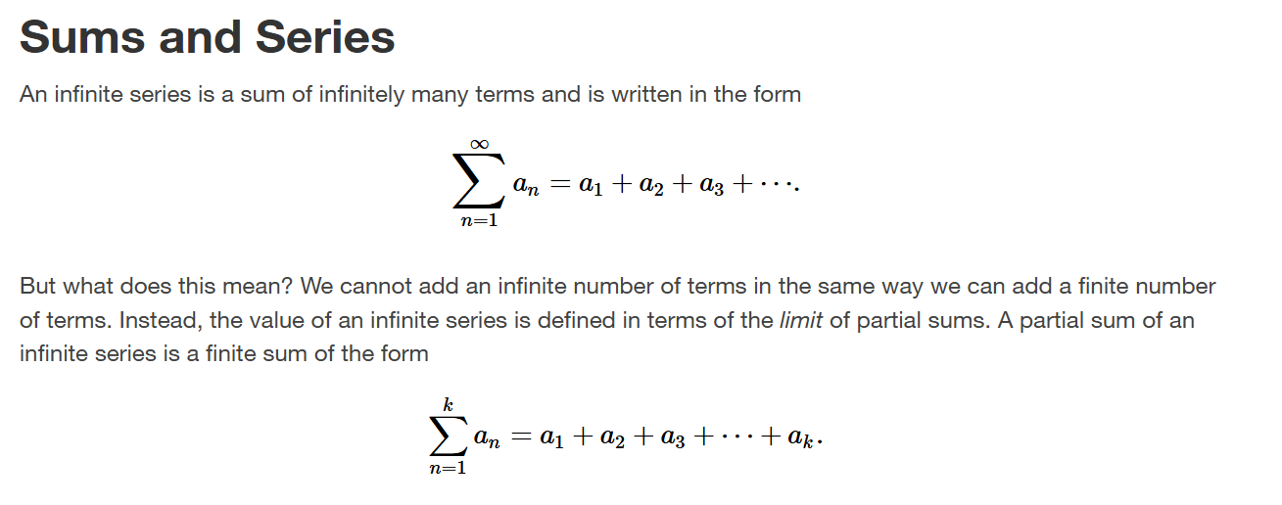

Slide 34
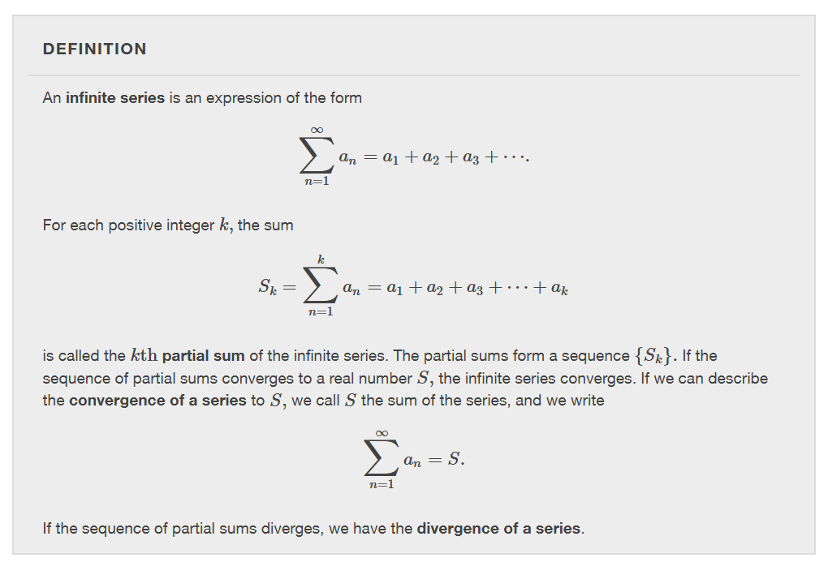

Slide 36
Notes:
This series is interesting because it diverges, but it diverges very slowly. It can be shown that the terms in the sequence of partial sums approaches infinity which implies the sequence is unbounded and therefore the Harmonic sequence diverges. Another way to show that the Harmonic Series is divergent is to use the Integral Test (which will be discussed later in Section 5.3).

Slide 37
Notes:
Since the sum of a convergent infinite series is defined as a limit of a sequence, the algebraic properties for series listed below follow directly from the algebraic properties for sequences.

Slide 41
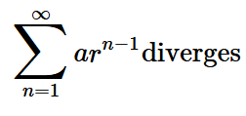
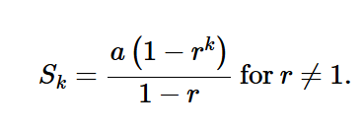
$$∞$$

Slide 44
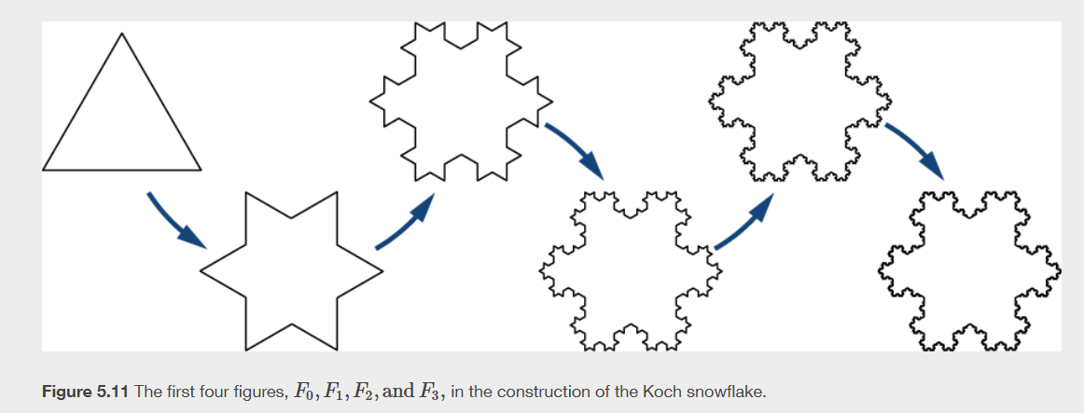

Slide 45
The divergence and integral tests
Section 5.3

Slide 47
Notes:
Note that we can only use this test to show that a series diverges. We cannot use it to prove that a series converges. Specifically if the limit of a_n is zero, the divergence test is inconclusive.

Slide 49
The integral test compares an infinite sum to an improper integral.

Slide 50
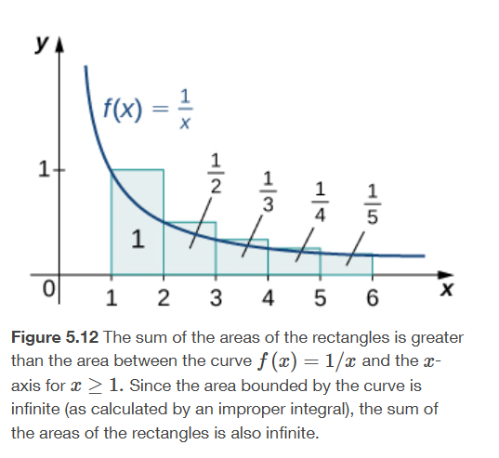
Notes:
To illustrate how the integral test works, we will use the harmonic series as an example.

Slide 52
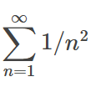
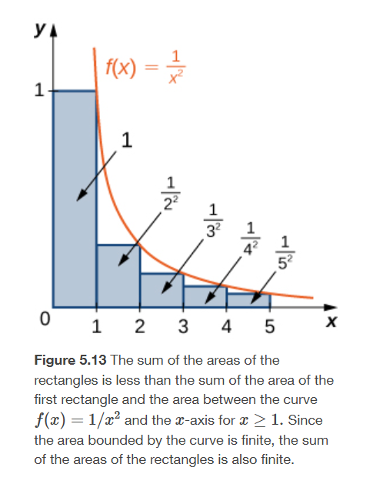
Notes:
Next we want to show how an integral can be used to prove that a series converges.
This example and the Harmonic series are what we call p-series.

Slide 54
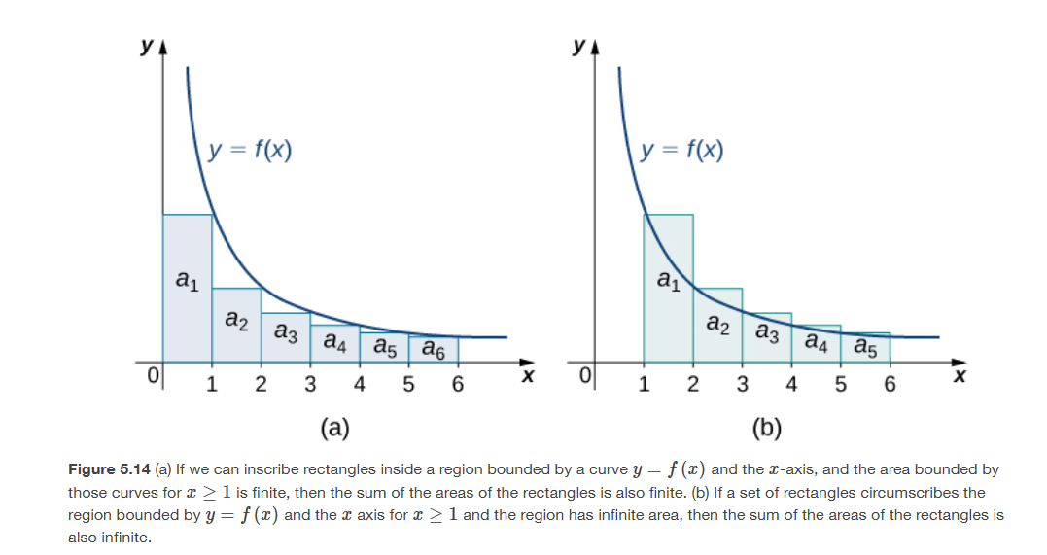

Slide 57
Notes:
We know the p-series converges if p=2 and diverges if p=1. What about other values of p? In general, it is difficult, if not impossible, to compute the exact value of most p-series. However, we can use the tests presented thus far to prove whether a p-series converges or diverges.

Slide 58
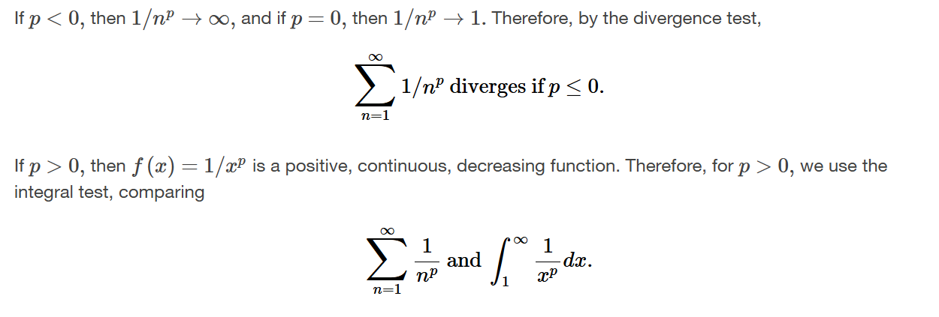

Slide 59
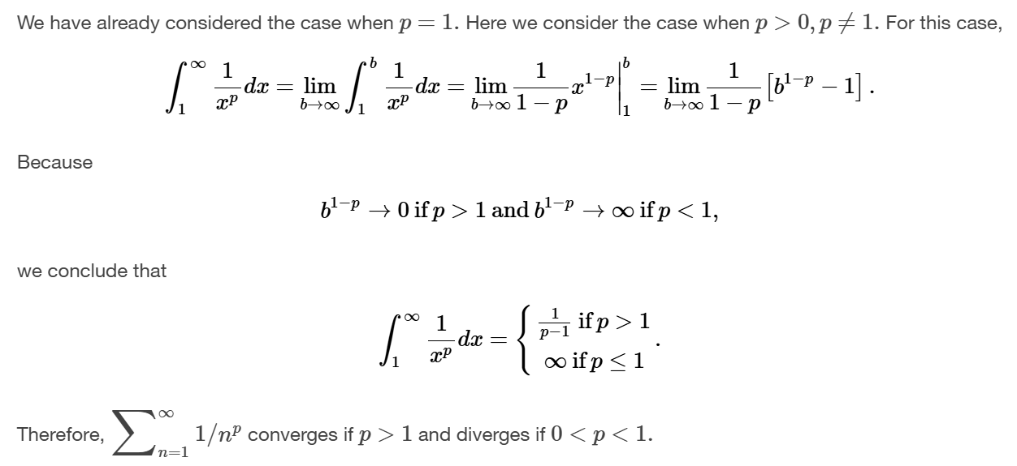

Slide 60
