Slide 1
Chapter 3 techniques of integration

Slide 2
Trigonometric integrals
Section 3.2
Notes:
In this section we look at how to integrate products and powers of trigonometric functions. These integrals are called trigonometric integrals. First we will look at products of powers of sine and cosine and then products of powers of tangent and secant. We will use trigonometric identities and the u-substitution method to evaluate trigonometric integrals.

Slide 3
Recall the two trigonometric identities:
Double-angle formula
Pythagorean identity
Show the following “power-reducing” identities:
Notes:
Which side of the equations for the power-reducing identities is easier to integrate?

Slide 4
Notes:
Note in the first two cases, the Pythagorean identity and u-substitution are used. In the third case we use the power-reducing identities.

Slide 8
Notes:
Notice that both trigonometric functions have the same angle.

Slide 20
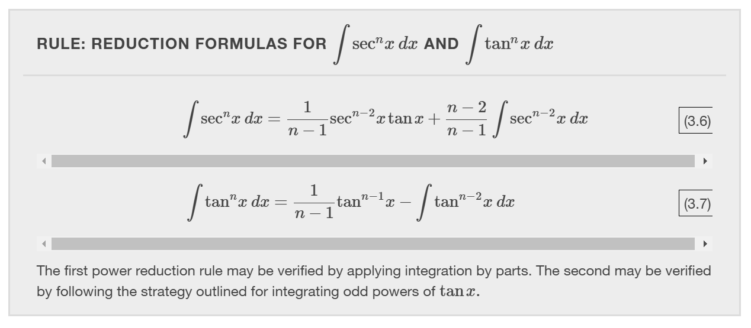

Slide 23
Trigonometric substitution
Section 3.3
Notes:
In this section, we explore integrals containing a square root of a sum or difference of two squares.

Slide 24
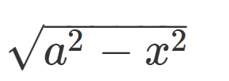
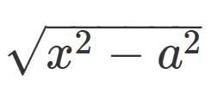

Slide 26
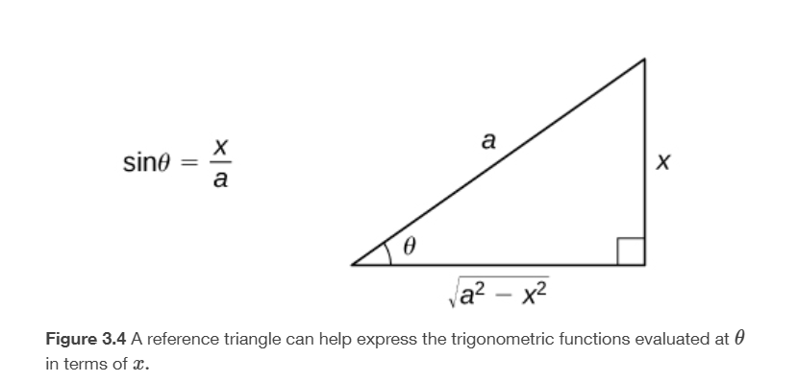

Slide 31
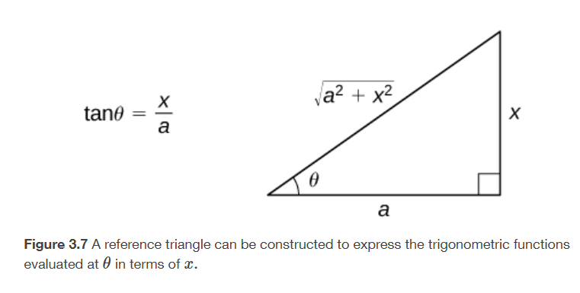

Slide 36
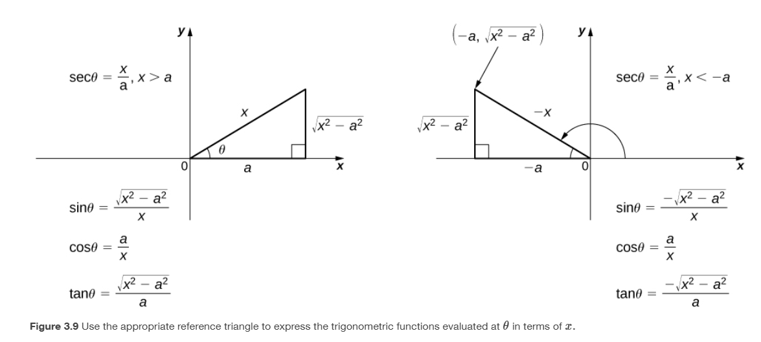

Slide 38
partial fractions
Section 3.1
Notes:
In this section, we examine the method of partial fraction decomposition, which allows us to decompose rational functions into sums of simpler, more easily integrated rational functions.

Slide 39
Finding a common denominator
Finding the partial fractions
Notes:
Which side of the equation is easier to integrate?
Notice that the degree of 3x is less than the degree of the denominator on the right side of the equation. When finding the partial fraction decomposition, it is important to start with an improper fraction (meaning the degree of the numerator is less than the degree of the numerator).

Slide 40
Notes:
Long divide first.

Slide 48
