Slide 1
Chapter 2 applications of integration

Slide 2
Physical applications
Section 2.5
Notes:
In this section we will talk about how to calculate (1) mass based on a density function (linear density and radial density) (2) work done by a variable force (Hooke’s law for springs), and (3) work done to pump a liquid from one height to another.

Slide 3
Mass = (constant linear density)(distance)
Mass = (constant radial density)(area)
Work = (constant force)(distance)
Hydrostatic Force = (constant weight density)(area)(depth)
Hydrostatic Pressure =(constant weight density)(depth)
Notes:
Mass is measured in kilograms in the metric system, and in avoirdupois pounds in the English system. Linear density is measured in kilograms per foot or kilograms per meter. Distance is measure in feet or meters. Force is measure in Newtons or pounds. The force required to move an object is the mass times the acceleration of gravity, which is the weight of the object (neglecting friction). Work is measured in Newton-meters (or joules) and in foot-pounds. The weight density of water is 62.4 lb/cubic foot (or 9810 N/cubic meter). Pressure is measured in pounds per square inch (psi) or N per square meter (or Pascal, Pa). The Greek letter rho (lower case) is used to denote density.

Slide 4
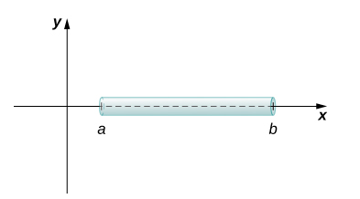
Notes:
First we consider a thin rod or wire. Orient the rod so it aligns with the x-axis, with the left end of the rod at x=a and the right end of the rod at x=b (Figure 6.48). Note that although we depict the rod with some thickness in the figures, for mathematical purposes we assume the rod is thin enough to be treated as a one-dimensional object.

Slide 5
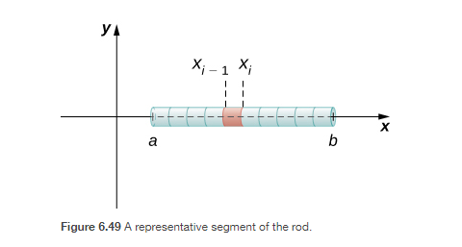

Slide 7
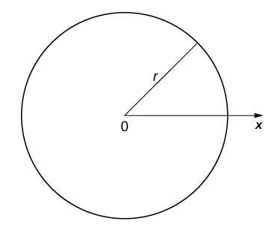

Slide 8
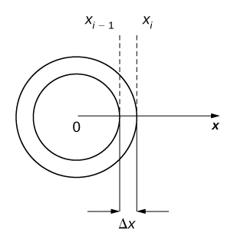
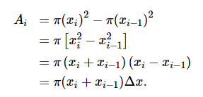

Slide 10
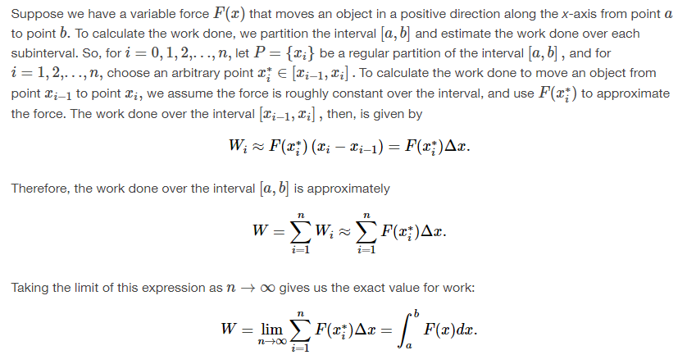
Notes:
In the English system, the unit of force is the pound and the unit of distance is the foot, so work is given in foot-pounds. In the metric system, kilograms and meters are used. One newton is the force needed to accelerate 11 kilogram of mass at the rate of 11 m/sec². Thus, the most common unit of work is the newton-meter. This same unit is also called the joule. Both are defined as kilograms times meters squared over seconds squared (kg⋅m2/s2).

Slide 12
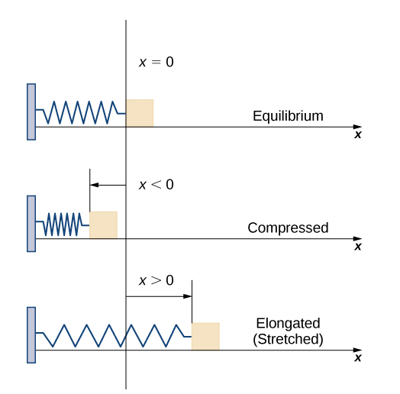
The Work Required to Stretch or Compress a Spring
According to Hooke’s law, the force required to compress or stretch a spring from an equilibrium position is given by
$$F\left(x\right)=kx$$
for some constant $k$, which depends on the physical characteristics of the spring. The constant $k$, is called the spring constant and is always positive.
Notes:
Now let’s look at the specific example of the work done to compress or elongate a spring. Consider a block attached to a horizontal spring. The block moves back and forth as the spring stretches and compresses. Although in the real world we would have to account for the force of friction between the block and the surface on which it is resting, we ignore friction here and assume the block is resting on a frictionless surface. When the spring is at its natural length (at rest), the system is said to be at equilibrium. In this state, the spring is neither elongated nor compressed, and in this equilibrium position the block does not move until some force is introduced. We orient the system such that x=0 corresponds to the equilibrium position (see the following figure).

Slide 14
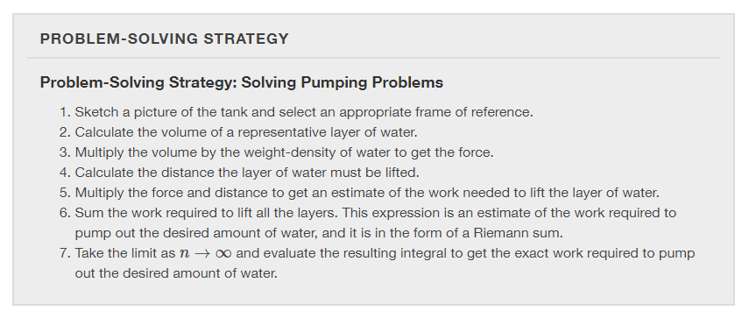
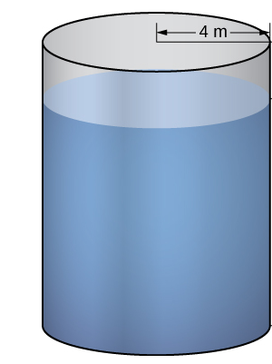
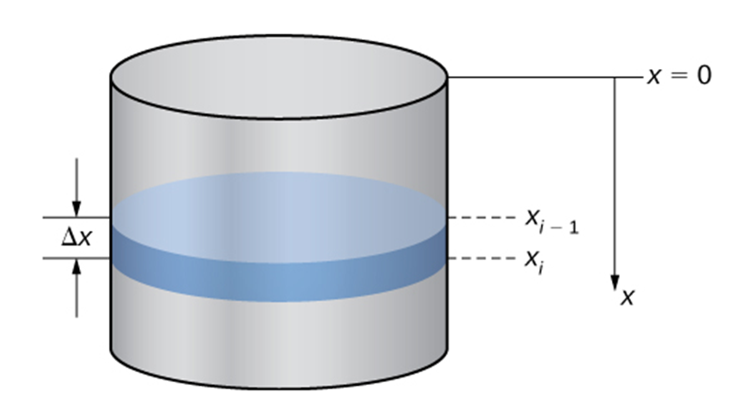

Slide 15
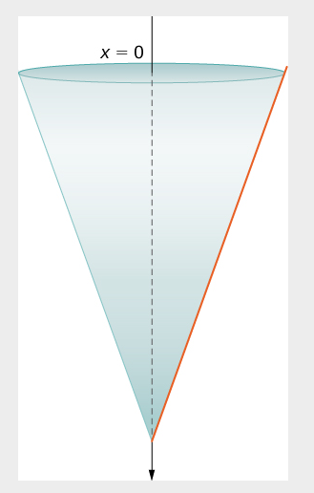
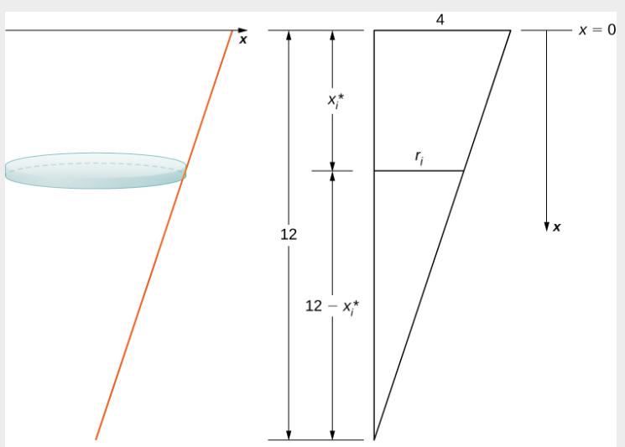
water weight-density
62.4 lb/cubic foot (or 9810 N/cubic meter).

Slide 16
Moments and centers of mass
Section 2.6

Slide 17
Center of Mass
balancing point, also called centroid when the density is a constant
Cases: 1. Objects along a line
2. Objects in a plane
3. Regions in the plane or also called thin plates
Symmetry
Theorem of Pappus for Volume

Slide 18
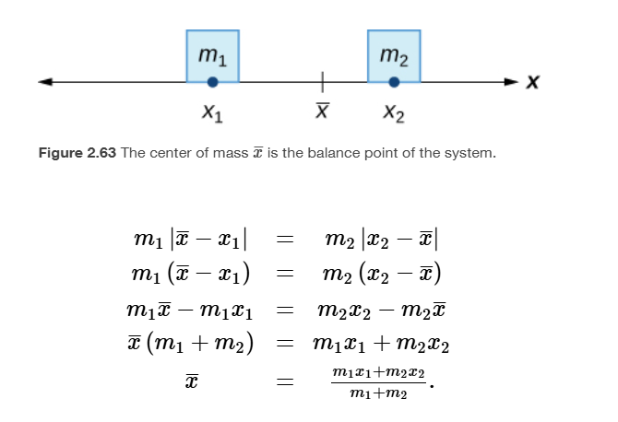
Case 1. Objects along a line

Slide 19
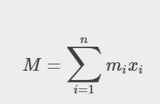

Slide 20
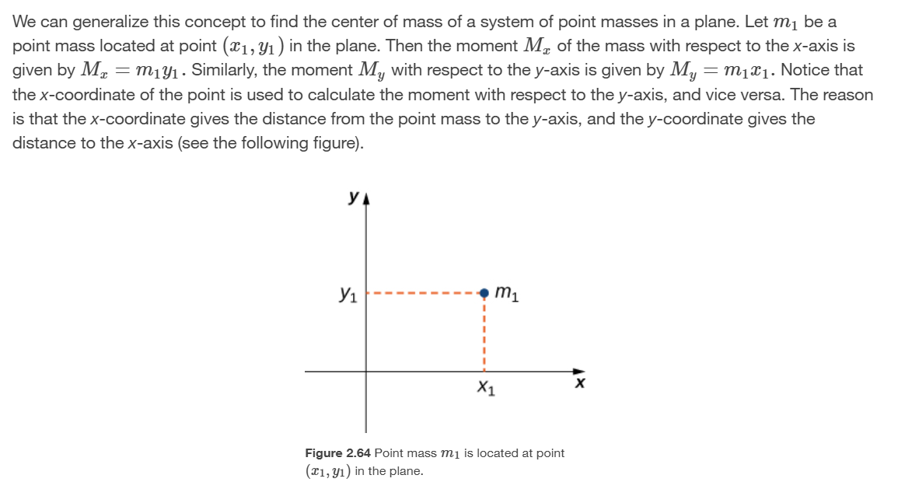
Case 2. Finite number of objects in the plane

Slide 23
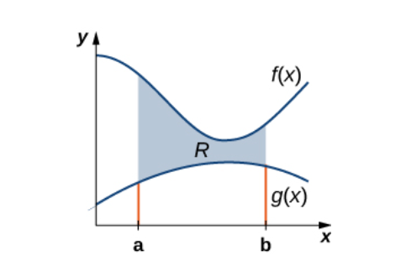
Case 3. Regions in the plane or also called thin plates
The mass of the system is distributed uniformly across a thin sheet or plate; in other words, the density is a constant at any point in the region. We call the thin plate of constant density a lamina, and the center of mass is called a centroid.

Slide 25
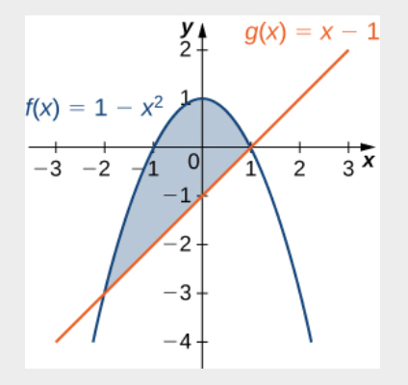

Slide 27
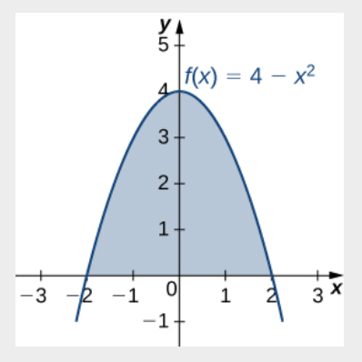

Slide 28
$$V=A∙d$$

Slide 29
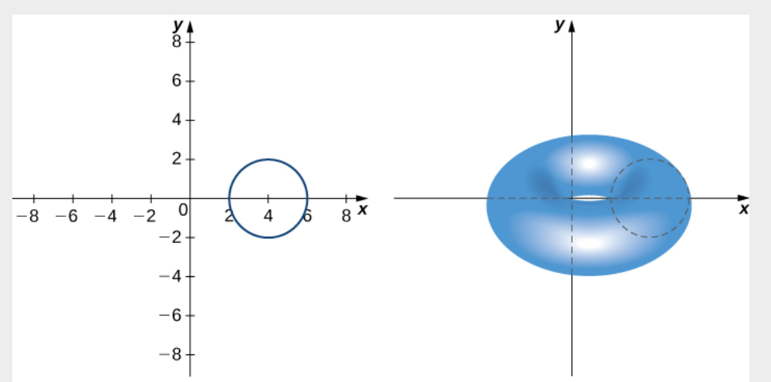
$$V=A∙d$$

Slide 30
Chapter 3 techniques of integration

Slide 31
Integration by parts
Section 3.1
Notes:
Associated with the Product Rule for Differentiation

Slide 33
Notes:
Notice that we need u to be differentiable and dv to be integrable.

Slide 35
LIATE for determining an appropriate choice for $u$
Logarithmic Functions
Inverse Trigonometric Functions
Algebraic Functions
Trigonometric Functions
Exponential Functions.

