Slide 1
Chapter 2 applications of integration

Slide 2
Determining volumes by slicing
Section 2.2

Slide 3
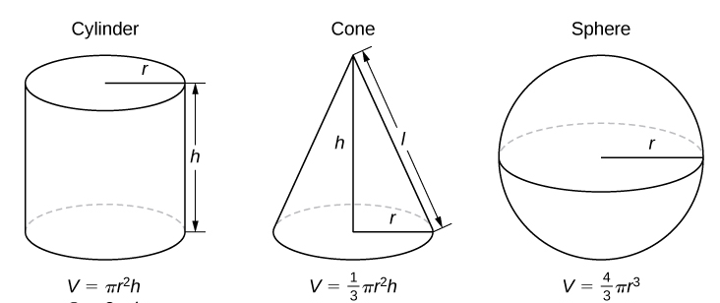
What do you already know about volume?
h
l
w
V = wlh

Slide 4
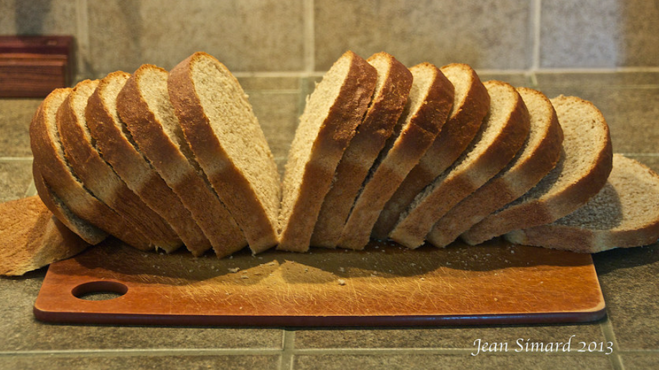
How would you estimate the volume of a loaf of bread?
Notes:
Assume the average volume of one slice of bread is 35 cubic centimeters and the loaf has 14 slices.

Slide 5
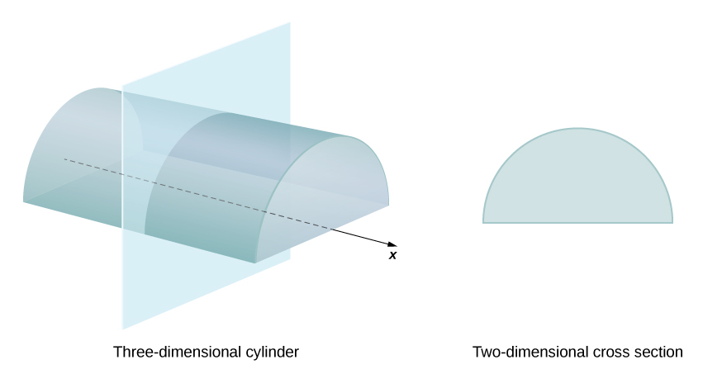
We define the cross-section of a solid to be the intersection of a plane with the solid.
Notes:
Note: The cross-section is perpendicular to the x-axis.

Slide 6
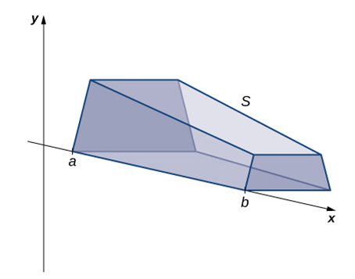
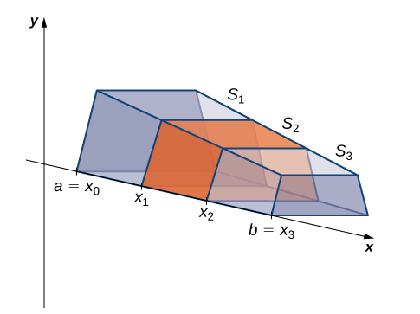
Notes:
Possibilities for A(x) include area of a triangle, square, rectangle, trapezoid, circle, etc.

Slide 8
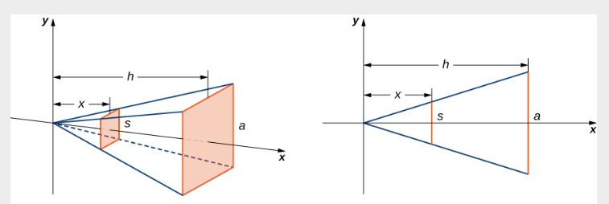
Notes:
One special case where the slicing method can be applied is when the cross-section is a disk (with the cross-sectional area being the area of a circle).

Slide 9
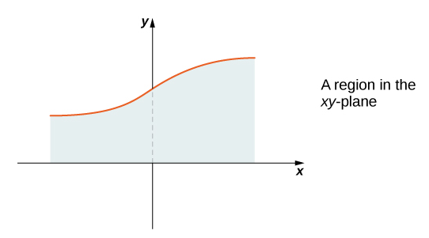
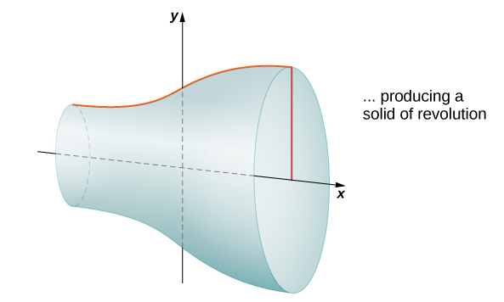
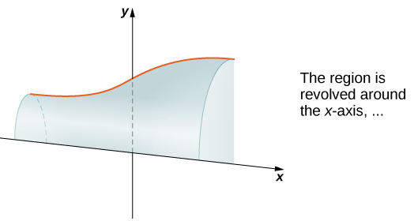
Notes:
One way to create a solid that has disks as its slices is to revolve a region about an axis. What do you notice about the cross-sectional area? Taking slices perpendicular to the x-axis, the cross-sections are disks with area pi times the radius squared. What is the radius? The radius is the distance between the axis and the curve, which is y=f(x).

Slide 10
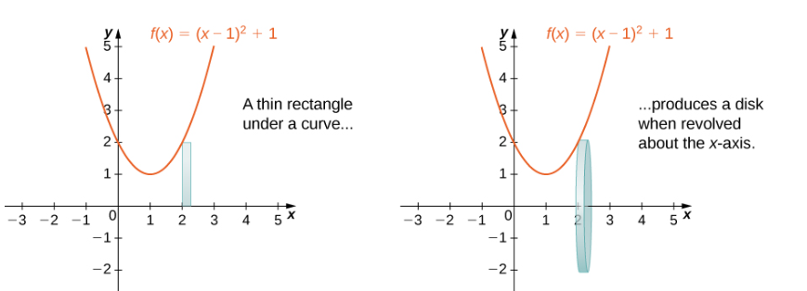
Cross-sectional Area =
= Area of Circle

Slide 12
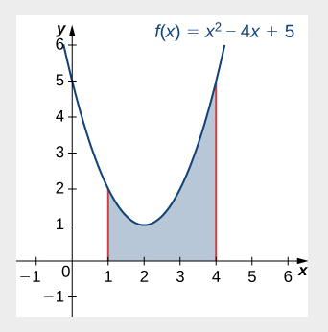
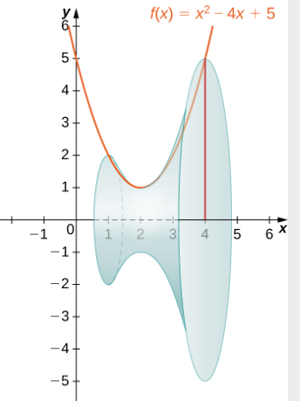

Slide 13
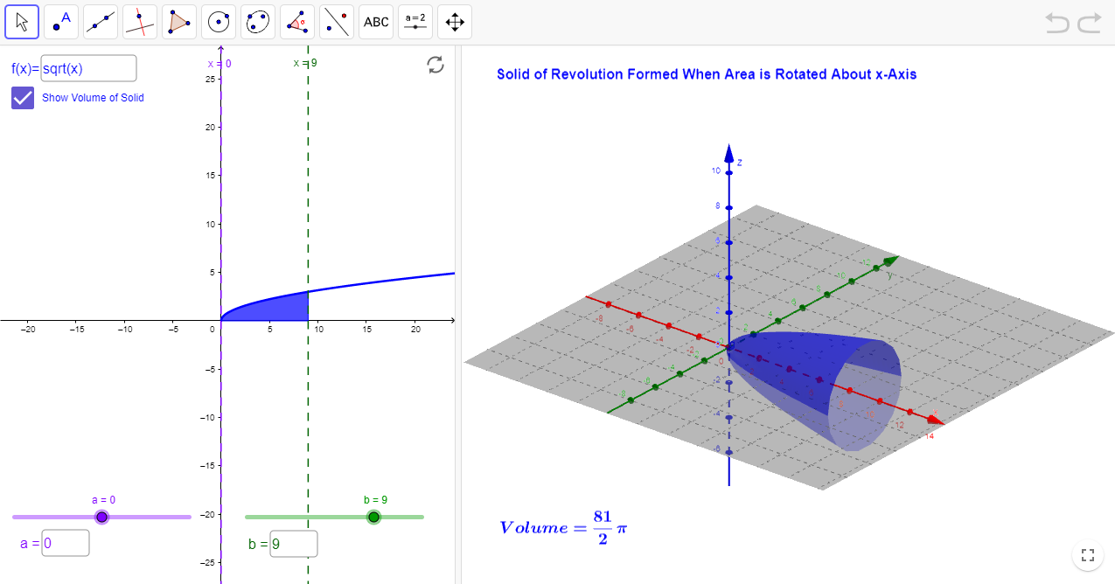
https://www.geogebra.org/m/mzWq2Cet

Slide 15
Notes:
So far, our examples have all concerned regions revolved around the x-axis, but we can generate a solid of revolution by revolving a plane region around any horizontal or vertical line. In the next example, we look at a solid of revolution that has been generated by revolving a region around the y-axis. The mechanics of the disk method are nearly the same as when the x-axis is the axis of revolution, but we express the function in terms of y and we integrate with respect to y as well.

Slide 17
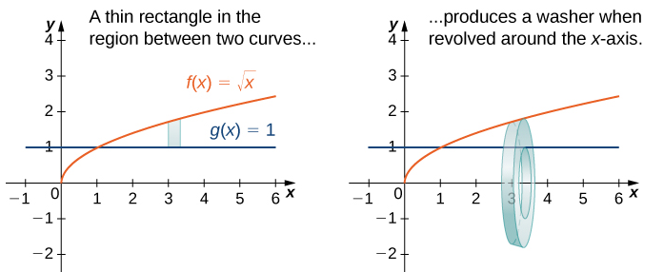
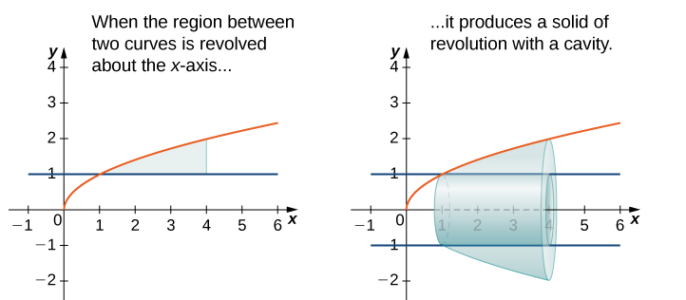
When the solid of revolution has a cavity in the middle, the slices used to approximate the volume are not disks, but washers (disks with holes in the center).

Slide 18
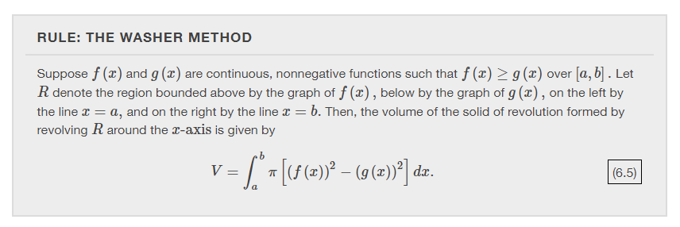

Slide 19
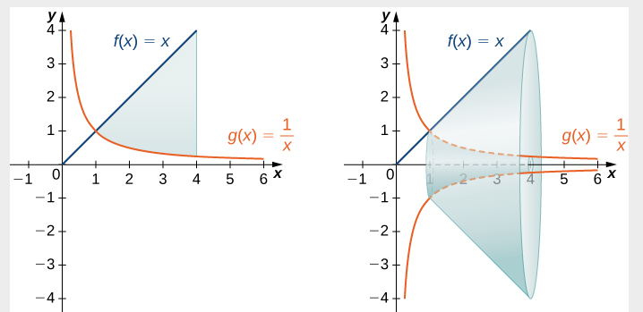

Slide 21
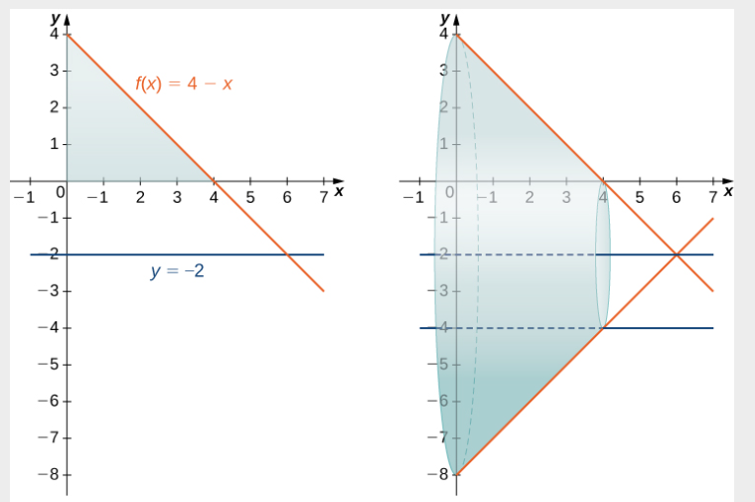

Slide 22
Volumes of revolution: cylindrical shells
Section 2.3

Slide 23
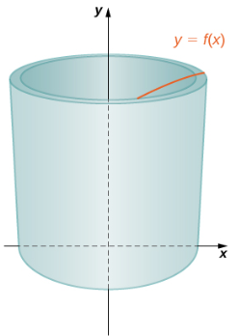
What is a cylindrical shell?
Notes:
Think of taking a regular piece of paper (8.5x11) and wrapping it around a can. When the paper is wrapped around the can, it has the shape of a cylindrical shell – illustrated here.

Slide 24
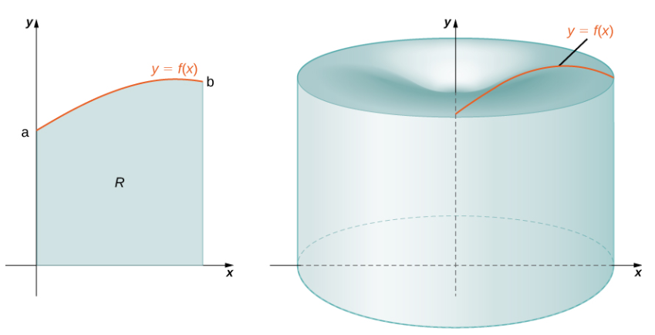
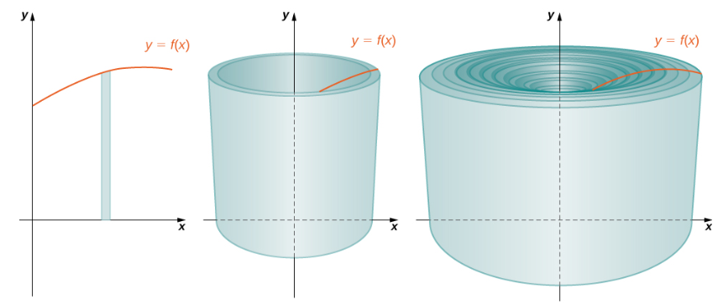
Notes:
What is the volume of the solid of revolution? The sum of the volumes of the cylindrical shells. How do we calculate the volume of a typical cylindrical shell?

Slide 25
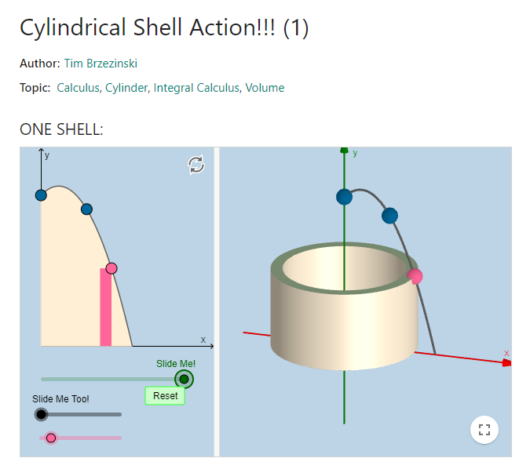
https://www.geogebra.org/m/TvkwtNqC
Notes:
To visualize cylindrical shells with animation, go to https://www.geogebra.org/m/TvkwtNqC

Slide 26
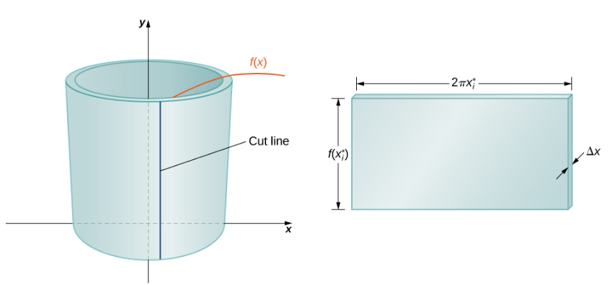
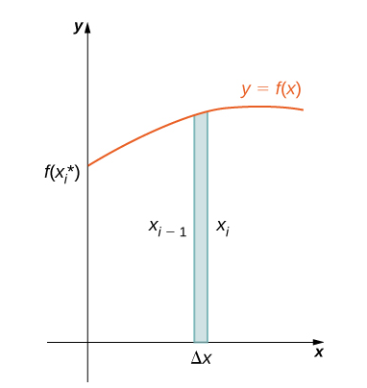

Slide 28
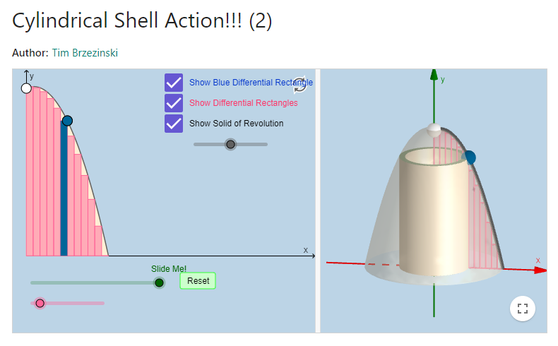
https://www.geogebra.org/m/SWBXZQxR

Slide 29
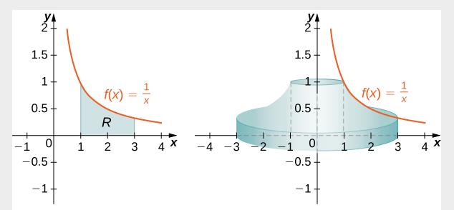

Slide 31
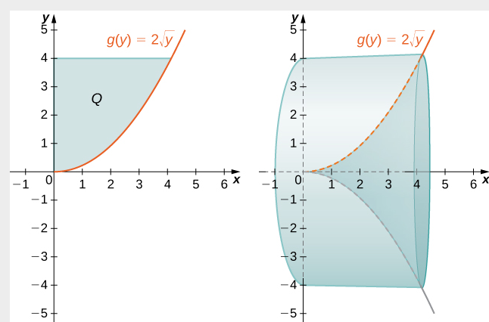

Slide 32
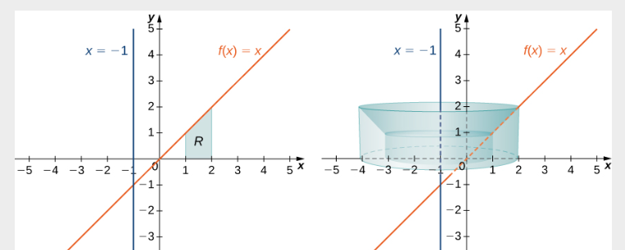

Slide 33
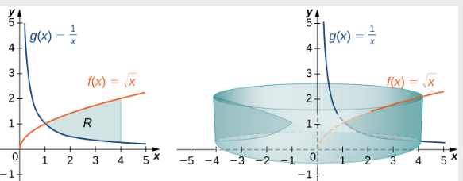

Slide 34
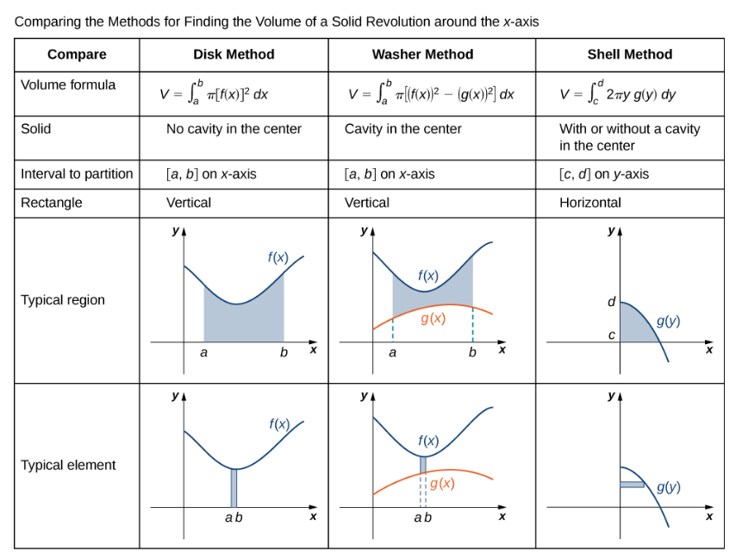

Slide 35
Arc length of a curve and surface area
Section 2.4

Slide 36
Arc length is the distance you would travel if you were walking along the path of the curve.
For calculating arc length, we require f(x) to be differentiable and f’(x) to be continuous. Such a function is called a smooth function.

Slide 37
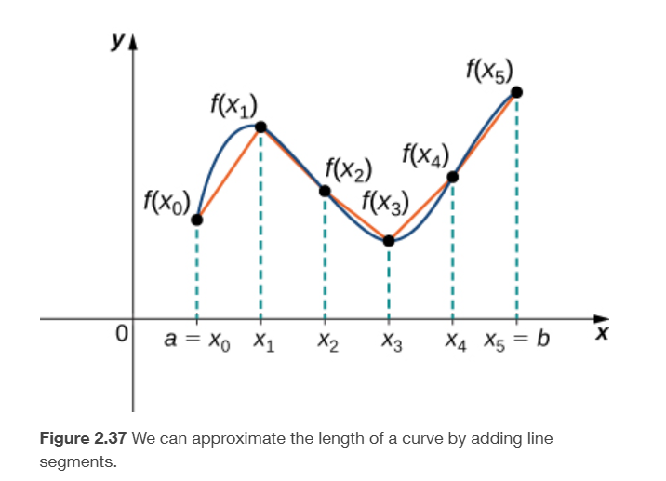

Slide 38
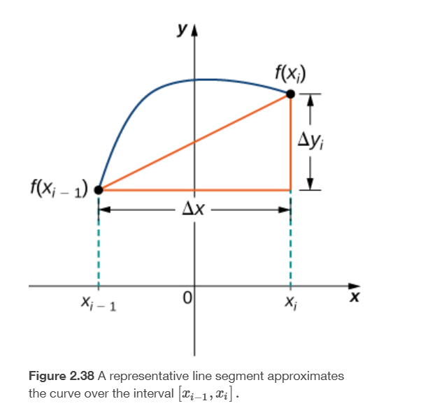
$d_{i}$ $=$ $\sqrt{{(∆x)}^{2}+{(∆y_{i})}^{2}}$
$d_{i}$ $= ∆x \sqrt{ 1+{\left[ \frac{∆y_{i}}{∆ x} \right]}^{2}}$
By the Mean Value Theorem, there is a point ${x_{i}}^{∗}$such that $f^{′}\left({x_{i}}^{∗}\right)=\frac{∆y_{i}}{∆x}$
$d_{i}$ $= ∆x \sqrt{ 1+{[{ f}^{′}\left({x_{i}}^{∗}\right) ]}^{2}}$
$$d_{i}$$

Slide 39
Notes:
Note that we are integrating an expression involving f′(x), so we need to be sure f′(x) is integrable. This is why we require f(x) to be smooth. The following example shows how to apply the theorem.
Although it is nice to have a formula for calculating arc length, this particular theorem can generate expressions that are difficult to integrate. We study some techniques for integration in Introduction to Techniques of Integration. In some cases, we may have to use a computer or calculator to approximate the value of the integral.

Slide 44
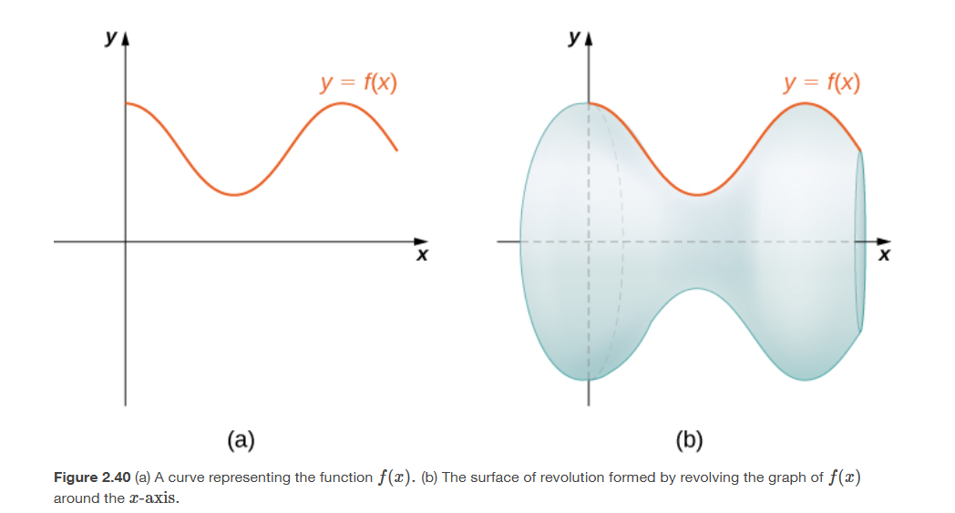
Surface area is the total area of the outer layer of an object.

Slide 45
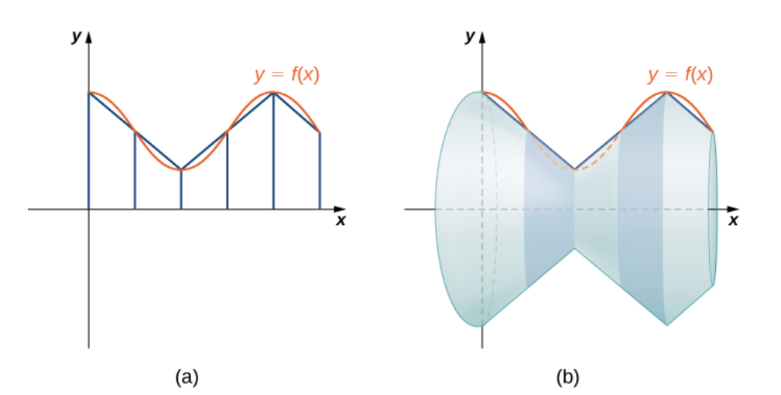

Slide 47
