Slide 1
Chapter 1 integration

Slide 2
Integration formulas and the net change theorem
Section 1.4

Slide 3
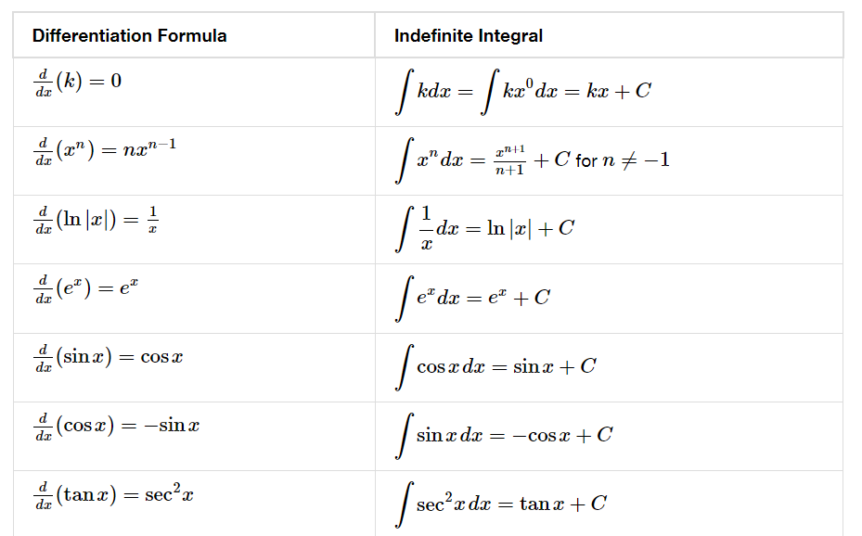

Slide 5
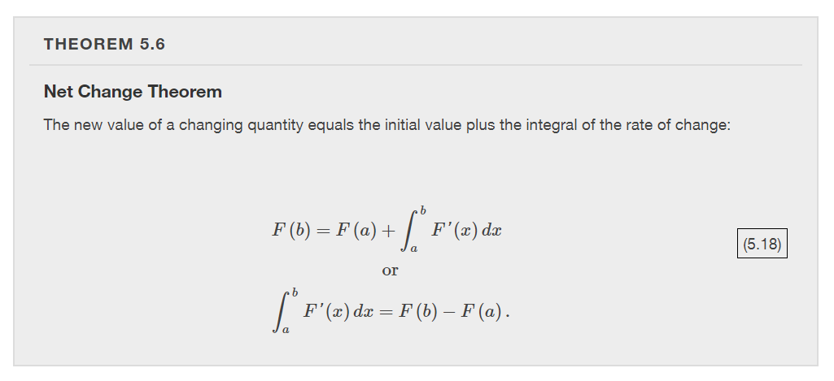

Slide 6
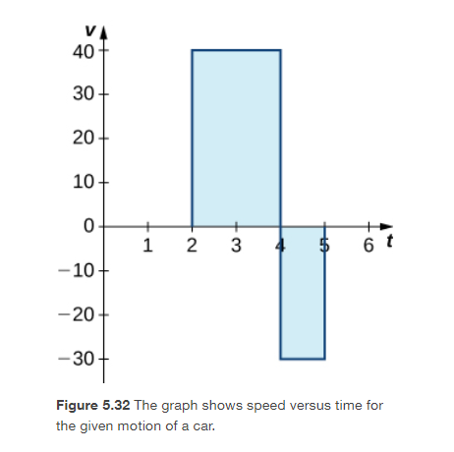
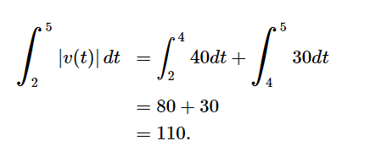

Slide 10
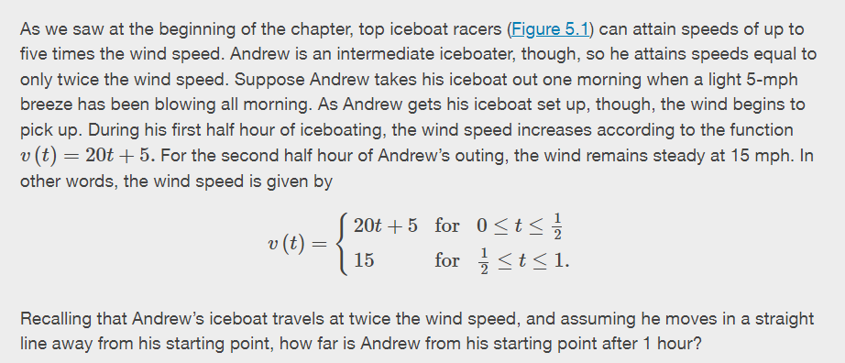

Slide 11
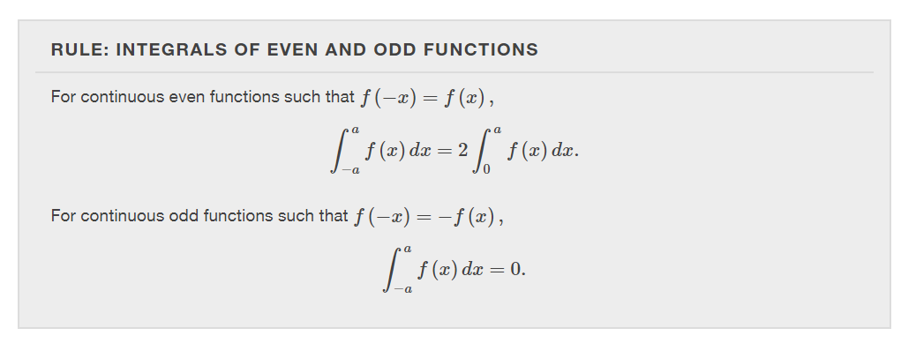

Slide 14
substitution
Section 1.5

Slide 16
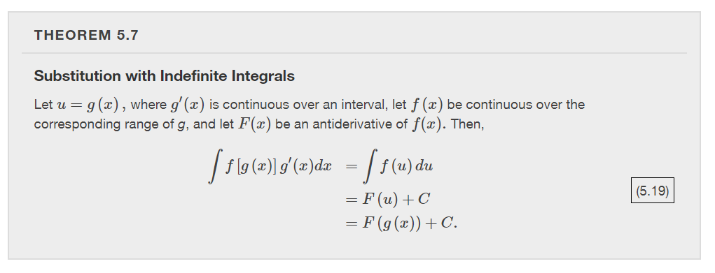

Slide 17
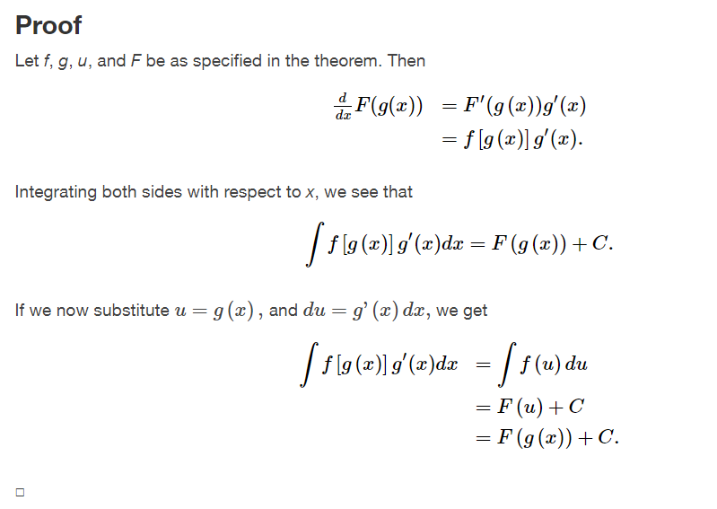

Slide 27
Integrals involving exponential and logarithmic functions
Section 1.6

Slide 31
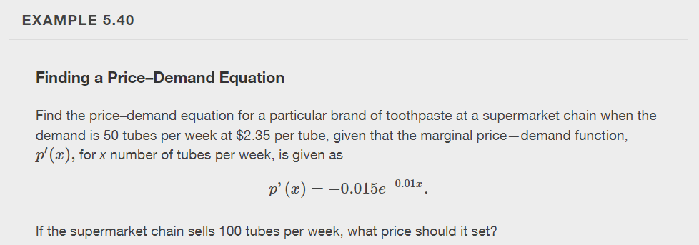

Slide 32
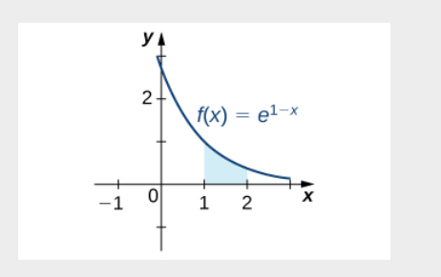

Slide 36
