Slide 1
Contemporary Mathematics
Chapter 7 PROBABILITY

Slide 2
7.4 Tree Diagrams, Tables, and Outcomes
Learning Objectives:
Determine the sample space of a single-stage experiment.
Use tables to list possible outcomes of a multi-stage experiment.
Use tree diagrams to list possible outcomes of a multi-stage experiment.

Slide 3
7.4 Single-Stage Experiments
A single-stage experiment is one action that has multiple possible outcomes. Experiments have unknown outcomes that generally rely on something random, so that if the experiment is repeated (or replicated) the outcome might be different. The set of possible outcomes is called the sample space.
Examples of single stage experiments include:
Flipping a coin
Drawing a card from a deck
Selecting a marble from bag containing marbles of a variety of colors

Slide 4
EXAMPLE – Finding the Sample Space of an Experiment
For each of the following experiments, identify the sample space.
Flip a coin (which has two faces, typically called “heads” and “tails”) and note which face is up.
Let “H” to denote “heads is facing up” and “T” to denote “tails is facing up”.
The sample space is {H, T}.
Flip a coin ten times and count the number of heads.
The sample space is {0, 1, 2, 3, 4, 5, 6, 7, 8, 9, 10}.

Slide 5
7.4 Multi-stage Experiments
A multi-stage experiment has more than one action where each action has multiple possible outcomes. Each action is called a stage. The stages can occur in succession or simultaneously.
Examples of multi-stage experiments include:
Flipping a coin two times
Drawing two cards from a deck one at a time
Rolling two dice simultaneously
When the stages do not affect each other, we say the stages are independent. Otherwise, the stages are dependent.

Slide 6
EXAMPLE - Determining Independence
Decide whether the two stages in these experiments are independent or dependent.
You flip a coin and note the result, and then flip the coin again and note the result.
You draw 2 cards from a standard deck (52 cards), one at a time.
Notes:
No matter what happens on the first flip, the second flip has the same sample space: {H, T} (You’ll sometimes hear the phrase “The coin has no memory”). So, these stages are independent.
Let’s say that the first card you draw is A♠♠. The sample space for the second draw consists of all the cards except A♠♠ (since that card is no longer in the deck, you can’t draw it again). If instead that first card was 2♡♡, the sample space for the second draw is different: it’s every card except 2♡♡. Since the sample space for the second card changes based on the result of the first draw, these stages are dependent.

Slide 7
7.4 Multi-stage Experiments
Tables are useful for finding the sample space for experiments that meet two criteria:
The experiment must have only two stages, and
the outcomes of each stage must have no effect on the outcomes of the other, ie. the stages are independent.

Slide 8
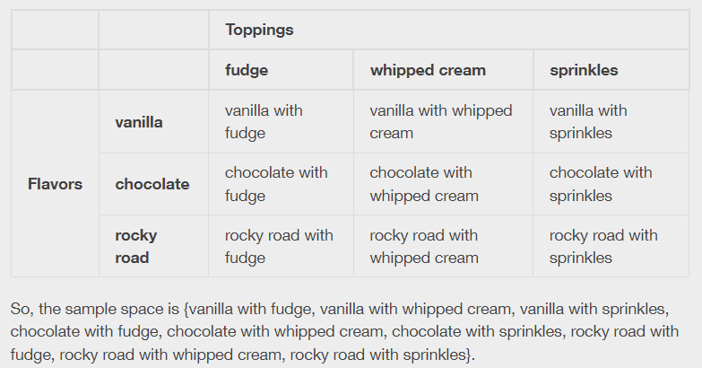
7.4 Multi-stage Experiments
For example, you’re in an ice-cream shop, and you’re going to get a single scoop of ice cream with one topping. The flavors of ice cream you’re considering are vanilla, chocolate, and rocky road; the toppings are fudge, whipped cream, and sprinkles.

Slide 9
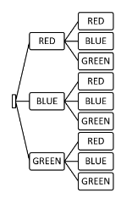
Tree Diagrams
A bag contains 7 red, 4 blue, and 6 green marbles. Two marbles are drawn from the bag in succession. The color and order in which the balls are drawn is noted. Use the tree diagram below to determine the sample space for possible outcomes. In writing the sample space, use R for red, B for blue, and G for green.
The sample space is {RR,RB,RG,BR,BB,BG,GR,GB,GG}

Slide 10
7.5 Basic Concepts of Probability
Learning Objectives:
Define probability including impossible and certain events.
Calculate basic theoretical probabilities.
Calculate basic empirical probabilities.
Calculate the probability of the complement of an event.

Slide 11
7.5 Introducing Probability
An event is a subset of the sample space of an experiment.
The probability of an event is the likelihood that event occurs.
We denote the event by 𝐸 and call the probability of that event 𝑃(𝐸).
The probability of an event is a number between 0 and 1 (inclusive).
If 𝑃(𝐸) = 0, then the event is impossible.
If 𝑃(𝐸) = 1, then the event is certain to occur.
In general, the higher the probability of an event, the more likely it is that the event will occur.

Slide 12
EXAMPLE – Determining Certain and Impossible Events
Consider an experiment that consists of rolling a single standard six-sided die (with faces numbered 1-6). Decide if these probabilities are equal to zero, equal to one, or somewhere in between.
The sample space is {1, 2, 3, 4, 5, 6}.
𝑃(roll a 4)
Note that 4 is the sample space, so 0 < 𝑃(roll a 4) < 1.
𝑃(roll a 7)
Notice that 7 is not in the sample space, 𝑃(roll a 7) = 0

Slide 13
7.5 Three Ways to Assign Probabilities (1 of 2)
Method 1: Theoretical Probability
For an experiment whose sample space 𝑆 consists of equally likely outcomes, the theoretical probability of the event 𝐸 is the ratio
where 𝑛(𝐸) and 𝑛(𝑆) denote the number of outcomes in the event and in the sample space, respectively.

Slide 14
EXAMPLE – Computing Theoretical Probabilities
Recall that a standard deck of cards consists of 52 unique cards which are labeled with a rank (the whole numbers from 2 to 10, plus J, Q, K, and A) and a suit (club, diamond, heart, or spade). A standard deck is thoroughly shuffled, and you draw one card at random (so every card has an equal chance of being drawn).
Find the theoretical probability of drawing a card that is a 10 of spades.
Notes:
There are 52 cards in the deck, so the sample space for each of these experiments has 52 elements. That will be the denominator for each of our probabilities.
There is only one 10 of spades in the deck, so this event only has one outcome in it.

Slide 15
7.5 Three Ways to Assign Probabilities (2 of 2)
Method 2: Empirical Probability
When we use the outcomes of previous replications of an experiment to find a probability of an event, we’re defining an empirical probability.
Empirical probability is the ratio of the number of times the event occurred and the total number of repetitions.

Slide 16
EXAMPLE – Finding Empirical Probabilities
Assign an empirical probability to the events described below.
Jose is on the basketball court practicing his shots from the free throw line. He made 47 out of his last 80 attempts. What is the probability he makes his next shot?
Since Jose made 47 out of his last 80 attempts, we can assign this event an empirical probability of

Slide 17
The Complement of an Event
Given an event E, the complement of E is the collection of outcomes that are not in E.
We denote the complement of E by E’.
P(E)=1−P(E')

Slide 18
EXAMPLE - The Complement of an Event
If you roll a standard 6-sided die, what is the probability that the result will be a number greater than one?
Here, the sample space is {1, 2, 3, 4, 5, 6}, E={2,3,4,5,6}, and E’={1}.
Since E is defined using the inequality roll>1, then E’ is defined using roll≤1.
Since there’s only one outcome (1) in E', we have P(E’)=1/6.
P(E)=1−P(E’)=1-1/6=5/6
Notes:
It’s easy enough to see that the probability in question is 5/6, because there are 5 outcomes that fall into the event “roll a number greater than 1.”

Slide 19
This resource contains adaptations of the OpenStax Algebra and Trigonometry 2e open textbook and is © by Susan Aydelotte under a CC BY-NC-SA 4.0 International license; it may be reproduced or modified for noncommercial purposes only but must be attributed to OpenStax, Rice University and any changes must be noted. Any adaptation must be shared under the same type of license.

