Slide 1
Contemporary Mathematics
Chapter 6 MONEY MANAGEMENT

Slide 2
6.11 Buying a Car
Learning Objectives:
Evaluate basics of car purchasing.
Compute purchase payments and identify the related interest cost.

Slide 3
6.11 The Basics of Car Purchasing
The sticker price of the car, called the manufacturer’s suggested retail price, or the negotiated price you arrive at, isn’t the end of the cost to buying a car. There are many fees which include, but not limited to:
sales tax
title and registration fee
destination fee
documentation fee
dealer preparation fee
extended warranties
One way to bring down payments on a car is to provide a down payment or a trade in.
Notes:
The title and registration fee, which includes registering the car with the state, getting the license plate, and assigning the title of the car to the lender.
A destination fee, which covers the cost of delivering the vehicle to the dealer.
A documentation fee, sometimes referred to as a processing fee or handling fee, is the cost of all the paperwork the dealer did to get the car.
A dealer preparation fee, which is for washing the car and other preparation of that sort. You should try to negotiate out that cost.
Extended warranties and maintenance plans, which help cover some of the costs of caring for the car.
Sales tax.

Slide 4
6.11 Purchase Payments and Interest
The payment, pmt, per period to pay off a loan with beginning principal P, is
where r is the annual interest rate in decimal form, t is the term in years, and n is the number of payments per year (typically, loans are paid monthly making n = 12). Note, payment to lenders is always rounded up to the next penny.

Slide 5
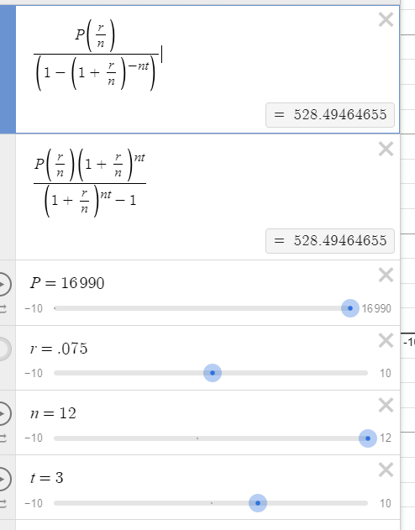
EXAMPLE – Used Car Payment
Calculate the monthly payment for the used car if the total to be financed is $16,990, the interest rate is 7.5%, and the loan term is 3 years.
The monthly car payment will be $528.50.

Slide 6
6.12 Renting and Homeownership
Learning Objectives:
Pros and cons of renting and homeownership.
Calculate the monthly payment for a mortgage and related interest cost.

Slide 7
6.12 Advantages and Disadvantages of Renting
When renting, you will likely sign a lease, which is a contract between a renter and a landlord. A landlord is the person or company that owns property that is rented. The lease will detail your responsibilities, restrictions on activities, deposits, fees, maintenance, repairs, and rent during the term of the lease. It also defines what your landlord can, and cannot, do with the property while you occupy the property.
Advantages to renting:
Lower cost.
Short-term commitment.
Little to no maintenance cost.
You have the option to move or stay at end of lease.
If renting in an apartment complex, there may be a pool or gym or community room for renters to use.

Slide 8
6.12 Advantages of Buying a Home
Advantages to buying a home:
There are tax incentives.
There are no restrictions on pets or occupants, unless laws in your area specify limits for homes.
You can redecorate any way you wish, limited only by the laws in your area.
Once your mortgage is set with a fixed-interest rate, your housing cost is fixed.
Your home grows equity, the difference between what you owe and what the house is worth grows.
As long as you pay your mortgage and maintain the home to the standards of your community, you can stay as long as you wish.

Slide 9
6.12 Disadvantages of Buying a Home
Disadvantages to buying a home:
The cost is higher than renting.
The owner is responsible for upkeep, maintenance, and repairs.
The owner cannot walk away from the property. It can be sold, but simply leaving the property, especially if not paid off yet, has serious consequences.

Slide 10
6.12 Escrow Payments
When you take out a mortgage, the payment is sometimes much higher than the principal and interest. This is because your mortgage company also has you pay into an escrow account, which is a savings account maintained by the mortgage company.
Your insurance payments will be set by your insurer and the mortgage company will pay them on time for you from your escrow account. Your property taxes are set by where you live and are typically a percentage of your property’s assessed value. The assessed value is the estimation of the value of your home and does not necessarily reflect the purchase or resale value of the home. Your property taxes will also be paid on time by the mortgage company from your escrow account.

Slide 11
6.12 Mortgages
A mortgage is a long-term loan and the property itself is the security. The title of the home belongs to the bank.
The payment, pmt, per month to pay off a loan with beginning principal P, is
where r is the annual interest rate (APR) in decimal form and t is in years. Note, payment to lenders is always rounded up to the next penny.

Slide 12
The total paid, T, on a t year mortgage with monthly payments pmt is
𝑇 = 𝑝𝑚𝑡 × 12 × 𝑡.
The amount of interest paid over the term of the loan is
I = 𝑇 $–$ P
where P is the principle.

Slide 13
EXAMPLE – 30-Year Mortgage
Cassandra buys a house. She pays a down payment and finances the rest with a 30-year mortgage. The loan amount is $325,000 with a 7.35% annual interest rate. If Cassandra pays off the mortgage over those 30 years, her monthly mortgage payment will be $2,239.16. How much will she have paid in total and how much interest will she pay over the term of the loan?
With mortgage payment $2,239.16, the total paid over 30 years is
𝑇 = 𝑝𝑚𝑡 × 12 × 𝑡 = $2239.16 × 12 × 30 = $806,097.60.
I = 𝑇 – P = $806,097.60 $−$ $325000 = $481,097.60

Slide 14
This resource contains adaptations of the OpenStax Algebra and Trigonometry 2e open textbook and is © by Susan Aydelotte under a CC BY-NC-SA 4.0 International license; it may be reproduced or modified for noncommercial purposes only but must be attributed to OpenStax, Rice University and any changes must be noted. Any adaptation must be shared under the same type of license.

