Slide 1
Contemporary Mathematics
Chapter 6 MONEY MANAGEMENT

Slide 2
6.8 The Basics of Loans
Learning Objectives:
Describe the terminology associated with loans.
Understand credit scoring.
Calculate the payment necessary to pay off a loan.
Calculate the cost of financing a loan.
Read an amortization table.

Slide 3
6.8 Terminology of Loans
Loans are taken out to pay for goods or services when a person does not have the cash to pay for the goods or services. The borrower agrees to pay back more than the amount of the loan.
A fixed interest rate loan has an interest rate that does not change during the life of the loan. A variable interest rate loan has an interest rate that may change during the life of the loan.
An installment loan is a loan with a fixed period, and the borrower pays a fixed amount per period until the loan is paid off. Loan amortization is the process used to calculate how much of each payment will be applied to principal and how much is applied to interest.
Revolving credit, also know as open-end credit, is how most credit cards work but is also a kind of loan account.

Slide 4
6.8 Terminology of Loans
An amortization table or amortization schedule is a table that provides the details of the periodic payments for a loan where the payments are applied to both the principal and the interest.
The cost to finance a loan, also called the cost of financing, is the sum of all costs, fees, interest, and other charges paid over the life of the loan.

Slide 5
Credit Scores
Interest rates for loans are based on your credit score.
Data is collected by three credit bureaus—Experian, Equifax, and TransUnion.
Credit scores are determined based on the following categories:
Payment History
Credit Utilization or Amount Owed
Length of Credit History
Credit Mix
New Credit
Credit scores range from 300 to 850.
Notes:
Payment History: Making your payments on time and not missing payments is by far the most important factor. All three credit types—revolving, installment, and open—contribute to this factor.
Credit Utilization or Amount Owed: How much do you owe on your credit card accounts? This category is concerned with the ratio of how much you owe on revolving credit accounts relative to your available credit, also known as your credit utilization ratio. This is the only category that depends solely on your revolving credit accounts.
Length of Credit History: This is the average age of your credit history, including the age of the oldest and newest accounts. All three types of credit accounts play a role in this category.
Credit Mix: This number represents the different types of credit accounts you have, such as credit cards, car loan, mortgages, and whether you are successful managing both revolving and installment accounts.
New Credit: Have you recently opened a new account or applied for new credit? Lenders want to know how much new credit you are taking on. So, if you are planning to buy a car and make another large purchase with a credit card, you may want to space these purchases out.

Slide 6
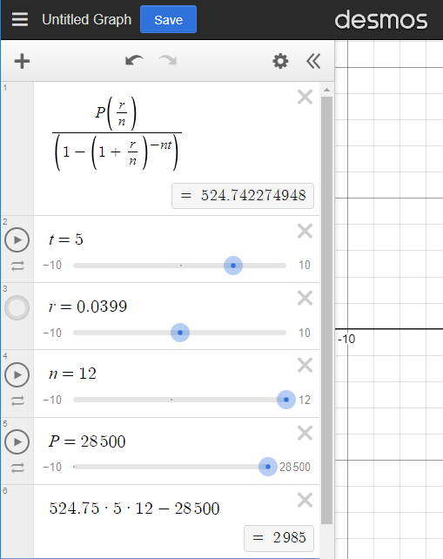
EXAMPLE – Calculating the Monthly Payment for a Loan
A car loan is taken out for $28,500 at an annual interest rate of 3.99%. Find the monthly payment necessary to pay off the loan in 5 years and calculate the amount of interest paid.
Substitute the values into the formula.
P = 28500, r = 0.0399, n = 12, t = 5
pmt = $ 524.74 rounding to nearest cent
Interest = (pmt)(n)(t) – P = $ 2985

Slide 7
EXAMPLE – Cost of Financing a Personal Loan
Irena signed a loan of $15,000 at 6.33% for 5 years. When she took out the loan, Irena paid a $750 origination fee. Over the course of the loan, she pays $2,537.96 in interest. What was her cost to finance the loan?
The cost to finance the loan is the sum of all interest and any fees paid for the loan.
$750.00 + $2,537.96 = $3,287.96

Slide 8
Amortization Schedule

Slide 9
6.9 Understanding Student Loans
Learning Objectives:
Understand types of student loans.
Understand the limits on student loans.
Understand repayment plans.
Calculate monthly payments on student loans.

Slide 10
6.9 Loan Types
Federal subsidized loans are backed by the U.S. Department of Education, and the government pays the interest while the student is enrolled in school at least half-time.
Federal unsubsidized loans are available for undergraduate and graduate students who cannot demonstrate financial need. Interest begins accruing as soon as the money is disbursed.
Parent Loans for Undergraduate Students (PLUS) are federal loans made directly to parents. They are available even if you are not deemed financially needy.
Private student loans are backed by a bank or credit institution and require a credit check, and interest rates are variable.

Slide 11
6.9 Loan Limits as of 2022
Year | Dependent Students Maximum amounts | Independent students Maximum amounts
First-Year Undergraduate | $5,500 but no more than $3,500 may be in subsidized loans. | $9,500 but no more than $3,500 may be in subsidized loans.
Second-Year Undergraduate | $6,500 but no more than $4,500 may be subsidized loans. | $10,500 but no more than $4,500 in subsidized loans.
Third-Year and Additional Years | $7,500 but no more than $5,500 may be in subsidized loans. | $12,500, but no more than $5,500 may be in subsidized loans.
Graduate and Professional | Not applicable | $20,500 in unsubsidized loans
Limits | $31,000 but no more than $23,000 in subsidized loans. | $57,500 for undergraduates, but no more than $23,000 in subsidized. $138,500 for graduate or professional but no more than $65,500 may be subsidized loans.

Slide 12
6.9 Loan Repayment Plans (1 of 3)
Standard Repayment Plans. These plans are available to everyone. Borrowers pay a fixed amount monthly so the loan is paid in full within 10 years. Consolidated loans may allow the payoff period to range from 10 to 30 years. Direct subsidized and unsubsidized loans, PLUS loans, and federal Stafford loans are eligible.
Graduated Repayment Plans. A graduated repayment plan is a plan where the amount of the payments gradually increases so that the loan is paid off in 10 years, or within 10 to 30 years for consolidated loans. Payments start off small and increase approximately every two years. Almost all loan types are eligible, including direct subsidized and unsubsidized loans, Stafford loans, PLUS loans, and consolidated loans.
Extended Repayment Plans. Extended repayment plans are available to the direct loan borrower if the outstanding direct loans are over $30,000. The payments, fixed or graduated, are designed so that the loans are satisfied within 25 years. Eligible loans include both direct subsidized or unsubsidized loans, Stafford loans, PLUS loans, and consolidated loans.

Slide 13
6.9 Loan Repayment Plans (2 of 3)
Pay As You Earn (PAYE) repayment plan. Monthly payments are 10% of discretionary income based on student’s updated income and family size. If a borrower files a joint tax return, their spouse’s income and debt may also be considered. Eligible loans include direct subsidized and unsubsidized loans, PLUS loans made to students, and some consolidated loans.
Revised Pay As You Earn (REPAYE) repayment plans. Payment amounts are based on income and family size and calculated as 10% of discretionary income. Eligible loans include direct subsidized and unsubsidized loans, direct PLUS loans, and some consolidated loans.
Income-Based Repayment (IBR) plan. This type of repayment plan sounds like a few of the others and there are similarities in them all. The payments are either 10% or 15% of discretionary income, but this plan is meant for those with a relatively high debt. Every year, your income and family size must be updated, and payments are calculated based on those figures. Eligible loans include direct subsidized and unsubsidized loans, Stafford loans, and PLUS loans made to students, and not PLUS loans made to parents.

Slide 14
6.9 Loan Repayment Plans (3 of 3)
Income-Contingent Repayment (ICR) plan. Payments are either 20% of discretionary income or whatever you would pay if you were on a fixed payment plan for more than 12 years, whichever is less. Eligible loans include direct subsidized and unsubsidized, PLUS loans to students, and consolidated loans.

Slide 15
EXAMPLE – Calculating the Monthly Payment for a Loan
A student owes $31,000 on student loans at an annual interest rate of 4.5%. Find the monthly payment necessary to pay off the loan in 10 years and calculate the amount of interest paid.
Substitute the values into the formula.
P = 31,000, r = 0.045, n = 12, t = 10
pmt = $ 321.28 rounding to nearest cent
Interest = (pmt)(n)(t) – P = $ 7,553.60

Slide 16
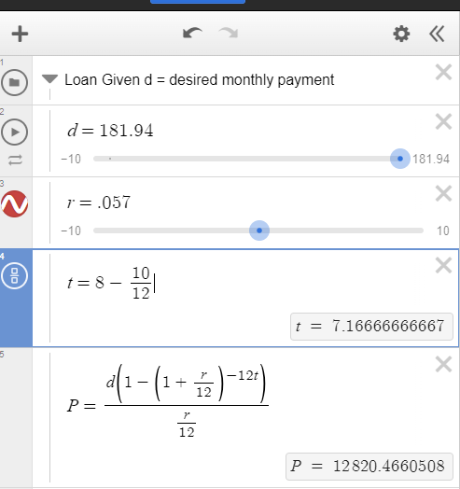
Homework exercise

Slide 17
6.10 Credit Cards
Learning Objectives:
Calculate the average daily balance.
Compute interest charges
Compute balance due.

Slide 18
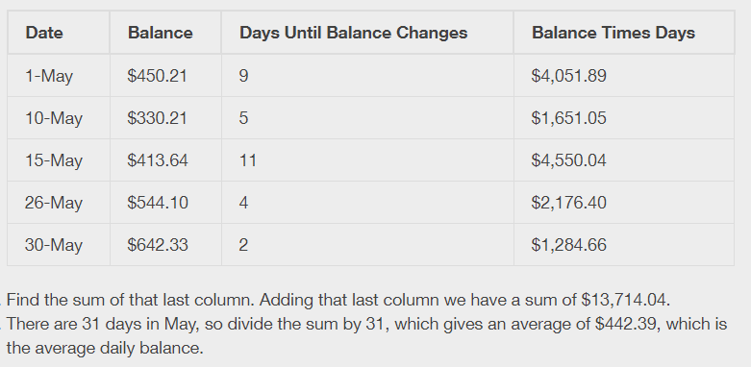
Average Daily Balance
The average daily balance (ADB) is the sum of the balance for each day in the billing cycle divided by the number of days in the billing cycle.

Slide 19
Interest charge for a Credit Card

Slide 20
Example

Slide 21
Calculating the Balance of a Credit Card
The balance, or sometimes referred to as balance due, on a credit card is the previous month’s balance, plus all expenses for the month, minus all payments and credits made during the month, plus the interest on the card (calculated using the average daily balance).
If the card was paid off, there is no interest to be paid.

Slide 22
Example

Slide 23
Minimum Payment Due
The minimum payment due is the smallest required amount to be paid on a credit card to avoid late fees and penalties, such as an increased interest rate. The calculations for this may differ from card to card. They also depend in the balance of the credit card. General guidelines for minimum payment due are:
For larger balances (usually over $1,000), the minimum payment will be some percentage of the balance due.
For moderate balances (between $25 and $1,000), the minimum would be a specified dollar amount. $25 seems to be a common value.
If the balance is small (under $25 for instance), then the minimum payment is the balance.
Those are just guidelines. Individual cards may vary in these values.

Slide 24
This resource contains adaptations of the OpenStax Algebra and Trigonometry 2e open textbook and is © by Susan Aydelotte under a CC BY-NC-SA 4.0 International license; it may be reproduced or modified for noncommercial purposes only but must be attributed to OpenStax, Rice University and any changes must be noted. Any adaptation must be shared under the same type of license.

