Slide 1
Contemporary Mathematics
Chapter 8 STATISTICS

Slide 2
8.5 Percentiles
Learning Objectives:
Understand percentiles.
Find the percentile for a given data value.
Find the data value at a given percentile.

Slide 3
8.5 Understanding Percentiles
A percentile is a measure of the position or relative standing of a particular value within a data set.
Percentiles divide the data into equal-sized groups and determine the position of a value within those groups.
If $p$% of the values in a data set are less than a number $n$,
then we say that $n$ is at the $p^{th}$percentile.
For example, if someone’s score is at the 80th percentile, it means they performed better than 80% of the people in the data set.

Slide 4
EXAMPLE – Finding Percentiles
Consider the data set
5, 8, 12, 1, 2, 16, 2, 15, 20, 22.
At what percentile is the value 5?
Put the data in increasing order: 1, 2, 2, 5, 8, 12, 15, 16, 20, 22.
There are three values (1, 2, and 2) in the set that are less than 5, and there are ten values in the set. Thus, 5 is at the percentile.

Slide 5
EXAMPLE – Finding Data Value at Given Percentile
Consider the data set
5, 8, 12, 1, 2, 16, 2, 15, 20, 22.
What value is at the 60th percentile?
Put the data in increasing order: 1, 2, 2, 5, 8, 12, 15, 16, 20, 22.
To find the value at the 60th percentile, we note that there are ten data values, and 60% of ten is six. Thus, the number we want is greater than exactly six of the data values. Thus, the 60th percentile is 15.

Slide 6
8.6 The Normal Distribution
Learning Objectives:
Describe the characteristics of the normal distribution.
Apply the 68-95-99.7 percent groups to normal distribution data sets.
Use the normal distribution to calculate a z-score.

Slide 7
8.6 Properties of Normal Distribution: 68-95-99.7 Rule (1 of 2)
Normal distributions can be completely described using two numbers we’ve seen before: the mean of the data and the standard deviation of the data.
In the coin flipping example below, the distribution of the number of heads for 10,000 trials was close to perfectly symmetric and bell-shaped:

Slide 8
8.6 Properties of Normal Distribution: 68-95-99.7 Rule (2 of 2)
The most important property of normal distributions is tied to its standard deviation.
The 68-95-99.7 Rule says that, for normally distributed data, 68% of the data fall within 1 standard deviation of the mean, 95% fall within 2 standard deviations of the mean, and 99.7% fall within 3 standard deviations of the mean.
Suppose we have a set of normally distributed data with mean 400 and standard deviation 100.

Slide 9
EXAMPLE – Finding Other Proportions Using the 68-95-99.7 Rule (1 of 2)
Assume we have data that are normally distributed with mean 80 and standard deviation 3.
What proportion of the data will be greater than 86?
Mark off sections that are multiples of the standard deviation away from the mean:
To figure out what proportion of the data will be greater than 86, let's start by shading in the area of data that are above 86 in our figure, or the data more than two standard deviations above the mean. That proportion is 2.5%.

Slide 10
EXAMPLE – Finding Other Proportions Using the 68-95-99.7 Rule (2 of 2)
Assume we have data that are normally distributed with mean 80 and standard deviation 3.
What proportion of the data will be between 74 and 77?
To figure out what proportion of the data will be between 74 and 77, let's start by shading in that area of data. These are data that are more than one but less than two standard deviations below the mean.
The proportion of data less than two standard deviations below the mean is 47.5% and 34% of the data is less than one standard deviation below the mean.
Subtracting, we see that the proportion of data between 74 and 77 is 13.5%.

Slide 11
8.6 Standardized Scores
When we want to apply the 68-95-99.7 Rule, we must first figure out how many standard deviations above or below the mean our data fall. This calculation is common enough that it has its own name: the standardized score. Values above the mean have positive standardized scores, while those below the mean have negative standardized scores. Since it's common to use the letter to represent a standard score, this value is also often referred to as a $z$-score.
If $x$ is a member of a normally distributed data set with mean $μ$ and standard deviation $σ$, then the standardized score for $x$ is:
If you know a $z$-score but not the original data value $x$, you can find it by solving the previous equation for

Slide 12
EXAMPLE – Standardizing Data
Suppose we have data that are normally distributed with mean 50 and standard deviation 6.
Compute the standardized scores (rounded to three decimal places) for a data value of 52.
Use the formula:
where the mean $μ=50$ and the standard deviation $σ=6$.
•

Slide 13
8.7 Applications of the Normal Distribution
Learning Objectives:
Apply the normal distribution to real-world scenarios.

Slide 14
EXAMPLE – Evaluating College Entrance Exam Scores (2 of 3)
According to the Digest of Education Statistics (https://openstax.org/r/nces_ed_gov), composite scores on the SAT have mean 1060 and standard deviation 195, while composite scores on the ACT have mean 21 and standard deviation 5.
What is the z-score of an ACT score of 27?
Use the formula:
we get

Slide 15
8.8 Scatter Plots, Correlation, and Regression Lines
Learning Objectives:
Construct a scatter plot for a data set.
Distinguish among positive, negative and no correlation.
Compute regression lines and the correlation coefficient.

Slide 16
8.8 Scatter Relationships Between Quantitative Datasets
When exploring the relationship between two datasets, if one set seems to depend on the other, we’ll say that dataset contains values of the response variable (or dependent variable).
The dataset that the response variable depends on contains values of what we call the explanatory variable (or independent variable).
If no dependence relationship can be identified, then we can assign either dataset to either role.

Slide 17
8.8 Scatter Creating Scatter Plots
A scatter plot is a visualization of the relationship between two quantitative sets of data. The ordered pairs are plotted in the $xy$-plane.
Notes:
The scatter plot is created by turning the datasets into ordered pairs: the first coordinate contains data values from the explanatory dataset, and the second coordinate contains the corresponding data values from the response dataset.

Slide 18
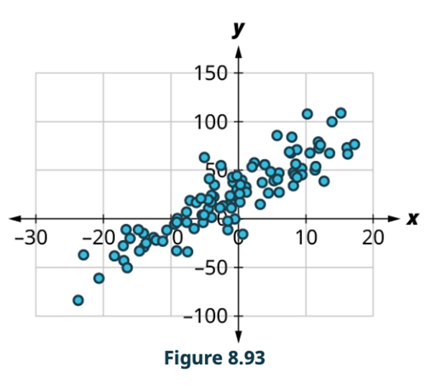
8.8 Positive Linear Relationships
Two datasets have a positive linear relationship if the values of the response tend to increase, on average, as the values of the explanatory variable increase.

Slide 19
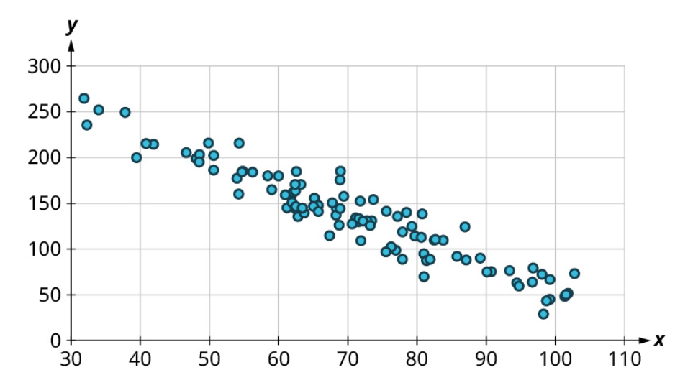
8.8 Negative Linear Relationships
If the values of the response decrease with increasing values of the explanatory variable, then there is a negative linear relationship between the two datasets.

Slide 20
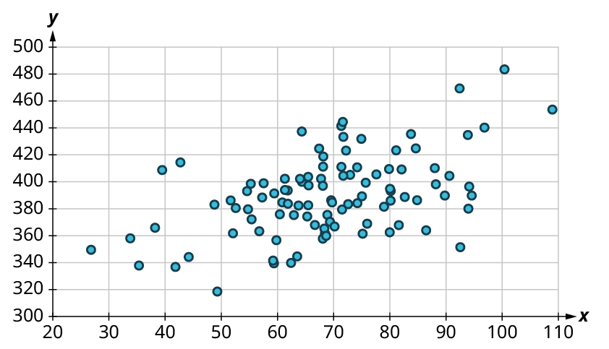
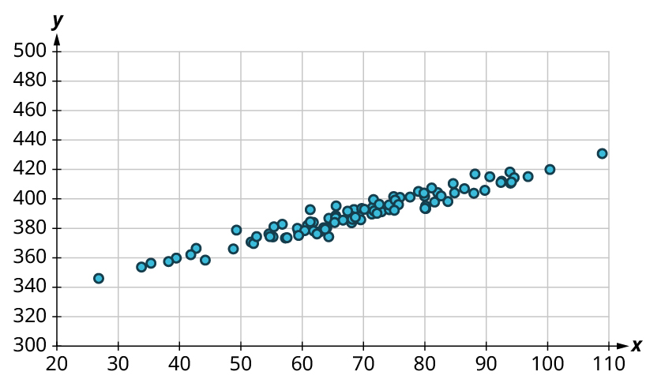
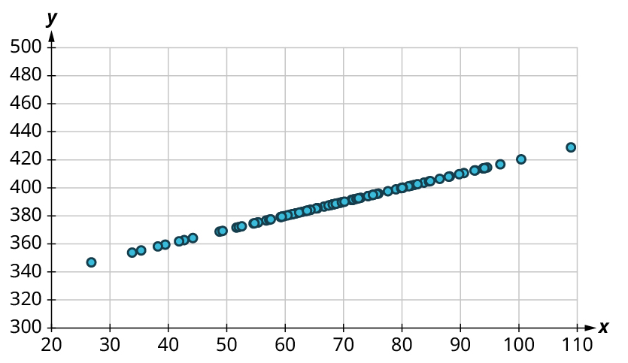
8.8 Correlation Coefficient
The strength and direction (positive or negative) of a linear relationship can also be measured with a statistic called the correlation coefficient (denoted $r$). Positive values of indicate a positive relationship, while negative values of indicate a negative relationship. Values of close to 0 indicate a weak relationship, while values close to 1 (or -1) correspond to a very strong relationship.

Slide 21
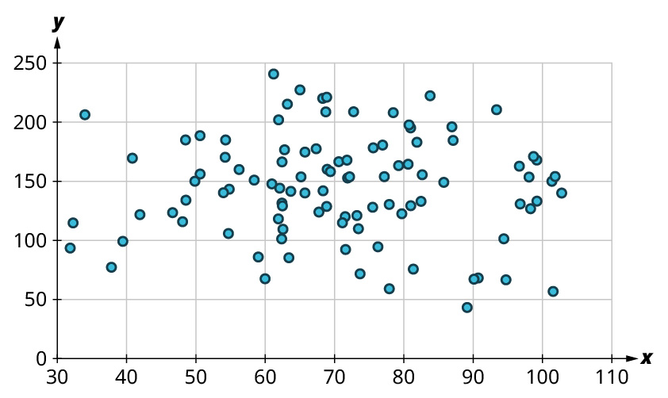
EXAMPLE of no correlation

Slide 22
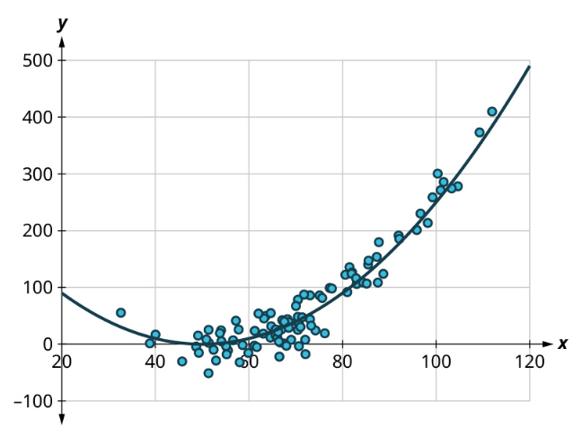
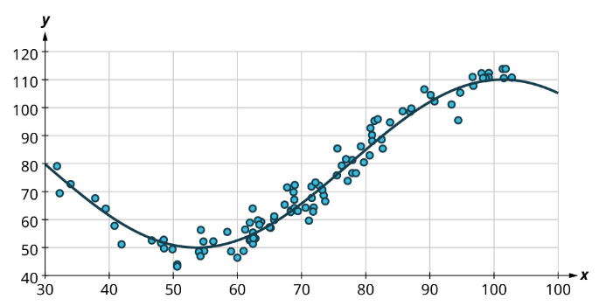
Nonlinear Relationships

Slide 23
EXAMPLE – Interpreting Scatter Plots
Consider the scatter plot. Classify the strength and direction of the relationship. Make a guess at the value of $r$.
Notes:
Since the points tend upward as we move from left to right, this is a positive relationship.
The points seem pretty closely grouped around a line, so it’s fairly strong.
The value of the correlation coefficient is around r = 0.9.

Slide 24
8.8 Linear Regression
The final step in our analysis of the relationship between two datasets is to find and use the equation of the regression line.
For a given set of explanatory and response data, the regression line (also called the least-squares line or line of best fit) is the line that does the best job of approximating the data.

Slide 25
8.8 – Finding the Equation of the Regression Line
If a line has slope m and passes through a point ${(x}_{0},y_{0})$, then the point-slope form of the equation of the line is:
Suppose x and y are explanatory and response data sets that have a linear relationship. If their means are
respectively, their standard deviations are $s_{x}$ and $s_{y}$ respectively, and their correlation coefficient is r, then the equation of the regression line is:

Slide 26
EXAMPLE – Finding the Equation of the Regression Line from Statistics
Suppose you have datasets $x$ and $y$ with the following statistics: $x$has mean 21 and standard deviation 4, $y$ has mean 8 and standard deviation 2, and their correlation coefficient is −0.4.
What’s the equation of the regression line?
Step 1: We’re given
Start with the formula for the equation of the regression line:
Step 2: Plugging in our values gives us:
Our final regression line equation is:
y = −0.2x + 12.2

Slide 27
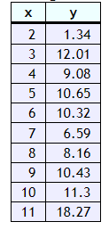
Using Desmos to find the Equation of the Linear Regression and Correlation Coefficient
Compute the equation of the linear regression line in the form y = mx + b, where m is the slope and b is the intercept.
Compute the correlation coefficient for this data set.

Slide 28
This resource contains adaptations of the OpenStax Algebra and Trigonometry 2e open textbook and is © by Susan Aydelotte under a CC BY-NC-SA 4.0 International license; it may be reproduced or modified for noncommercial purposes only but must be attributed to OpenStax, Rice University and any changes must be noted. Any adaptation must be shared under the same type of license.

