Slide 1
Trigonometric Identities and Equations
Chapter 9
Algebra and Trigonometry 2e, OpenStax, Jay Abramson
Notes:
Images and notes within these slides are from the OpenStax textbook Algebra and Trigonometry 2e

Slide 2
9.4 Sum-to-Product and Product-to-Sum Formulas
Notes:
Images and notes within these slides are from the OpenStax textbook Algebra and Trigonometry 2e

Slide 3
What are the learning objectives for this section?
Express products as sums.
Express sums as products.

Slide 12
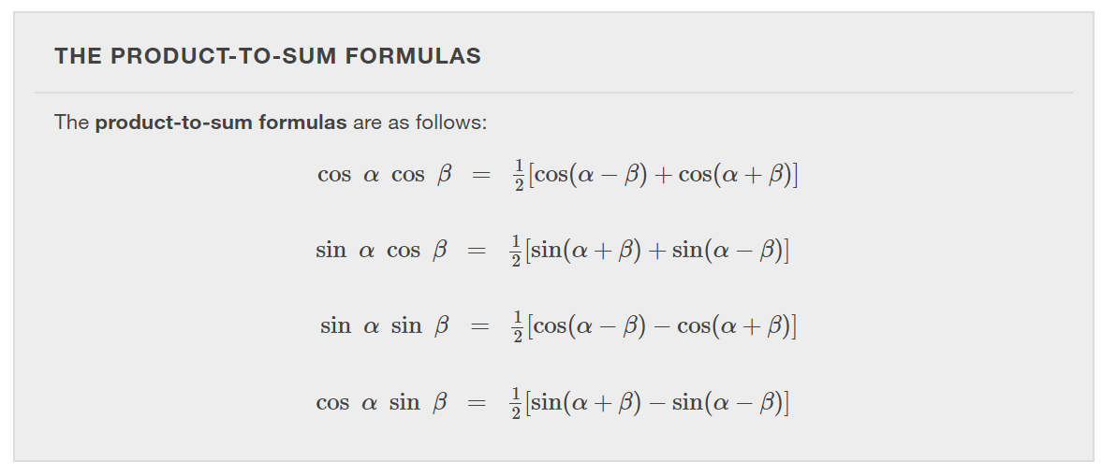

Slide 22
What did you learn in this section?
Express products as sums.
Express sums as products.
Notes:
Do you have any questions?

Slide 23
This resource is an adaptation of the OpenStax Algebra and Trigonometry 2e open textbook and is © Susan Aydelotte under a CC BY-NC-SA 4.0 International license; it may be reproduced or modified for noncommercial purposes only but must be attributed to OpenStax, Rice University and any changes must be noted. Any adaptation must be shared under the same type of license.

