Slide 1
Trigonometric Identities and Equations
Chapter 9
Algebra and Trigonometry 2e, OpenStax, Jay Abramson
Notes:
Images and notes within these slides are from the OpenStax textbook Algebra and Trigonometry 2e

Slide 2
9.3 Double-Angle, Half-Angle, and Reduction Formulas
Notes:
Images and notes within these slides are from the OpenStax textbook Algebra and Trigonometry 2e

Slide 3
What are the learning objectives for this section?
Use double-angle formulas to find exact values.
Use double-angle formulas to verify identities.
Use reduction formulas to simplify an expression.
Use half-angle formulas to find exact values.

Slide 5
Notes:
Deriving the double-angle formula for sine begins with the sum formula,

Slide 6
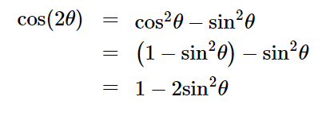

Slide 15
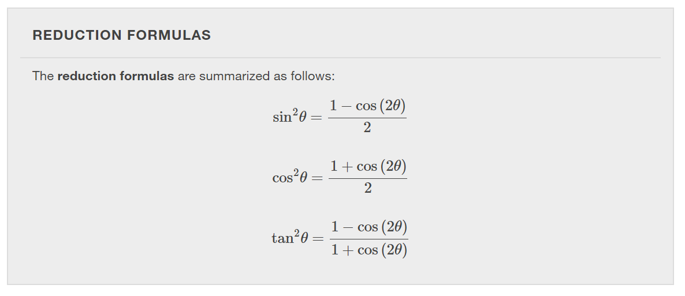
Notes:
We can use two of the three double-angle formulas for cosine to derive the reduction formulas for sine and cosine.

Slide 16
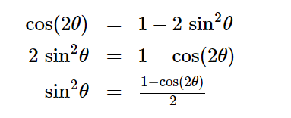
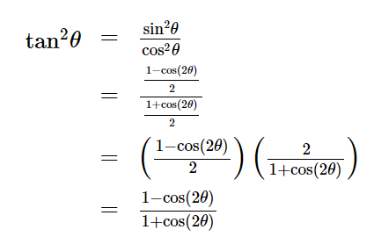
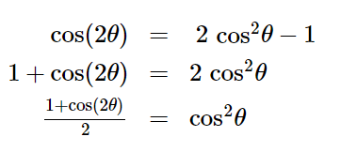
Notes:
Solve the first equation for $\sin^{2}θ$. Solve the second equation for $\cos^{2}θ$. Use the results to determine a formula for $\tan^{2}θ$. [Move/delete the boxes to reveal the steps.]

Slide 21
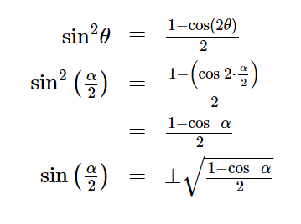
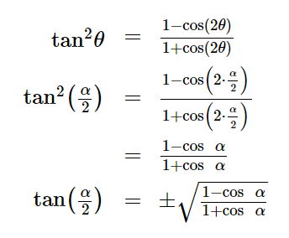
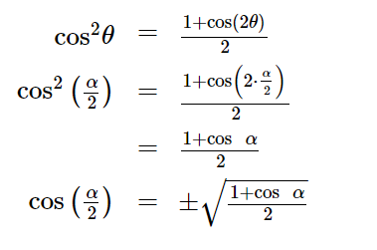
Replace $θ$ with $\frac{α}{2}$
Notes:
[Move/delete the boxes to reveal the steps.] Note that the half-angle formulas are preceded by a ± sign. This does not mean that both the positive and negative expressions are valid. Rather, it depends on the quadrant in which α/2 terminates.

Slide 27
What did you learn in this section?
Use double-angle formulas to find exact values.
Use double-angle formulas to verify identities.
Use reduction formulas to simplify an expression.
Use half-angle formulas to find exact values.
Notes:
Do you have any questions?

Slide 28
This resource is an adaptation of the OpenStax Algebra and Trigonometry 2e open textbook and is © Susan Aydelotte under a CC BY-NC-SA 4.0 International license; it may be reproduced or modified for noncommercial purposes only but must be attributed to OpenStax, Rice University and any changes must be noted. Any adaptation must be shared under the same type of license.

