Slide 1

Trigonometric Identities and Equations
Chapter 9
Algebra and Trigonometry 2e, OpenStax, Jay Abramson
Notes:
Images and notes within these slides are from the OpenStax textbook Algebra and Trigonometry 2e

Slide 2
9.2 Sum and Difference Identities
Notes:
Images and notes within these slides are from the OpenStax textbook Algebra and Trigonometry 2e

Slide 3
What are the learning objectives for this section?
Use sum and difference formulas for cosine.
Use sum and difference formulas for sine.
Use sum and difference formulas for tangent.
Use sum and difference formulas for cofunctions.
Use sum and difference formulas to verify identities.

Slide 4
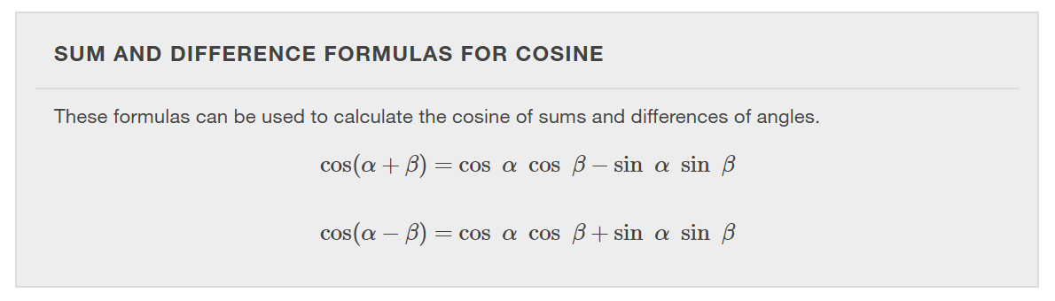

Slide 5
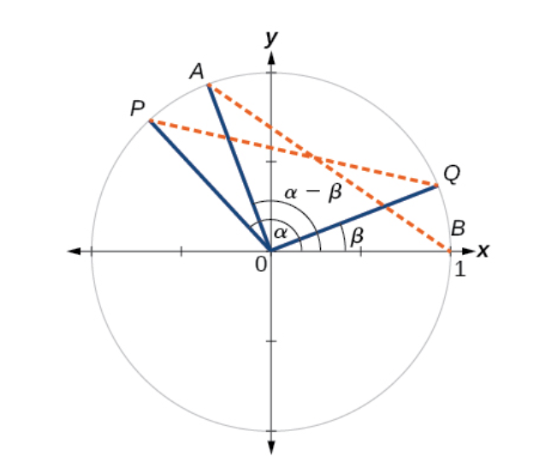
Notes:
First, we will prove the difference formula for cosines. Let’s consider two points on the unit circle. Point P is at an angle α from the positive x-axis with coordinates (cosα,sinα) and point Q is at an angle of β from the positive x-axis with coordinates (cosβ,sinβ). Note the measure of angle POQ is α−β.
Label two more points: A at an angle of (α−β) from the positive x-axis with coordinates (cos(α−β),sin(α−β)); and point B with coordinates (1,0). Triangle POQ is a rotation of triangle AOB and thus the distance from P to Q is the same as the distance from A to B.

Slide 6
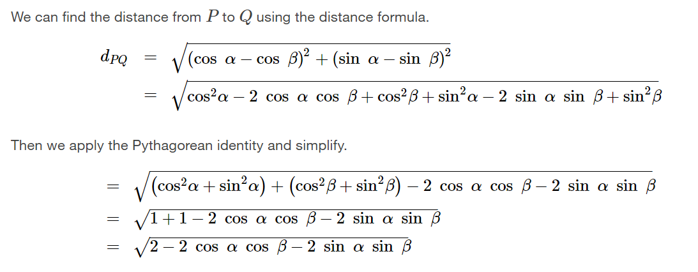

Slide 7
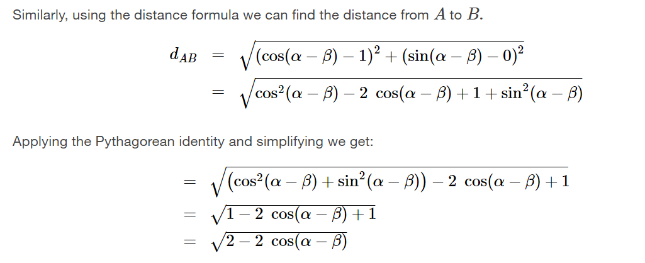

Slide 8
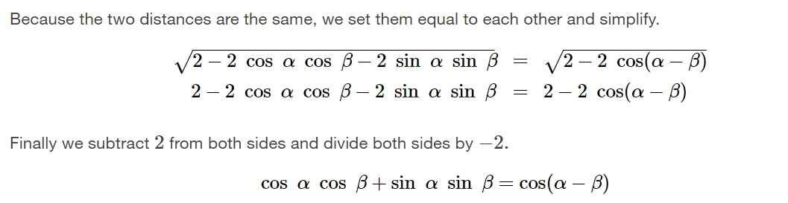
Notes:
Thus, we have the difference formula for cosine. We can use similar methods to derive the cosine of the sum of two angles.

Slide 9
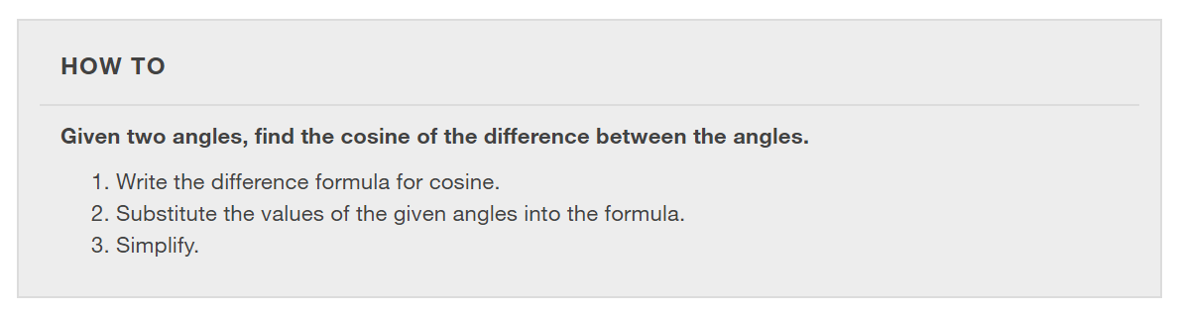

Slide 10
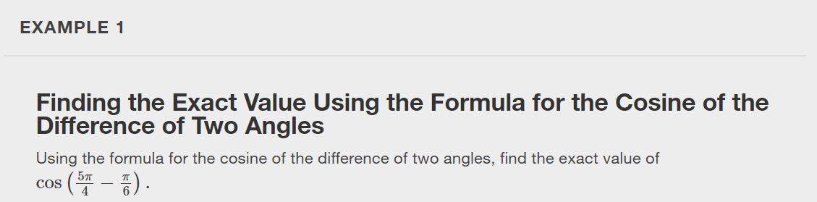

Slide 11
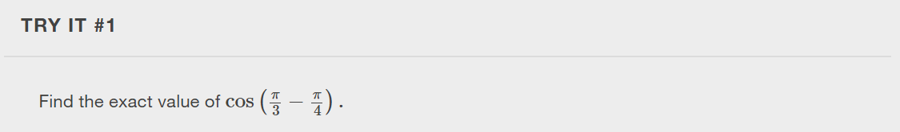

Slide 12
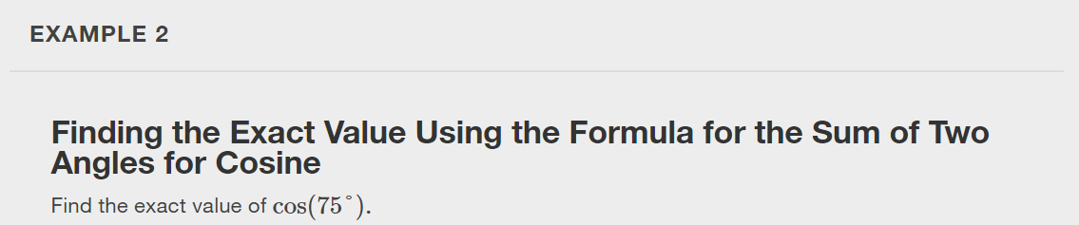

Slide 13
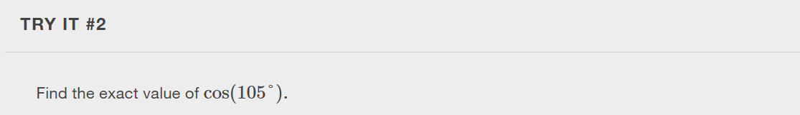

Slide 14
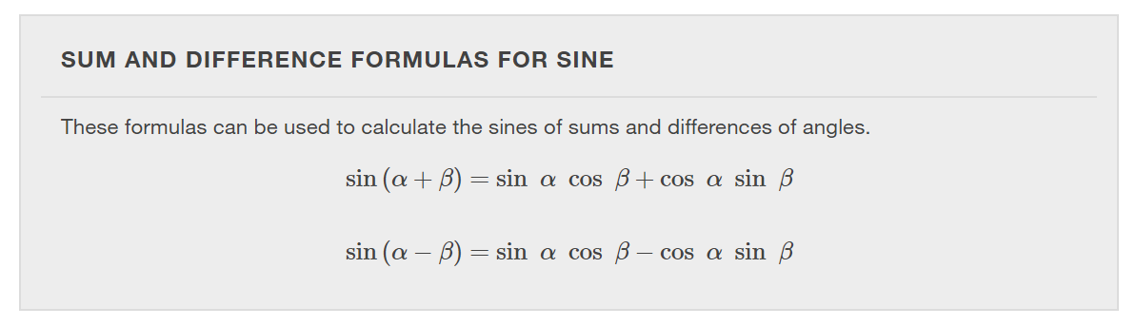

Slide 15
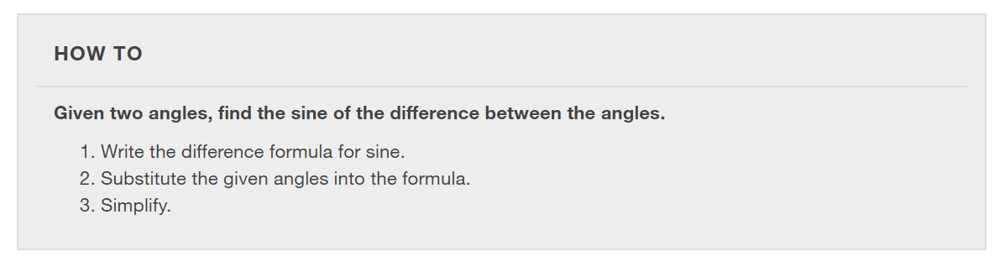

Slide 16
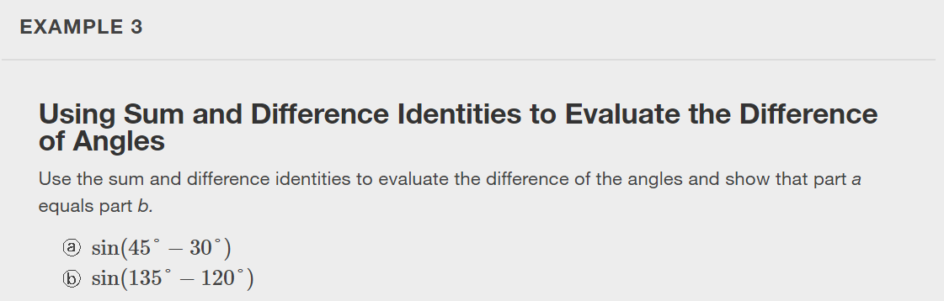

Slide 17
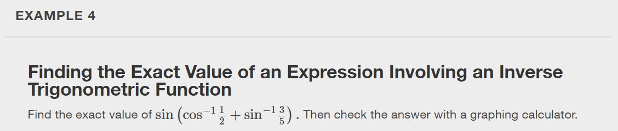

Slide 18
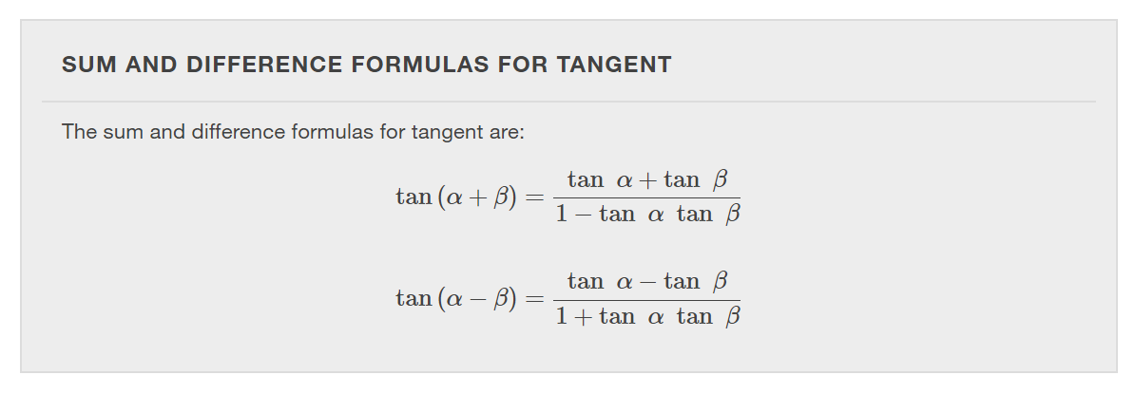

Slide 19

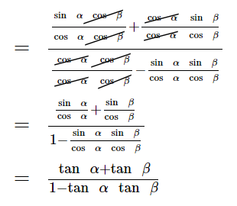
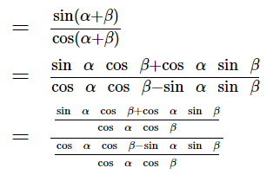
Notes:
Let’s derive the sum formula for tangent. [Move the boxes to reveal each step.]

Slide 20
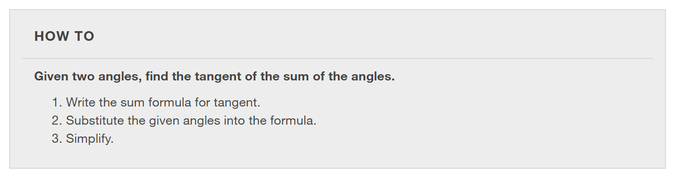

Slide 21
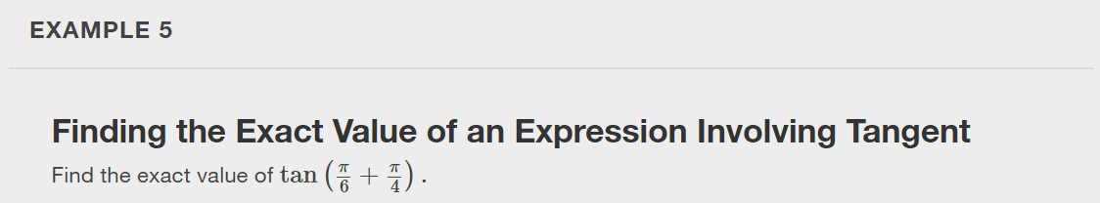

Slide 22
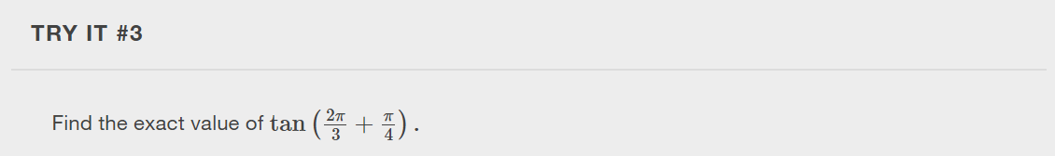

Slide 23
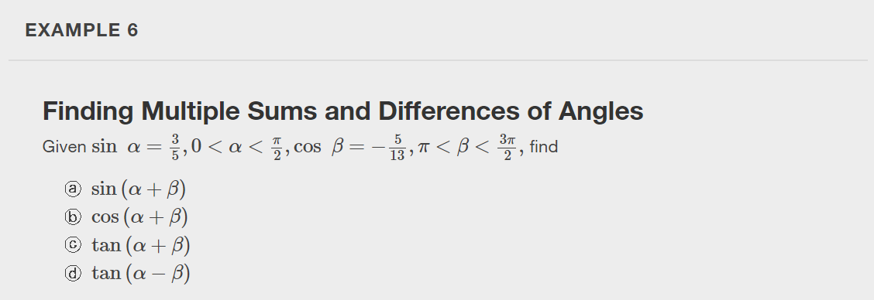

Slide 24
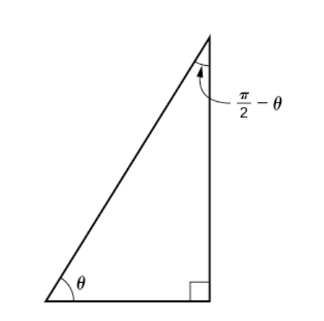


Slide 25
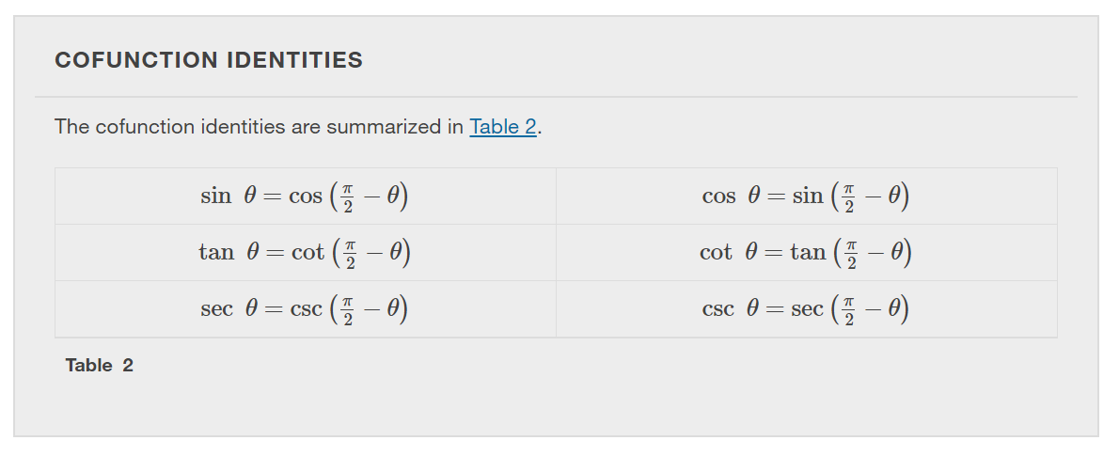
Notes:
The cofunction formulas in the table may also be justified algebraically using the sum and difference formulas.

Slide 26
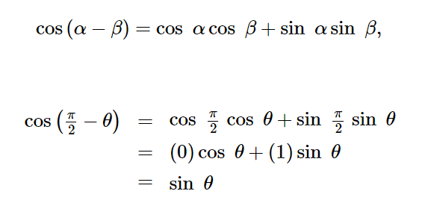

Slide 27
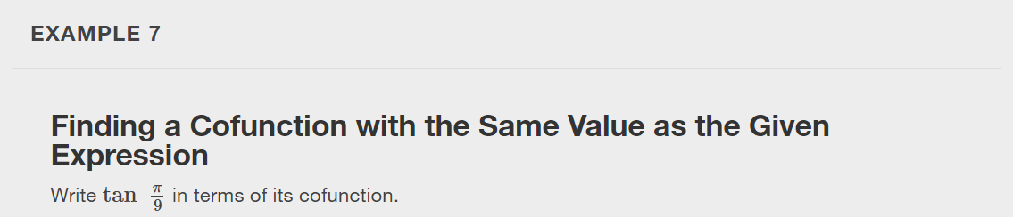

Slide 28
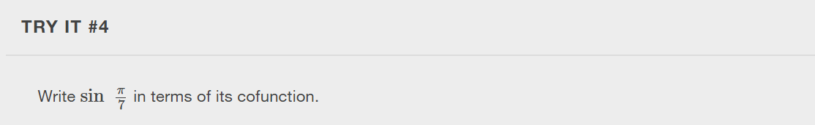

Slide 29
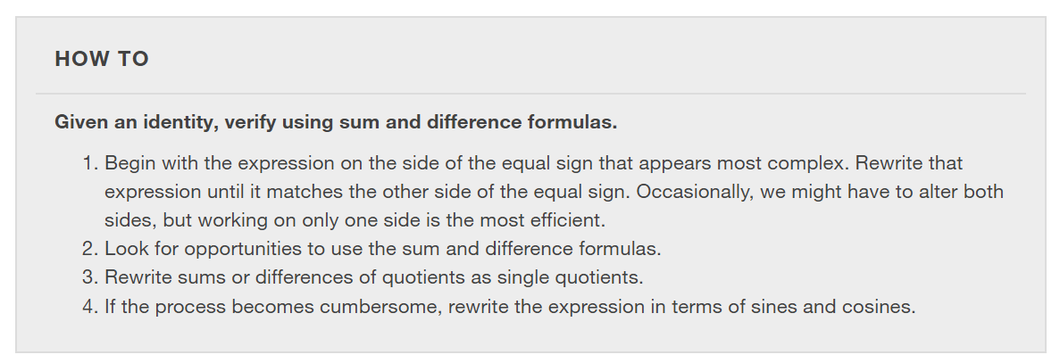

Slide 30
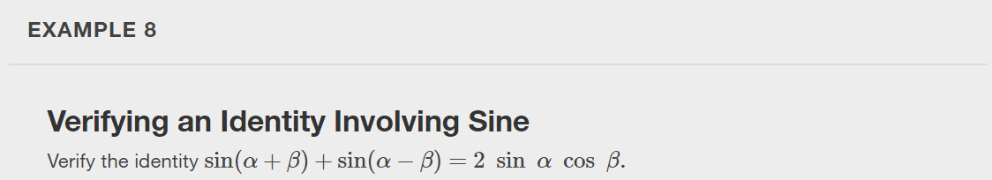

Slide 31
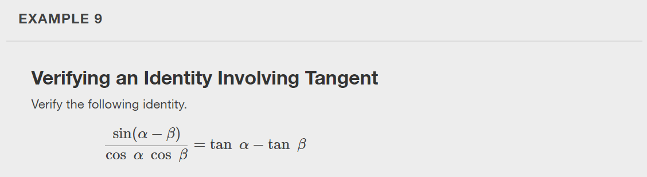

Slide 32
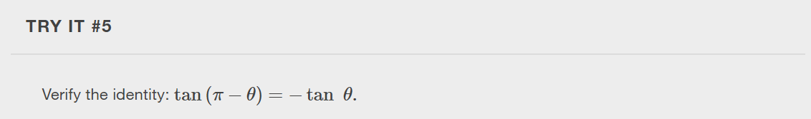

Slide 33
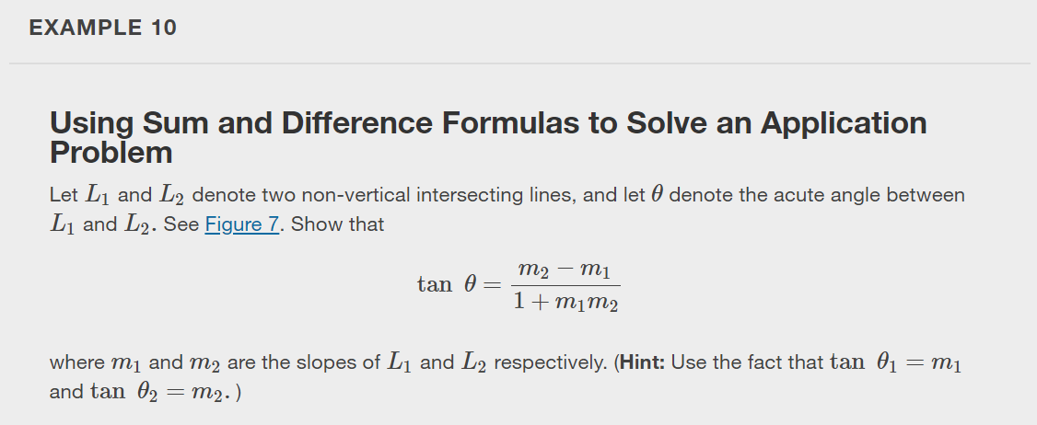
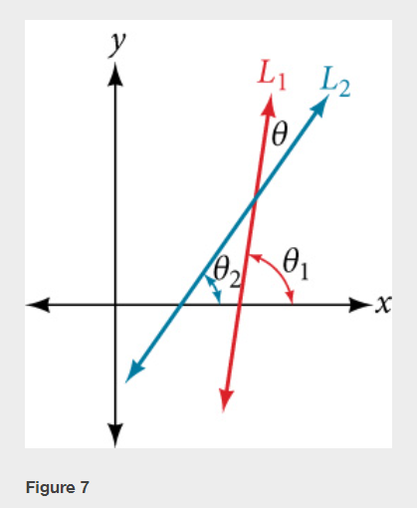

Slide 34
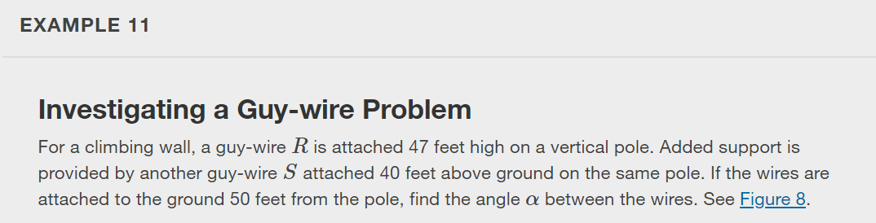
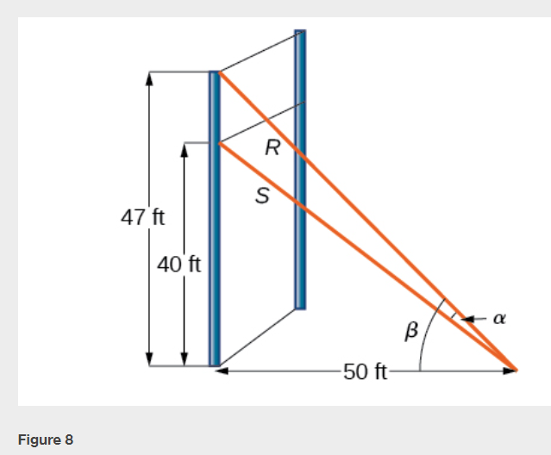

Slide 35
What did you learn in this section?
Use sum and difference formulas for cosine.
Use sum and difference formulas for sine.
Use sum and difference formulas for tangent.
Use sum and difference formulas for cofunctions.
Use sum and difference formulas to verify identities.
Notes:
Do you have any questions?

Slide 36
This resource is an adaptation of the OpenStax Algebra and Trigonometry 2e open textbook and is © Susan Aydelotte under a CC BY-NC-SA 4.0 International license; it may be reproduced or modified for noncommercial purposes only but must be attributed to OpenStax, Rice University and any changes must be noted. Any adaptation must be shared under the same type of license.

