Slide 1

Trigonometric Identities and Equations
Chapter 9
Algebra and Trigonometry 2e, OpenStax, Jay Abramson
Notes:
Images and notes within these slides are from the OpenStax textbook Algebra and Trigonometry 2e

Slide 2
9.1 Verifying Trigonometric Identities and Using Trigonometric Identities to Simplify Trigonometric Expressions
Notes:
Images and notes within these slides are from the OpenStax textbook Algebra and Trigonometry 2e

Slide 3
What are the learning objectives for this section?
Verify the fundamental trigonometric identities.
Simplify trigonometric expressions using algebra and the identities.

Slide 4
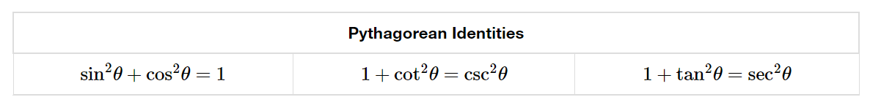
Review
https://youtu.be/91Jxfu4FntM?si=c_XU7pFvrdfEj8EP
Notes:
We have already used the Pythagorean identities, which are equations involving trigonometric functions based on the properties of a right triangle. For one way to prove these identities, watch the video by clicking the link. In the next two slides we will prove the second and third identities with a different technique, which is to show that the left side of the equation does indeed equal the right side of the equation. In this process we will use the first Pythagorean identity involving sine and cosine.

Slide 5
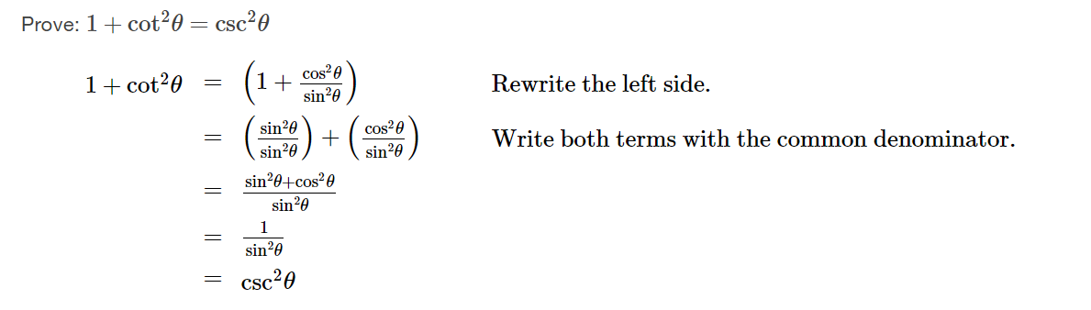

Slide 6
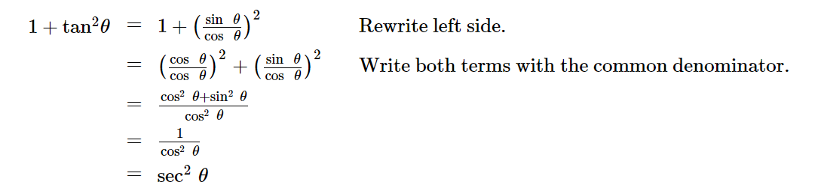

Slide 7
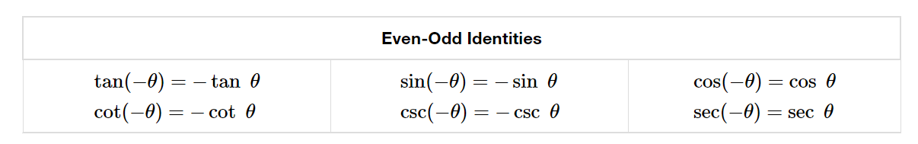
Review
Notes:
Recall that we already determined which trigonometric functions are odd and which are even. The even-odd identities relate the value of a trigonometric function at a given angle to the value of the function at the opposite angle.

Slide 8
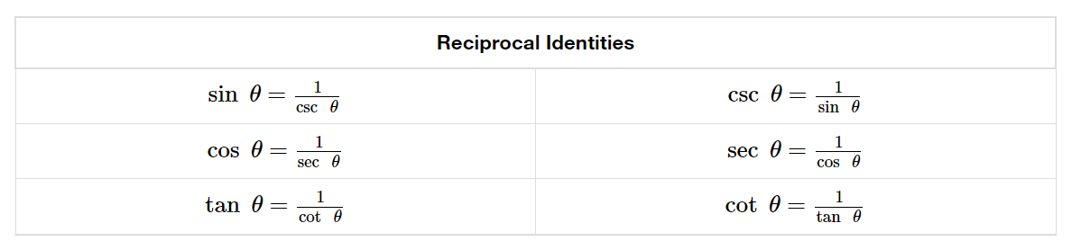

Review
Notes:
The reciprocal and quotient identities are derived from the definitions of the basic trigonometric functions.

Slide 9
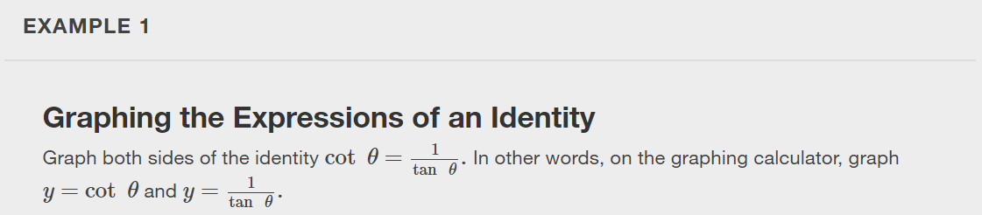

Slide 10
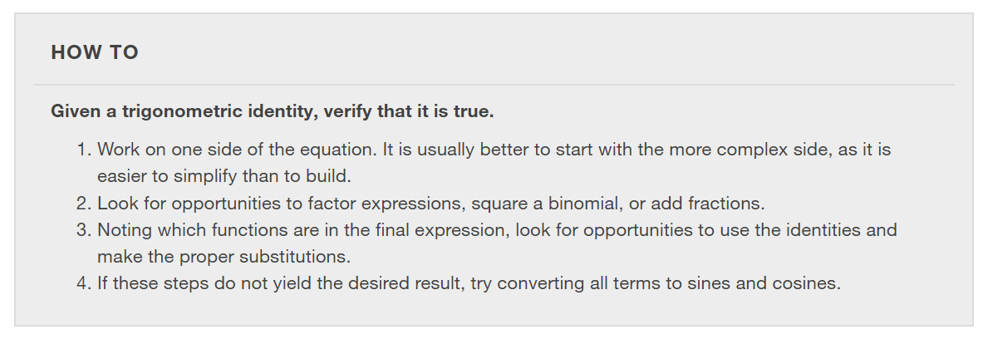

Slide 11
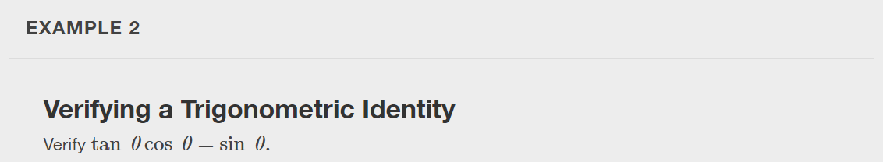

Slide 12
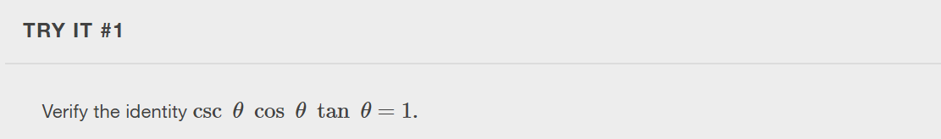

Slide 13
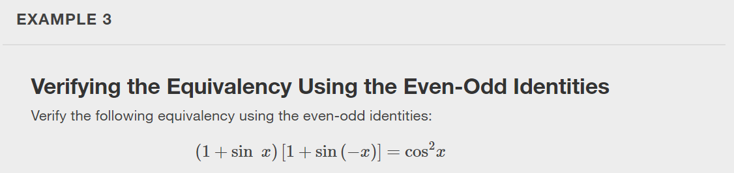

Slide 14
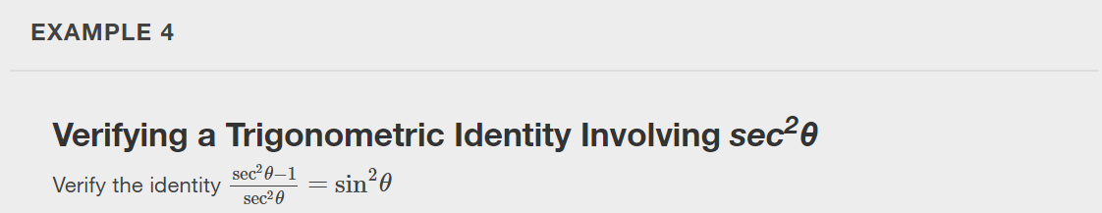

Slide 15


Slide 16
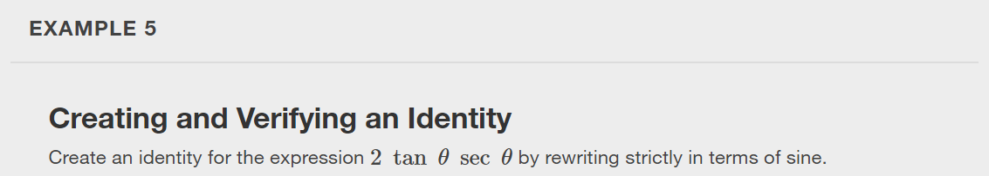

Slide 17
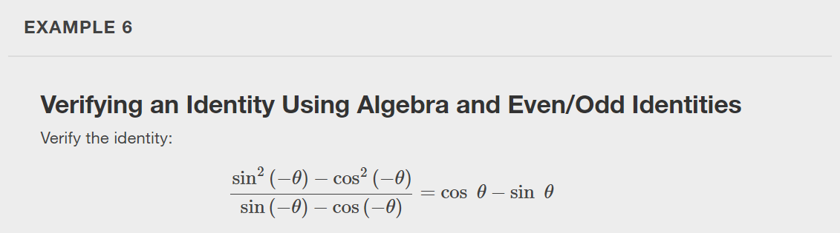

Slide 18
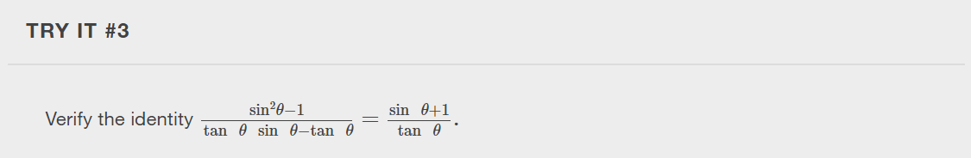

Slide 19
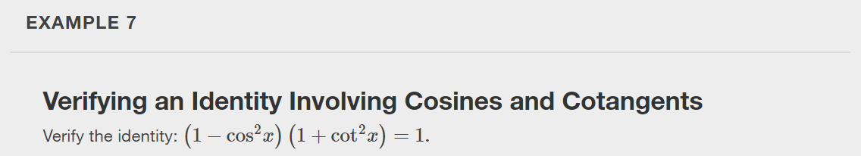

Slide 20
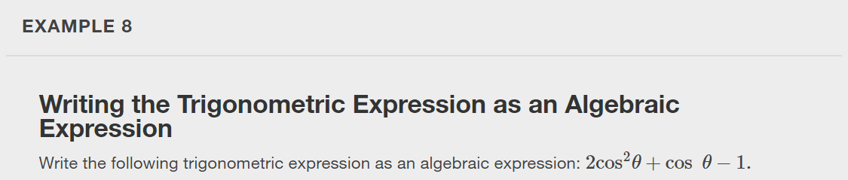
Notes:
Hint: Let $x = cos θ$.

Slide 21
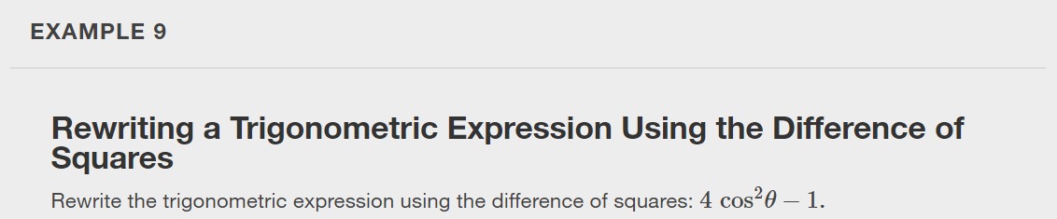

Slide 22
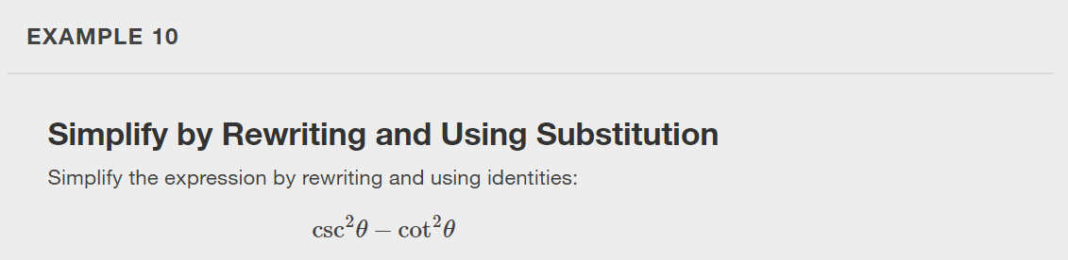

Slide 23
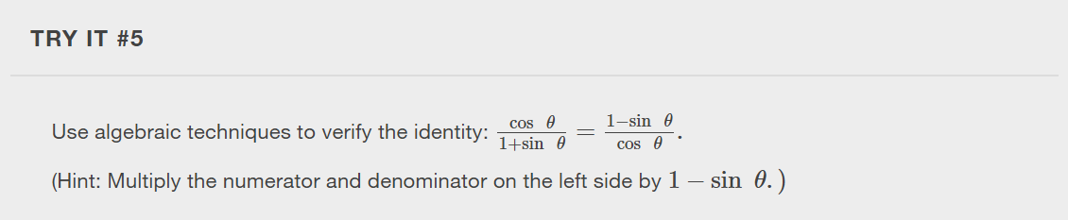

Slide 24
What did you learn in this section?
Verify the fundamental trigonometric identities.
Simplify trigonometric expressions using algebra and the identities.
Notes:
Do you have any questions?

Slide 25
This resource is an adaptation of the OpenStax Algebra and Trigonometry 2e open textbook and is © Susan Aydelotte under a CC BY-NC-SA 4.0 International license; it may be reproduced or modified for noncommercial purposes only but must be attributed to OpenStax, Rice University and any changes must be noted. Any adaptation must be shared under the same type of license.

