Slide 1
Periodic Functions
Chapter 8
Algebra and Trigonometry 2e, OpenStax, Jay Abramson
Notes:
Images and notes within these slides are from the OpenStax textbook Algebra and Trigonometry 2e

Slide 2
8.3 Inverse Trigonometric Functions
Notes:
Images and notes within these slides are from the OpenStax textbook Algebra and Trigonometry 2e

Slide 3
What are the learning objectives for this section?
Understand and use the inverse sine, cosine, and tangent functions.
Find the exact value of expressions involving the inverse sine, cosine, and tangent functions.
Use a calculator to evaluate inverse trigonometric functions.
Find exact values of composite functions with inverse trigonometric functions.

Slide 4
Notes:
In order to use inverse trigonometric functions, we need to understand that an inverse trigonometric function “undoes” what the original trigonometric function “does,” as is the case with any other function and its inverse. In other words, the domain of the inverse function is the range of the original function, and vice versa. Bear in mind that the sine, cosine, and tangent functions are not one-to-one functions. The graph of each function would fail the horizontal line test. In fact, no periodic function can be one-to-one because each output in its range corresponds to at least one input in every period, and there are an infinite number of periods. As with other functions that are not one-to-one, we will need to restrict the domain of each function to yield a new function that is one-to-one.

Slide 5
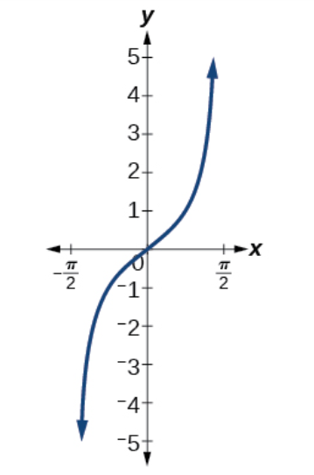
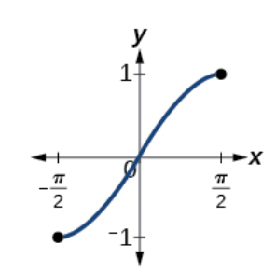
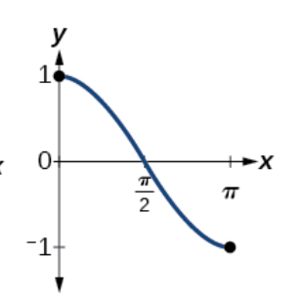
Notes:
The first graph is sin x; what is the restricted domain for sin x? What is the range?
The second graph is cos x; what is the restricted domain for cos x? What is the range?
The third graph is tan x; what is the restricted domain for tan x? What is the range?

Slide 6
Notes:
Note that the inverse sine is also notated with arcsin x.

Slide 7
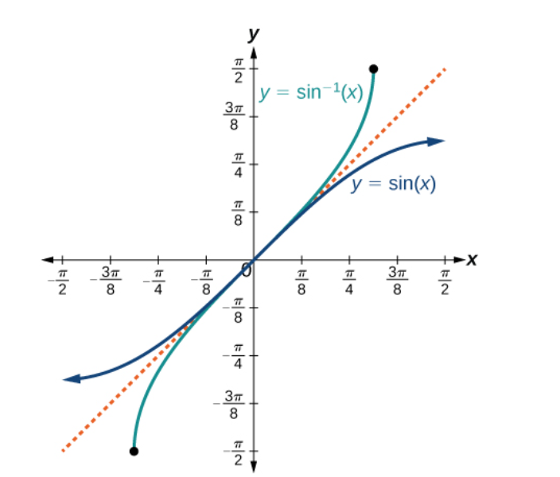
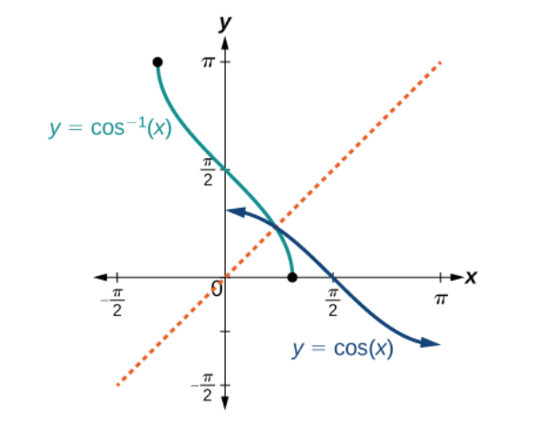
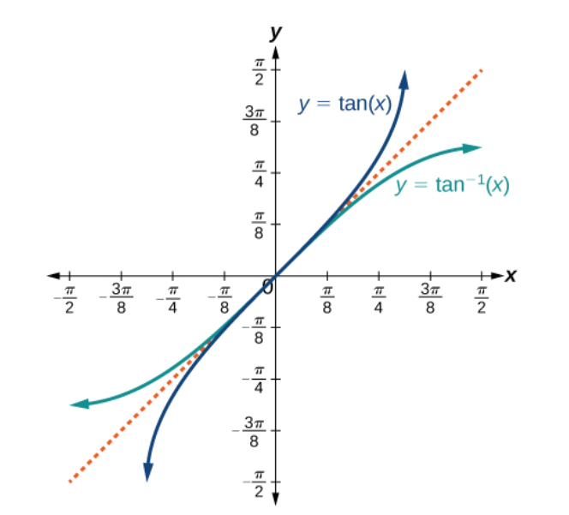

Slide 16
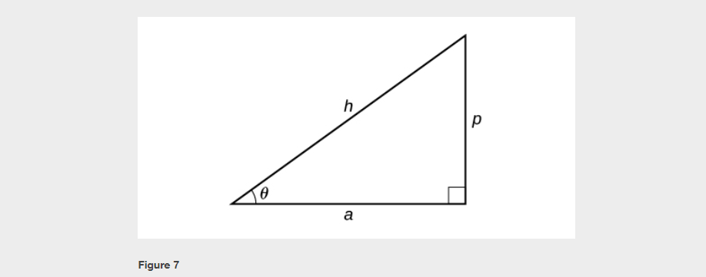

Slide 18
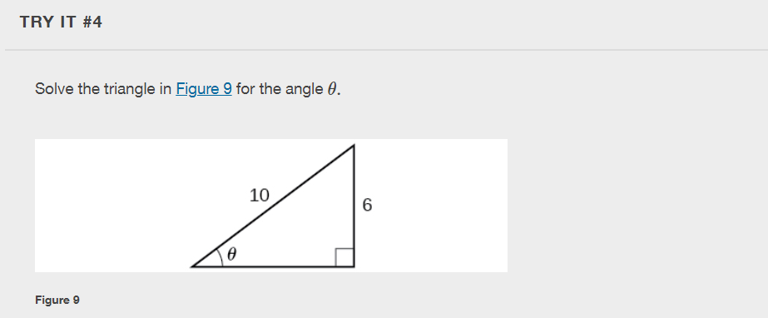

Slide 20
Notes:
Can you think of an example where this statement is true? And an example where the equation is not true?
No. This equation is correct if x belongs to the restricted domain [−π/2,π/2], but sine is defined for all real input values, and for x outside the restricted interval, the equation is not correct because its inverse always returns a value in [−π/2,π/2]. The situation is similar for cosine and tangent and their inverses. For example, $(\sin^{−1} (3π/4))=π/4$.

Slide 33
What did you learn in this section?
Understand and use the inverse sine, cosine, and tangent functions.
Find the exact value of expressions involving the inverse sine, cosine, and tangent functions.
Use a calculator to evaluate inverse trigonometric functions.
Find exact values of composite functions with inverse trigonometric functions.
Notes:
Do you have any questions?

Slide 34
This resource is an adaptation of the OpenStax Algebra and Trigonometry 2e open textbook and is © Susan Aydelotte under a CC BY-NC-SA 4.0 International license; it may be reproduced or modified for noncommercial purposes only but must be attributed to OpenStax, Rice University and any changes must be noted. Any adaptation must be shared under the same type of license.

