Slide 1

Periodic Functions
Chapter 8
Algebra and Trigonometry 2e, OpenStax, Jay Abramson
Notes:
Images and notes within these slides are from the OpenStax textbook Algebra and Trigonometry 2e

Slide 2
8.2 Graphs of the Other Trigonometric Functions
Notes:
Images and notes within these slides are from the OpenStax textbook Algebra and Trigonometry 2e

Slide 3
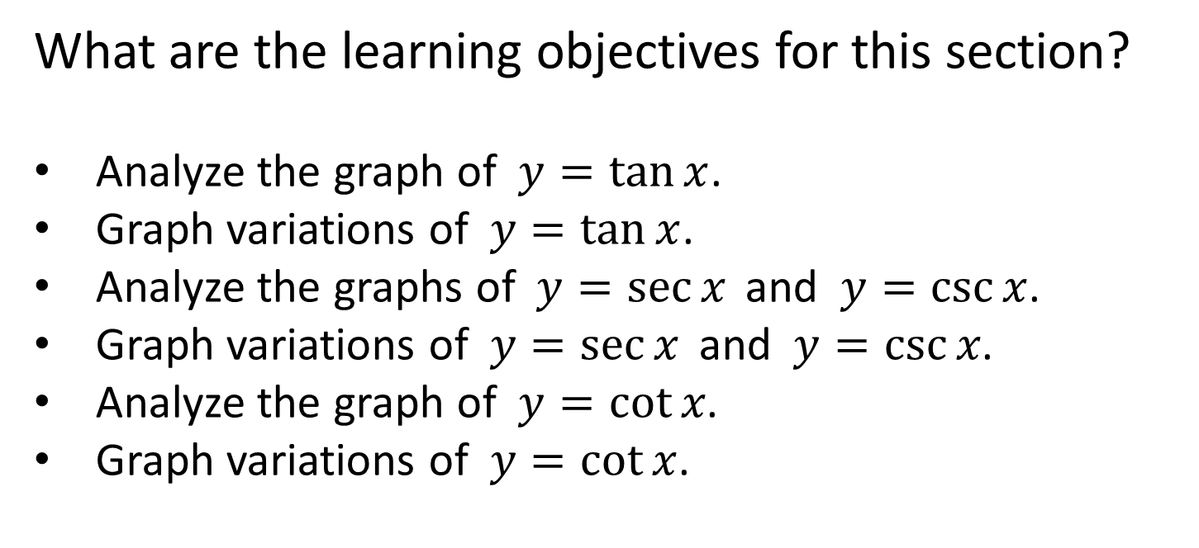
What are the learning objectives for this section?
Analyze the graph of $y=tan x$.
Graph variations of $y=tan x$.
Analyze the graphs of $y=sec x$and $y=csc x$.
Graph variations of $y=sec x$and $y=csc x$.
Analyze the graph of $y=cot x$.
Graph variations of $y=cot x$.

Slide 4
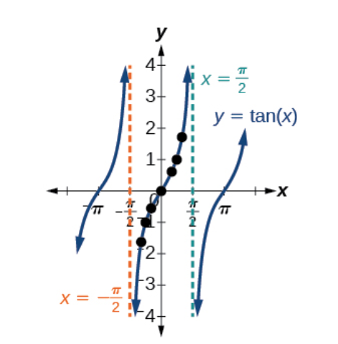
Notes:
What do you notice about this graph?

Slide 5
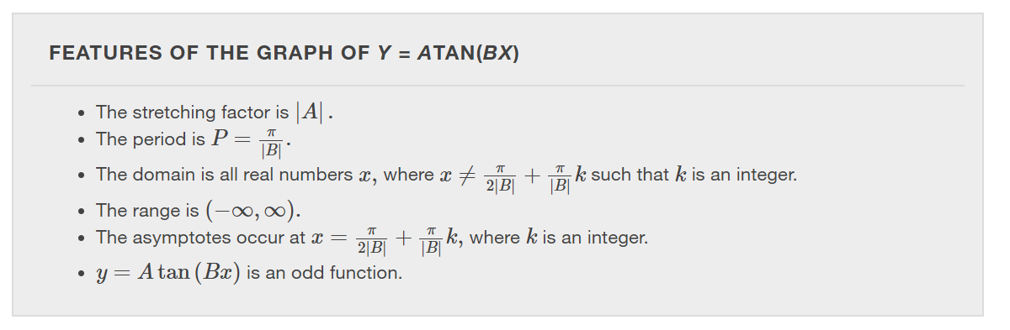

Slide 6
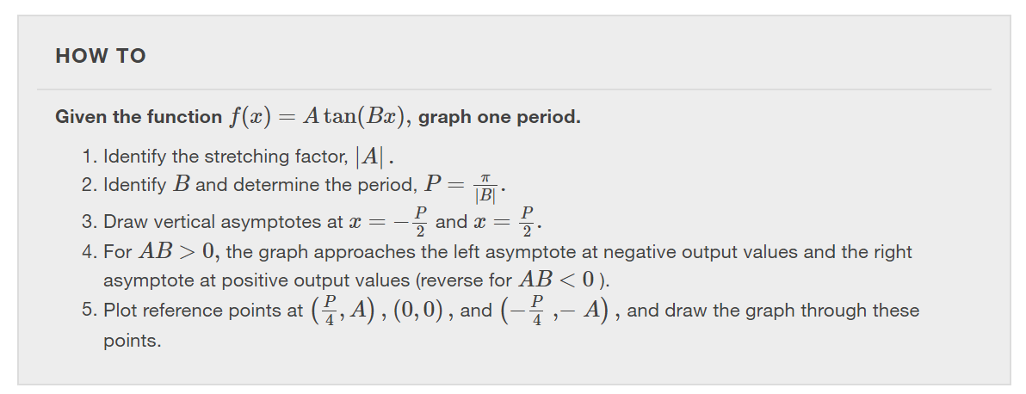

Slide 7
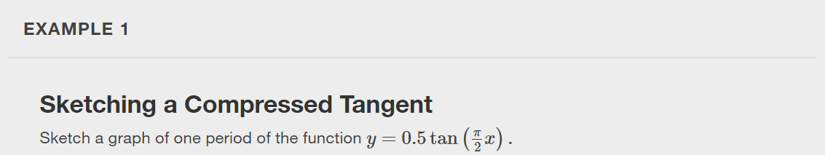

Slide 8


Slide 9

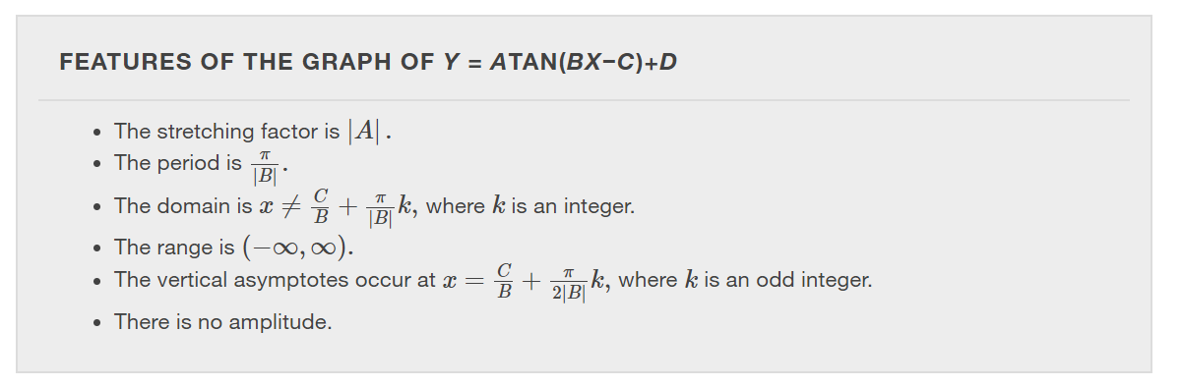

Slide 10
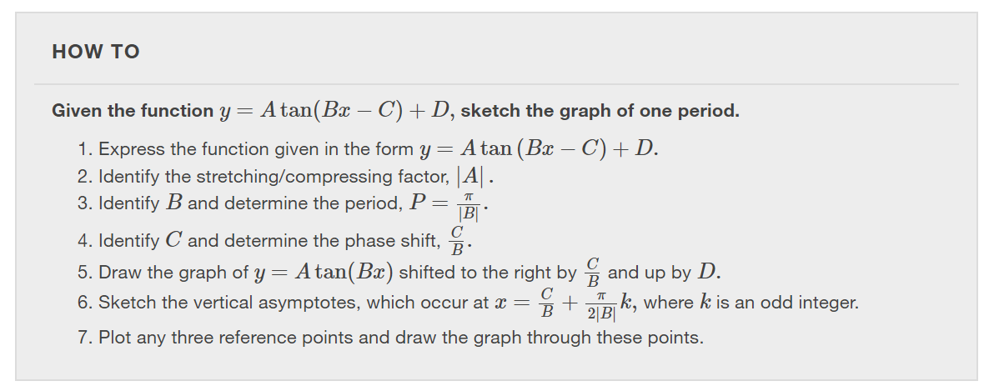

Slide 11
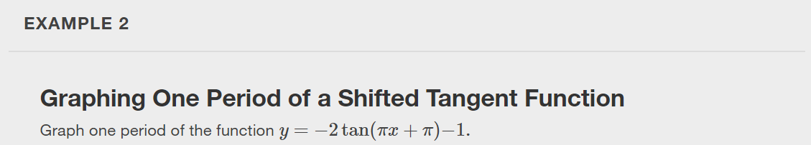

Slide 12
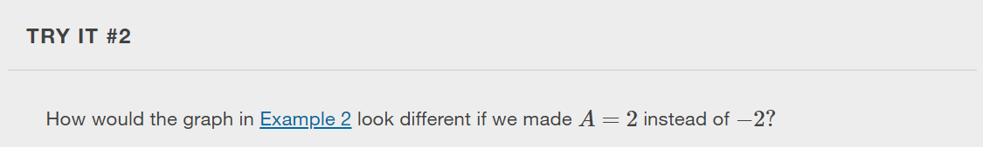

Slide 13
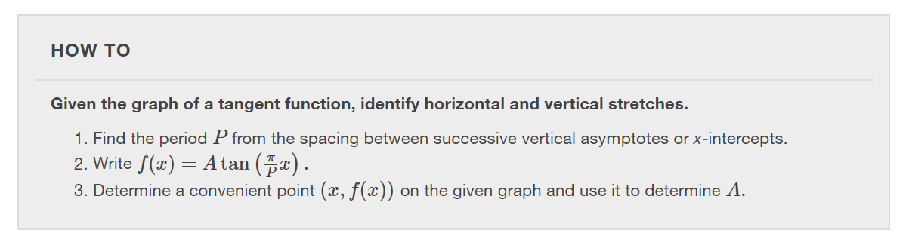

Slide 14
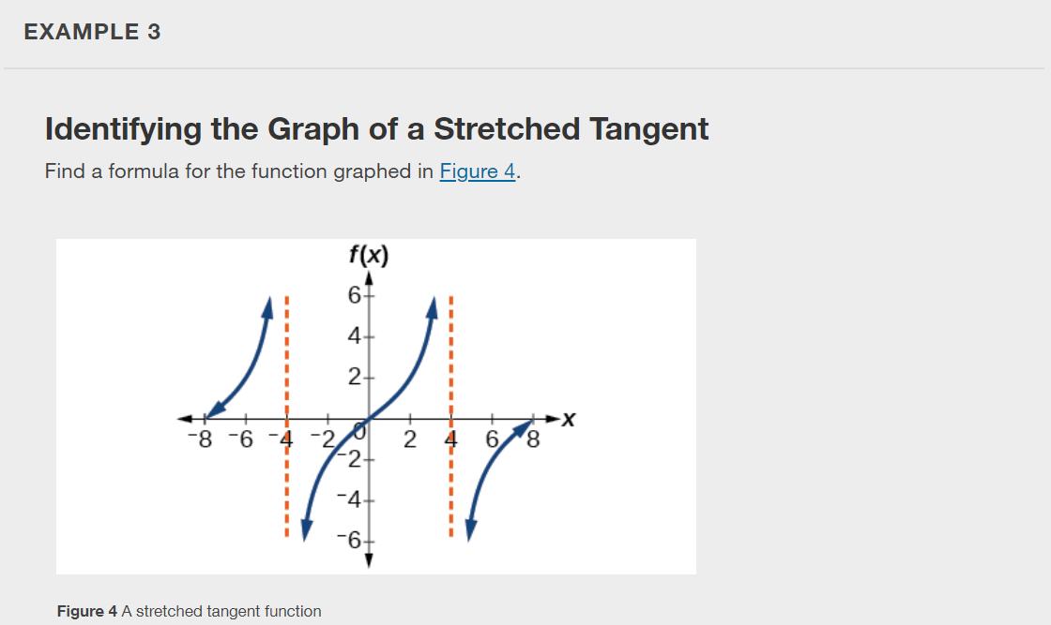

Slide 15
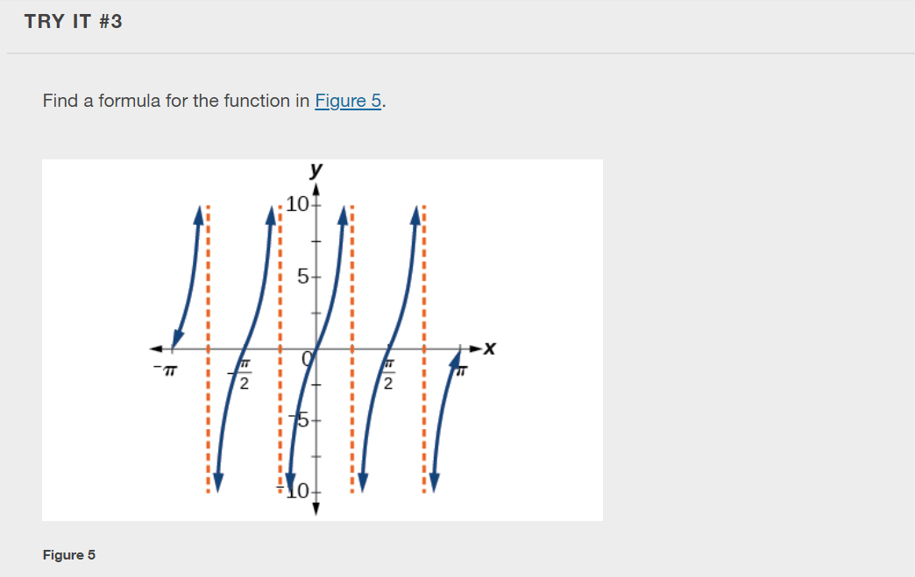

Slide 16
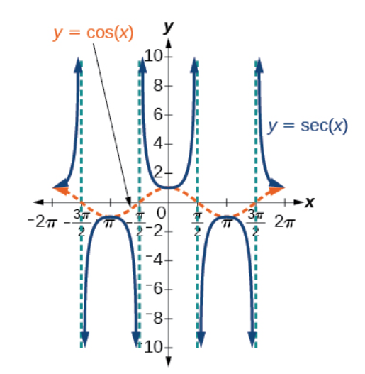
Notes:
What do you notice about the graph of the sec x? How does it compare with the graph of the cos x?

Slide 17
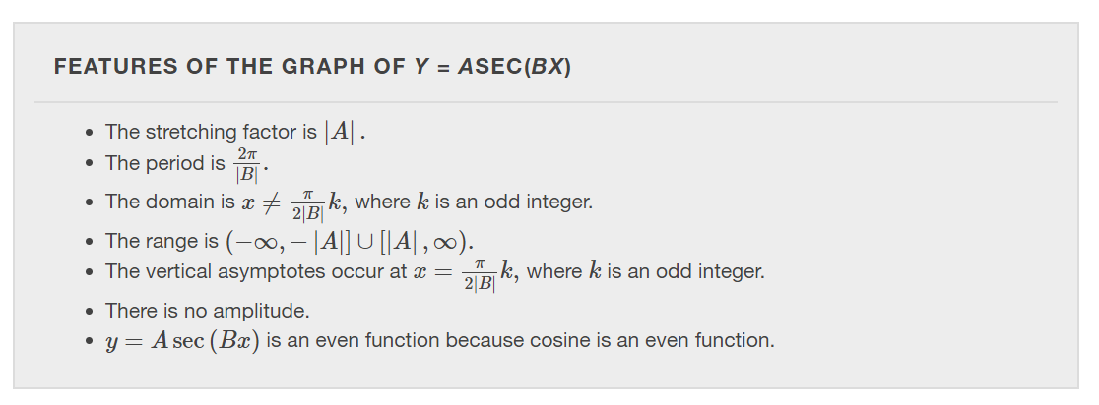

Slide 18
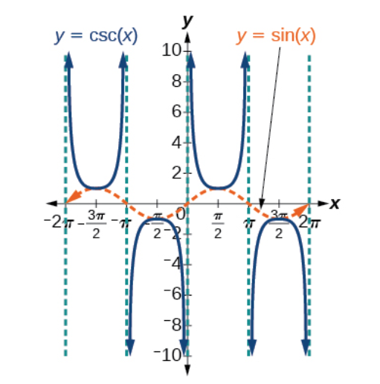
Notes:
What do you notice about the graph of the csc x? How does it compare with the graph of the sin x?

Slide 19
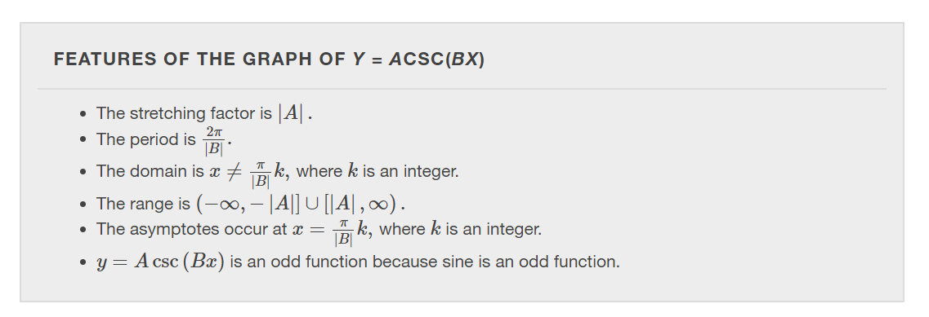

Slide 20
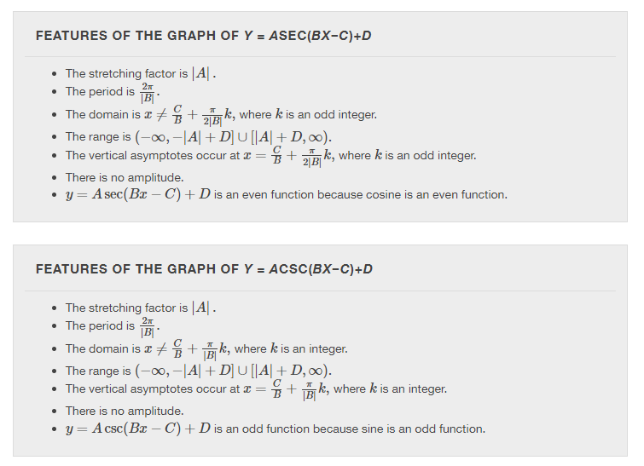


Notes:
What are the similarities? What are the differences?

Slide 21
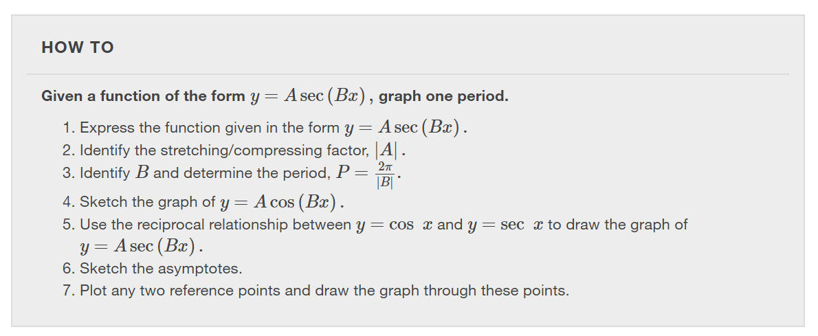

Slide 22
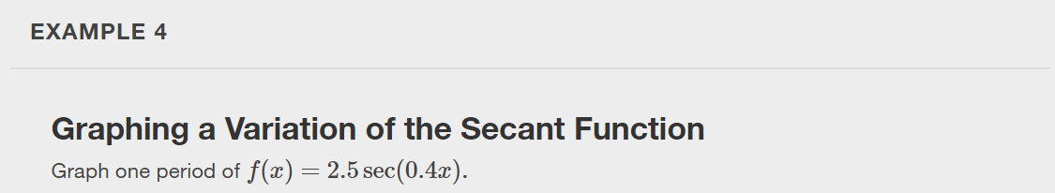

Slide 23
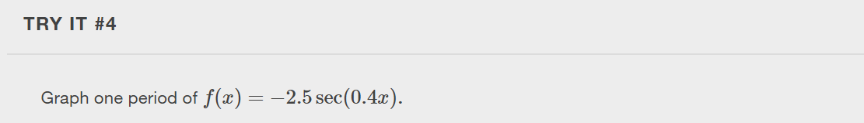

Slide 24
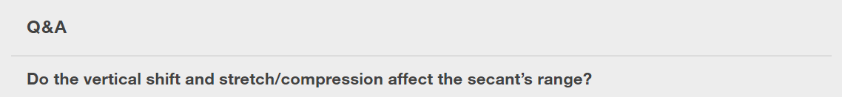
Notes:
Yes. The range of f(x)=Asec(Bx−C)+Df(x) is (−∞,−|A|+D]∪[|A|+D,∞).

Slide 25
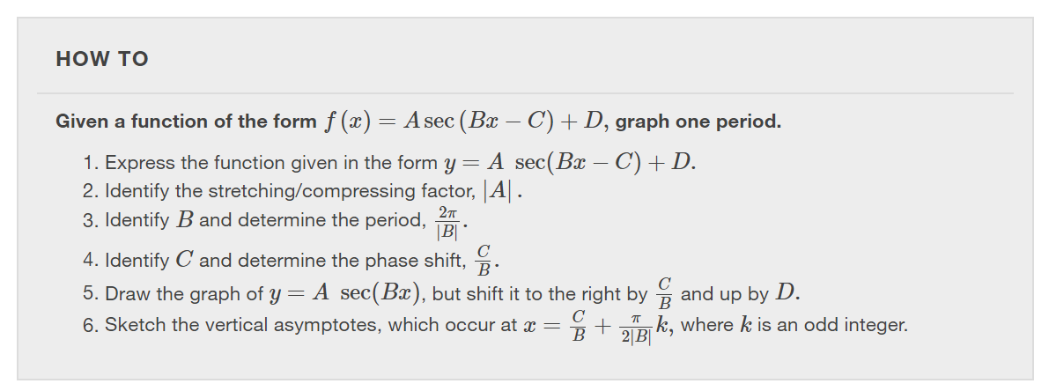

Slide 26
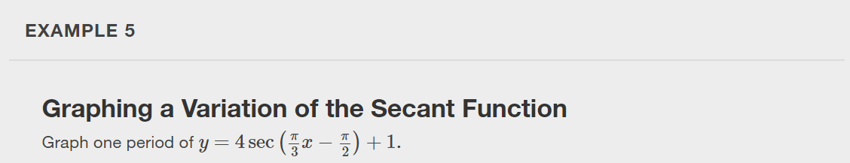

Slide 27


Slide 28
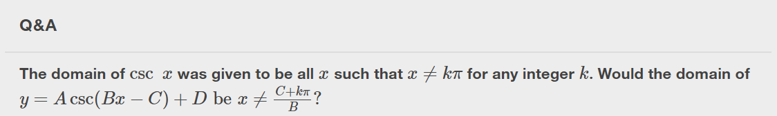
Notes:
Yes. The excluded points of the domain follow the vertical asymptotes. Their locations show the horizontal shift and compression or expansion implied by the transformation to the original function’s input.

Slide 29
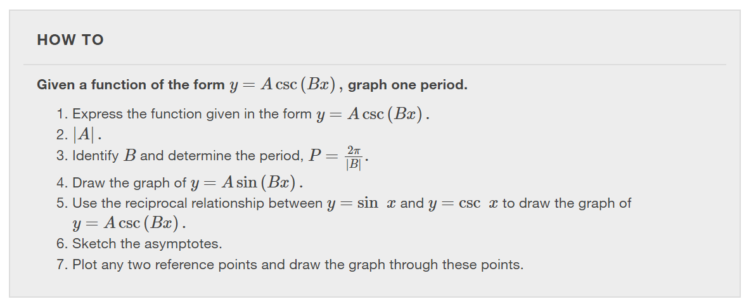

Slide 30
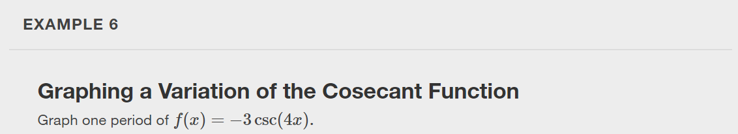

Slide 31


Slide 32
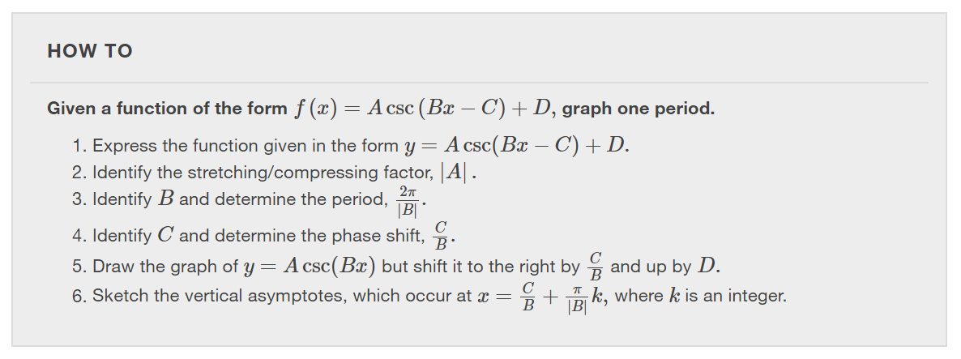

Slide 33
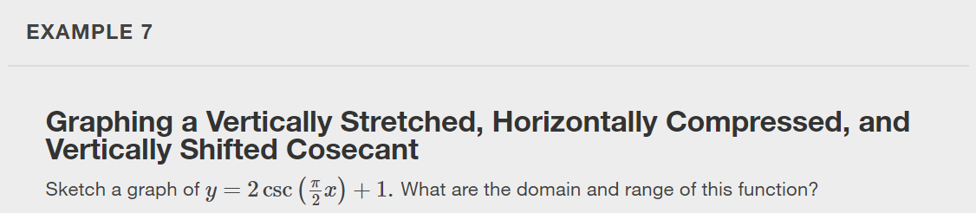

Slide 34
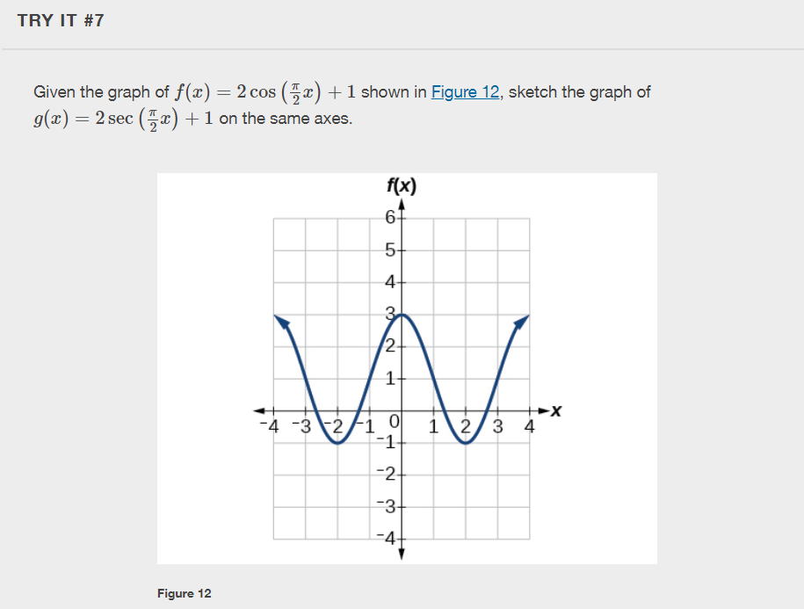

Slide 35
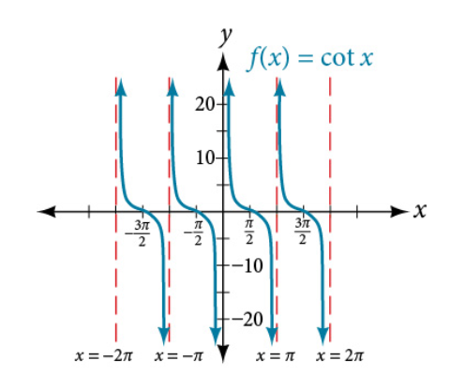
Notes:
What do you notice about the graph of the cot x? How does it compare with the graph of the tan x?

Slide 36
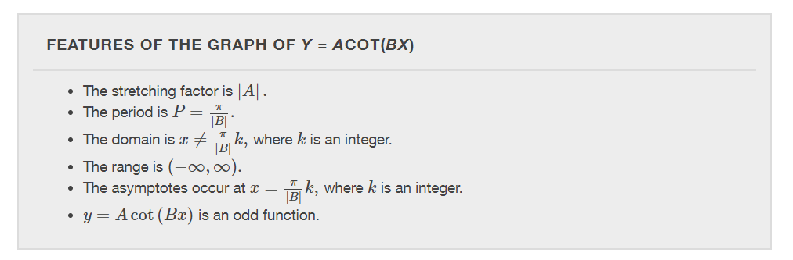

Slide 37
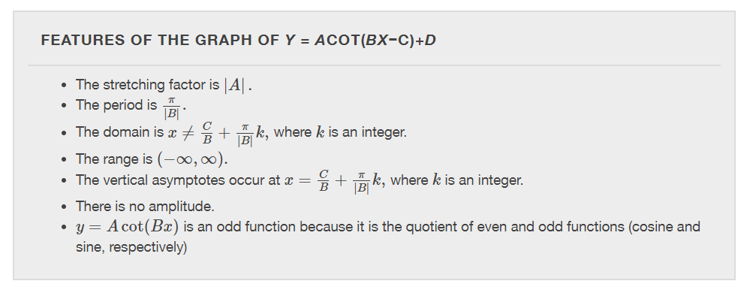


Slide 38
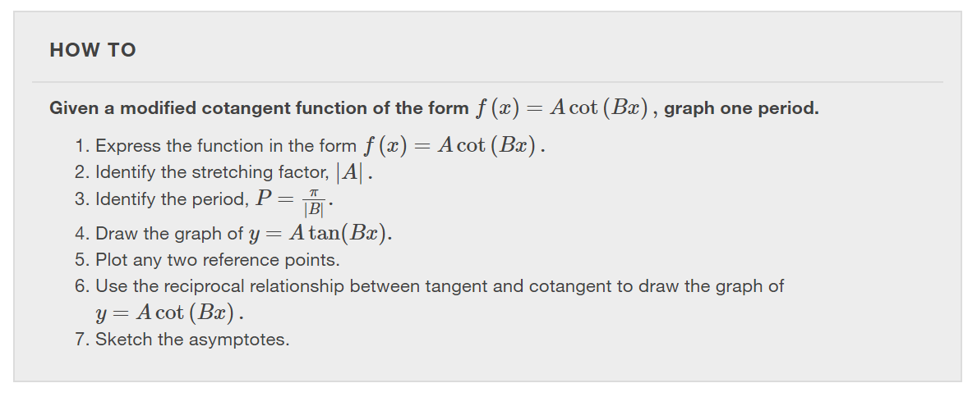

Slide 39
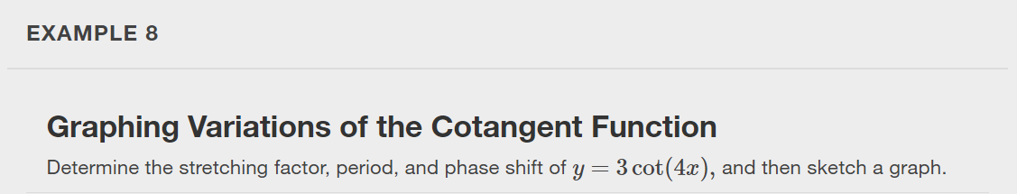

Slide 40
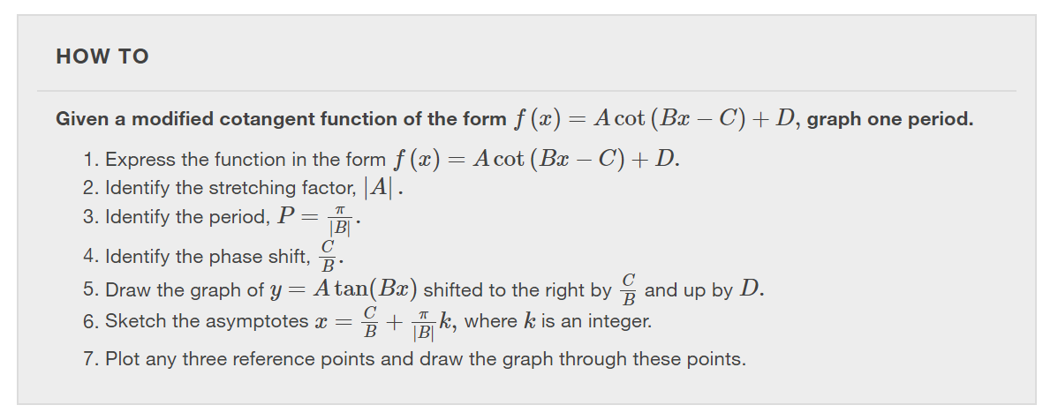

Slide 41
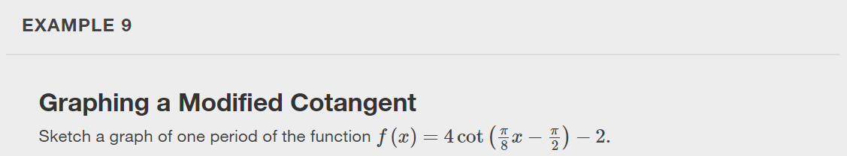

Slide 42
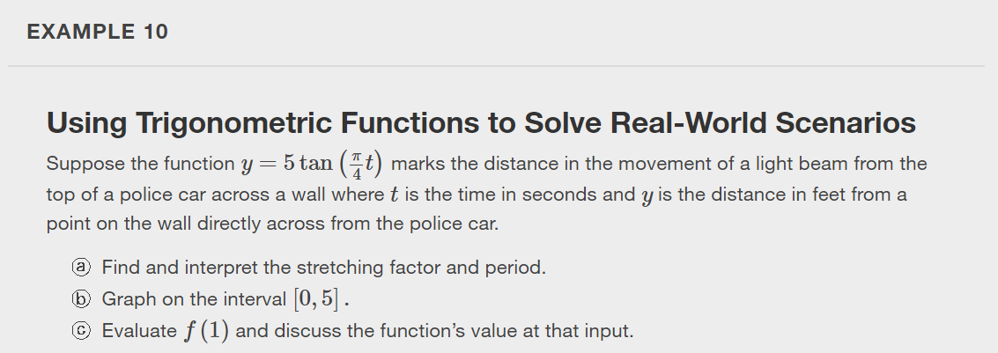

Slide 43
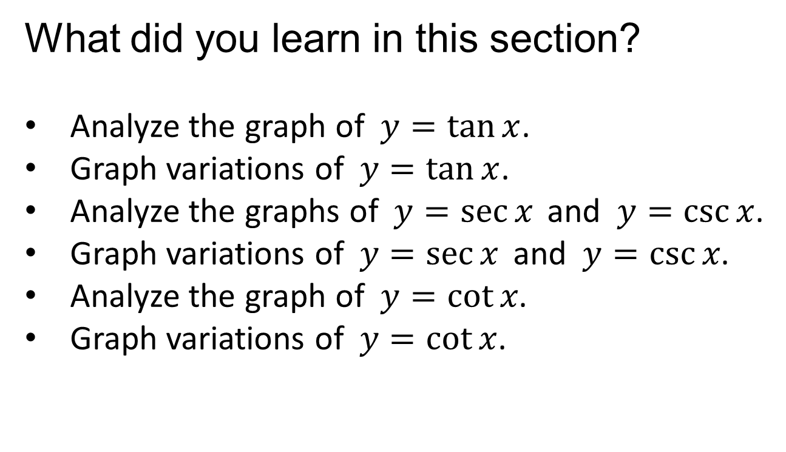
What did you learn in this section?
Analyze the graph of $y=tan x$.
Graph variations of $y=tan x$.
Analyze the graphs of $y=sec x$and $y=csc x$.
Graph variations of $y=sec x$and $y=csc x$.
Analyze the graph of $y=cot x$.
Graph variations of $y=cot x$.
Notes:
Do you have any questions?

Slide 44
This resource is an adaptation of the OpenStax Algebra and Trigonometry 2e open textbook and is © Susan Aydelotte under a CC BY-NC-SA 4.0 International license; it may be reproduced or modified for noncommercial purposes only but must be attributed to OpenStax, Rice University and any changes must be noted. Any adaptation must be shared under the same type of license.

