Slide 1

Periodic Functions
Chapter 8
Algebra and Trigonometry 2e, OpenStax, Jay Abramson
Notes:
Images and notes within these slides are from the OpenStax textbook Algebra and Trigonometry 2e

Slide 2
8.1 Graphs of the Sine and Cosine Functions
Notes:
Images and notes within these slides are from the OpenStax textbook Algebra and Trigonometry 2e

Slide 3
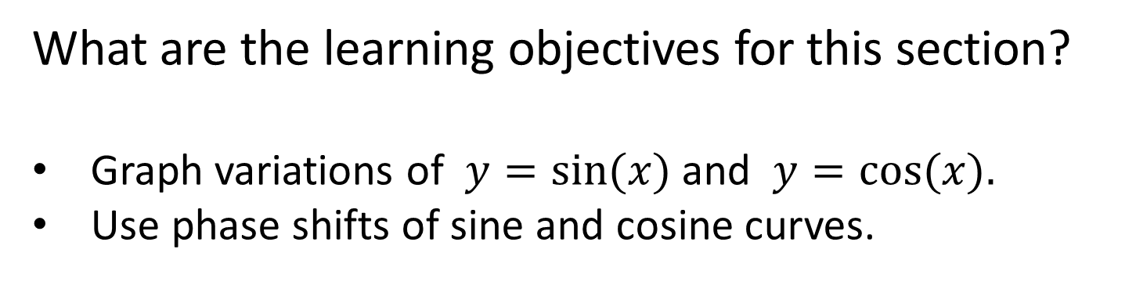
What are the learning objectives for this section?
Graph variations of $y=sin⁡(x)$and $y=cos⁡(x).$
Use phase shifts of sine and cosine curves.

Slide 4
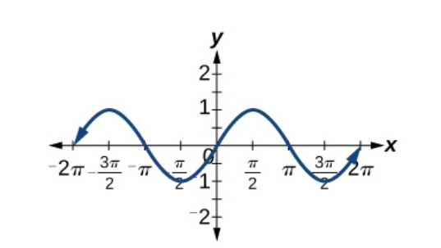
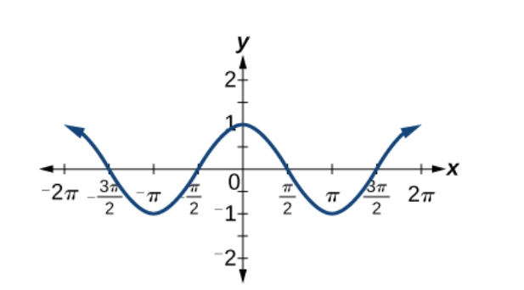
Notes:
One of these graphs is the graph of the cosine function and the other is of the sine function. Which is which? And how do you know?
What do you notice about the period of each graph? What is the domain for each function? Which one is symmetric about the origin? Which one is symmetric about the y-axis?

Slide 5
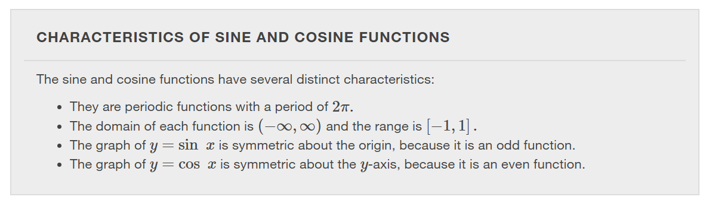

Slide 6
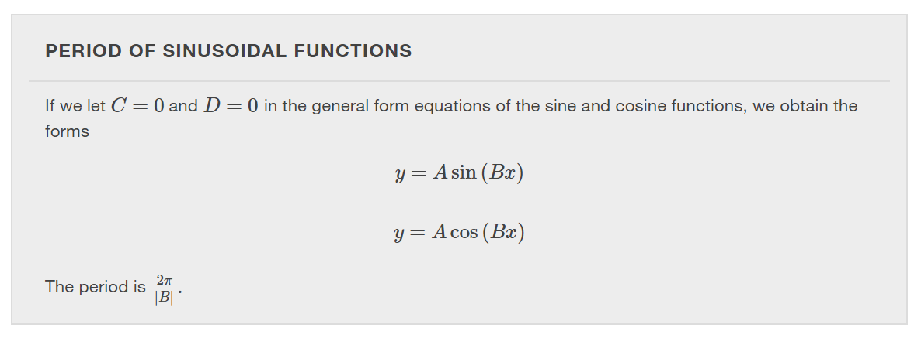
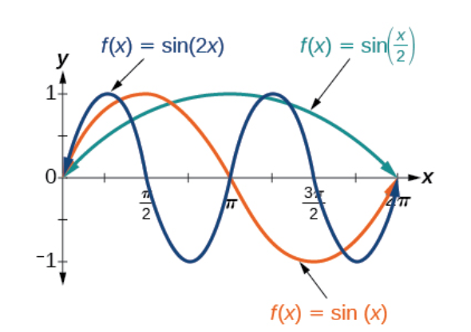
Notes:
Use the period formula to determine the period for the sin(2x) and sin(x/2). Then confirm the period for sin(2x) using the graph.

Slide 7
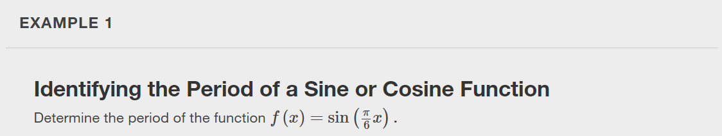
Notes:
Use the period formula and graph the function to confirm.

Slide 8


Slide 9
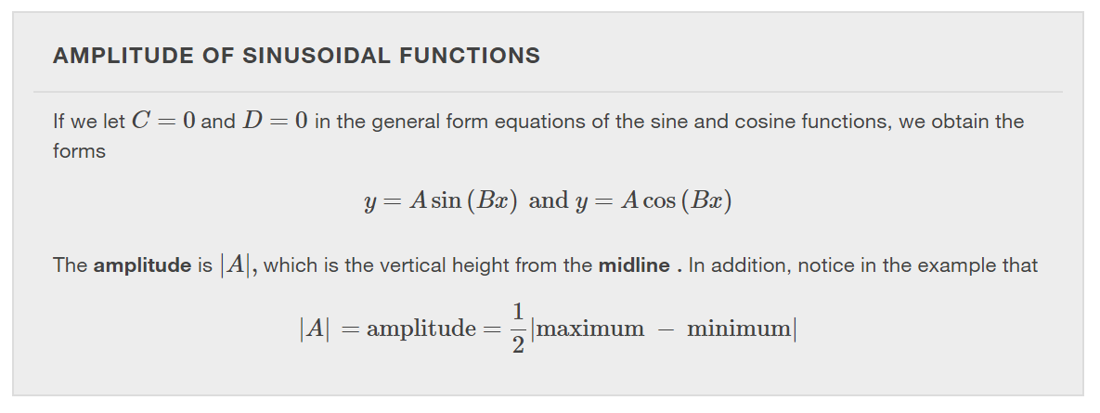
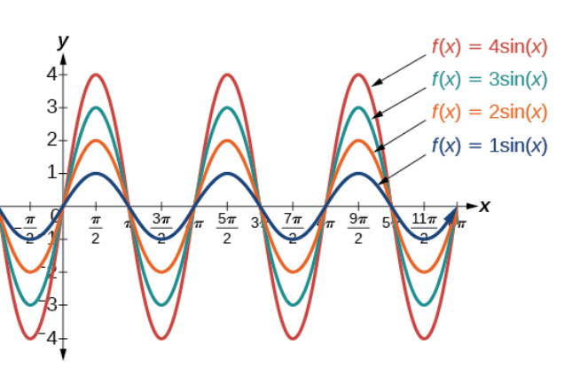
Notes:
The midline for these examples is the x-axis.

Slide 10
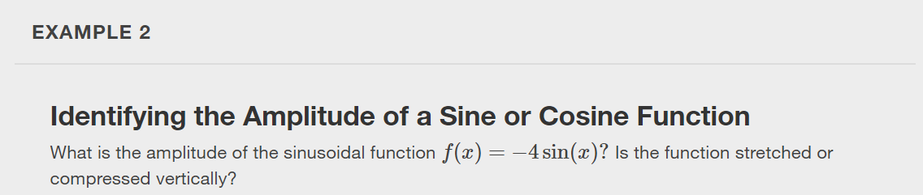
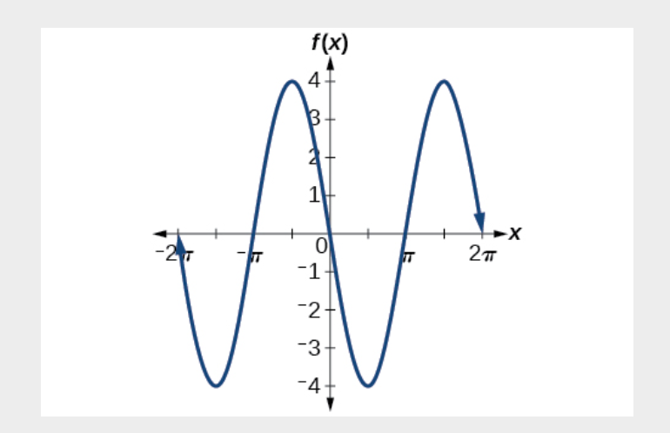

Slide 11
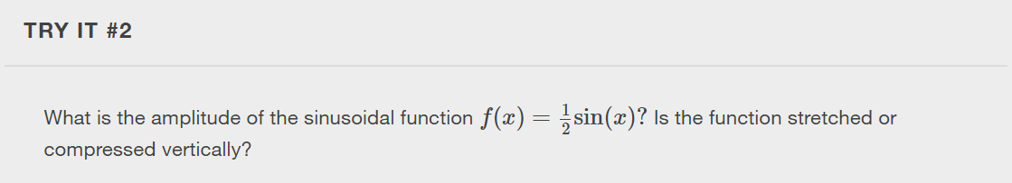

Slide 12
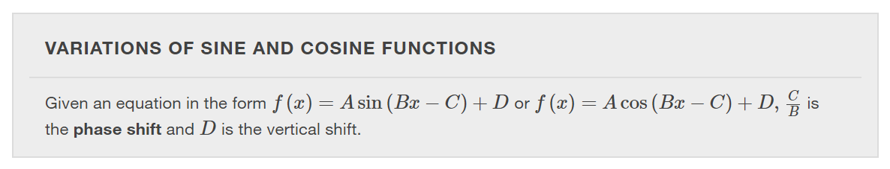
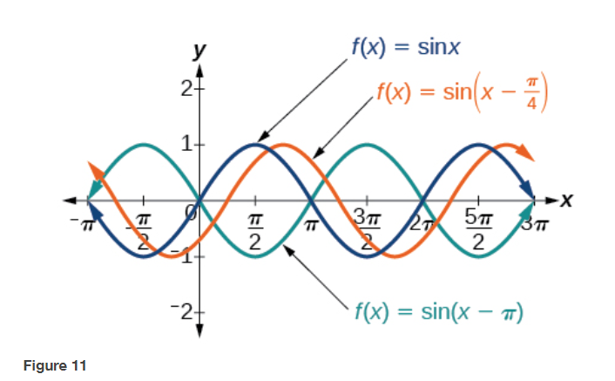
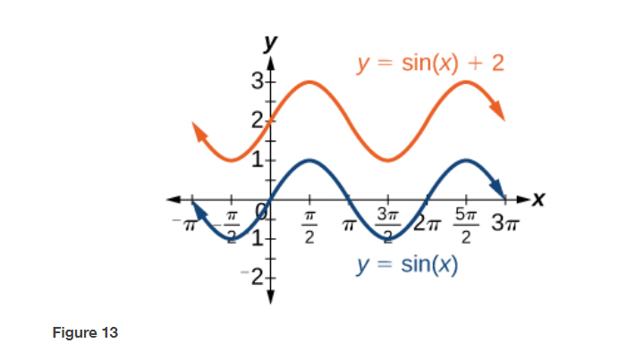
Notes:
Figure 11 illustrates a phase shift of $\frac{π}{4}$ and a phase shift of $π$. Figure 13 is an example of a vertical shift of 2 units upward.

Slide 13
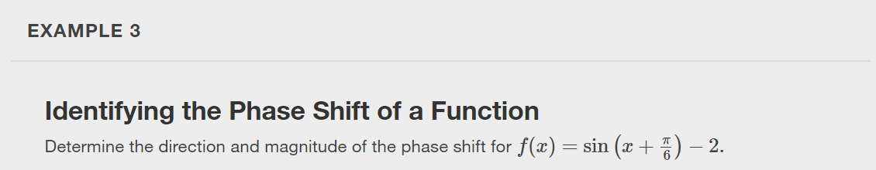

Slide 14


Slide 15
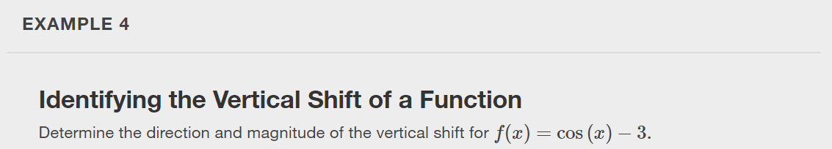

Slide 16


Slide 17
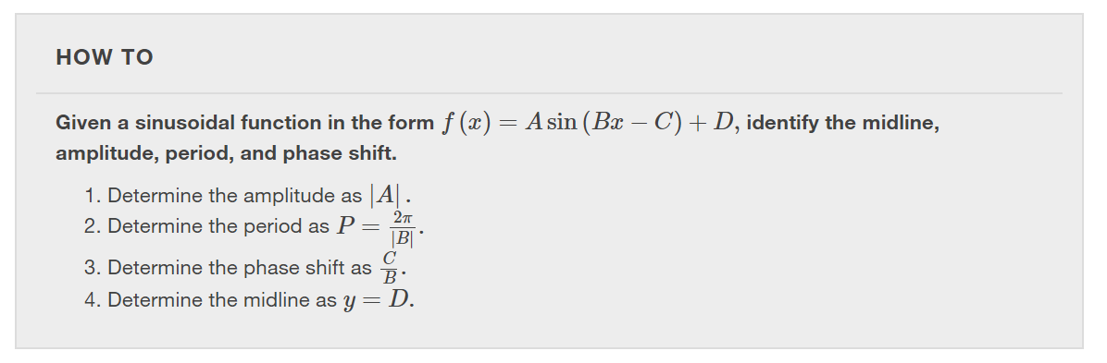

Slide 18
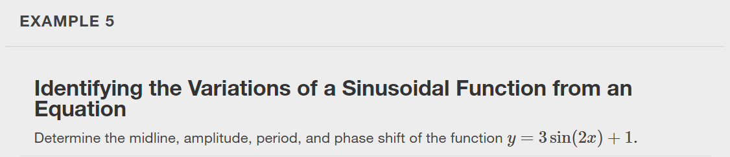
Notes:
Make the calculations using the formulas and then confirm using a graph of the function.

Slide 19
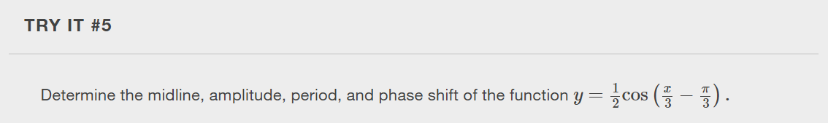

Slide 20
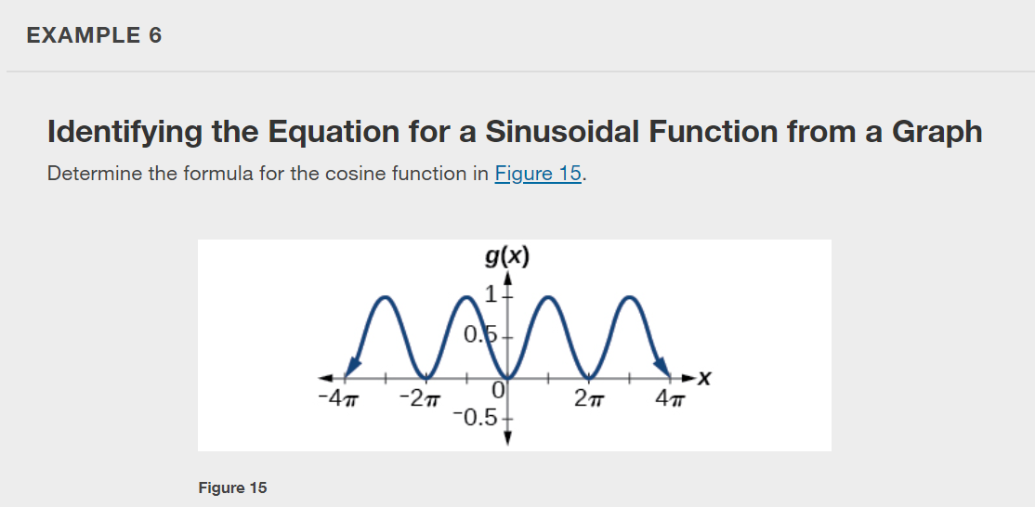

Slide 21
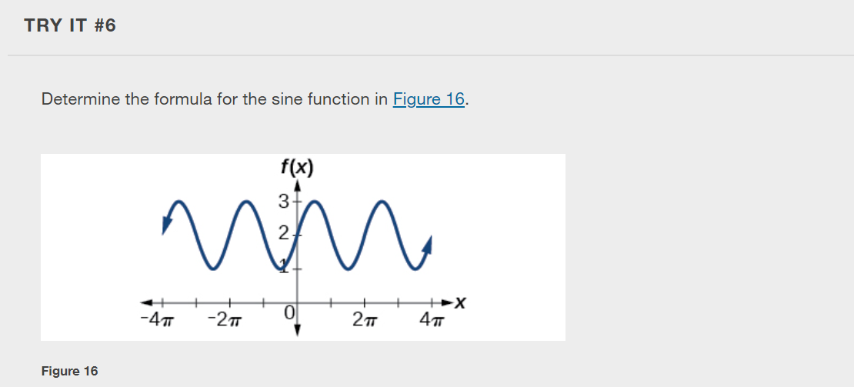

Slide 22
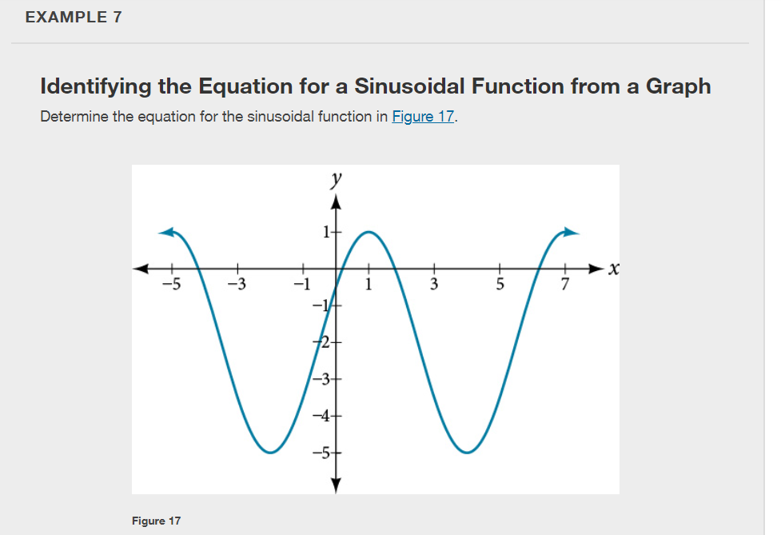

Slide 23
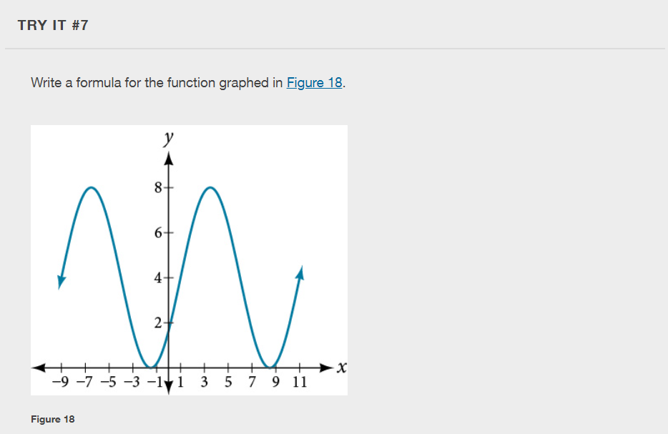

Slide 24
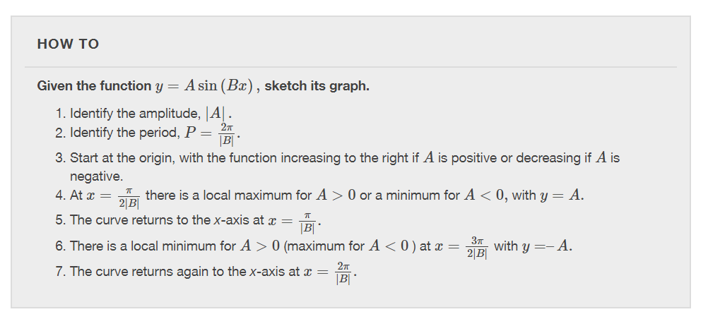

Slide 25
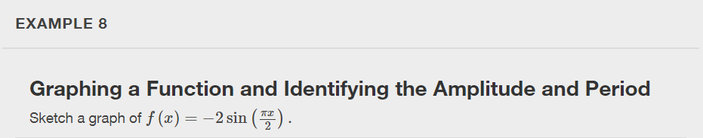

Slide 26


Slide 27
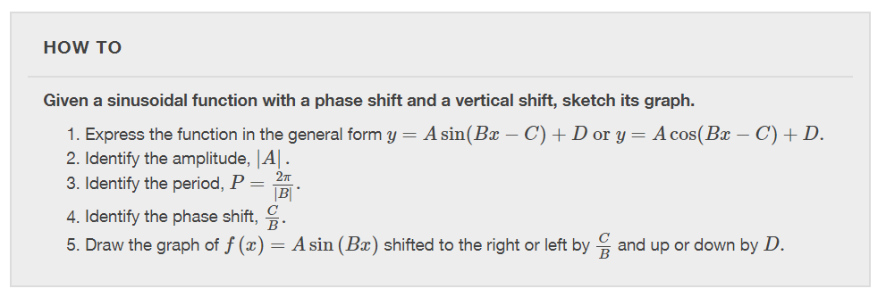

Slide 28
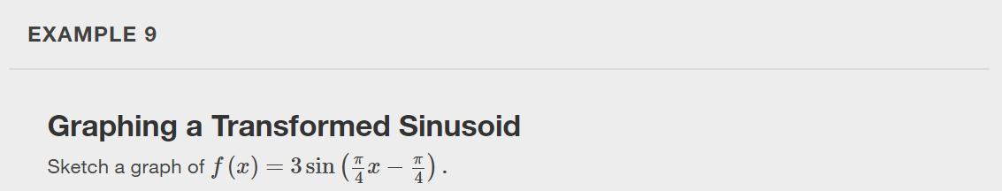

Slide 29
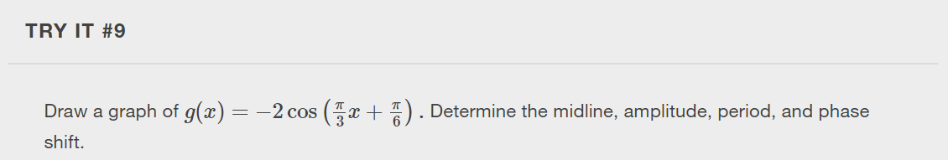

Slide 30
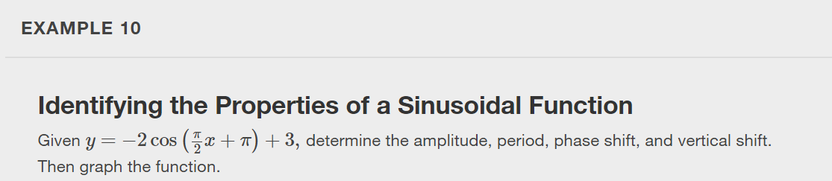

Slide 31
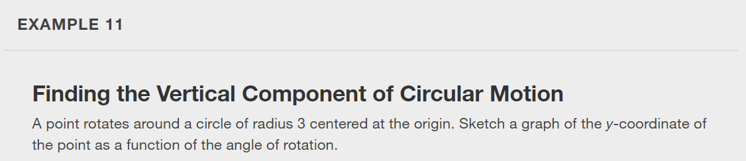

Slide 32


Slide 33
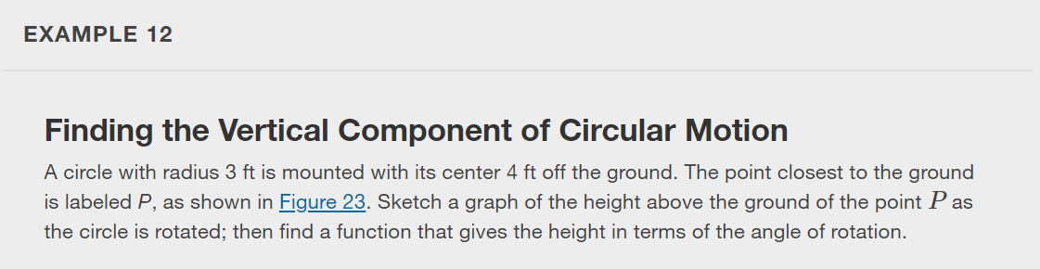
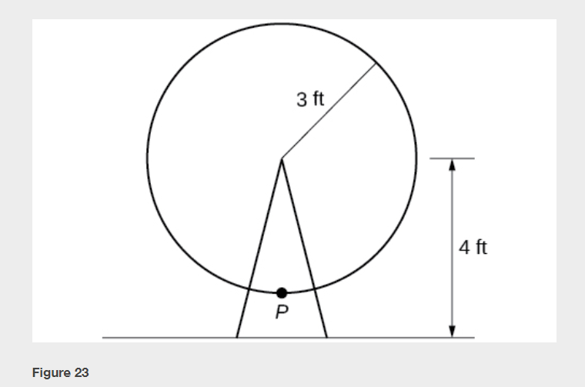

Slide 34
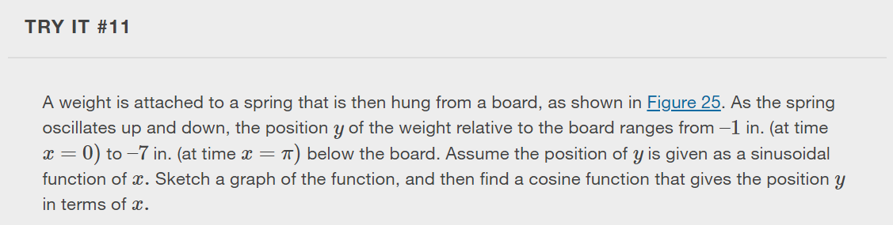
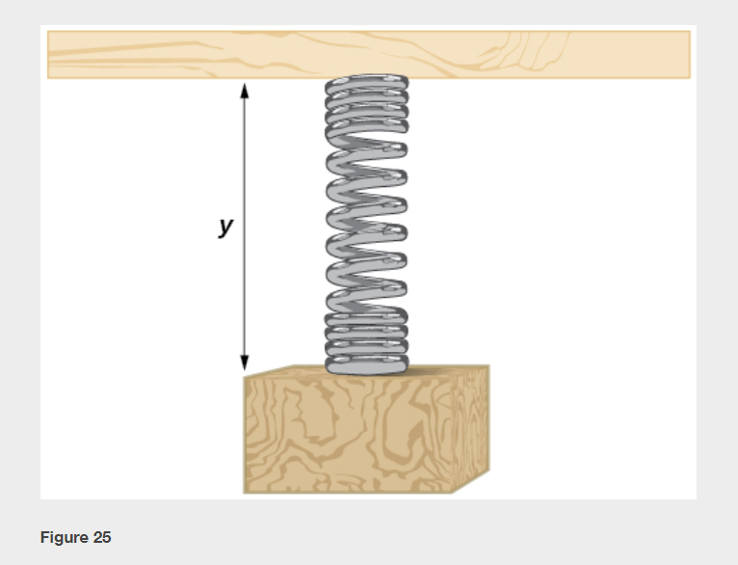

Slide 35
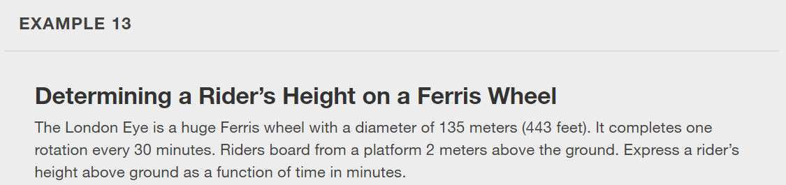

Slide 36
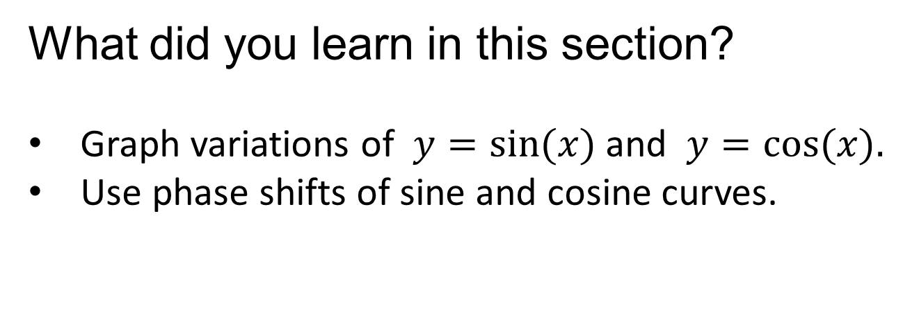
What did you learn in this section?
Graph variations of $y=sin⁡(x)$and $y=cos⁡(x).$
Use phase shifts of sine and cosine curves.
Notes:
Do you have any questions?

Slide 37
This resource is an adaptation of the OpenStax Algebra and Trigonometry 2e open textbook and is © Susan Aydelotte under a CC BY-NC-SA 4.0 International license; it may be reproduced or modified for noncommercial purposes only but must be attributed to OpenStax, Rice University and any changes must be noted. Any adaptation must be shared under the same type of license.

