Slide 1
The Unit Circle: Sine and Cosine Functions
Chapter 7
Algebra and Trigonometry 2e, OpenStax, Jay Abramson
Notes:
Images and notes within these slides are from the OpenStax textbook Algebra and Trigonometry 2e

Slide 2
7.4 The Other Trigonometric Functions
Notes:
Images and notes within these slides are from the OpenStax textbook Algebra and Trigonometry 2e

Slide 3
What are the learning objectives for this section?
Find exact values of the trigonometric functions secant, cosecant, tangent, and cotangent of π/3,π/4, and π/6.
Use reference angles to evaluate the trigonometric functions secant, tangent, and cotangent.
Use properties of even and odd trigonometric functions.
Recognize and use fundamental identities.
Evaluate trigonometric functions with a calculator.

Slide 4
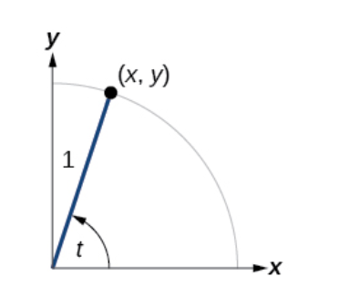

Slide 6
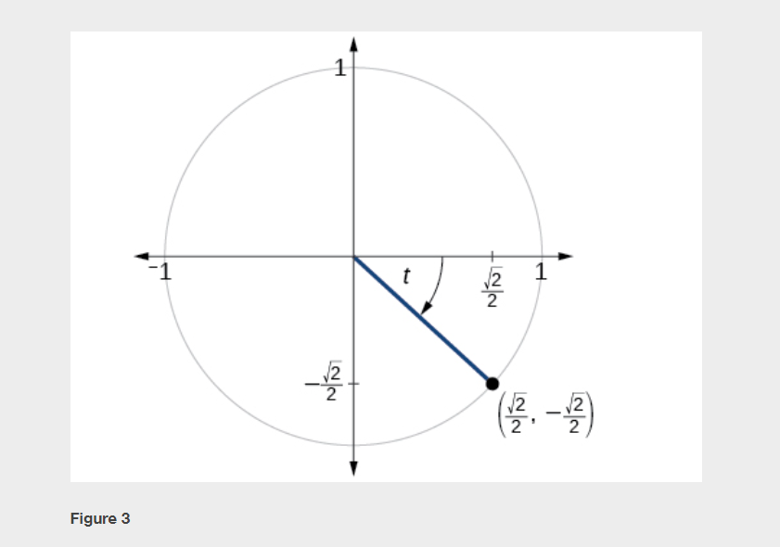

Slide 9
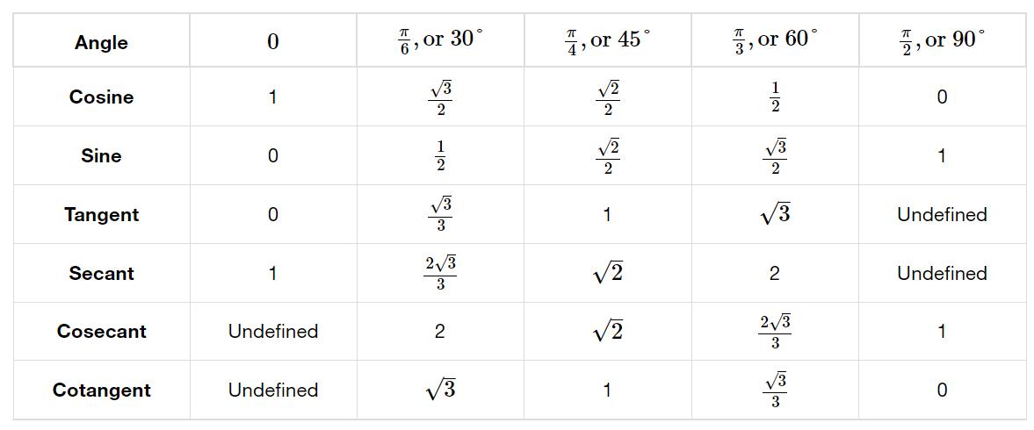
Notes:
Because we know the sine and cosine values for the common first-quadrant angles, we can find the other function values for those angles as well by setting x equal to the cosine and y equal to the sine and then using the definitions of tangent, secant, cosecant, and cotangent. [When not in presentation mode, click and slide the blue box to the right to reveal one column at a time.]

Slide 10
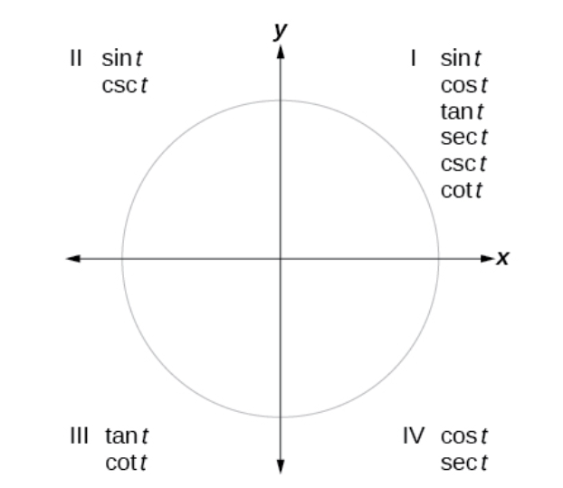
Notes:
The trigonometric functions are each listed in the quadrants in which they are positive.

Slide 17
Notes:
We have explored a number of properties of trigonometric functions. Now, we can take the relationships a step further, and derive some fundamental identities. Identities are statements that are true for all values of the input on which they are defined. Usually, identities can be derived from definitions and relationships we already know. For example, the Pythagorean Identity we learned earlier was derived from the Pythagorean Theorem and the definitions of sine and cosine.

Slide 22
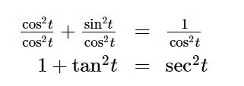
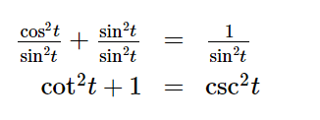

Slide 23
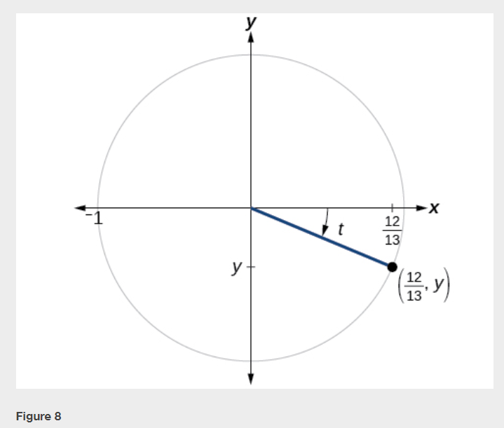

Slide 26
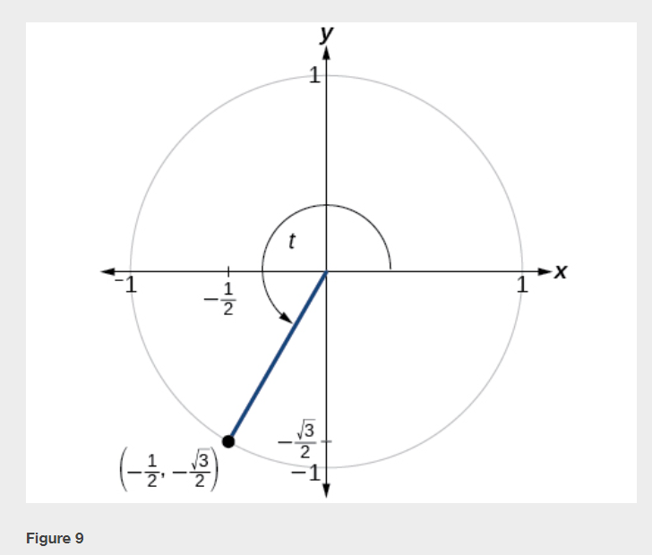

Slide 27
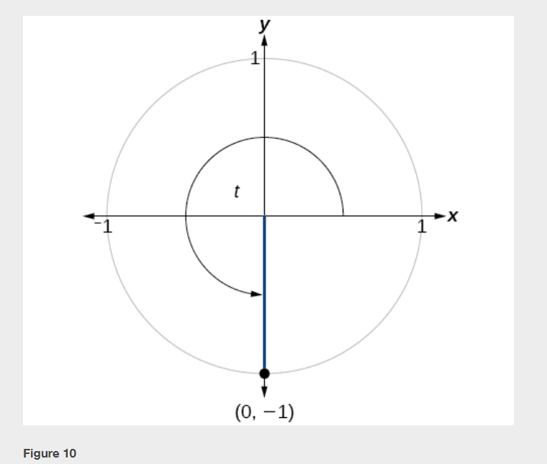

Slide 30
Notes:
[Also demonstrate how to use desmos.com/calculator.]

Slide 33
What did you learn in this section?
Find exact values of the trigonometric functions secant, cosecant, tangent, and cotangent of π/3,π/4, and π/6.
Use reference angles to evaluate the trigonometric functions secant, tangent, and cotangent.
Use properties of even and odd trigonometric functions.
Recognize and use fundamental identities.
Evaluate trigonometric functions with a calculator.
Notes:
Do you have any questions?

Slide 34
This resource is an adaptation of the OpenStax Algebra and Trigonometry 2e open textbook and is © Susan Aydelotte under a CC BY-NC-SA 4.0 International license; it may be reproduced or modified for noncommercial purposes only but must be attributed to OpenStax, Rice University and any changes must be noted. Any adaptation must be shared under the same type of license.

