Slide 1
The Unit Circle: Sine and Cosine Functions
Chapter 7
Algebra and Trigonometry 2e, OpenStax, Jay Abramson
Notes:
Images and notes within these slides are from the OpenStax textbook Algebra and Trigonometry 2e

Slide 2
7.3 Unit Circle
Notes:
Images and notes within these slides are from the OpenStax textbook Algebra and Trigonometry 2e

Slide 3
What are the learning objectives for this section?
Find function values for the sine and cosine of 30°, 45°, and 60°.
Identify the domain and range of sine and cosine functions.
Find reference angles.
Use reference angles to evaluate trigonometric functions.

Slide 4
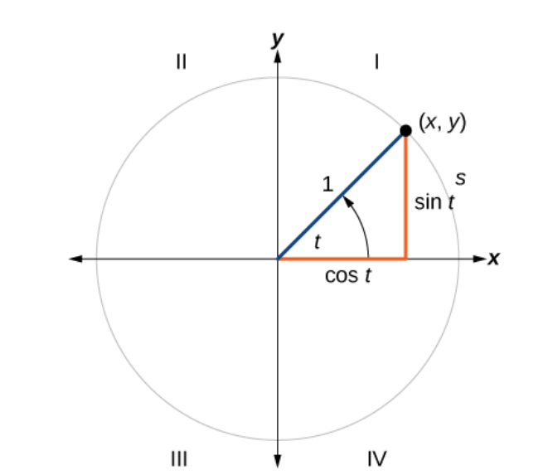
Notes:
What do you notice about this figure? What is the radius? Where is the center of the circle? The radius is 1, so this circle is the unit circle.
What is x as a function of t? What is y as a function of t? Notice that x is the length of the adjacent side for the angle t and y is the length of the opposite side of the angle t. cos t = adjacent/hypotenuse = x/1 =x and sin t = opposite/hypotenuse = y/1 = y.

Slide 7
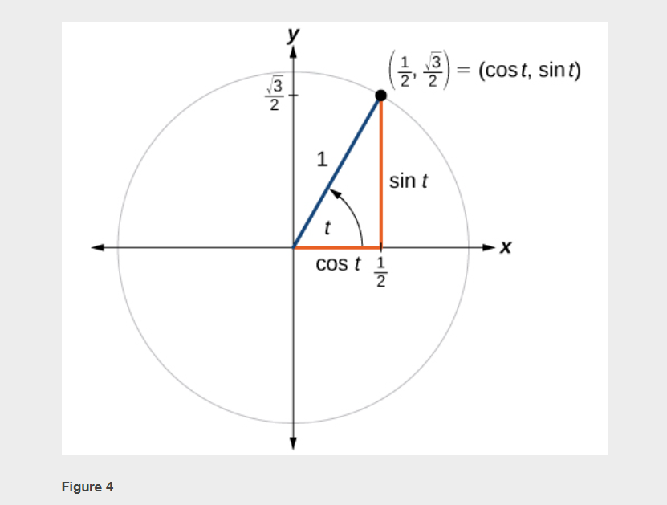

Slide 8
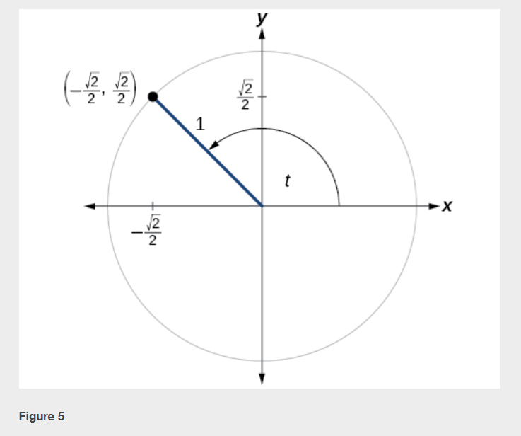

Slide 15
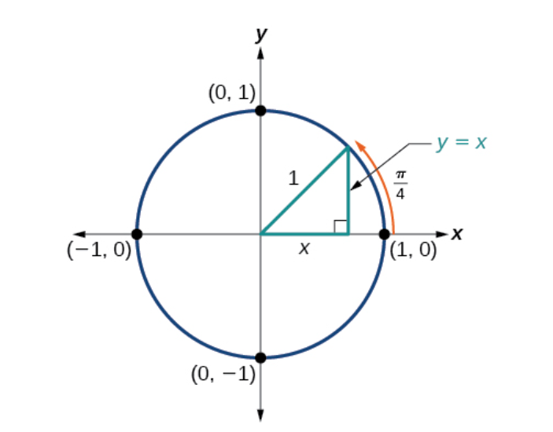
Finding Sines and Cosines of 45° Angles
Notes:
If you have a right triangle with one of the angles measures 45 degrees, then third angle in the triangle must also measure 45 degrees, because the sum of the angles is 180 degrees. This means you have an isosceles where the adjacent and opposite sides have the same length. Now use the Pythagorean Theorem to determine the lengths of the sides (where the length of the hypotenuse is 1). Once you have all three lengths, you can calculate the sine of 45 degrees and the cosine of 45 degrees.

Slide 16
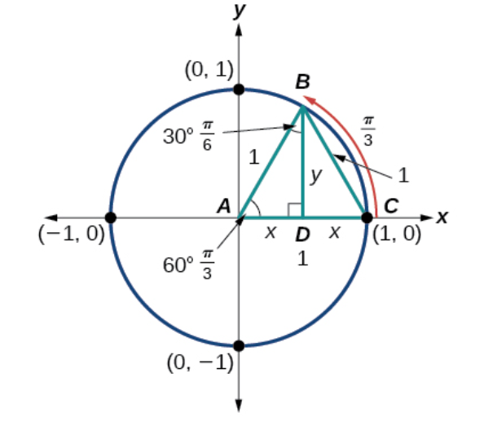
Finding Sines and Cosines of 30° and 60° Angles
Notes:
The special triangle is highlighted in yellow; it’s triangle ABD. The largest triangle, triangle ABC, is an equilateral triangle, with side lengths equal to 1. This means that x = 1/2 and y is the square root of (1^2 – (1/2)^2) = the square root of 3 divided by 2. Use these lengths to calculate the sine and the cosine for both 30 degrees and for 60 degrees.

Slide 17
Finding Sines and Cosines of Special Angles
Notes:
One way to summarize the values of sine and cosine for the special angles in the first quadrant is to use a table. What do you notice about these values? What patterns do you see?
You could start by writing down 0, 1, 2, 3, 4; then take the square root of each of those numbers and finally divide by two and simplify; the result is the values for the sine. After you have those values simply reverse the order and the result is the values for the cosine.

Slide 18
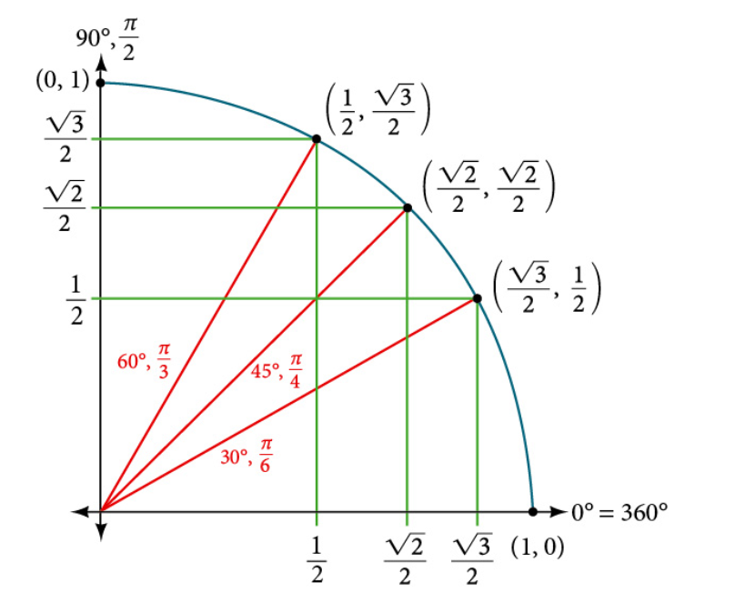
Notes:
Another way to organize these values for sine and cosine is using the unit circle.

Slide 19
Using a Calculator to Find Sine and Cosine
Notes:
To find the cosine and sine of angles other than the special angles, we turn to a computer or calculator. Be aware: Most calculators can be set into “degree” or “radian” mode, which tells the calculator the units for the input value. When we evaluate cos(30)cos(30) on our calculator, it will evaluate it as the cosine of 30 degrees if the calculator is in degree mode, or the cosine of 30 radians if the calculator is in radian mode.

Slide 22
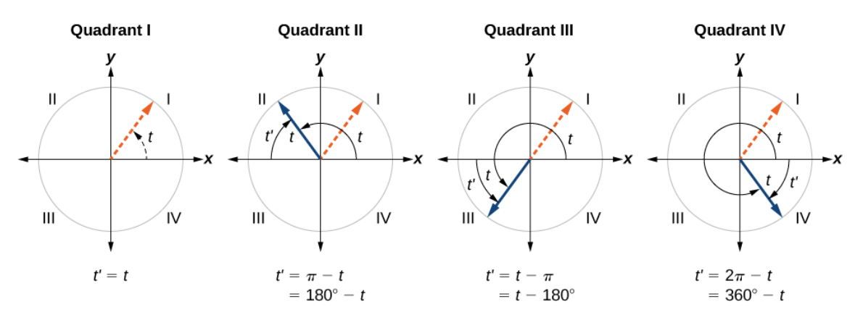
Finding Reference Angles
An angle’s reference angle is the acute angle, $t$, formed by the terminal side of the angle $t$ and the horizontal axis. An acute angle is an angle with a measurement between $0$ and $90°$, which is the same as between $0$ and $π/2$ radians.

Slide 24
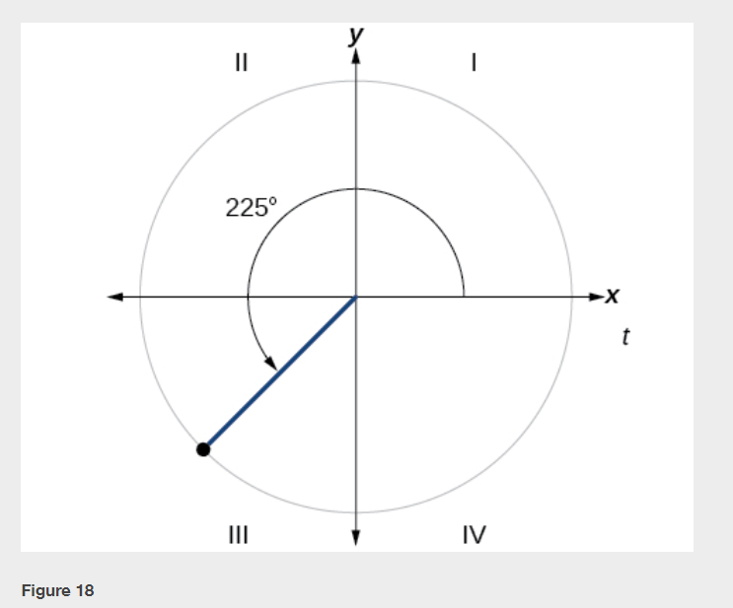

Slide 30
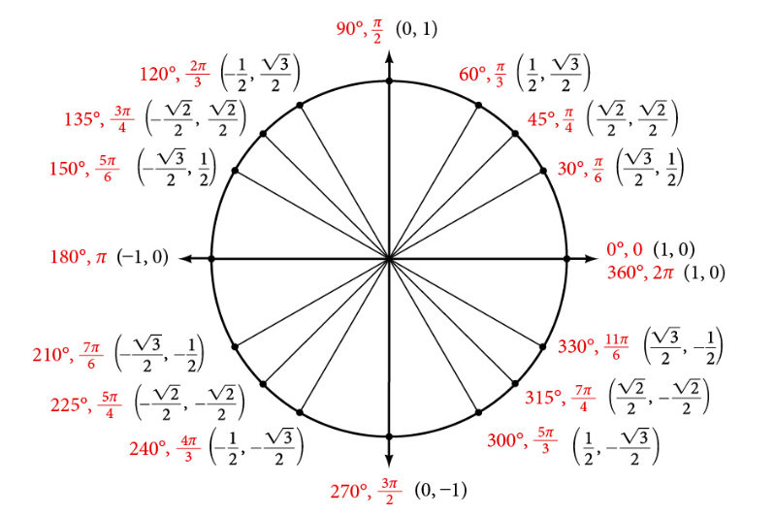
Using Reference Angles to Find Coordinates
Notes:
Now that we have learned how to find the cosine and sine values for special angles in the first quadrant, we can use symmetry and reference angles to fill in cosine and sine values for the rest of the special angles on the unit circle. Take time to learn the (x,y) coordinates of the major angles in the first quadrant.

Slide 34
What did you learn in this section?
Find function values for the sine and cosine of 30°, 45°, and 60°.
Identify the domain and range of sine and cosine functions.
Find reference angles.
Use reference angles to evaluate trigonometric functions.
Notes:
Do you have any questions?

Slide 35
This resource is an adaptation of the OpenStax Algebra and Trigonometry 2e open textbook and is © Susan Aydelotte under a CC BY-NC-SA 4.0 International license; it may be reproduced or modified for noncommercial purposes only but must be attributed to OpenStax, Rice University and any changes must be noted. Any adaptation must be shared under the same type of license.

