Slide 1

The Unit Circle:
Sine and Cosine Functions
Chapter 7
Algebra and Trigonometry 2e, OpenStax, Jay Abramson
Notes:
Images and notes within these slides are from the OpenStax textbook Algebra and Trigonometry 2e

Slide 2
7.2 Right Triangle Trigonometry
Notes:
Images and notes within these slides are from the OpenStax textbook Algebra and Trigonometry 2e

Slide 3
What are the learning objectives for this section?
Use right triangles to evaluate trigonometric functions.
Find function values for 30°, 45°, and 60°.
Use equal cofunctions of complementary angles.
Use the deﬁnitions of trigonometric functions of any angle.
Use right-triangle trigonometry to solve applied problems.

Slide 4
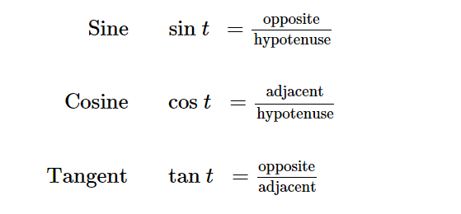
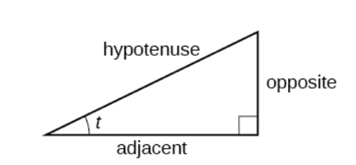
Using Right Triangles to Evaluate Trigonometric Functions
We will define the trigonometric functions in terms an angle t and the lengths of the sides of the triangle. The adjacent side is the side closest to the angle, x. The opposite side is the side across from the angle, y. The hypotenuse is the side of the triangle opposite the right angle, 1.
Notes:
Remember that a right triangle is a triangle where one of its angles is a 90-degree angle. A common mnemonic for remembering these relationships is SohCahToa.

Slide 5
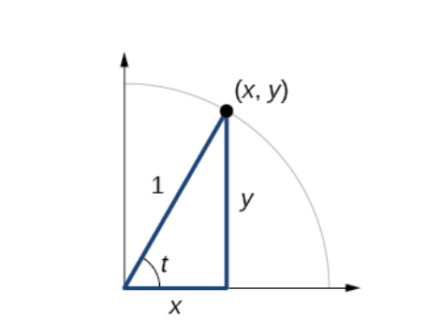
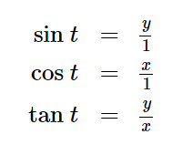
Unit Circle
Notes:
This figure shows a right triangle with a vertical side of length y and a horizontal side has length x.. Notice that the triangle is inscribed in a circle of radius 1. Such a circle, with a center at the origin and a radius of 1, is known as a unit circle.

Slide 6
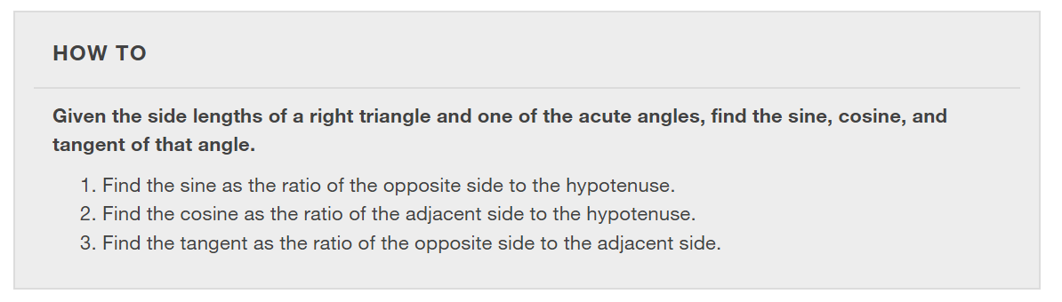

Slide 7
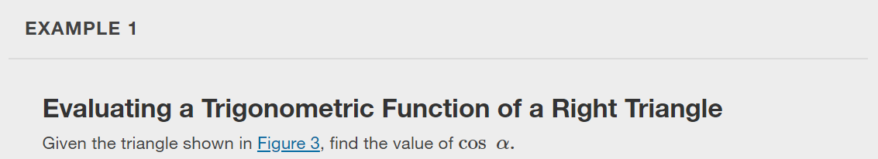
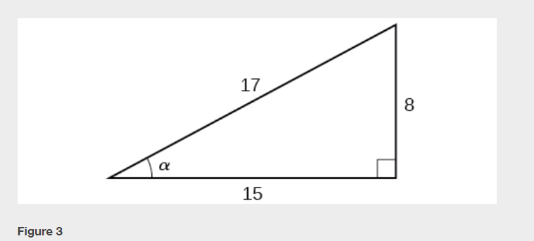

Slide 8
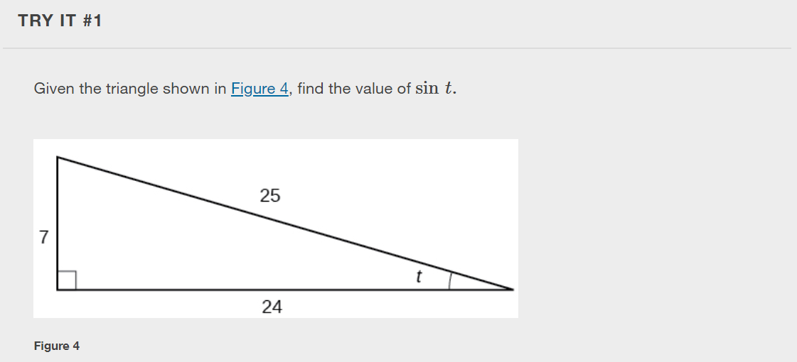

Slide 9
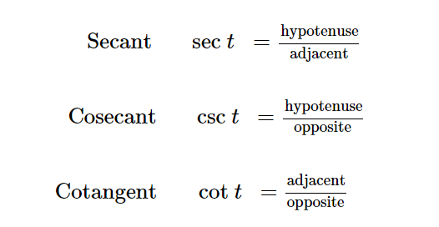
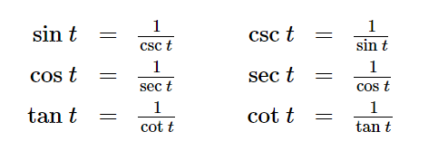
Reciprocal Functions
In addition to sine, cosine, and tangent, there are three more functions. These too are defined in terms of the sides of the triangle.
Notes:
Take another look at these definitions. These functions are the reciprocals of the first three functions.

Slide 10
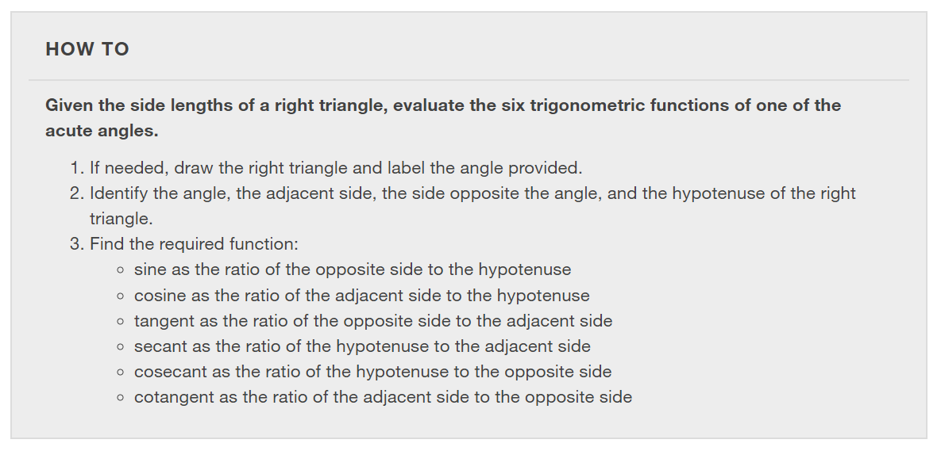

Slide 11
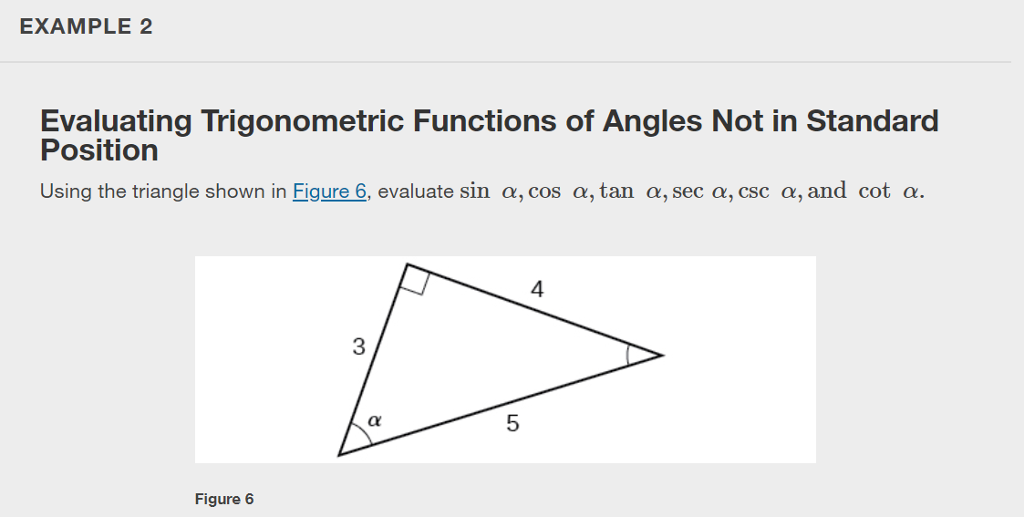

Slide 12
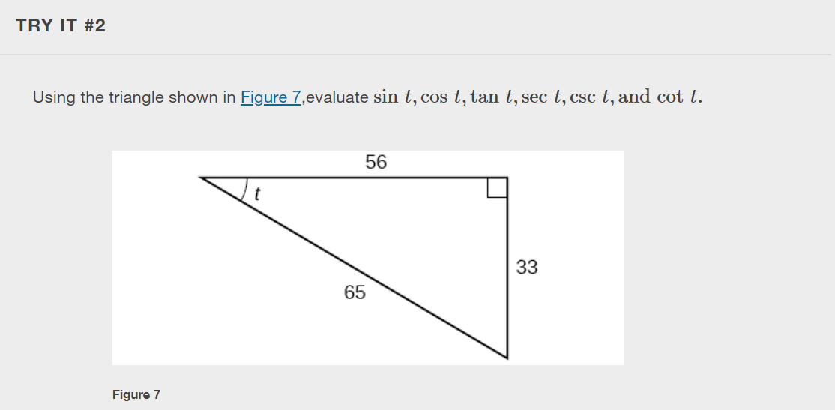

Slide 13
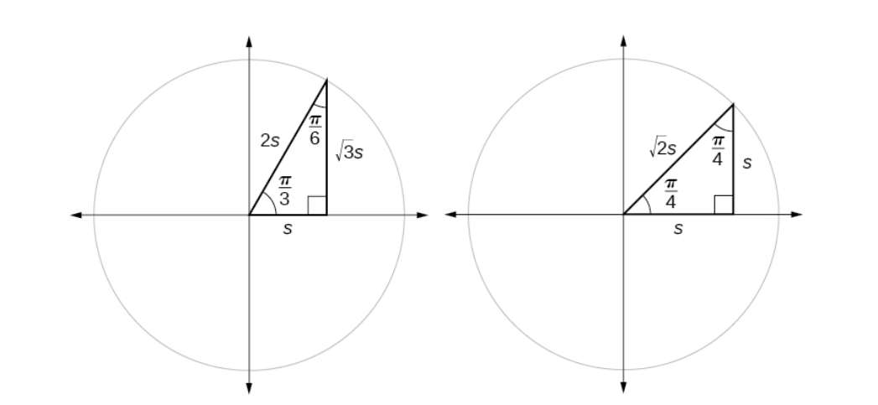
Two Special Triangles
Notes:
We can then use the ratios of the side lengths to evaluate trigonometric functions of special angles.

Slide 14
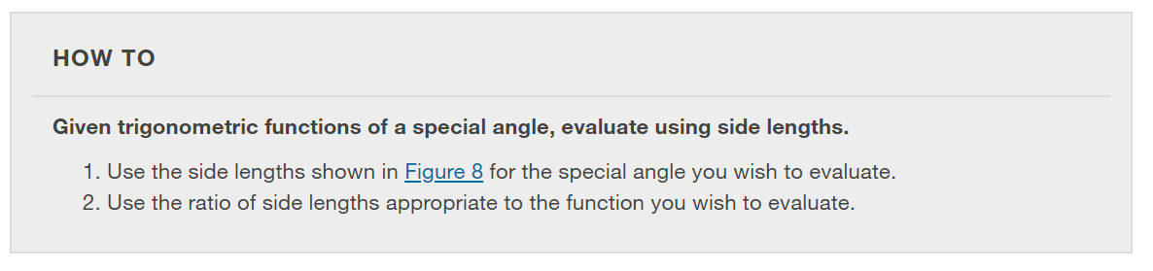

Slide 15
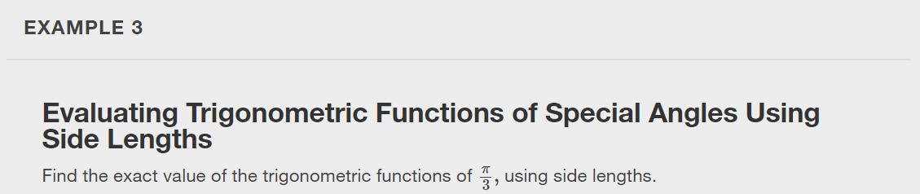

Slide 16


Slide 17
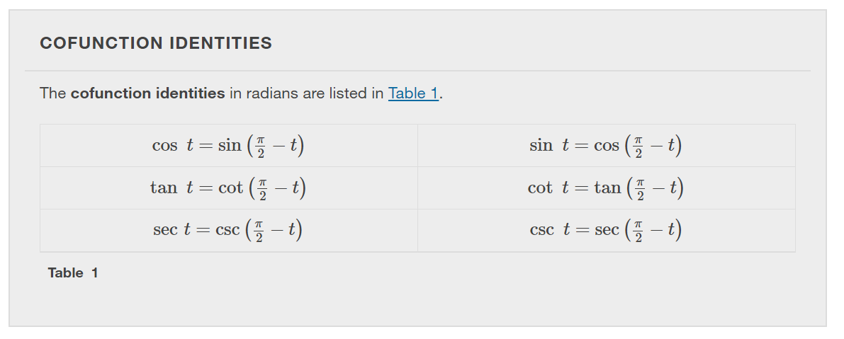

Slide 18
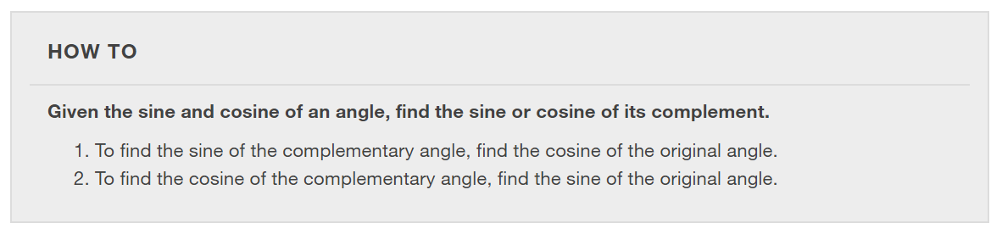

Slide 19
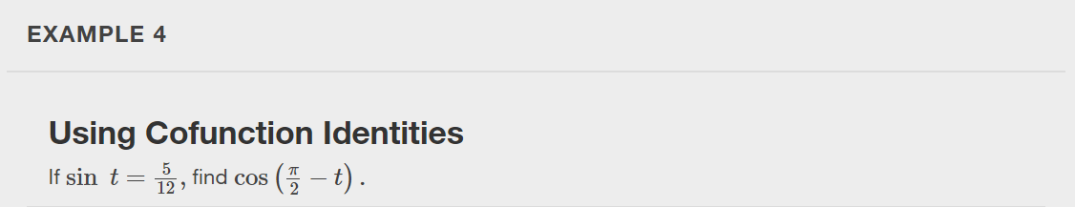

Slide 20
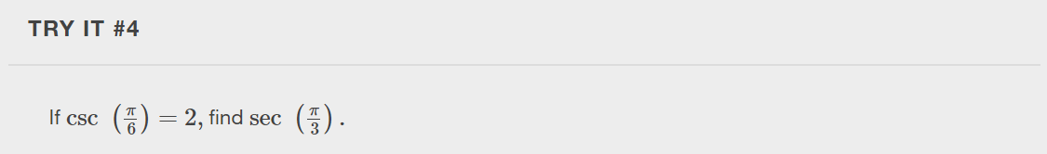

Slide 21
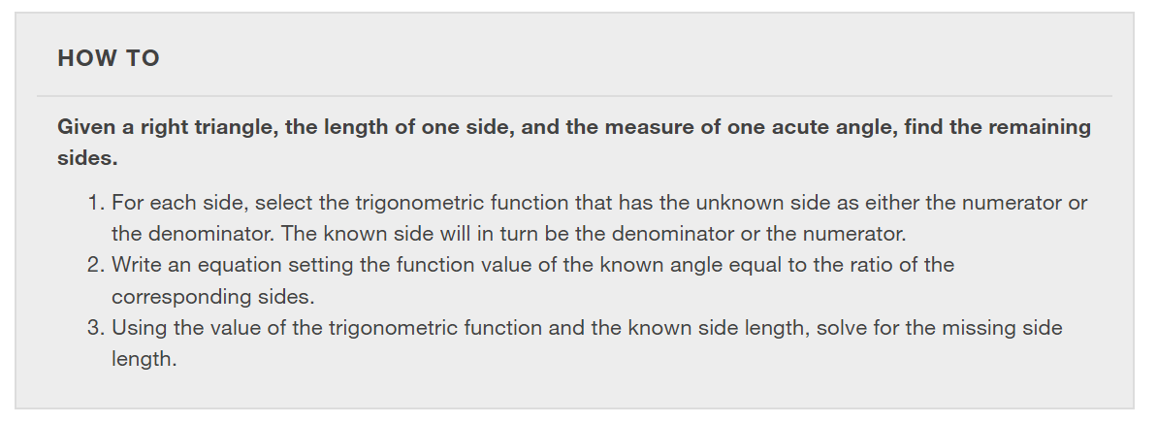

Slide 22
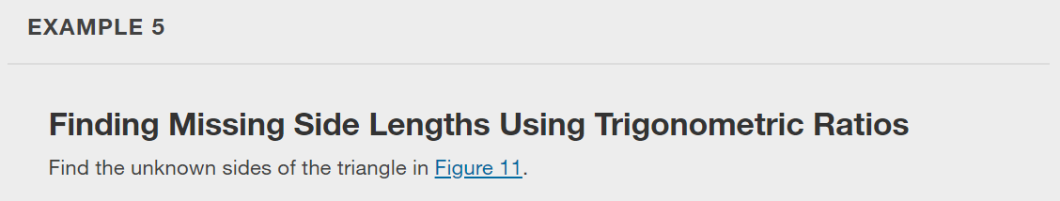
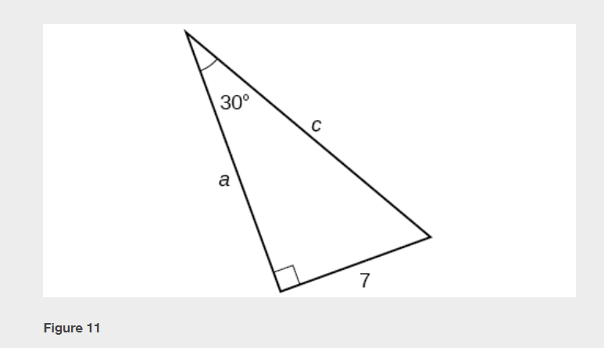

Slide 23
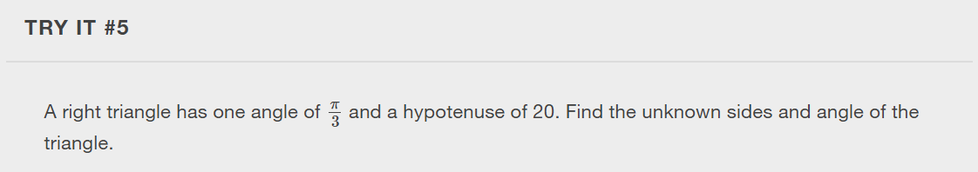

Slide 24
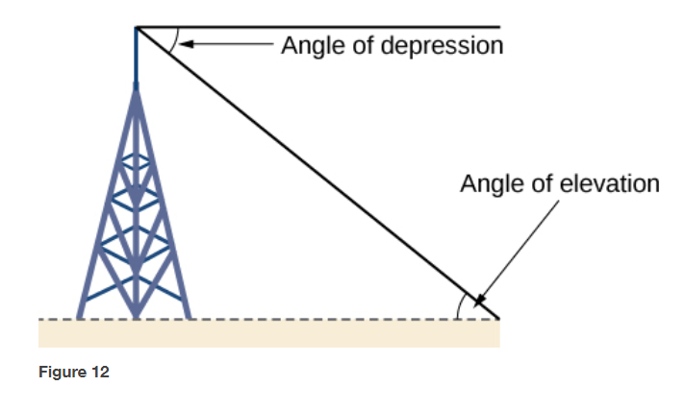
Using Right Triangle Trigonometry to Solve Applied Problems
Notes:
Right-triangle trigonometry has many practical applications. For example, the ability to compute the lengths of sides of a triangle makes it possible to find the height of a tall object without climbing to the top or having to extend a tape measure along its height. We do so by measuring a distance from the base of the object to a point on the ground some distance away, where we can look up to the top of the tall object at an angle. The angle of elevation of an object above an observer relative to the observer is the angle between the horizontal and the line from the object to the observer's eye. The right triangle this position creates has sides that represent the unknown height, the measured distance from the base, and the angled line of sight from the ground to the top of the object. Knowing the measured distance to the base of the object and the angle of the line of sight, we can use trigonometric functions to calculate the unknown height.
Similarly, we can form a triangle from the top of a tall object by looking downward. The angle of depression of an object below an observer relative to the observer is the angle between the horizontal and the line from the object to the observer's eye.

Slide 25
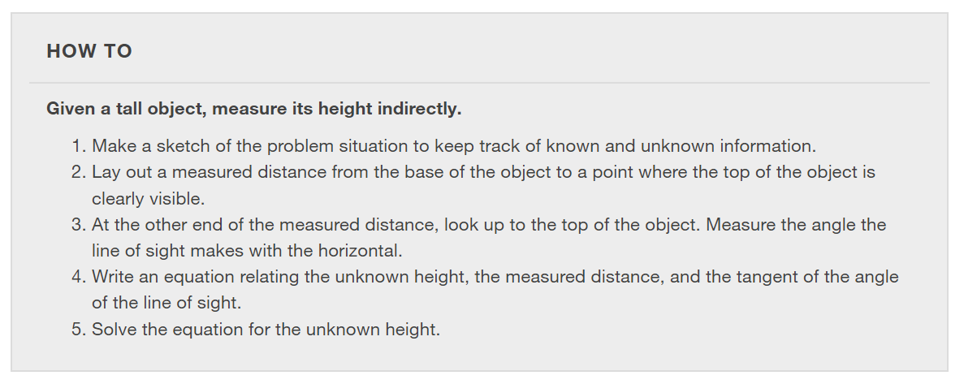

Slide 26
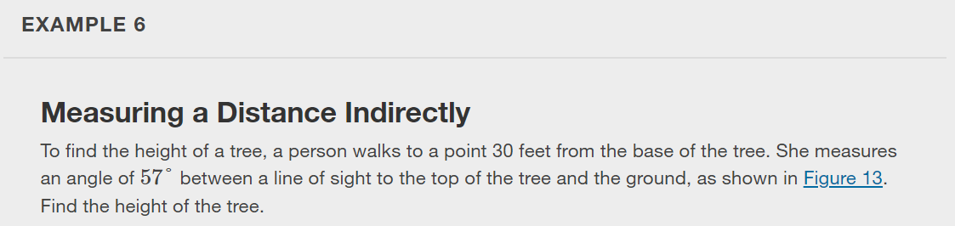
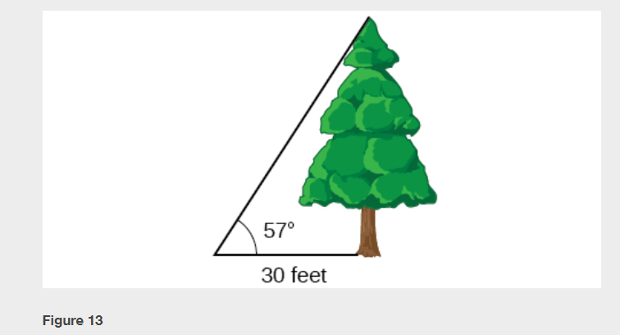

Slide 27
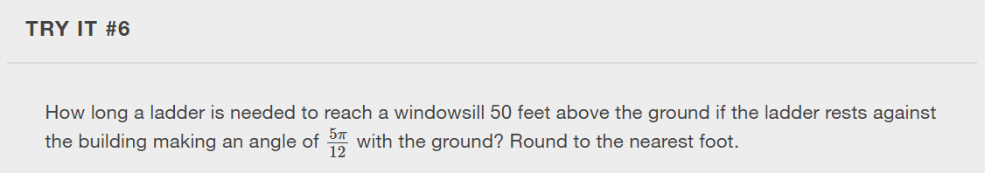

Slide 28
What did you learn in this section?
Use right triangles to evaluate trigonometric functions.
Find function values for 30°, 45°, and 60°.
Use equal cofunctions of complementary angles.
Use the deﬁnitions of trigonometric functions of any angle.
Use right-triangle trigonometry to solve applied problems.
Notes:
Do you have any questions?

Slide 29
This resource is an adaptation of the OpenStax Algebra and Trigonometry 2e open textbook and is © Susan Aydelotte under a CC BY-NC-SA 4.0 International license; it may be reproduced or modified for noncommercial purposes only but must be attributed to OpenStax, Rice University and any changes must be noted. Any adaptation must be shared under the same type of license.

