Slide 1

The Unit Circle:
Sine and Cosine Functions
Chapter 7
Algebra and Trigonometry 2e, OpenStax, Jay Abramson
Notes:
Images and notes within these slides are from the OpenStax textbook Algebra and Trigonometry 2e

Slide 2
7.1 Angles
Notes:
Images and notes within these slides are from the OpenStax textbook Algebra and Trigonometry 2e

Slide 3
What are the learning objectives for this section?
Draw angles in standard position.
Convert between degrees and radians.
Find coterminal angles.
Find the length of a circular arc.
Use linear and angular speed to describe motion on a circular path.

Slide 4
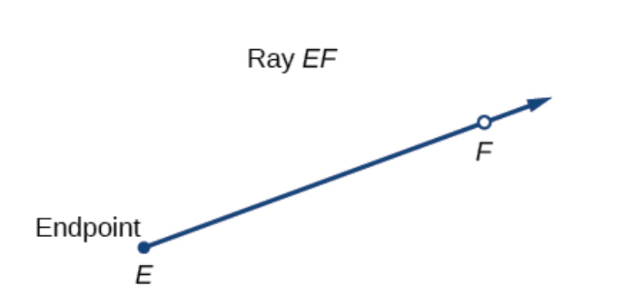

Ray
Properly defining an angle first requires that we define a ray.
A ray is a directed line segment.
Notes:
It consists of one point on a line and all points extending in one direction from that point. The first point is called the endpoint of the ray. We can refer to a specific ray by stating its endpoint and any other point on it.

Slide 5
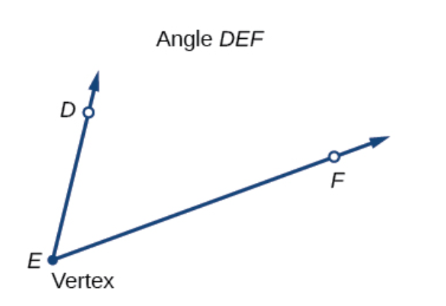

Angle
An angle is the union of two rays having a common endpoint. The endpoint is called the vertex of the angle, and the two rays are the sides of the angle.

Slide 6
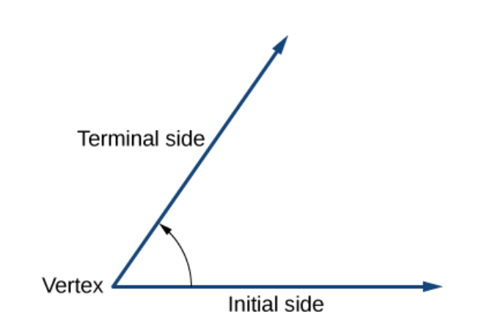
Angle
Angle creation is a dynamic process. We start with two rays lying on top of one another. We leave one fixed in place, and rotate the other. The fixed ray is the initial side, and the rotated ray is the terminal side. In order to identify the different sides, we indicate the rotation with a small arrow close to the vertex.
Notes:
The measure of an angle is the amount of rotation from the initial side to the terminal side. Probably the most familiar unit of angle measurement is the degree. One degree is 1/360 of a circular rotation, so a complete circular rotation contains 360 degrees. An angle measured in degrees should always include the unit “degrees” after the number, or include the degree symbol °. For example, 90 degrees = 90°.

Slide 7
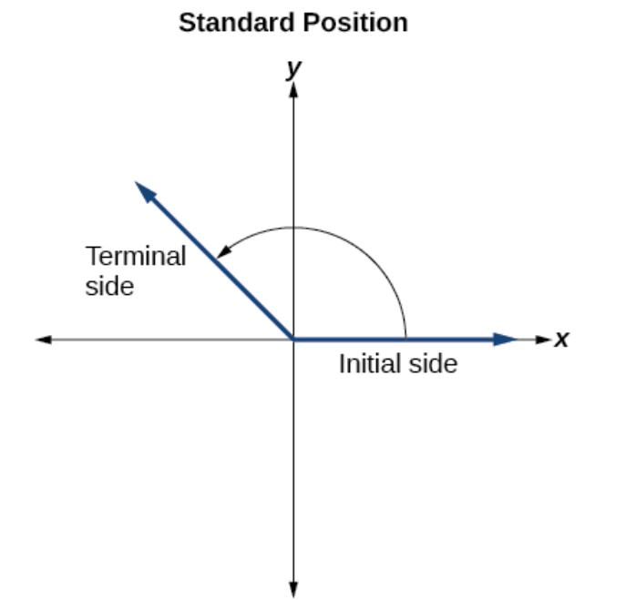
Drawing Angles in Standard Position
Notes:
To formalize our work, we will begin by drawing angles on an x-y coordinate plane. Angles can occur in any position on the coordinate plane, but for the purpose of comparison, the convention is to illustrate them in the same position whenever possible. An angle is in standard position if its vertex is located at the origin, and its initial side extends along the positive x-axis. If the angle is measured in a counterclockwise direction from the initial side to the terminal side, the angle is said to be a positive angle. If the angle is measured in a clockwise direction, the angle is said to be a negative angle.

Slide 8
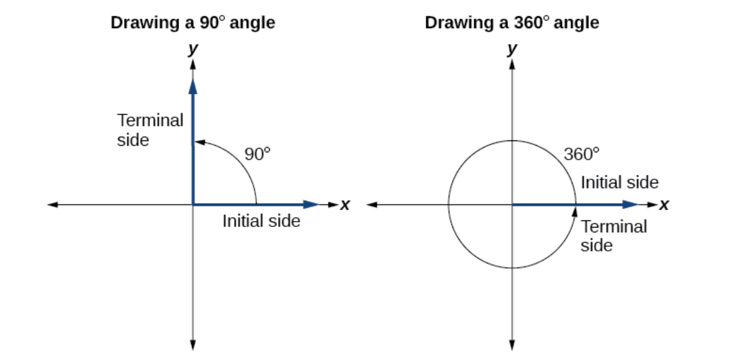

Slide 9
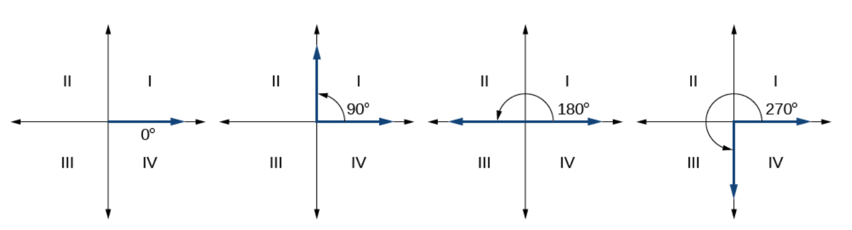
Notes:
Since we define an angle in standard position by its terminal side, we have a special type of angle whose terminal side lies on an axis, a quadrantal angle. This type of angle can have a measure of 0°, 90°, 180°, 270°, or 360°.

Slide 10
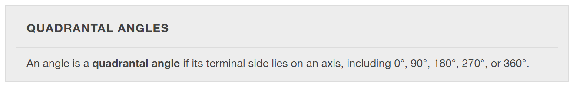

Slide 11
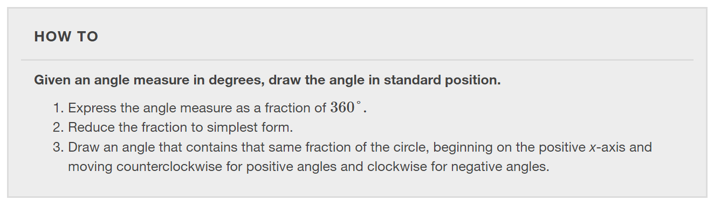

Slide 12
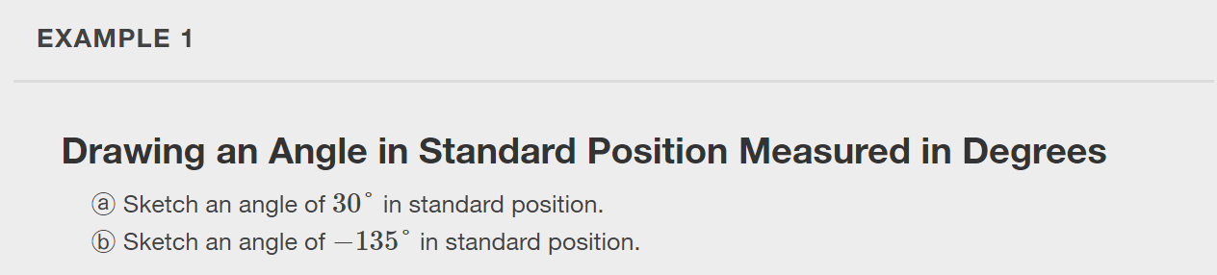
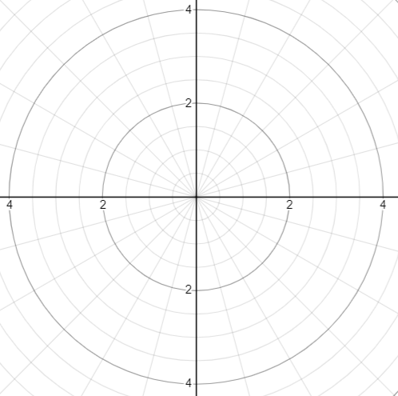

Slide 13


Slide 14
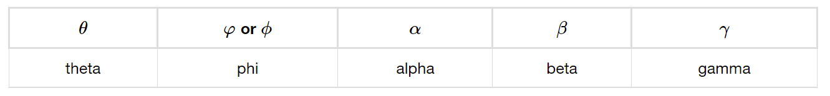
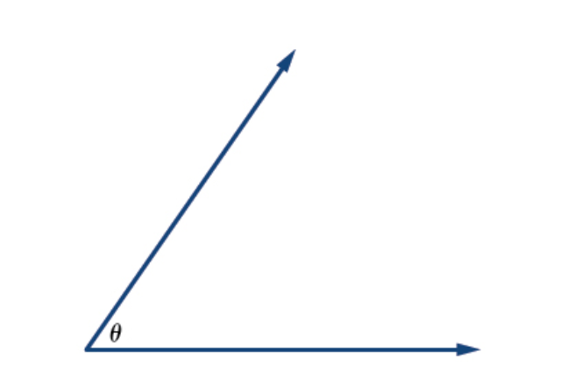
Greek letters
Notes:
Greek letters are often used as variables for the measure of an angle.

Slide 15
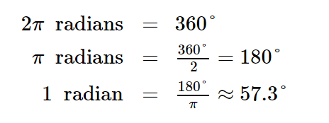
Angles measured in radians
A central angle is an angle formed at the center of a circle by two radii. One radian is the measure of a central angle of a circle that intercepts an arc equal in length to the radius of that circle. Because the total circumference equals 2π times the radius, a full circular rotation is 2π radians.

Slide 16
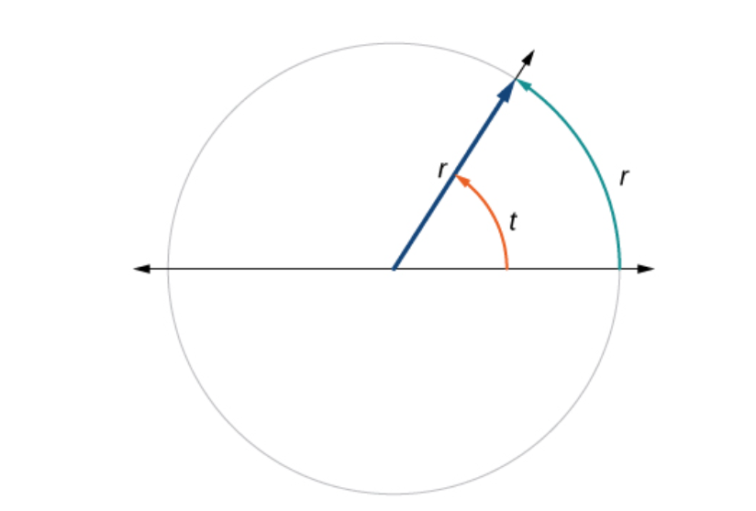
Angles measured in radians
A central angle is an angle formed at the center of a circle by two radii. One radian is the measure of a central angle of a circle that intercepts an arc equal in length to the radius of that circle. Because the total circumference equals 2π times the radius, a full circular rotation is 2π radians.
Notes:
The angle t sweeps out a measure of one radian. Note that the length of the intercepted arc is the same as the length of the radius of the circle.

Slide 17
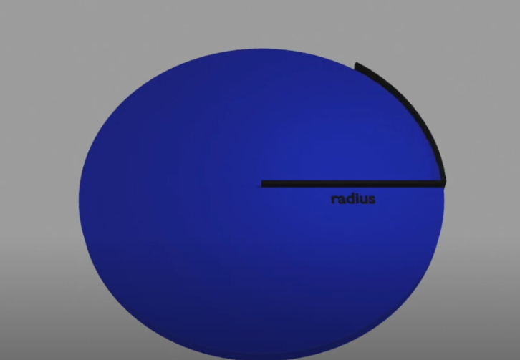
Angles measured in radians
Click the image or link below to view the video.
https://youtu.be/Wa5neKHs7jg?si=Lewu3Oz3xi739Tst

Slide 18
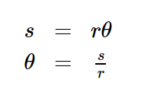

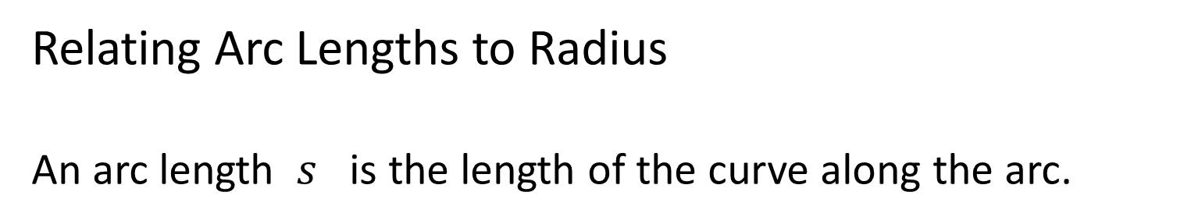
Relating Arc Lengths to Radius
An arc length $s$ is the length of the curve along the arc.

Slide 19
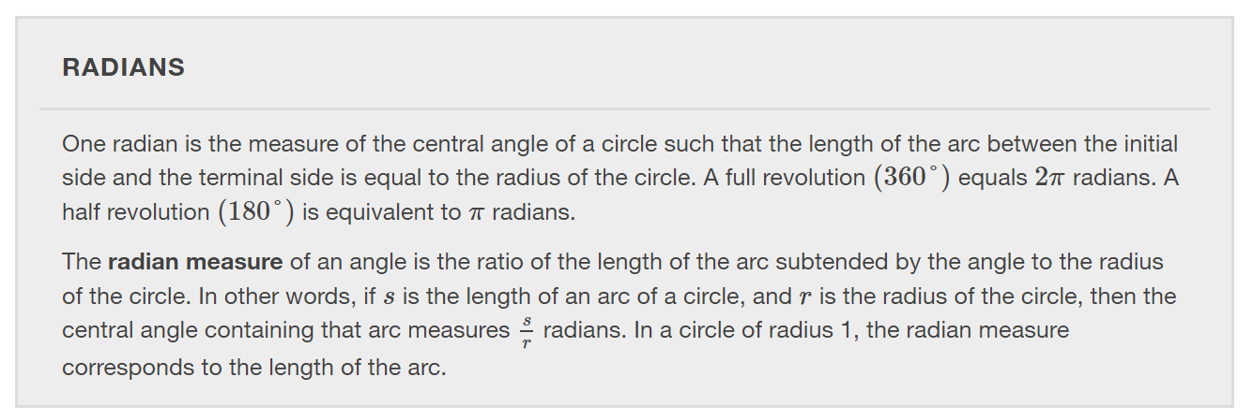

Slide 20
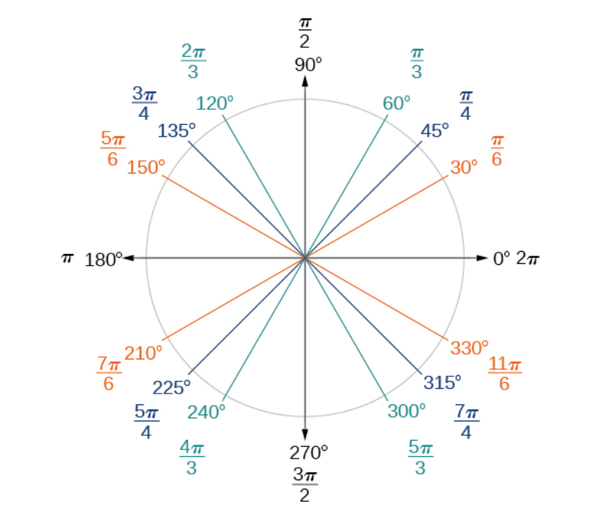

Slide 21
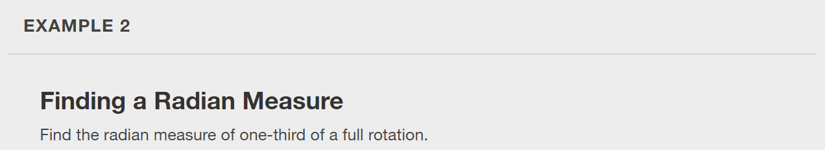

Slide 22
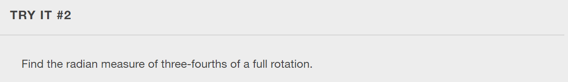

Slide 23
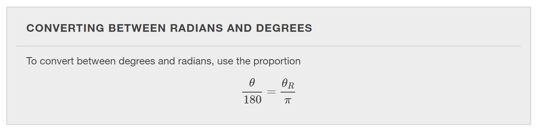

Slide 24
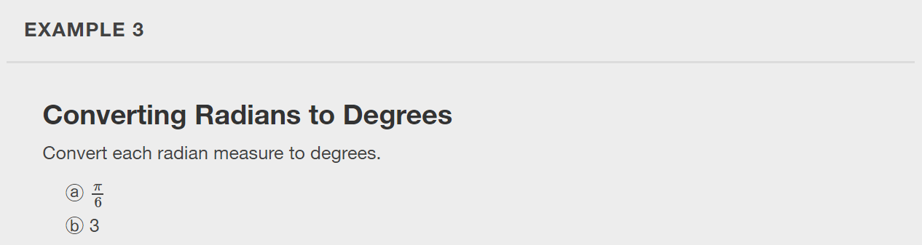

Slide 25


Slide 26
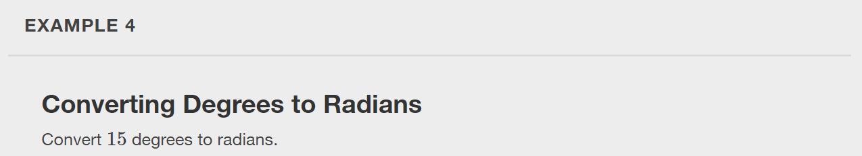

Slide 27


Slide 28
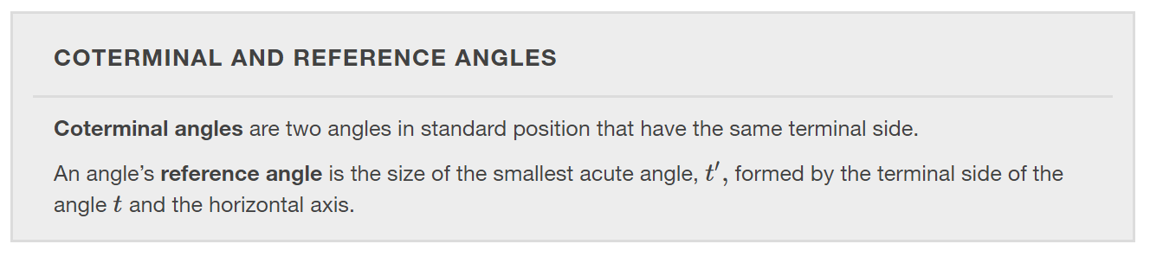

Slide 29
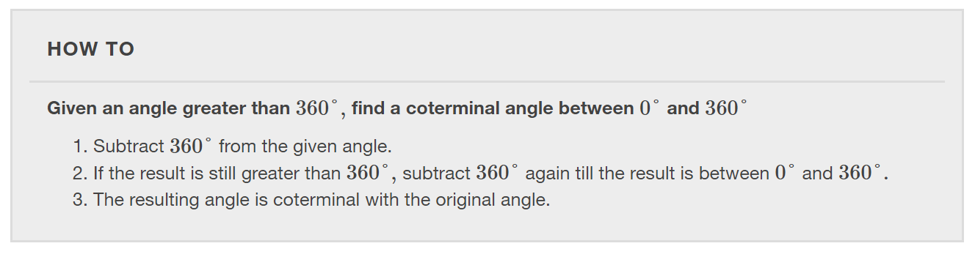

Slide 30
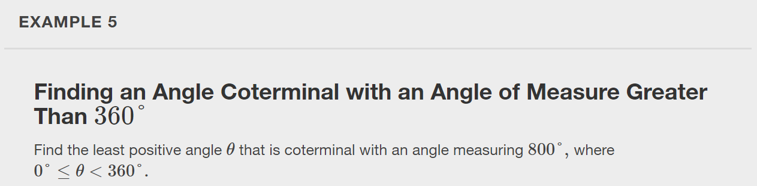

Slide 31


Slide 32
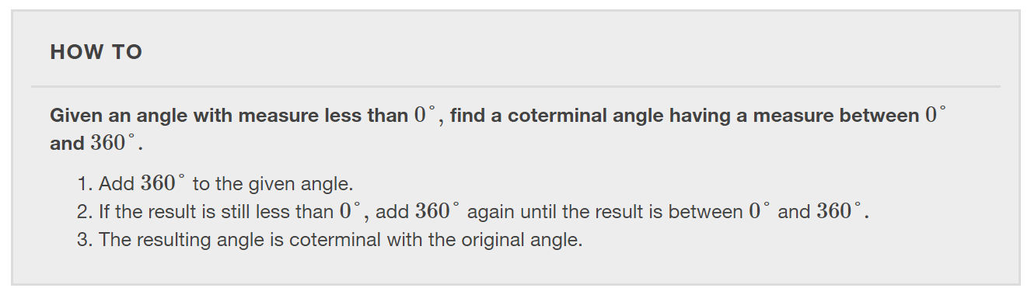

Slide 33
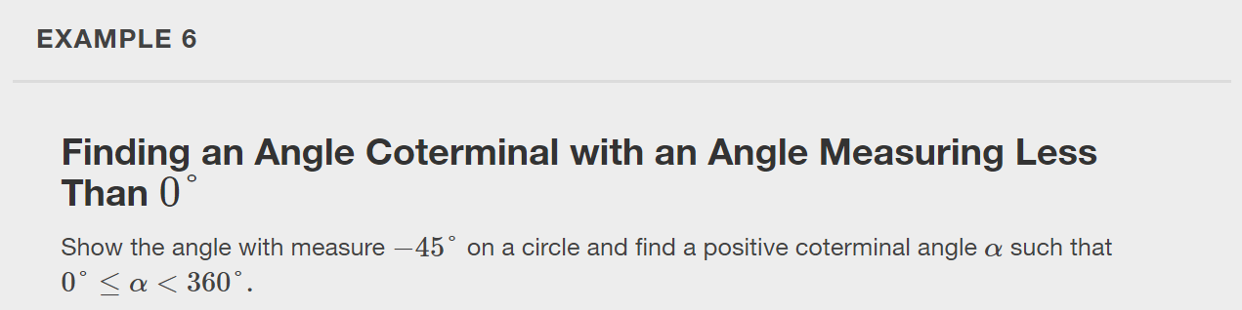

Slide 34
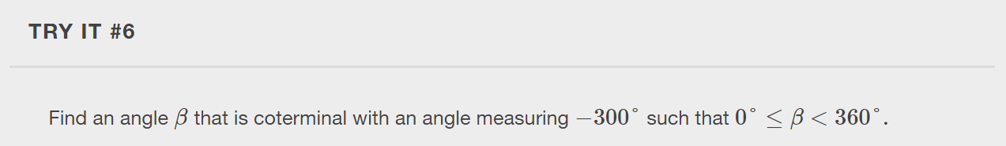

Slide 35
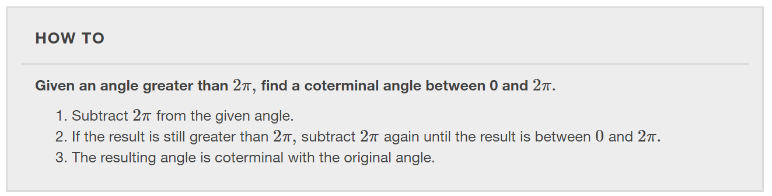

Slide 36
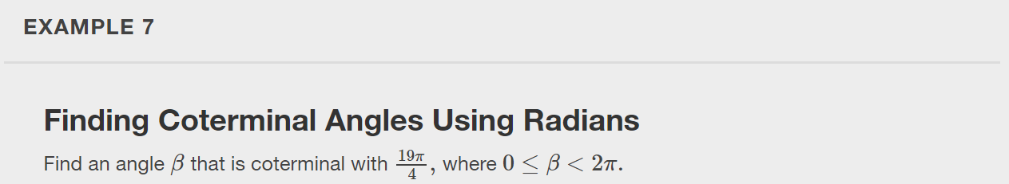

Slide 37
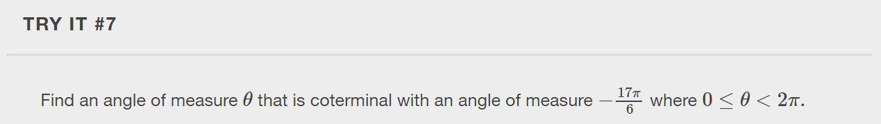

Slide 38
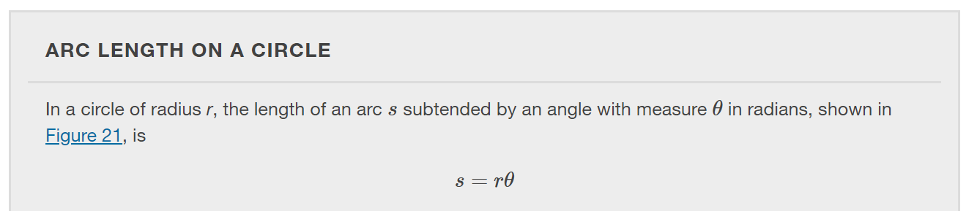
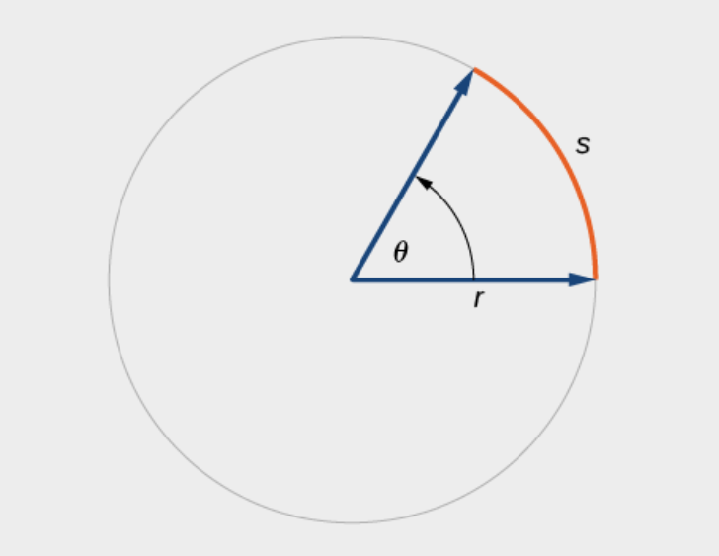

Slide 39
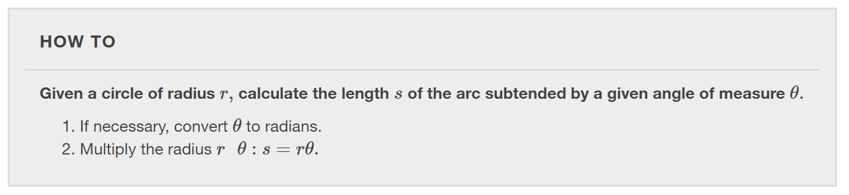

Slide 40
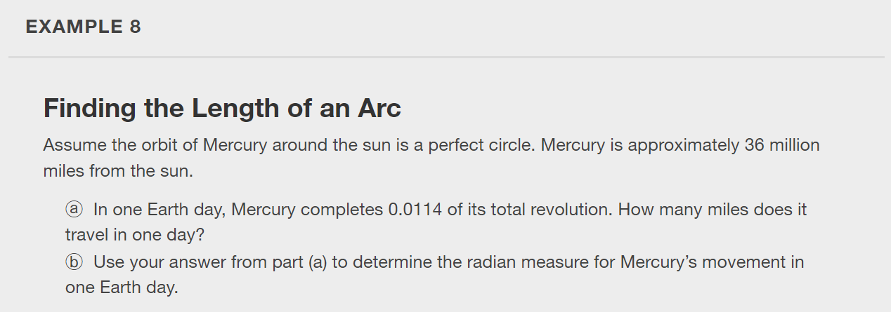

Slide 41


Slide 42
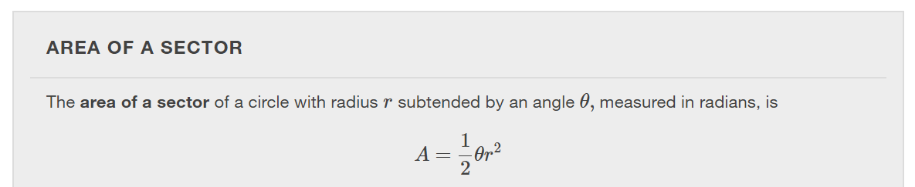
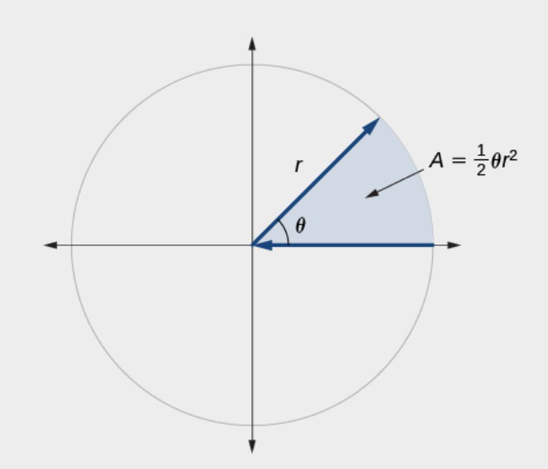

Slide 43
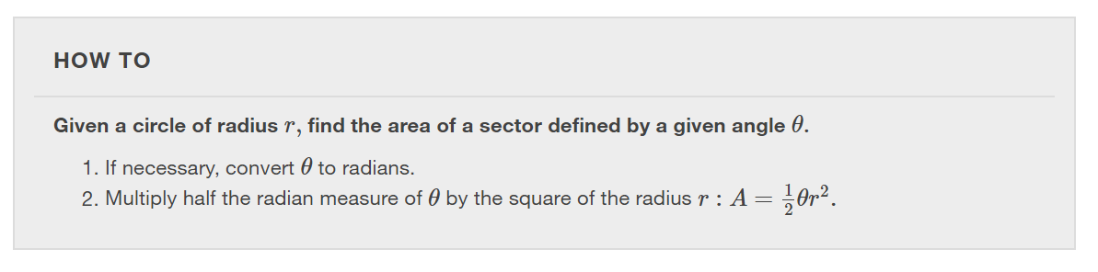

Slide 44
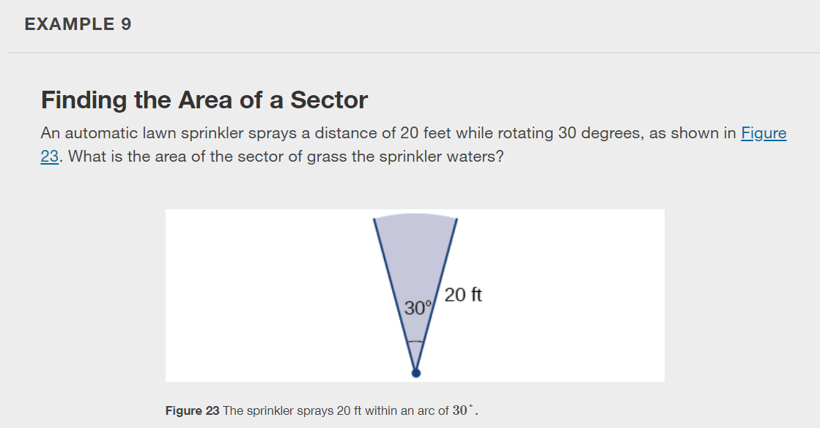

Slide 45
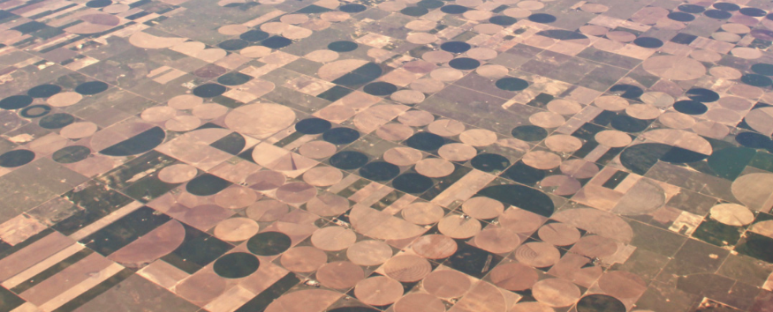
In central pivot irrigation, which creates the field shapes similar to the image below, a large irrigation pipe on wheels rotates around a center point. A farmer has a central pivot system with a radius of 400 meters. If water restrictions only allow her to water 150 thousand square meters a day, what angle should she set the system to cover? Write the answer in radian measure to two decimal places.

Slide 46
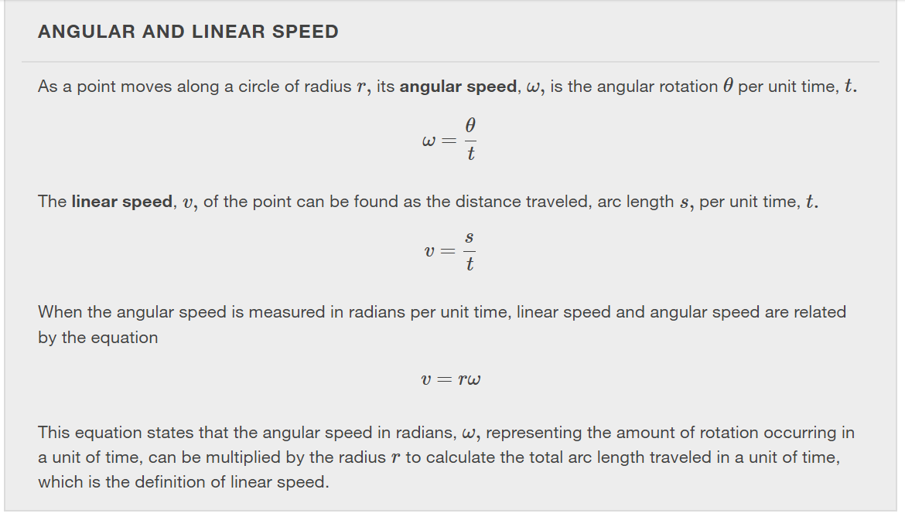

Slide 47
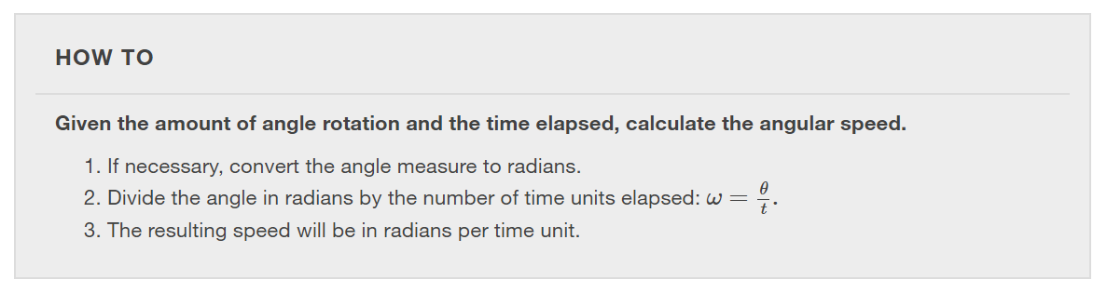

Slide 48
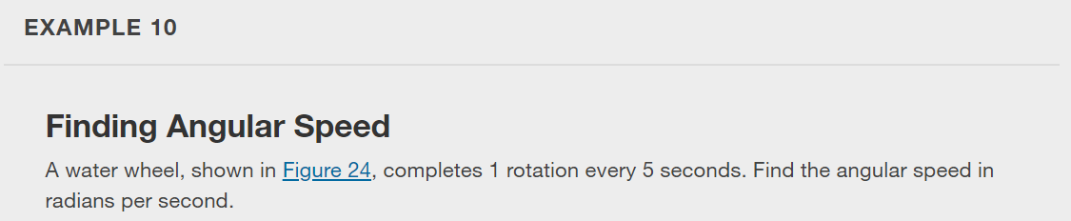
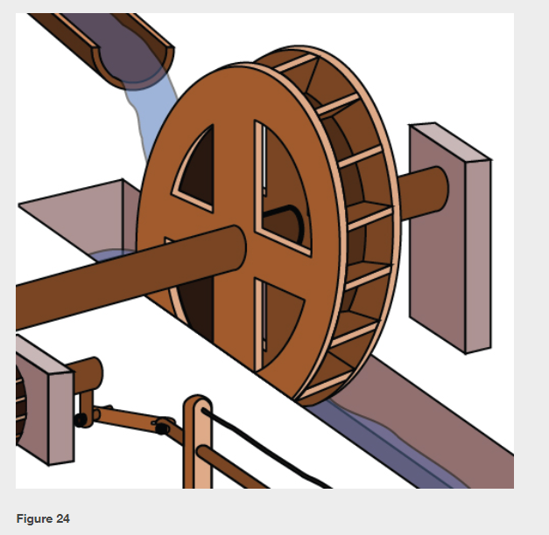

Slide 49
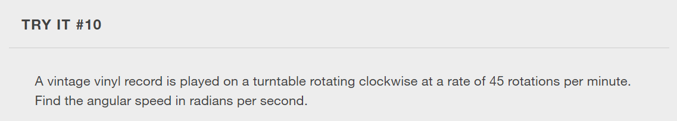

Slide 50
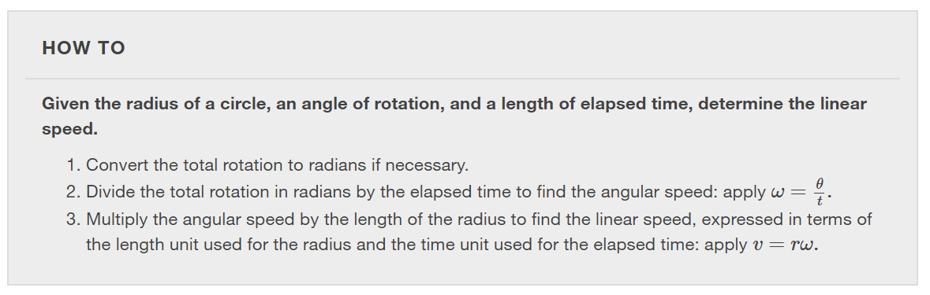

Slide 51
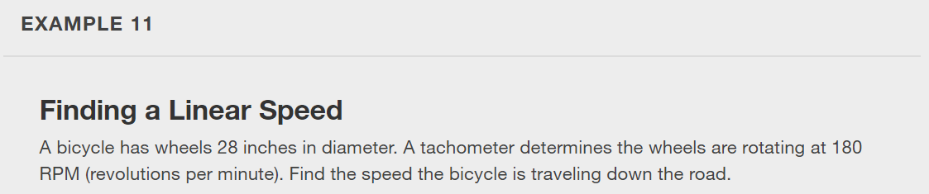

Slide 52
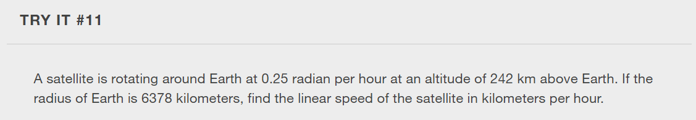

Slide 53
What did you learn in this section?
Draw angles in standard position.
Convert between degrees and radians.
Find coterminal angles.
Find the length of a circular arc.
Use linear and angular speed to describe motion on a circular path.
Notes:
Do you have any questions?

Slide 54
This resource is an adaptation of the OpenStax Algebra and Trigonometry 2e open textbook and is © Susan Aydelotte under a CC BY-NC-SA 4.0 International license; it may be reproduced or modified for noncommercial purposes only but must be attributed to OpenStax, Rice University and any changes must be noted. Any adaptation must be shared under the same type of license.

