Slide 1
Exponential and Logarithmic Functions
Chapter 6
Algebra and Trigonometry 2e, OpenStax, Jay Abramson
Notes:
Images and notes within these slides are from the OpenStax textbook Algebra and Trigonometry 2e

Slide 2
6.7 Exponential and Logarithmic Models
Notes:
Images and notes within these slides are from the OpenStax textbook Algebra and Trigonometry 2e

Slide 3
What are the learning objectives for this section?
Model exponential growth and decay.
Use Newton’s Law of Cooling.
Use logistic-growth models.
Choose an appropriate model for data.
Express an exponential model in base $e.$

Slide 4
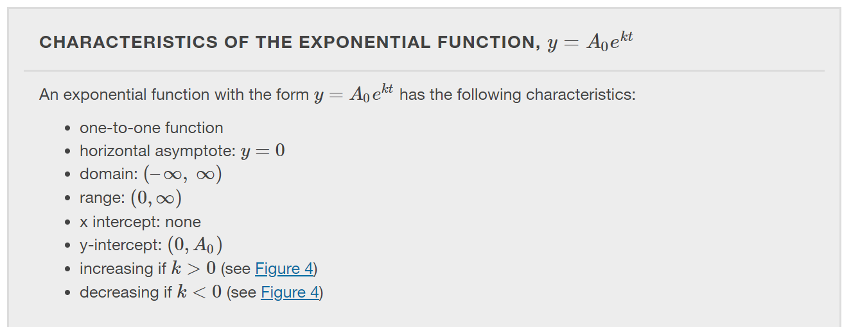

Slide 5
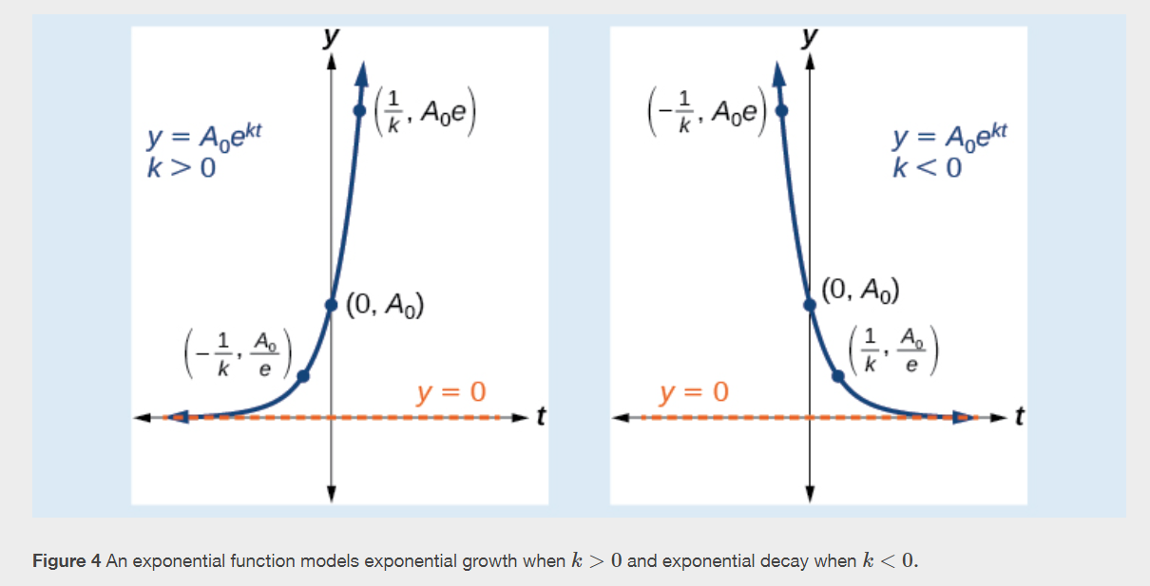

Slide 7
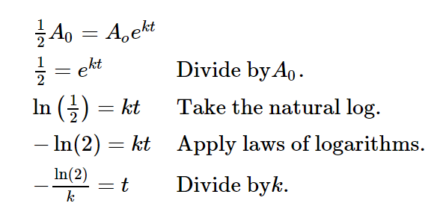
Exponential Decay and Half-Life
To find the half-life of a function describing exponential decay, solve the following equation for $t$:

Slide 11
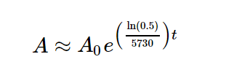
Radiocarbon Dating
The formula for radioactive decay is important in radiocarbon dating, which is used to calculate the approximate date a plant or animal died.
Since the half-life of carbon-14 is 5,730 years, the formula for the amount of carbon-14 remaining after $t$ years is

Slide 15
Calculating Doubling Time
For decaying quantities, we determined how long it took for half of a substance to decay. For growing quantities, we want to find out how long it takes for a quantity to double. The time it takes for a quantity to double is called the doubling time.
The formula for the doubling time is derived as follows:

Slide 23
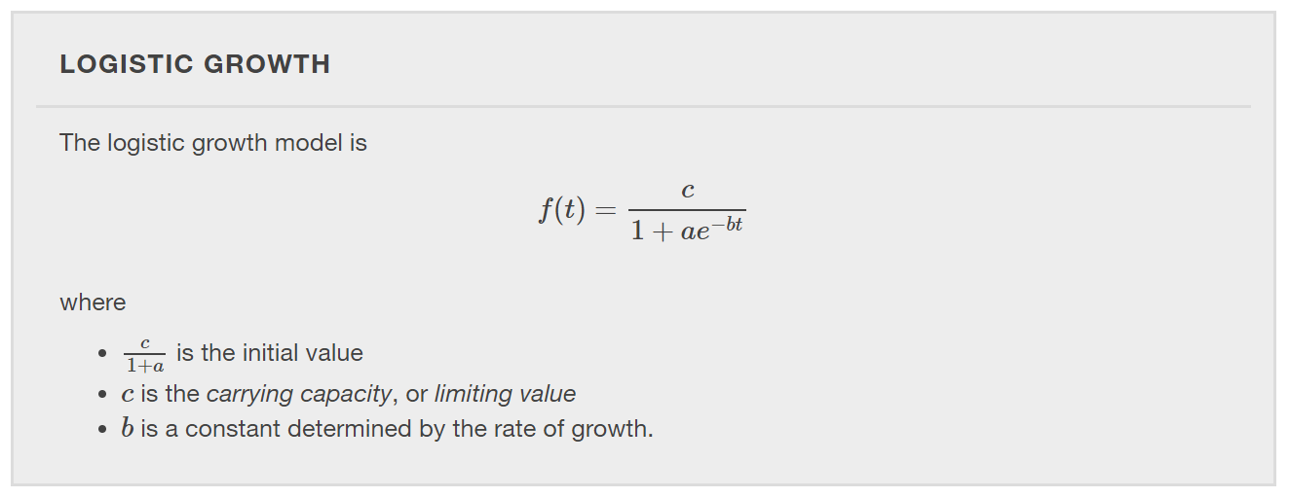
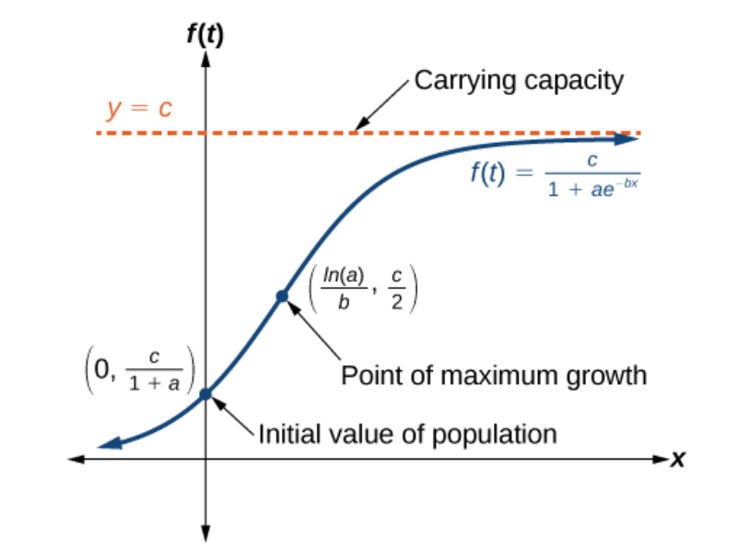

Slide 28
Expressing an Exponential Model in Base $e$
While powers and logarithms of any base can be used in modeling, the two most common bases are 10 and $e$. In science and mathematics, the base $e$ is often preferred.

Slide 31
What did you learn in this section?
Model exponential growth and decay.
Use Newton’s Law of Cooling.
Use logistic-growth models.
Choose an appropriate model for data.
Express an exponential model in base $e.$
Notes:
Do you have any questions?

Slide 32
This resource is an adaptation of the OpenStax Algebra and Trigonometry 2e open textbook and is © Susan Aydelotte under a CC BY-NC-SA 4.0 International license; it may be reproduced or modified for noncommercial purposes only but must be attributed to OpenStax, Rice University and any changes must be noted. Any adaptation must be shared under the same type of license.

