Slide 1
Exponential and Logarithmic Functions
Chapter 6
Algebra and Trigonometry 2e, OpenStax, Jay Abramson
Notes:
Images and notes within these slides are from the OpenStax textbook Algebra and Trigonometry 2e

Slide 2
6.6 Exponential and Logarithmic Equations
Notes:
Images and notes within these slides are from the OpenStax textbook Algebra and Trigonometry 2e

Slide 3
What are the learning objectives for this section?
Use like bases to solve exponential equations.
Use logarithms to solve exponential equations.
Use the definition of a logarithm to solve logarithmic equations.
Use the one-to-one property of logarithms to solve logarithmic equations.
Solve applied problems involving exponential and logarithmic equations.

Slide 7
Rewriting Equations So All Powers Have the Same Base

Slide 12
Notes:
No. Recall that the range of an exponential function is always positive. While solving the equation, we may obtain an expression that is undefined.

Slide 14
Confirm your answer by graphing each side of the equation.

Slide 15
Solving Exponential Equations Using Logarithms

Slide 18
Notes:
Yes. The solution is 0.

Slide 19
Equations Containing e

Slide 22
Notes:
No. There is a solution when k≠0, and when y and A are either both 0 or neither 0, and they have the same sign. An example of an equation with this form that has no solution is 2=−3e^t.

Slide 25
Extraneous Solutions
Sometimes the methods used to solve an equation introduce an extraneous solution, which is a solution that is correct algebraically but does not satisfy the conditions of the original equation.
Notes:
One such situation arises in solving when the logarithm is taken on both sides of the equation. In such cases, remember that the argument of the logarithm must be positive. If the number we are evaluating in a logarithm function is negative, there is no output.

Slide 28
Notes:
No. Keep in mind that we can only apply the logarithm to a positive number. Always check for extraneous solutions.

Slide 38
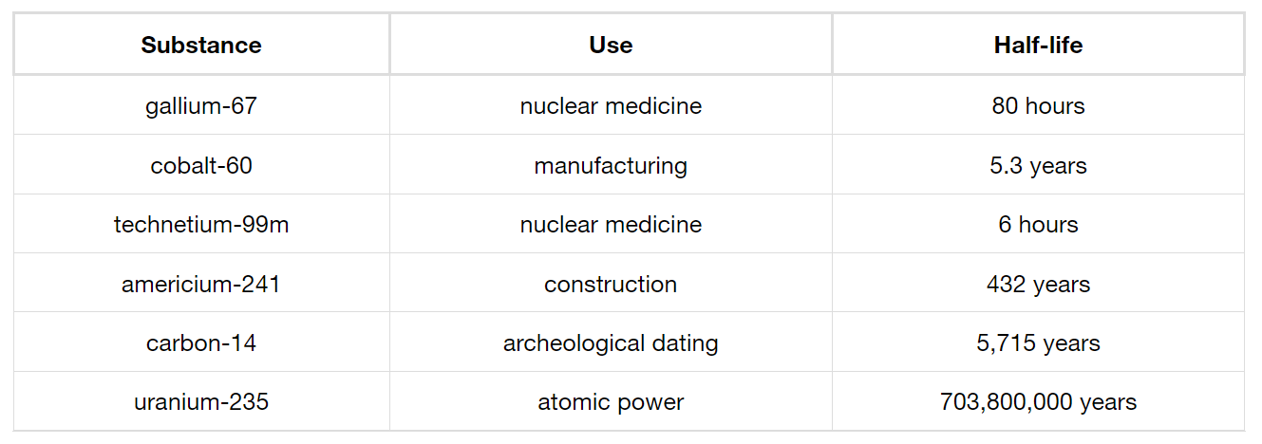
Solving Applied Problems: Radioactive Decay
The half-life of a radioactive substance is the time it takes for half of the unstable material to decay.

Slide 39
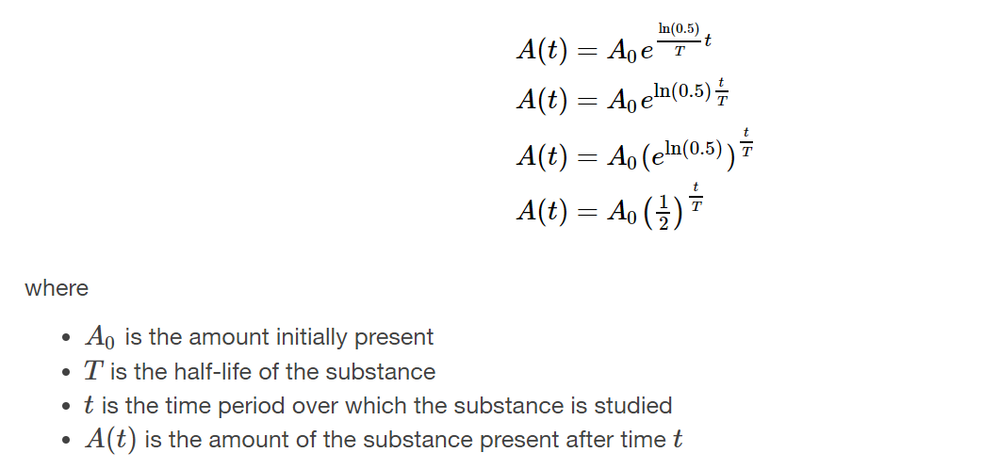
Knowing the half-life of a substance allows us to calculate the amount remaining after a specified time. We can use the formula for radioactive decay:

Slide 40
Notes:
Hint: Ten percent of 1000 grams is 100 grams. If 100 grams decay, the amount of uranium-235 remaining is 900 grams.

Slide 42
What did you learn in this section?
Use like bases to solve exponential equations.
Use logarithms to solve exponential equations.
Use the definition of a logarithm to solve logarithmic equations.
Use the one-to-one property of logarithms to solve logarithmic equations.
Solve applied problems involving exponential and logarithmic equations.
Notes:
Do you have any questions?

Slide 43
This resource is an adaptation of the OpenStax Algebra and Trigonometry 2e open textbook and is © Susan Aydelotte under a CC BY-NC-SA 4.0 International license; it may be reproduced or modified for noncommercial purposes only but must be attributed to OpenStax, Rice University and any changes must be noted. Any adaptation must be shared under the same type of license.

