Slide 1

Exponential and Logarithmic Functions
Chapter 6
Algebra and Trigonometry 2e, OpenStax, Jay Abramson
Notes:
Images and notes within these slides are from the OpenStax textbook Algebra and Trigonometry 2e

Slide 2
6.5 Logarithmic Properties
Notes:
Images and notes within these slides are from the OpenStax textbook Algebra and Trigonometry 2e

Slide 3
What are the learning objectives for this section?
Use the product rule for logarithms.
Use the quotient rule for logarithms.
Use the power rule for logarithms.
Expand logarithmic expressions.
Condense logarithmic expressions.
Use the change-of-base formula for logarithms.

Slide 4
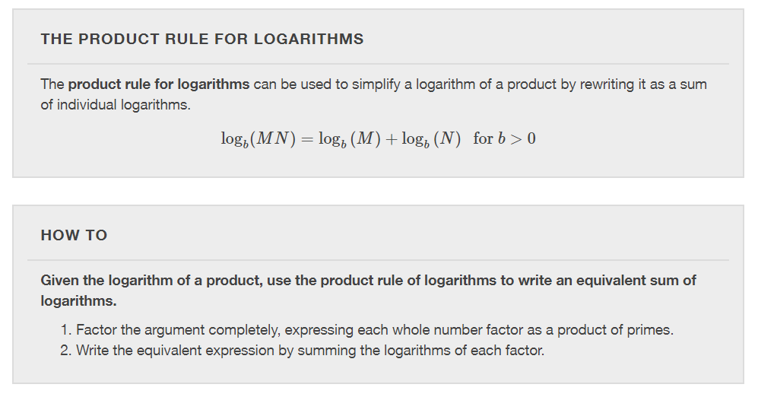

Slide 5
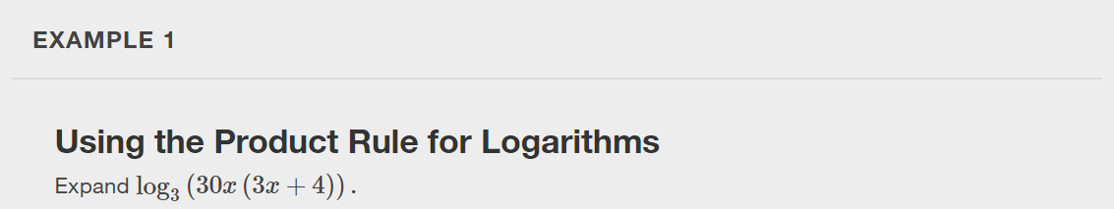

Slide 6
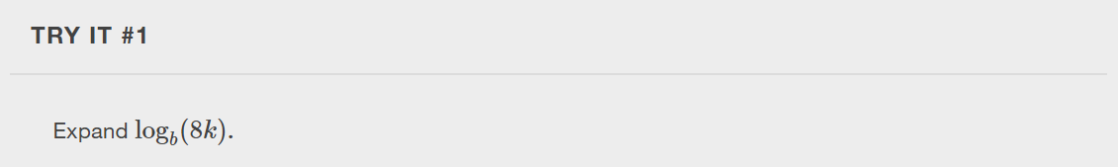

Slide 7
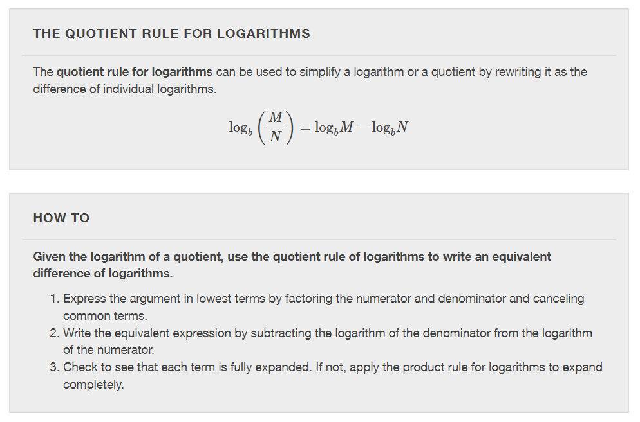

Slide 8
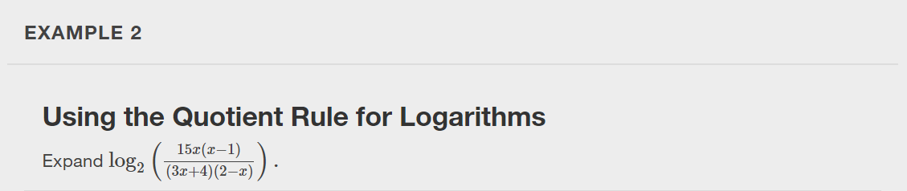

Slide 9
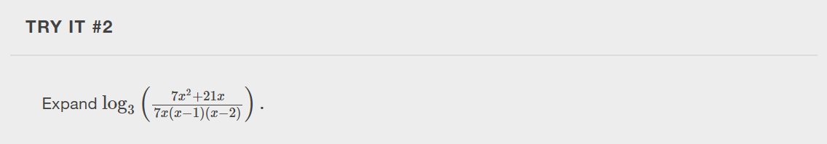

Slide 10
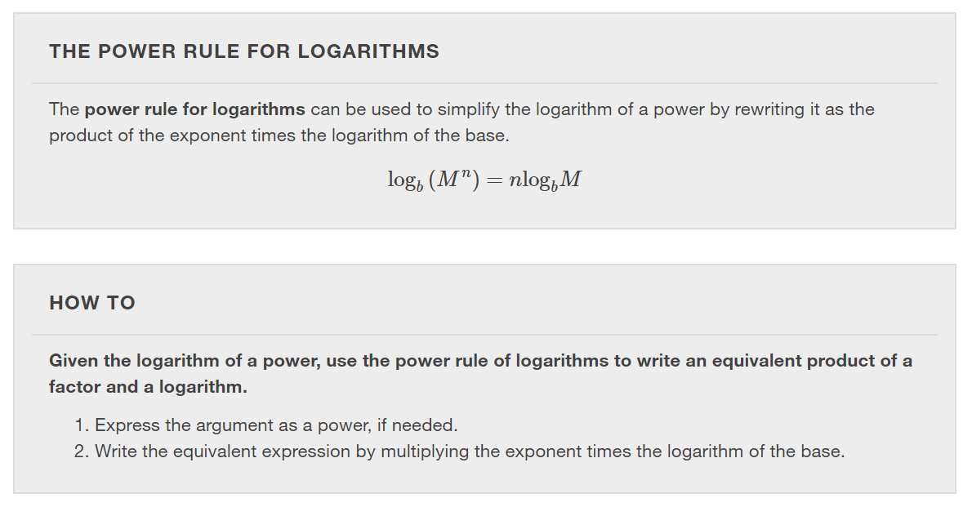

Slide 11
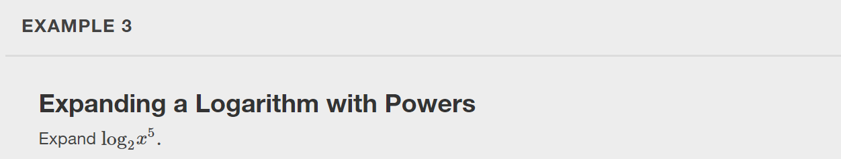

Slide 12
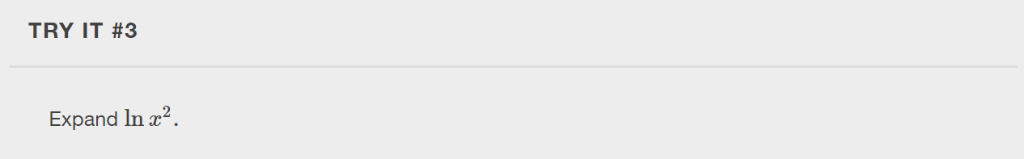

Slide 13
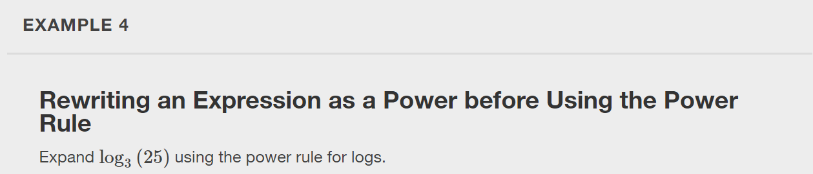

Slide 14
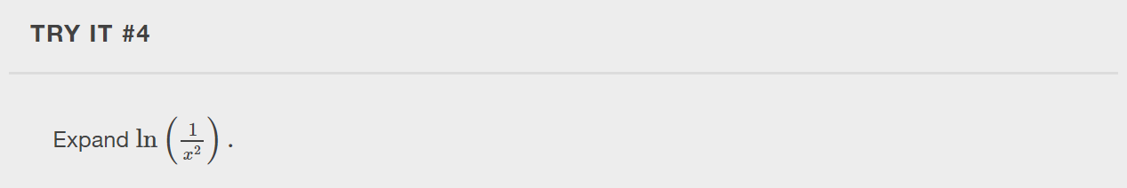

Slide 15
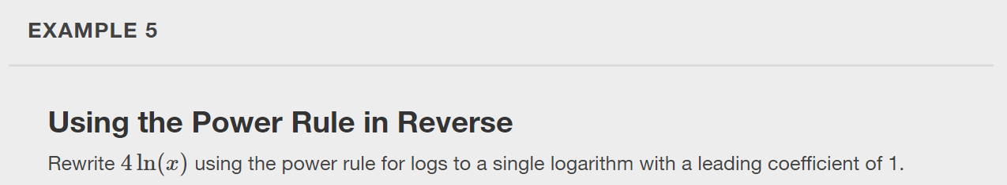

Slide 16
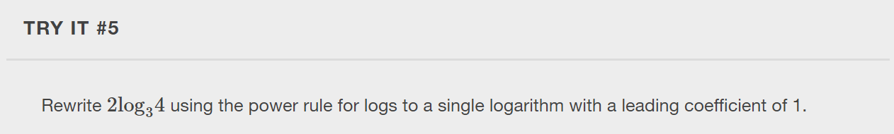

Slide 17
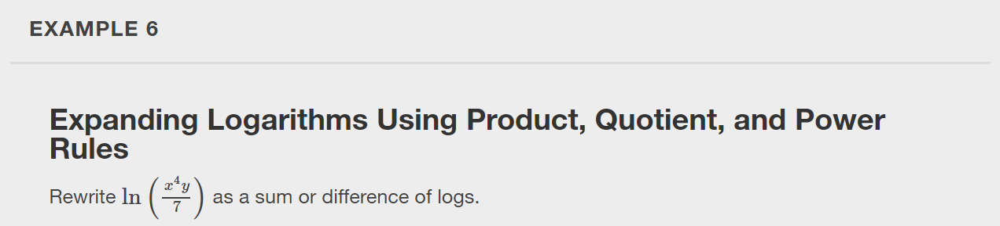

Slide 18
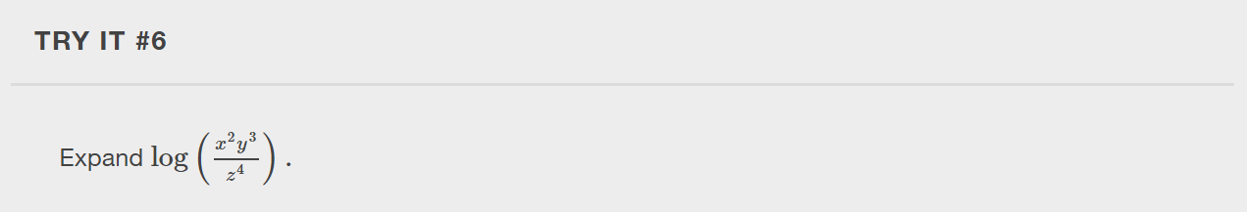

Slide 19
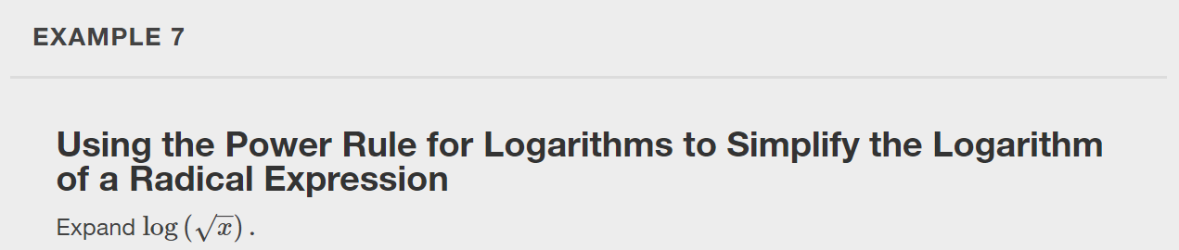

Slide 20


Slide 21
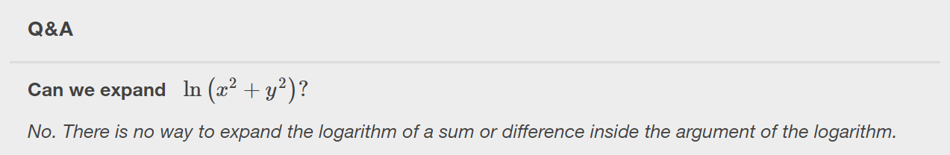

Slide 22
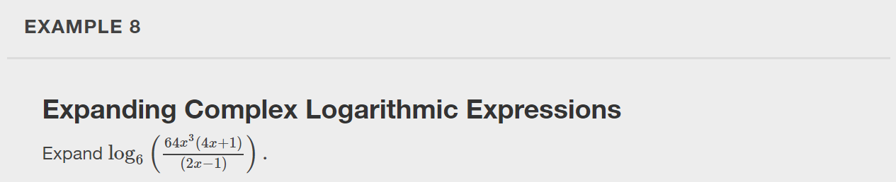

Slide 23
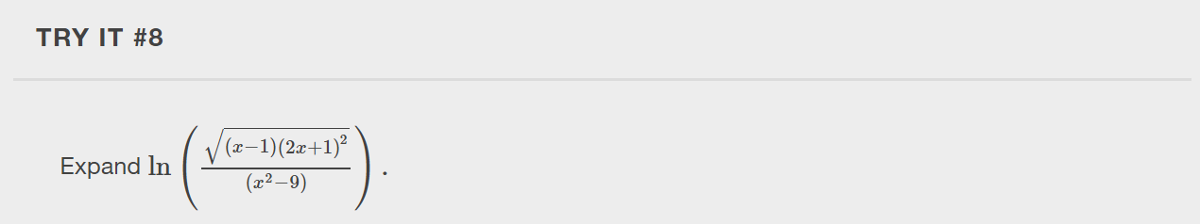

Slide 24
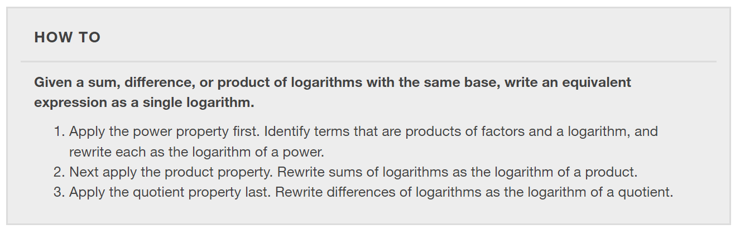
Condensing Logarithmic Expressions

Slide 25
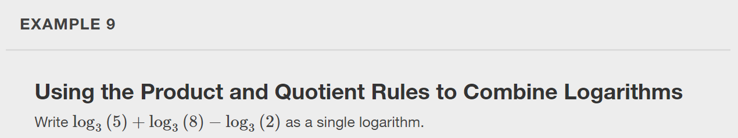

Slide 26
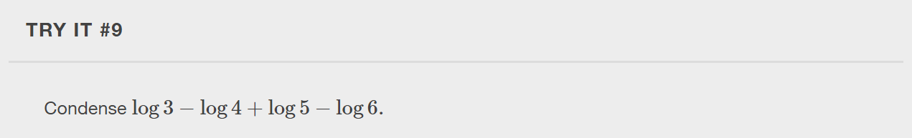

Slide 27
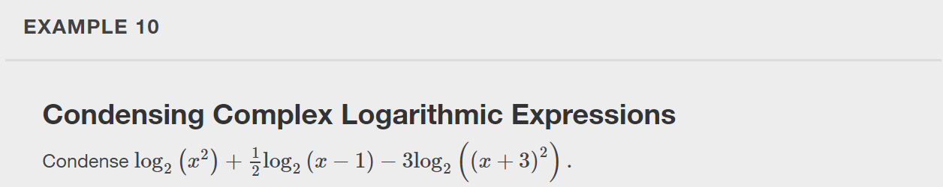

Slide 28
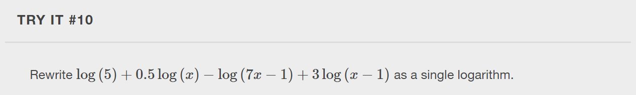

Slide 29
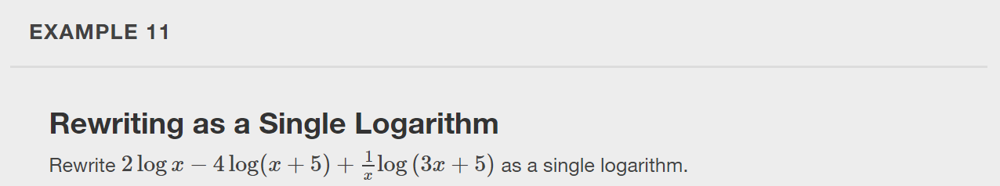

Slide 30
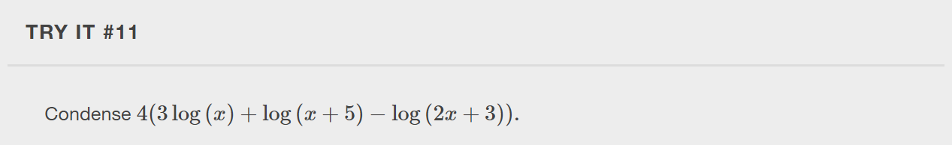

Slide 31
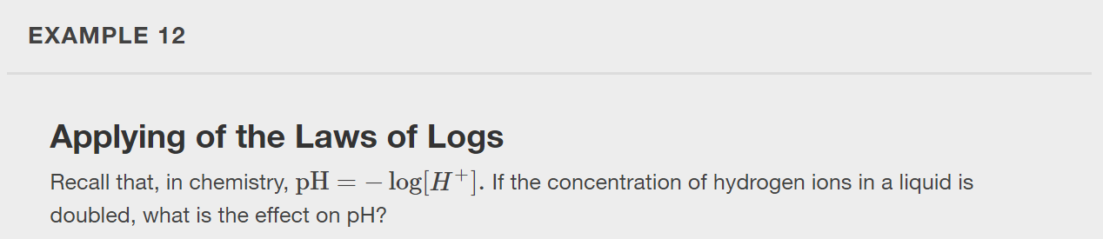

Slide 32
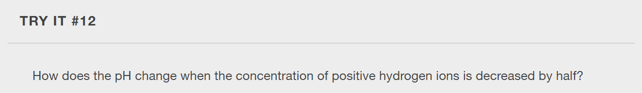

Slide 33
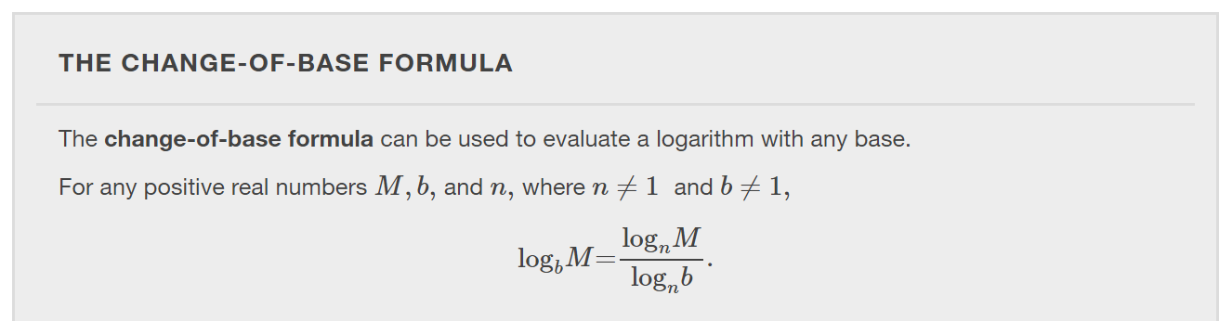
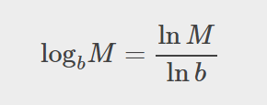
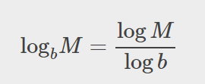

Slide 34
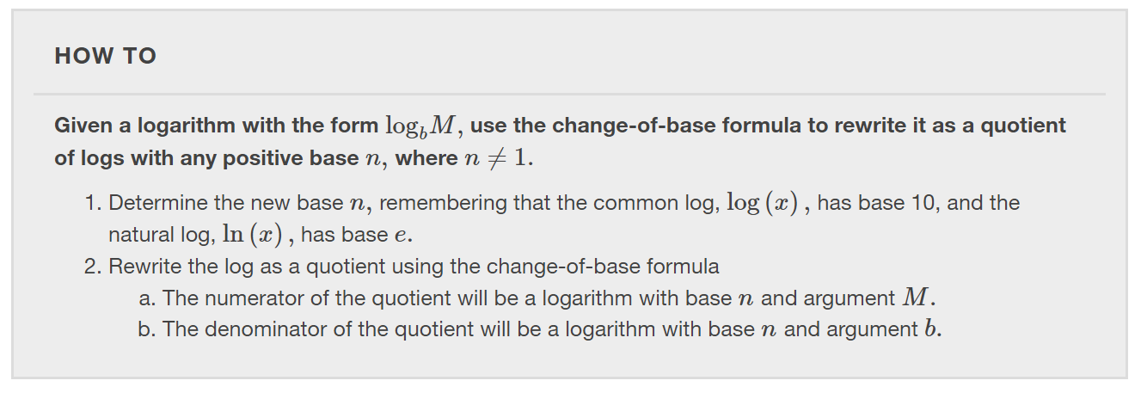

Slide 35
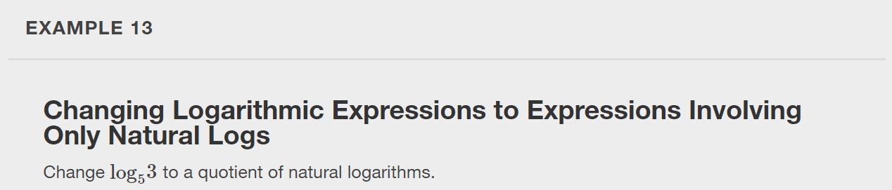

Slide 36
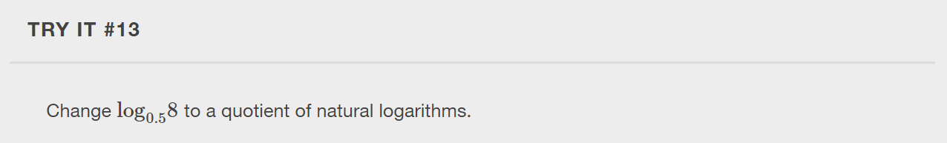

Slide 37
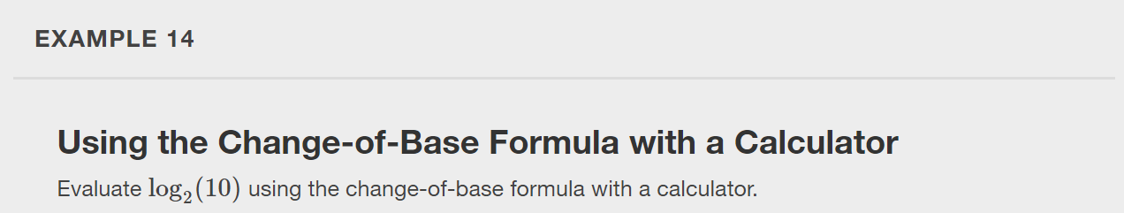
Type in the logarithm above as is into desmos.com/calculator and compare the values.

Slide 38
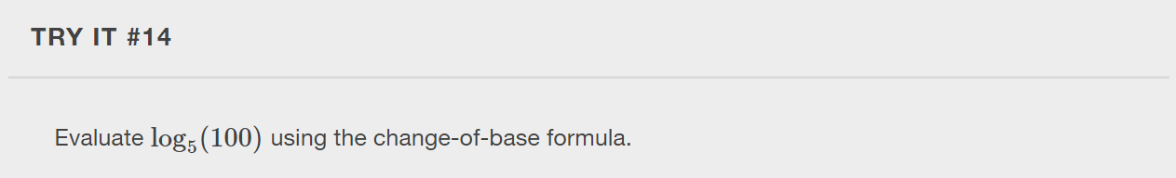
Type in the logarithm above as is into desmos.com/calculator and compare the values.

Slide 39
What did you learn in this section?
Use the product rule for logarithms.
Use the quotient rule for logarithms.
Use the power rule for logarithms.
Expand logarithmic expressions.
Condense logarithmic expressions.
Use the change-of-base formula for logarithms.
Notes:
Do you have any questions?

Slide 40
This resource is an adaptation of the OpenStax Algebra and Trigonometry 2e open textbook and is © Susan Aydelotte under a CC BY-NC-SA 4.0 International license; it may be reproduced or modified for noncommercial purposes only but must be attributed to OpenStax, Rice University and any changes must be noted. Any adaptation must be shared under the same type of license.

