Slide 1

Exponential and Logarithmic Functions
Chapter 6
Algebra and Trigonometry 2e, OpenStax, Jay Abramson
Notes:
Images and notes within these slides are from the OpenStax textbook Algebra and Trigonometry 2e

Slide 2
6.4 Graphs of Logarithmic Functions
Notes:
Images and notes within these slides are from the OpenStax textbook Algebra and Trigonometry 2e

Slide 3
What are the learning objectives for this section?
Identify the domain of a logarithmic function.
Graph logarithmic functions.

Slide 4
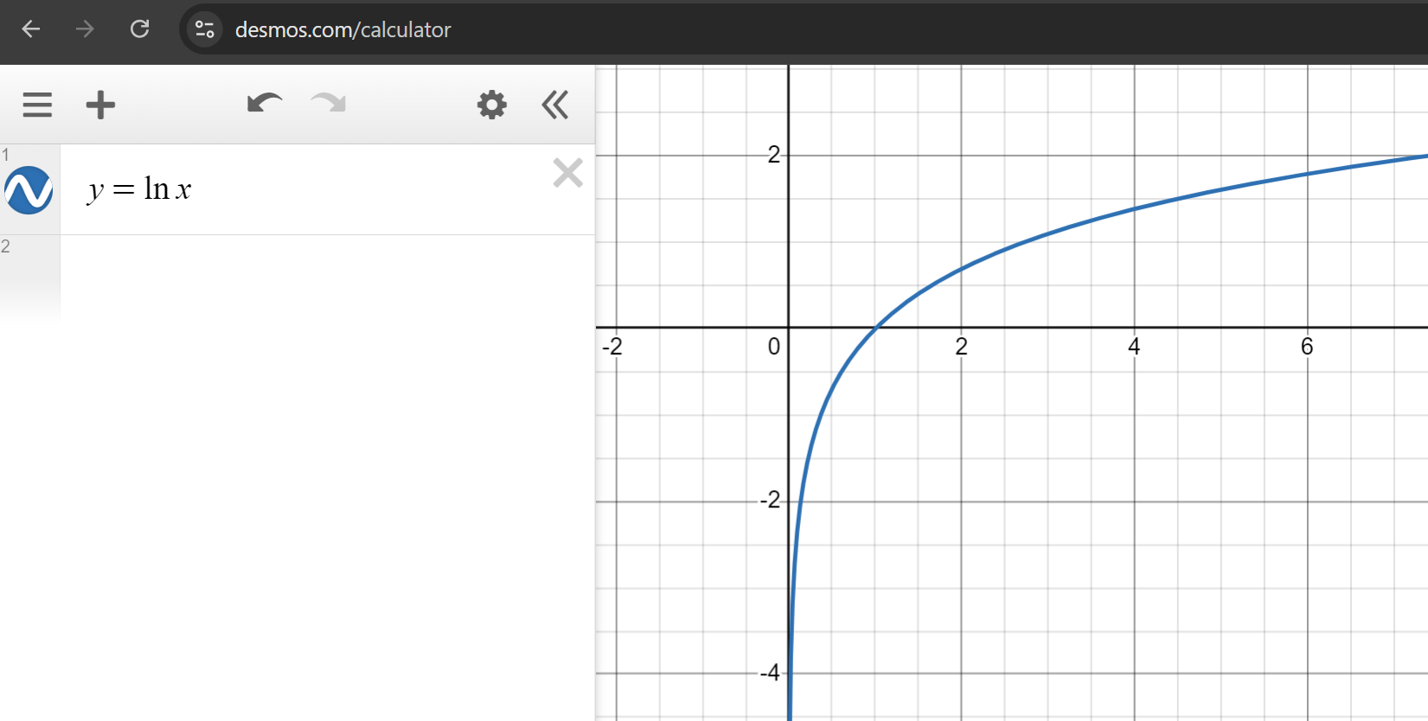
What is the domain of the function? What is the range of the function?

Slide 5
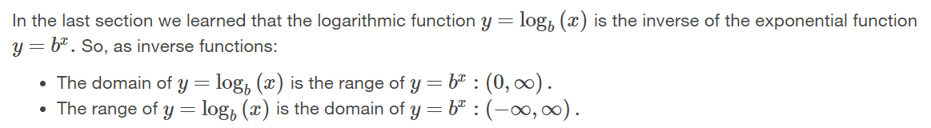
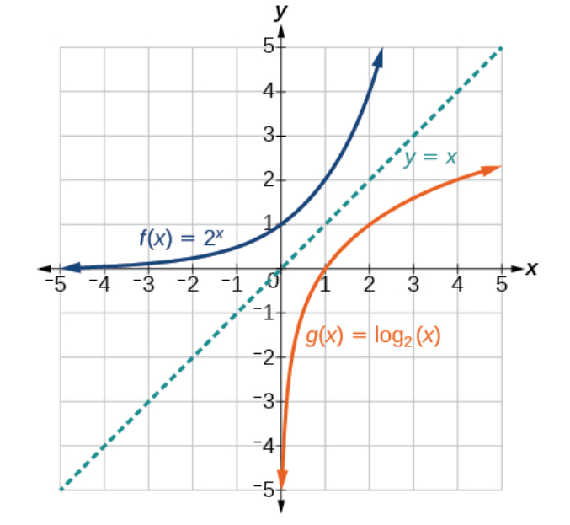

Slide 6
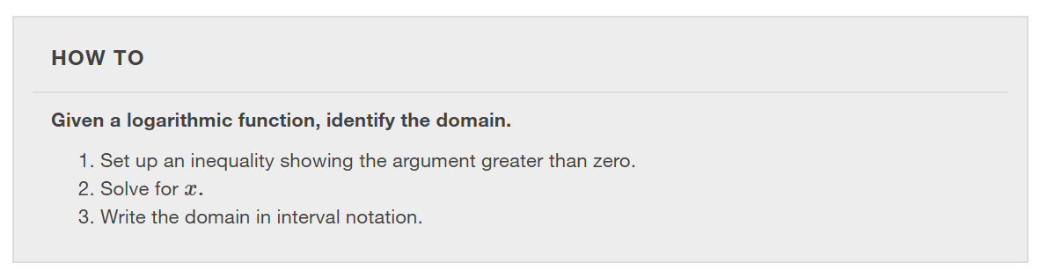

Slide 7
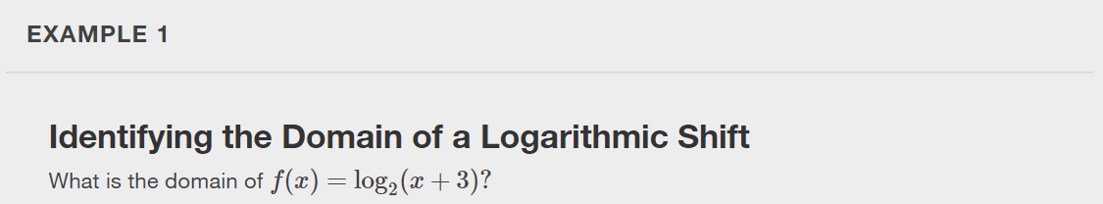

Slide 8


Slide 9
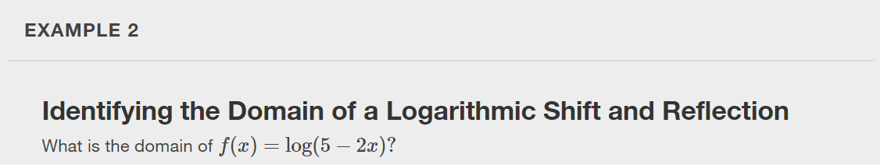

Slide 10


Slide 11
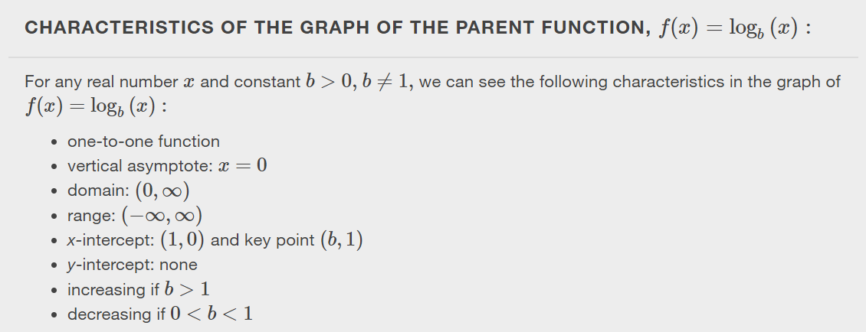
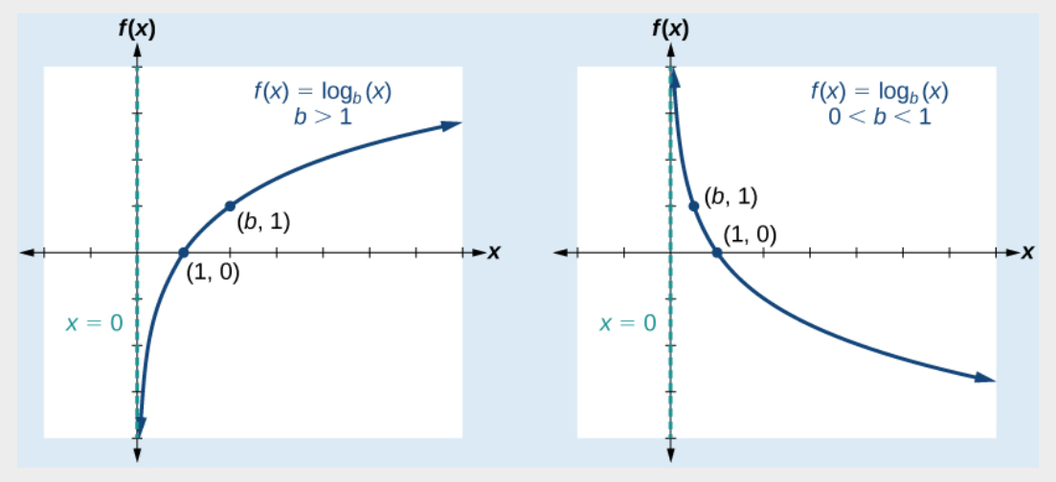

Slide 12
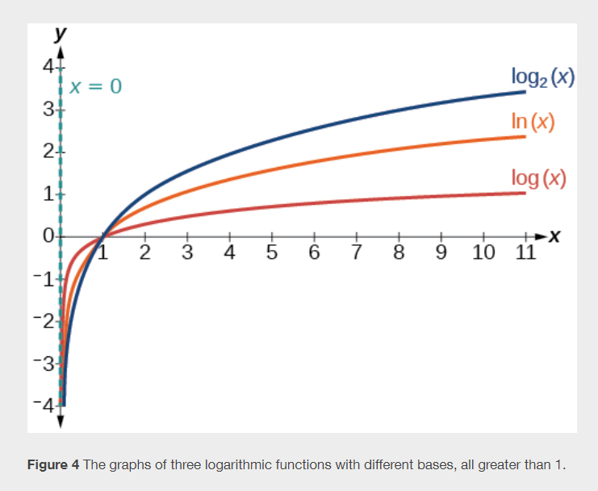

Slide 13
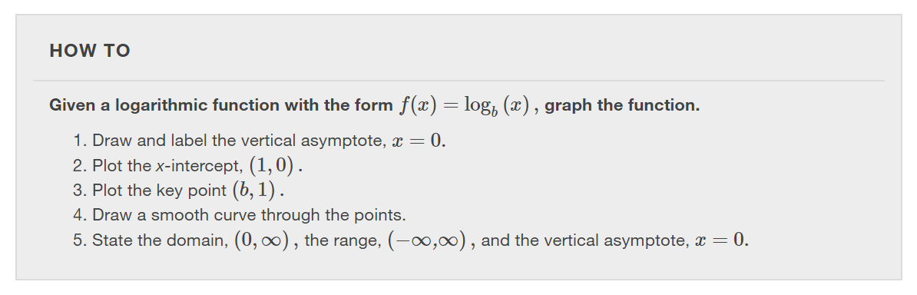

Slide 14
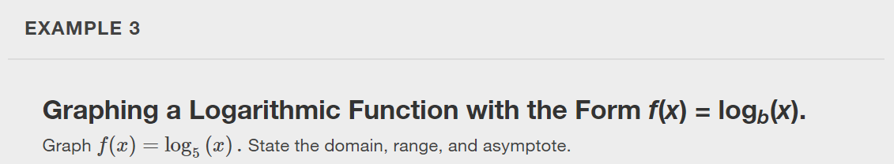

Slide 15
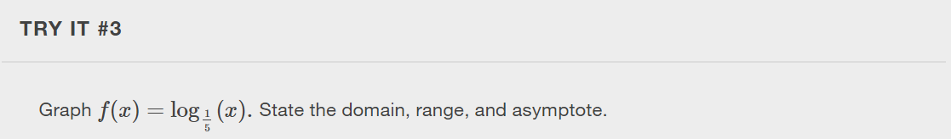

Slide 16
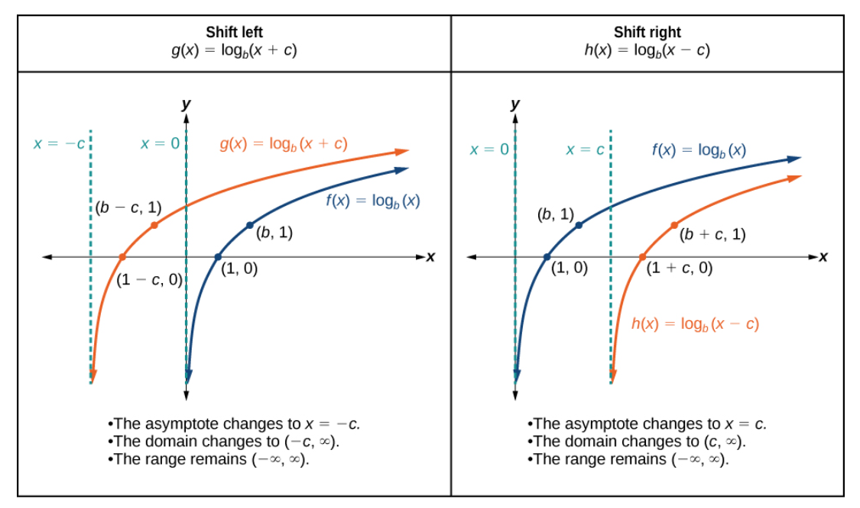

Slide 17
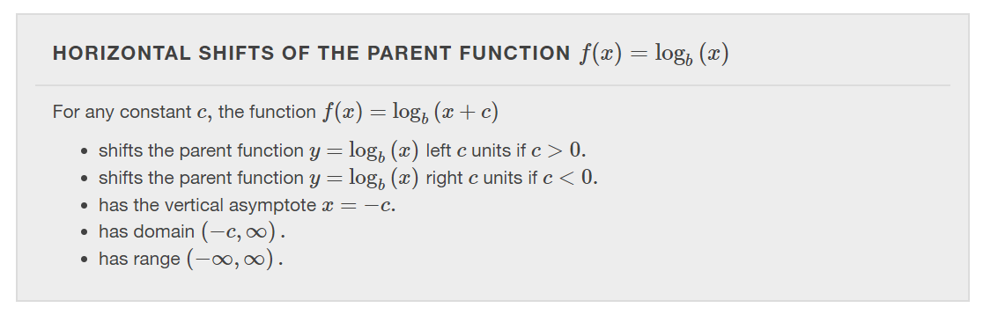

Slide 18
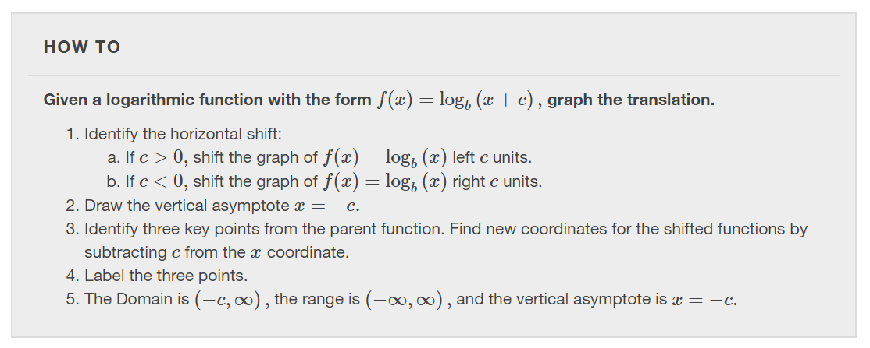

Slide 19
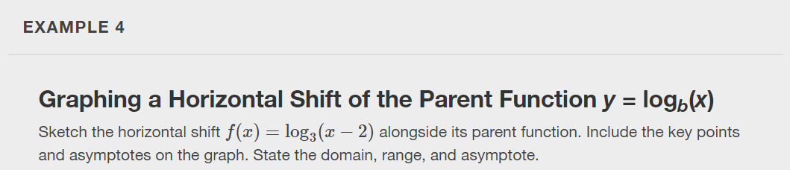

Slide 20
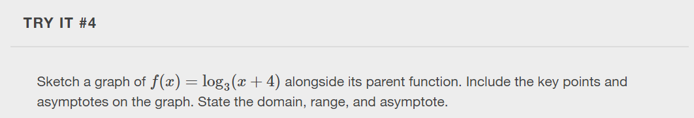

Slide 21
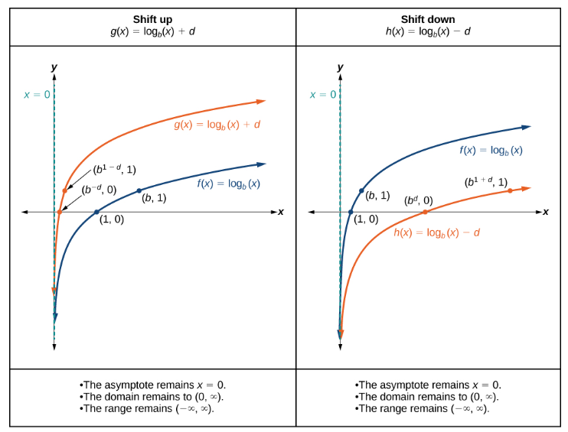

Slide 22
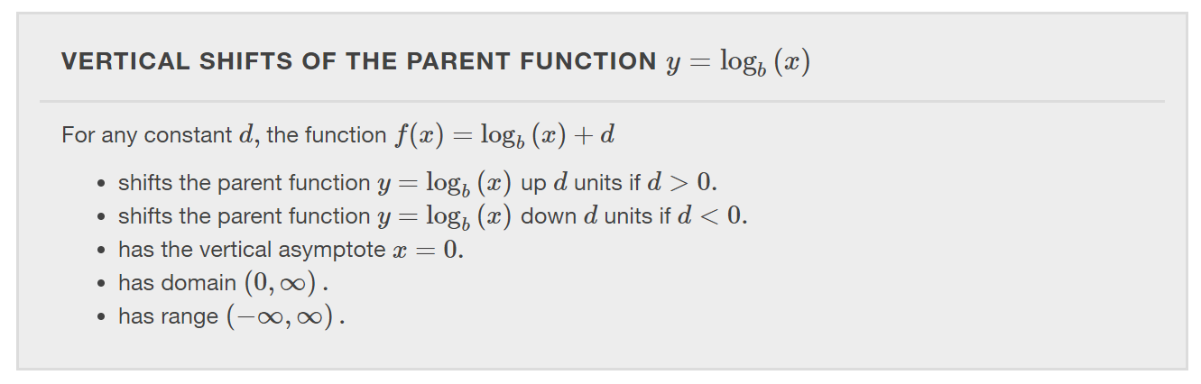

Slide 23
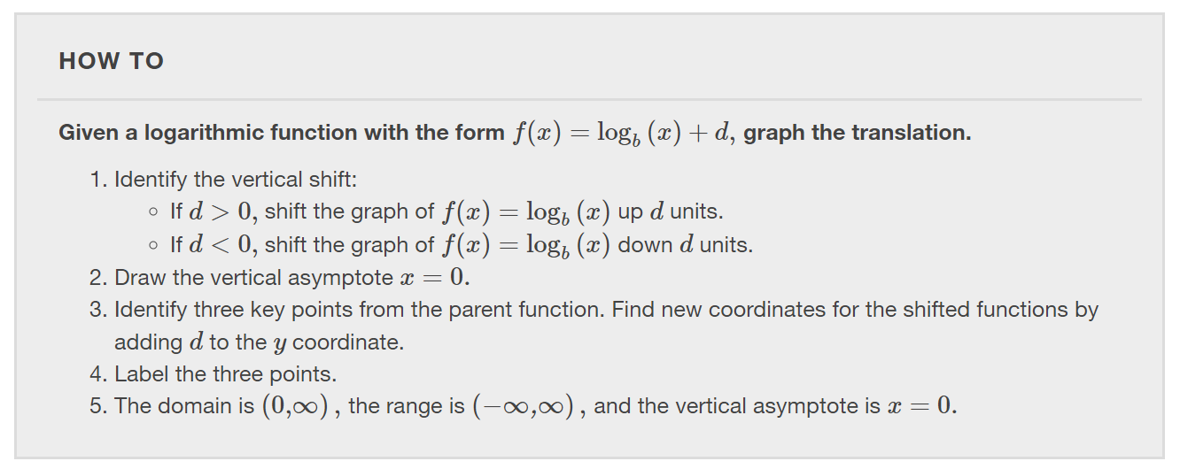

Slide 24
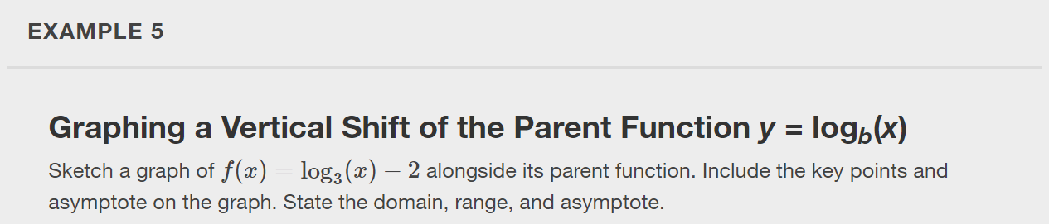

Slide 25
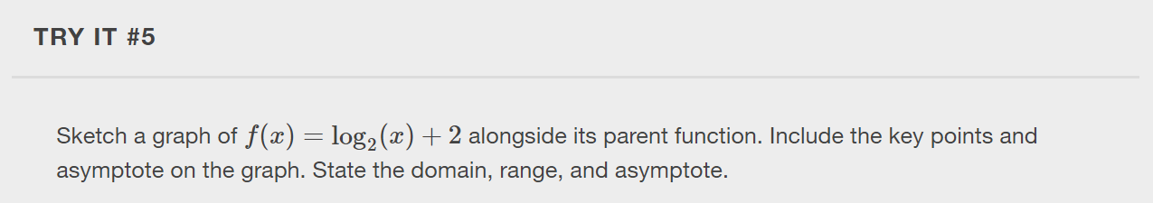

Slide 26
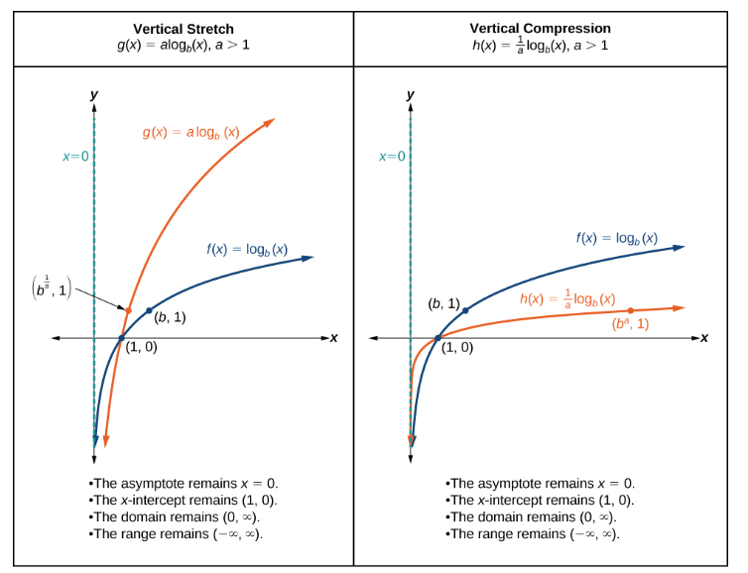

Slide 27
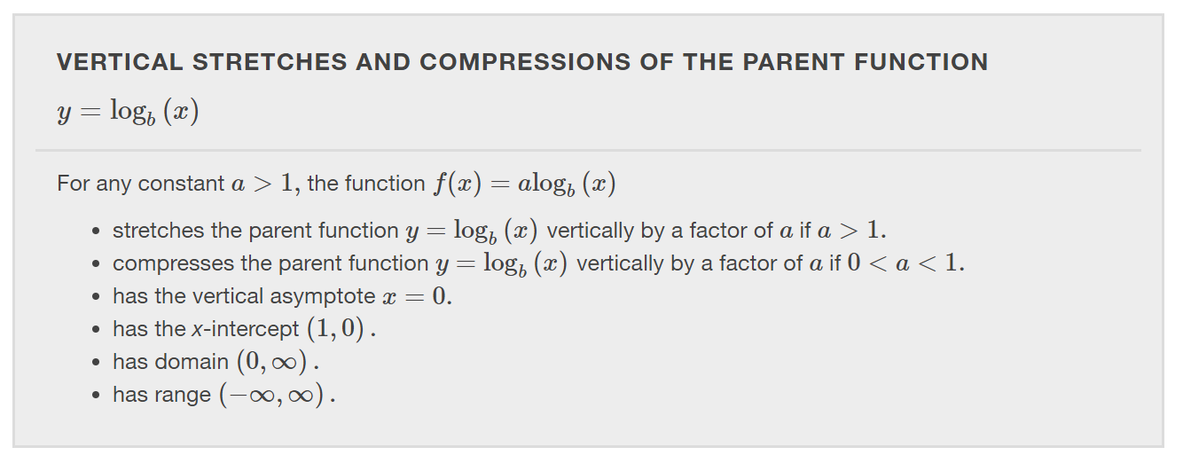

Slide 28
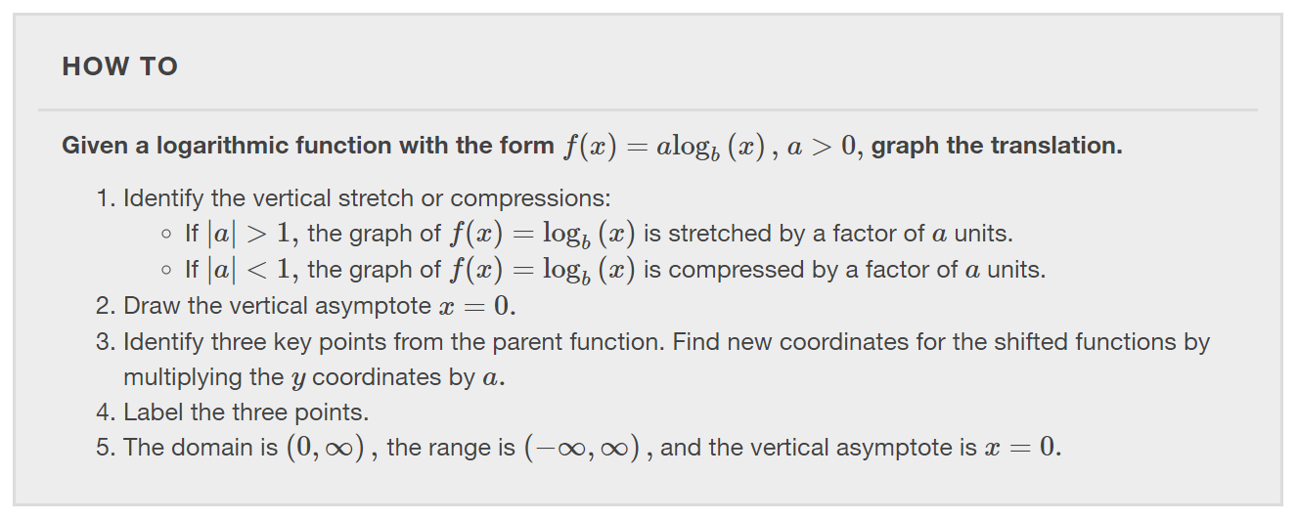

Slide 29
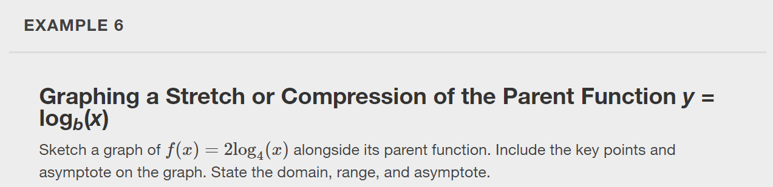

Slide 30
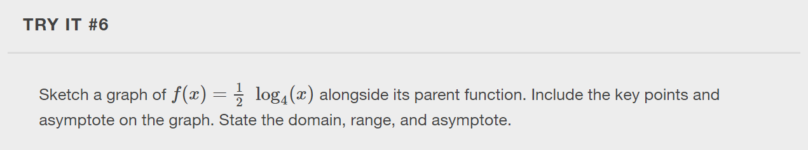

Slide 31
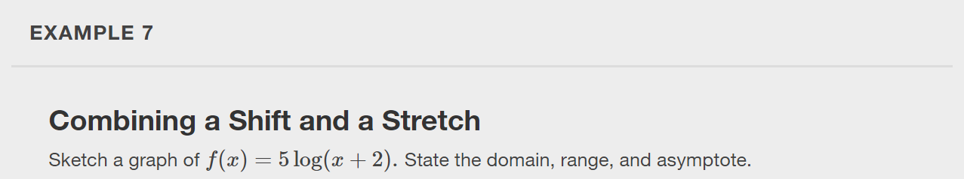

Slide 32


Slide 33
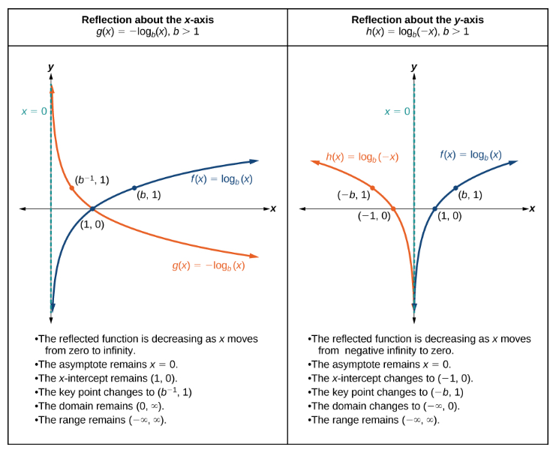

Slide 34
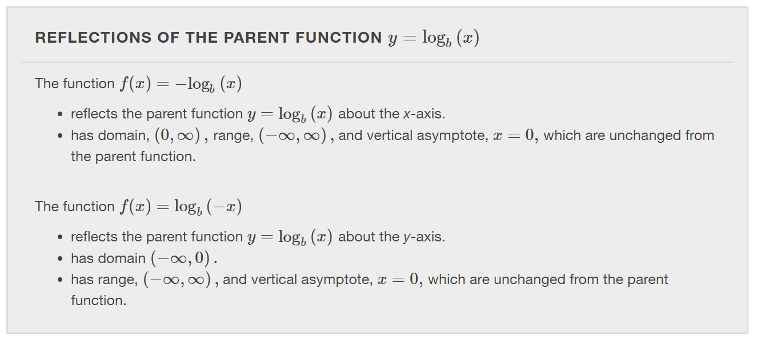

Slide 35
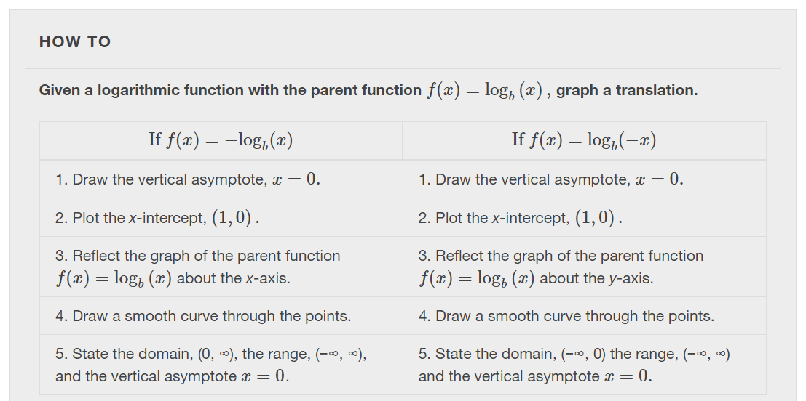

Slide 36
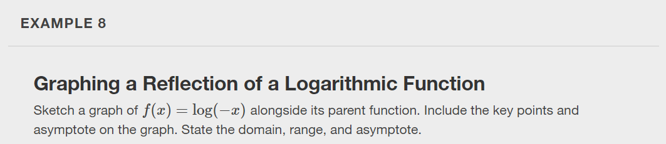

Slide 37
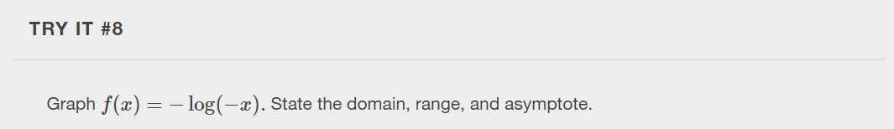

Slide 38
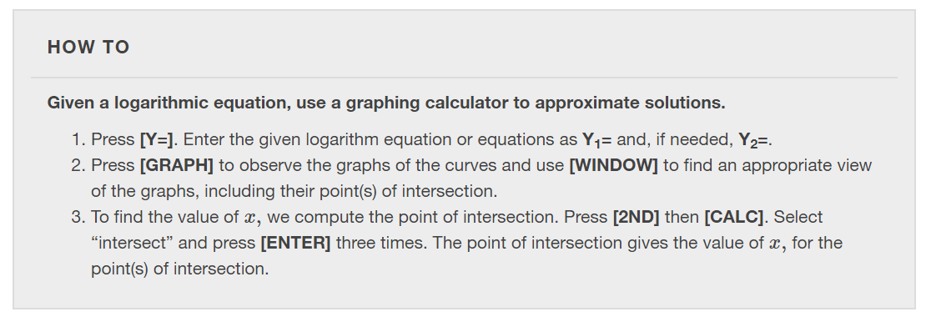

Slide 39
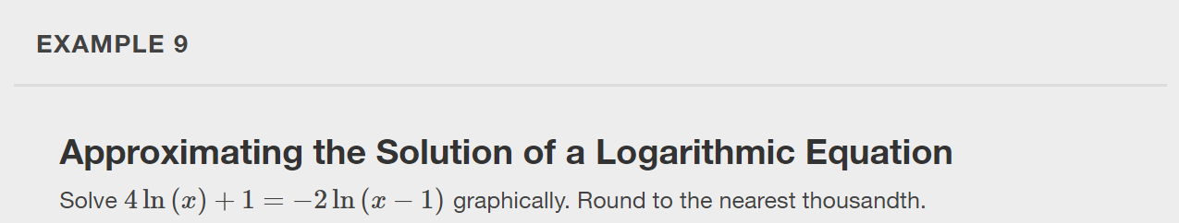

Slide 40
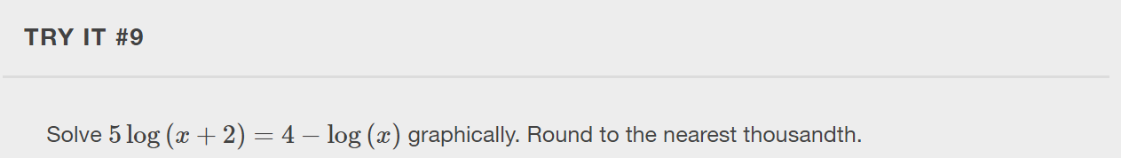

Slide 41
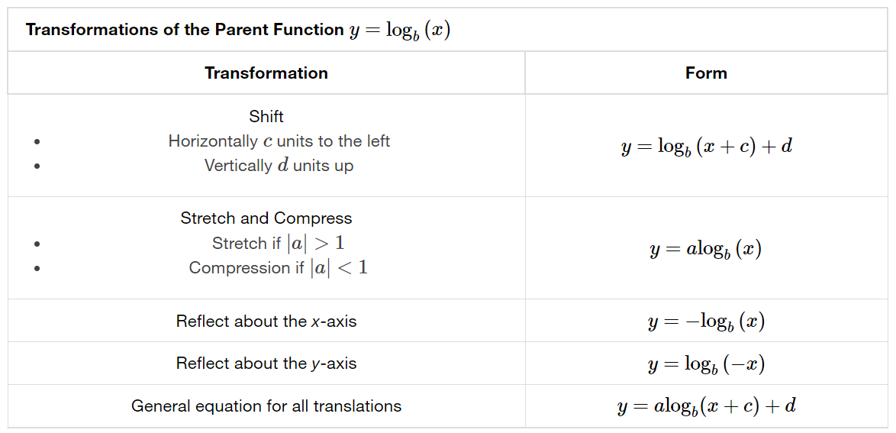

Slide 42
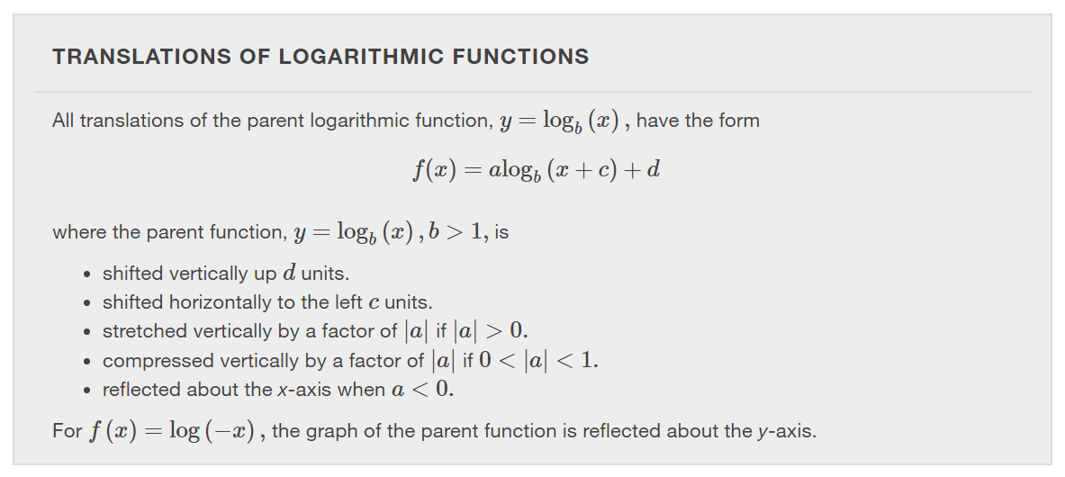

Slide 43
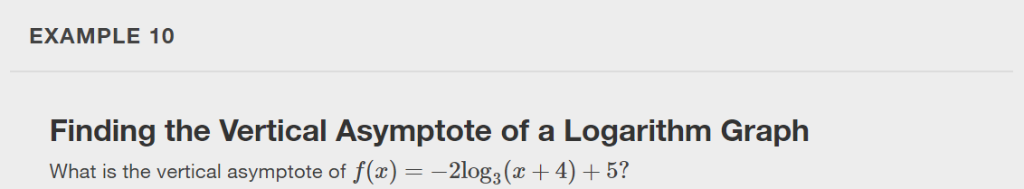

Slide 44


Slide 45
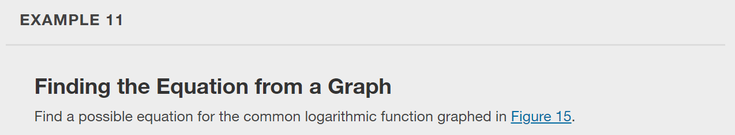
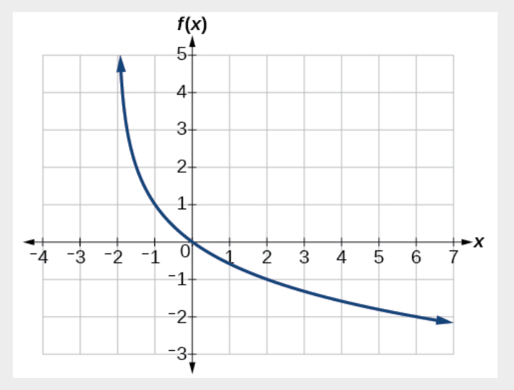

Slide 46

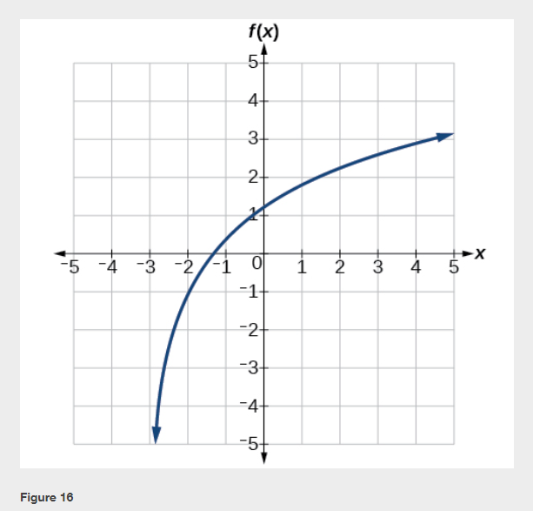

Slide 47
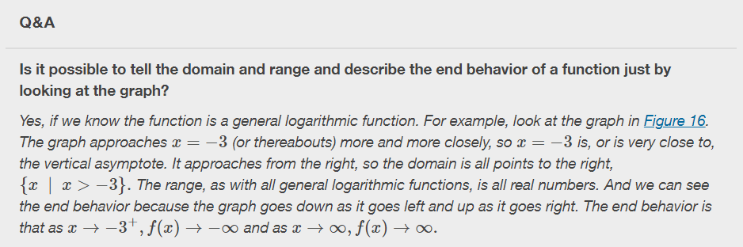

Slide 48
What did you learn in this section?
Identify the domain of a logarithmic function.
Graph logarithmic functions.
Notes:
Do you have any questions?

Slide 49
This resource is an adaptation of the OpenStax Algebra and Trigonometry 2e open textbook and is © Susan Aydelotte under a CC BY-NC-SA 4.0 International license; it may be reproduced or modified for noncommercial purposes only but must be attributed to OpenStax, Rice University and any changes must be noted. Any adaptation must be shared under the same type of license.

