Slide 1
Exponential and Logarithmic Functions
Chapter 6
Algebra and Trigonometry 2e, OpenStax, Jay Abramson
Notes:
Images and notes within these slides are from the OpenStax textbook Algebra and Trigonometry 2e

Slide 2
6.1 Exponential Functions
Notes:
Images and notes within these slides are from the OpenStax textbook Algebra and Trigonometry 2e

Slide 3
What are the learning objectives for this section?
Evaluate exponential functions.
Find the equation of an exponential function.
Use compound interest formulas.
Evaluate exponential functions with base $e$.

Slide 5
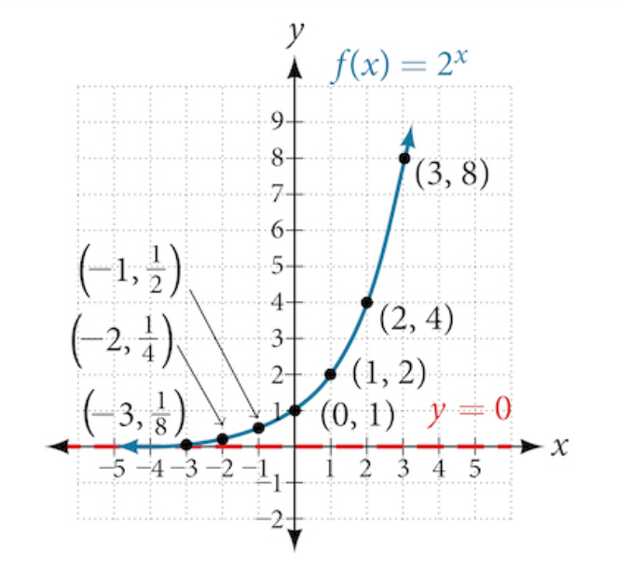

Slide 10
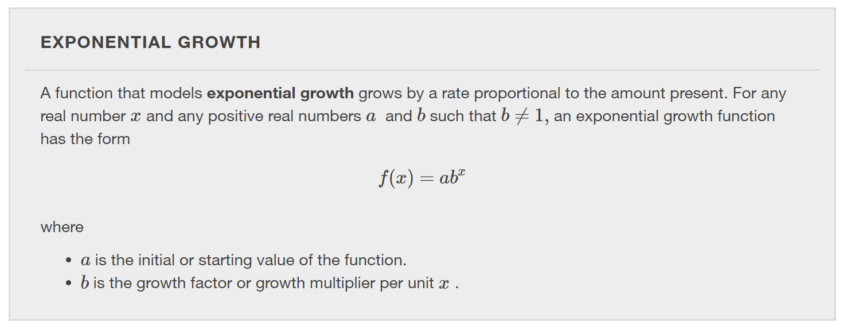

Slide 20
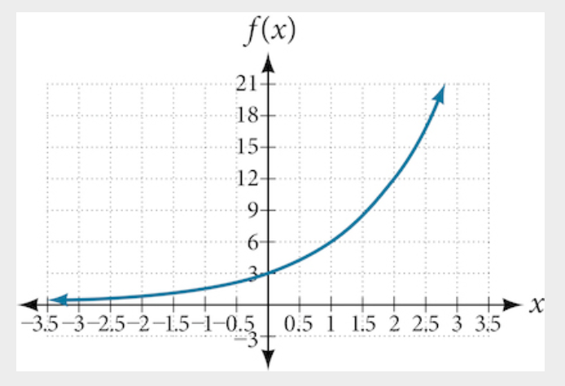

Slide 21
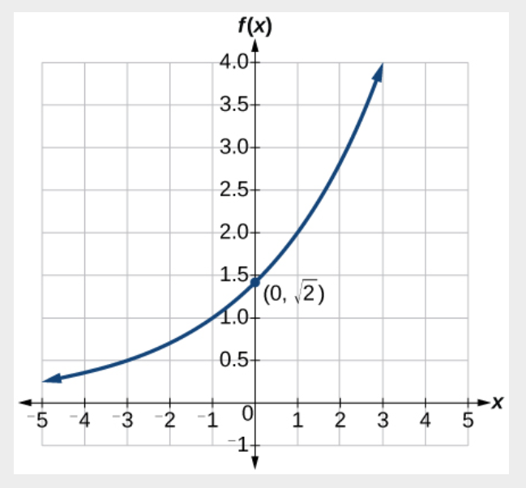

Slide 23
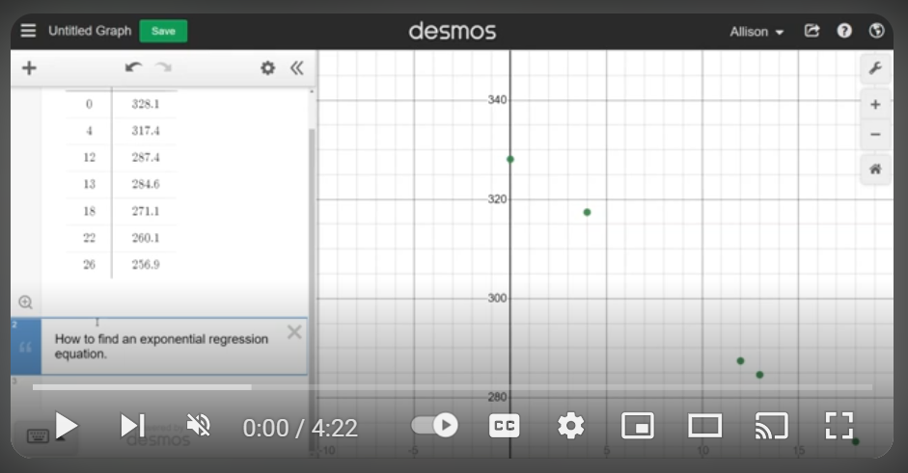
How to use desmos.com/calculator to find an exponential regression equation
Watch the video at https://youtu.be/Pyedx6dLfYc?si=gcYKYV4p_dYD0HYS
Note: You can copy and paste a table of data into desmos.com/calculator or create
a new table and type in the data values.

Slide 26
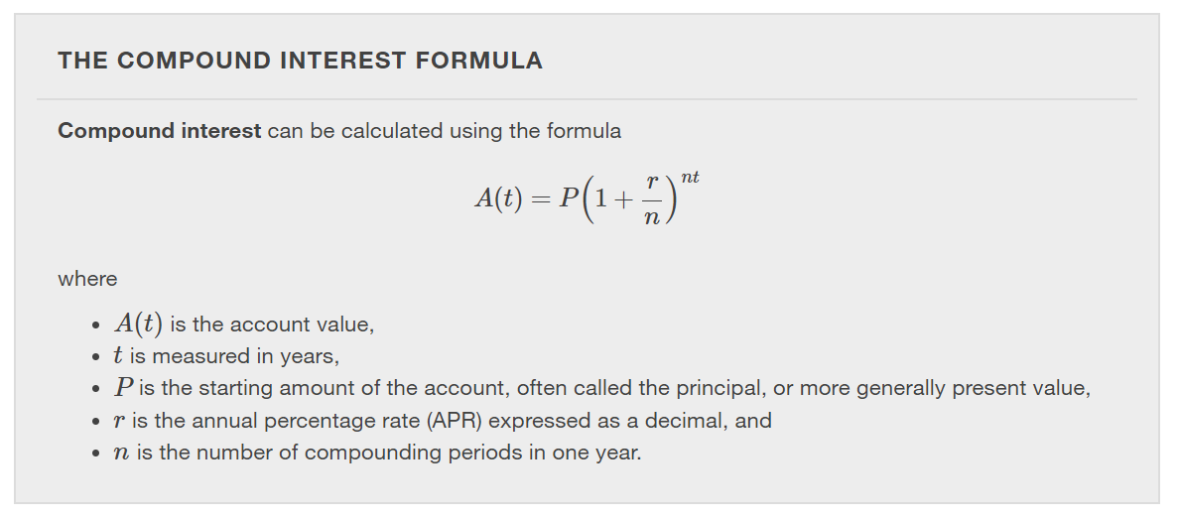

Slide 41
What did you learn in this section?
Evaluate exponential functions.
Find the equation of an exponential function.
Use compound interest formulas.
Evaluate exponential functions with base $e$.
Notes:
Do you have any questions?

Slide 42
This resource is an adaptation of the OpenStax Algebra and Trigonometry 2e open textbook and is © Susan Aydelotte under a CC BY-NC-SA 4.0 International license; it may be reproduced or modified for noncommercial purposes only but must be attributed to OpenStax, Rice University and any changes must be noted. Any adaptation must be shared under the same type of license.

