Slide 1

Polynomial and Rational Functions
Chapter 5
Algebra and Trigonometry 2e, OpenStax, Jay Abramson
Notes:
Images and notes within these slides are from the OpenStax textbook Algebra and Trigonometry 2e

Slide 2
5.7 Inverses and Radical Functions
Notes:
Images and notes within these slides are from the OpenStax textbook Algebra and Trigonometry 2e

Slide 3
What are the learning objectives for this section?
Find the inverse of an invertible polynomial function.
Restrict the domain to find the inverse of a polynomial function.
Find inverse function of a radical function.
Use radical functions to solve application problems.

Slide 4
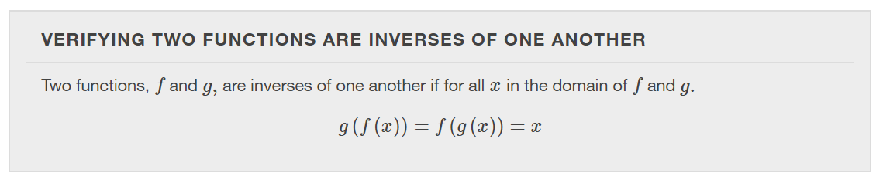

Slide 5
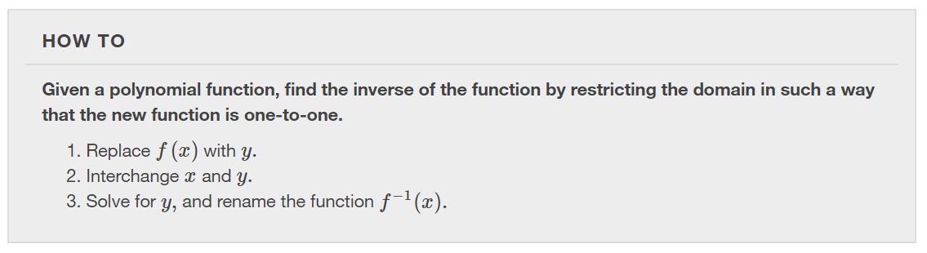

Slide 6
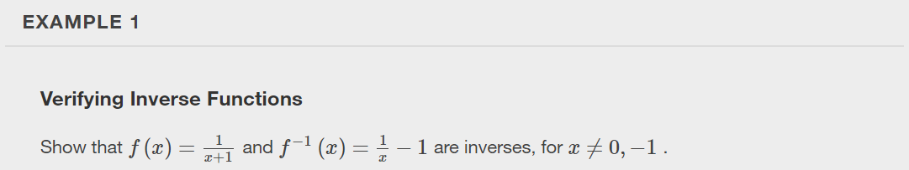

Slide 7


Slide 8
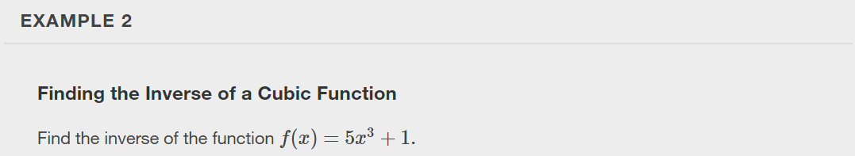

Slide 9
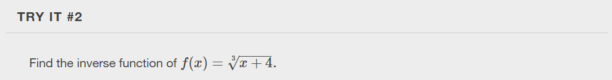

Slide 10
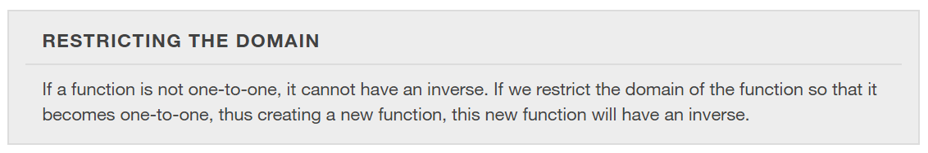

Slide 11
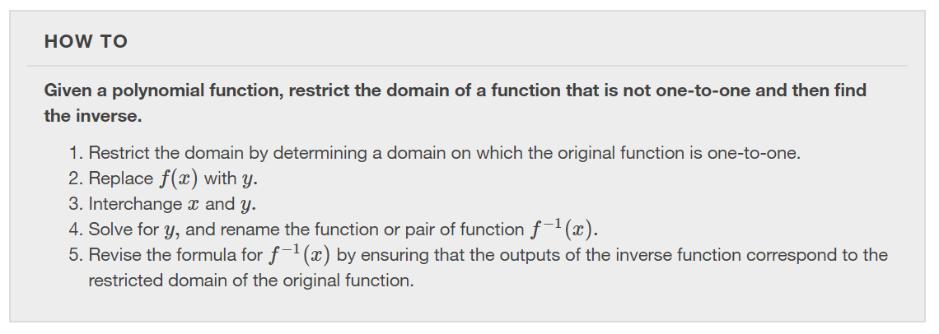

Slide 12
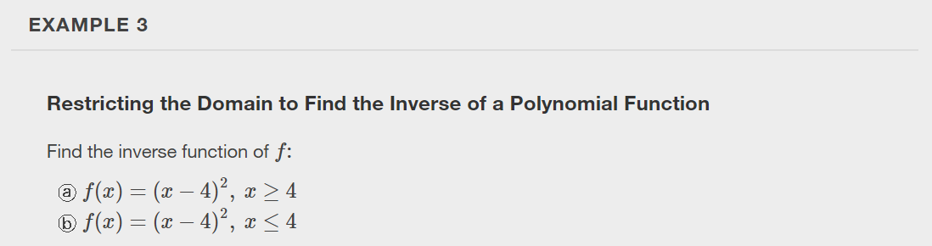

Slide 13
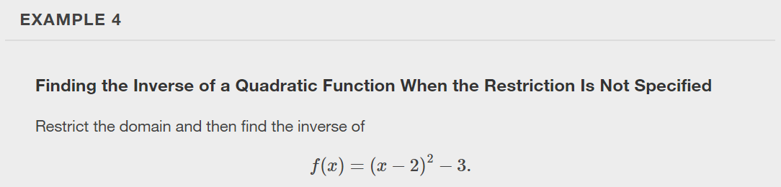

Slide 14
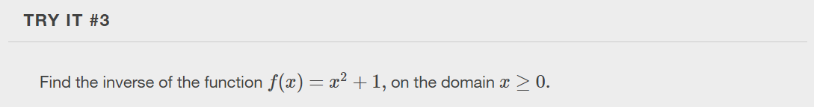

Slide 15
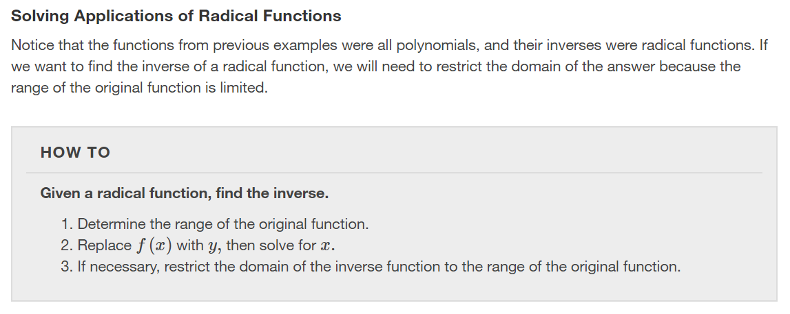

Slide 16
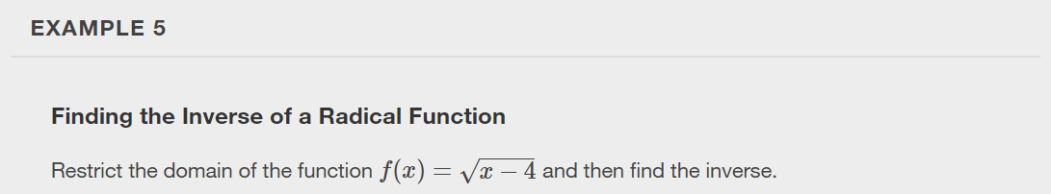

Slide 17
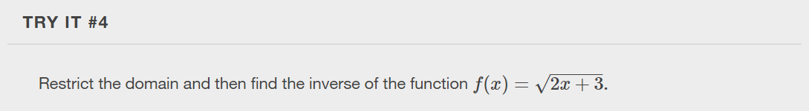

Slide 18
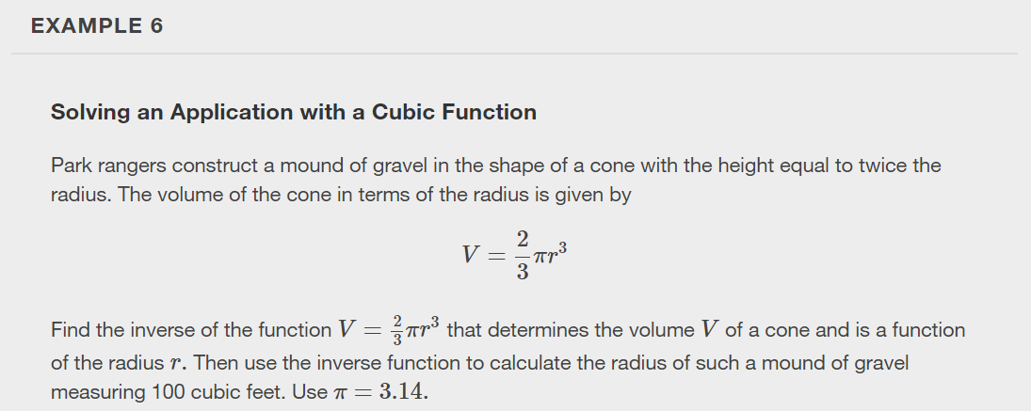

Slide 19
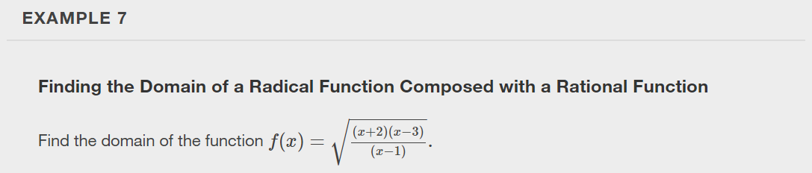

Slide 20
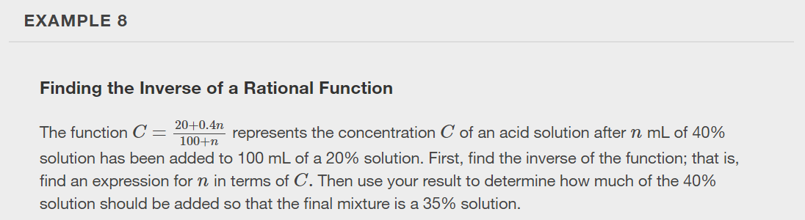

Slide 21
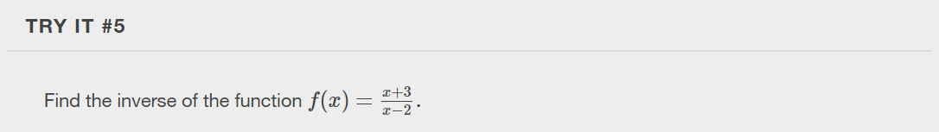

Slide 22
What did you learn in this section?
Find the inverse of an invertible polynomial function.
Restrict the domain to find the inverse of a polynomial function.
Find inverse function of a radical function.
Use radical functions to solve application problems.
Notes:
Do you have any questions?

Slide 23
This resource is an adaptation of the OpenStax Algebra and Trigonometry 2e open textbook and is © Susan Aydelotte under a CC BY-NC-SA 4.0 International license; it may be reproduced or modified for noncommercial purposes only but must be attributed to OpenStax, Rice University and any changes must be noted. Any adaptation must be shared under the same type of license.

