Slide 1

Polynomial and Rational Functions
Chapter 5
Algebra and Trigonometry 2e, OpenStax, Jay Abramson
Notes:
Images and notes within these slides are from the OpenStax textbook Algebra and Trigonometry 2e

Slide 2
5.6 Rational Functions
Notes:
Images and notes within these slides are from the OpenStax textbook Algebra and Trigonometry 2e

Slide 3
What are the learning objectives for this section?
Use arrow notation.
Solve applied problems involving rational functions.
Find the domains of rational functions.
Identify vertical asymptotes.
Identify horizontal asymptotes.
Graph rational functions.

Slide 4
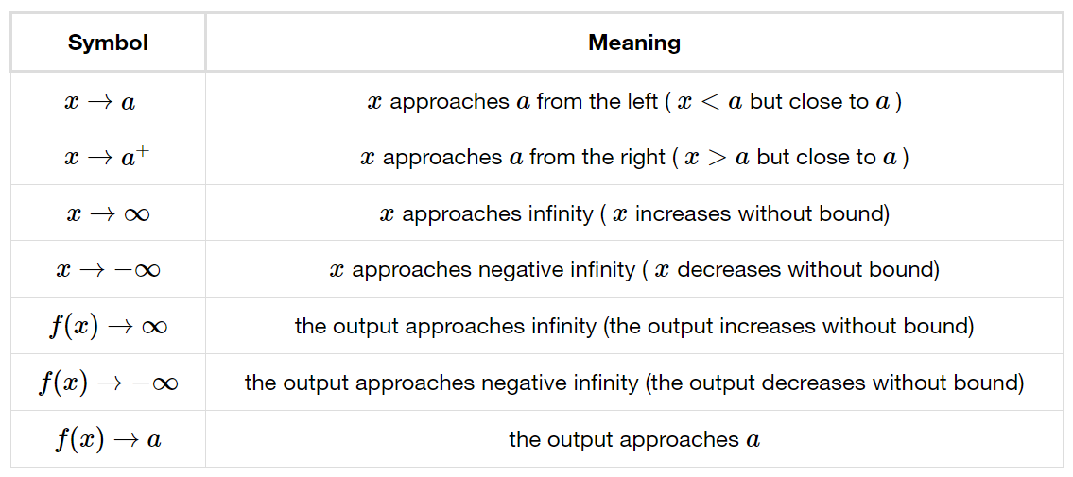
Using Arrow Notation
We use arrow notation to show that x or f(x) is approaching a particular value.
Notes:
we use arrow notation to show that x or f(x) is approaching a particular value.

Slide 5
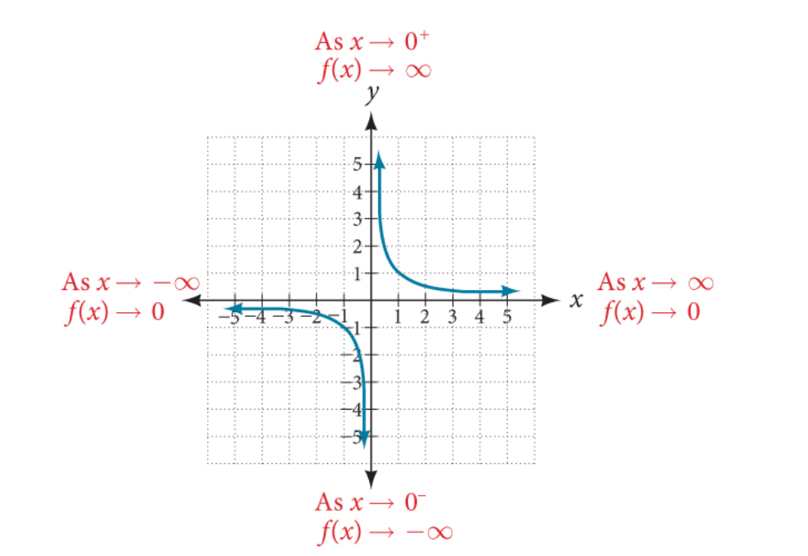
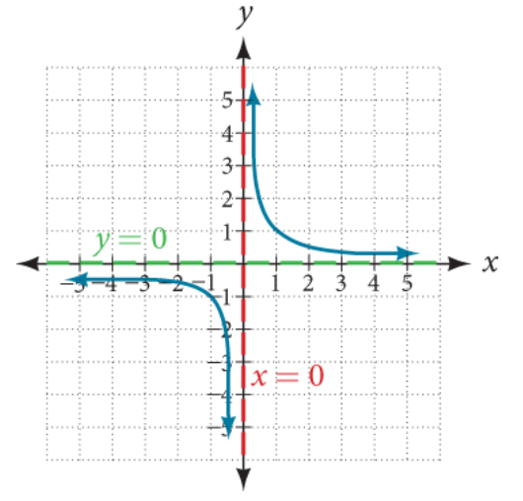
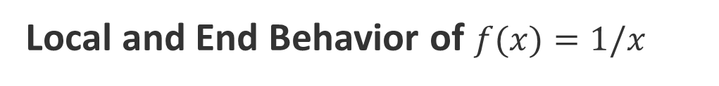
Local and End Behavior of $f(x)=1/x$
Notes:
Notice that the graph approached the vertical line x=0 but never crosses it. This means the graph of the function has a vertical asymptote at x=0.
Also notice that the value of the function approaches 0 as x increases and as x decreases. This means the graph of the function has a horizontal asymptote at y=0.

Slide 6
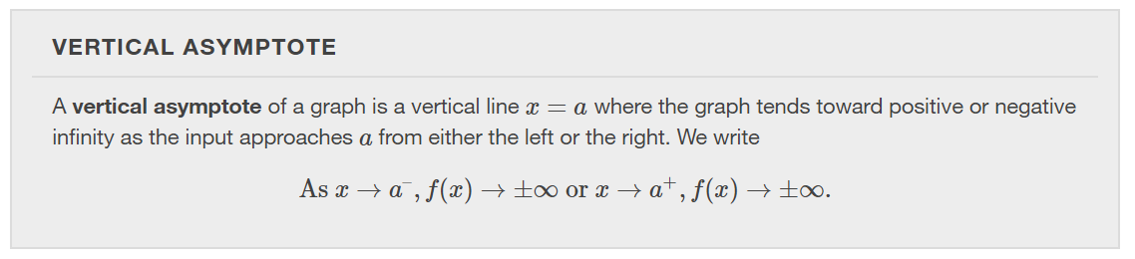
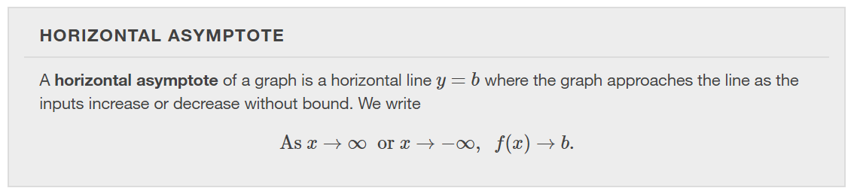

Slide 7
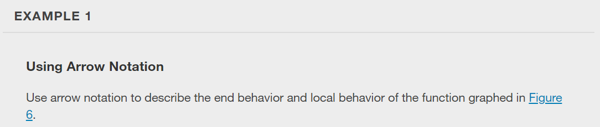
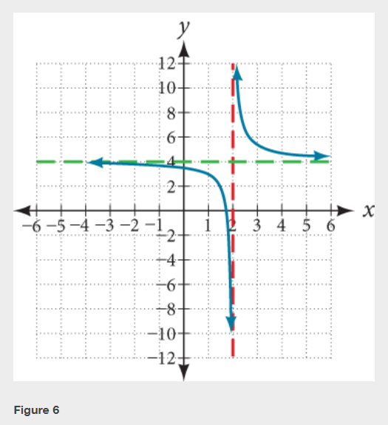

Slide 8
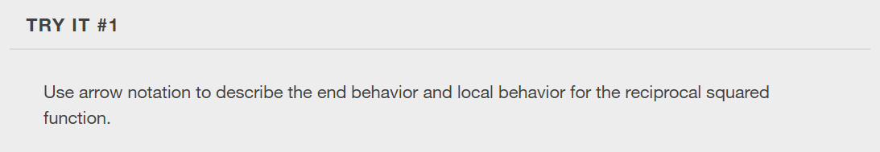

Slide 9
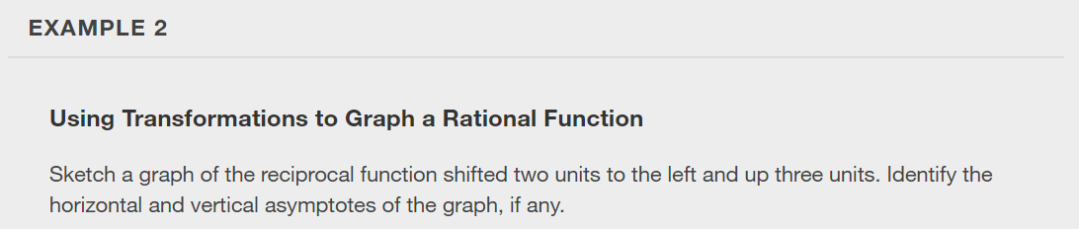

Slide 10
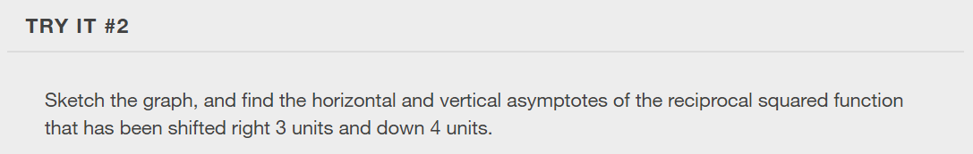

Slide 11
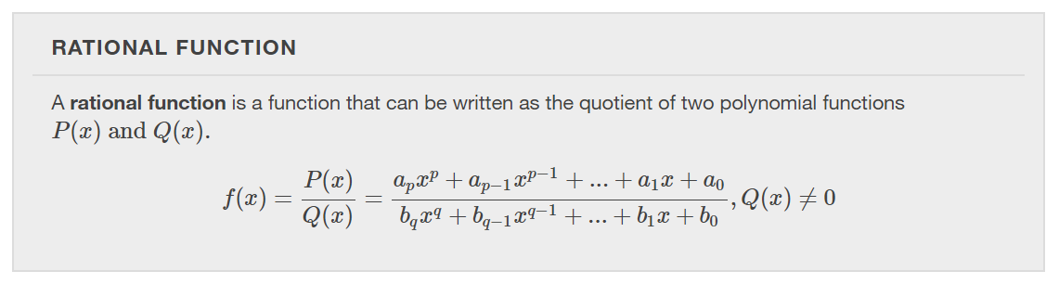

Slide 12
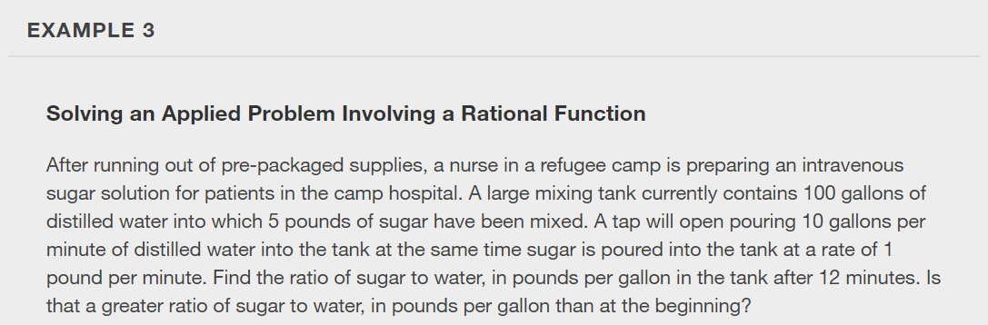

Slide 13
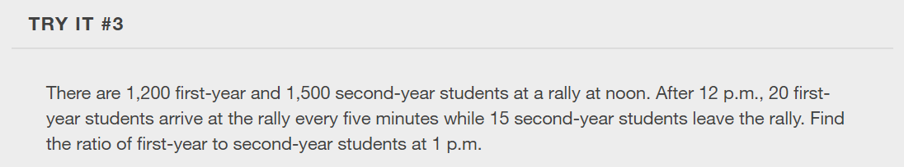

Slide 14
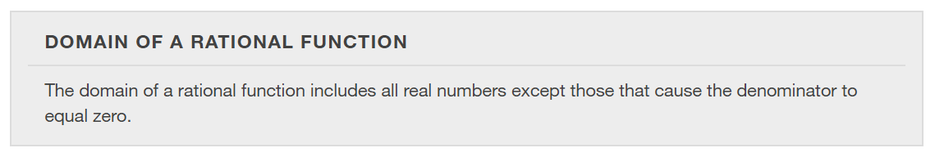

Slide 15
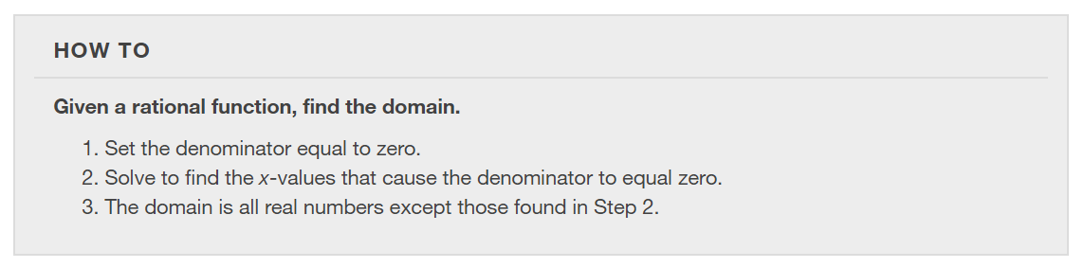

Slide 16
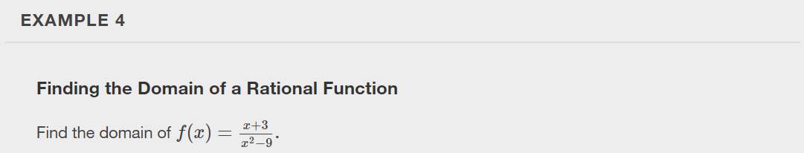

Slide 17
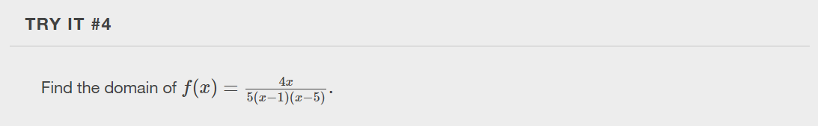

Slide 18
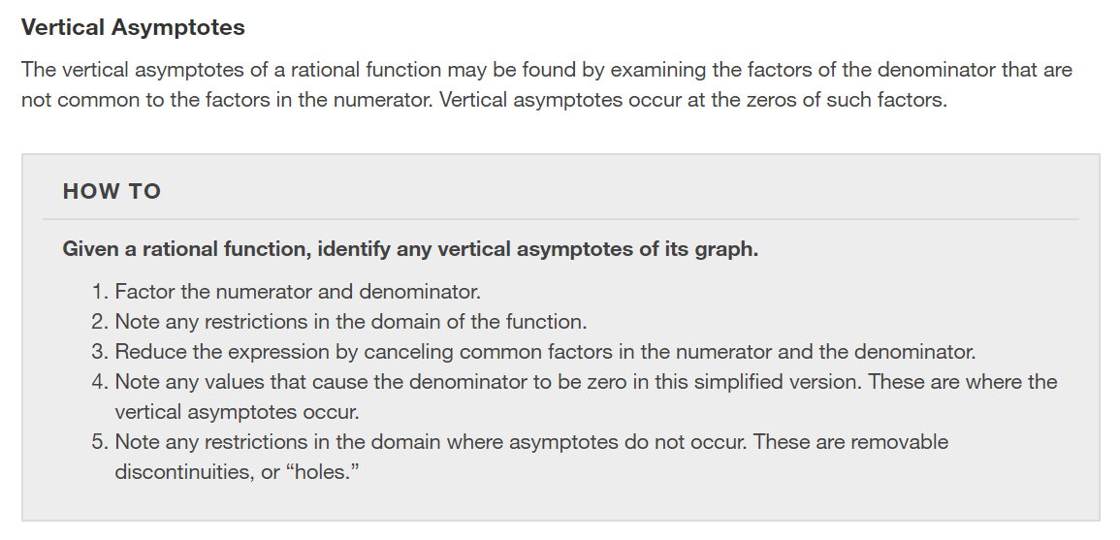

Slide 19
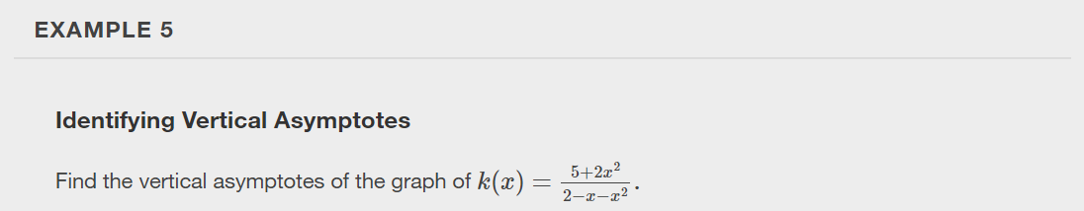

Slide 20
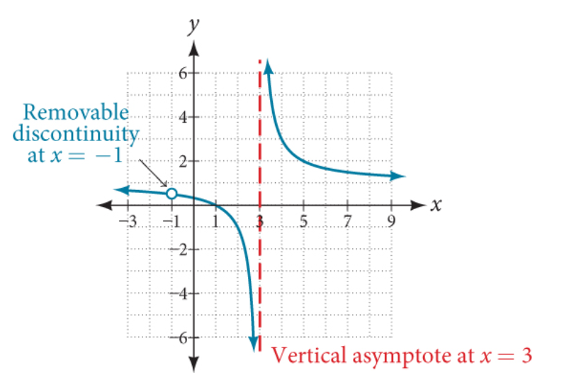

Removable Discontinuities
Occasionally, a graph will contain a hole: a single point where the graph is not defined, indicated by an open circle. We call such a hole a removable discontinuity.

Slide 21
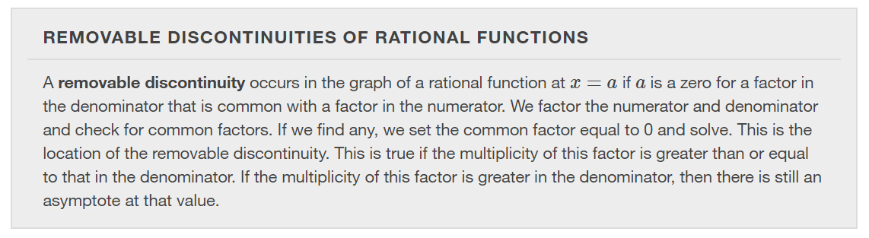

Slide 22
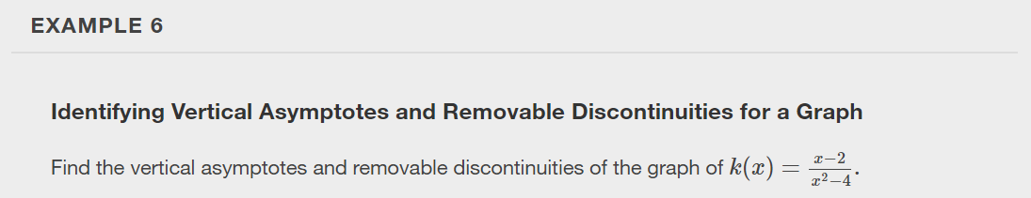

Slide 23
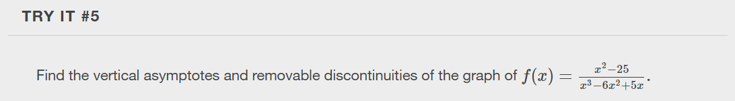

Slide 24
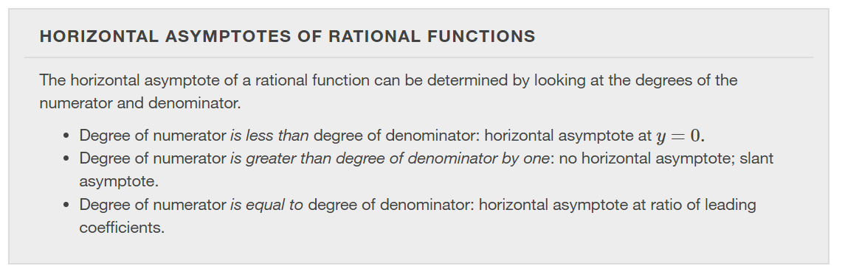

Slide 25
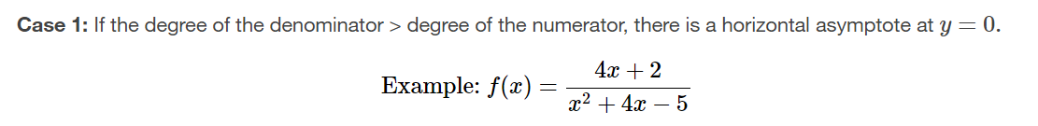
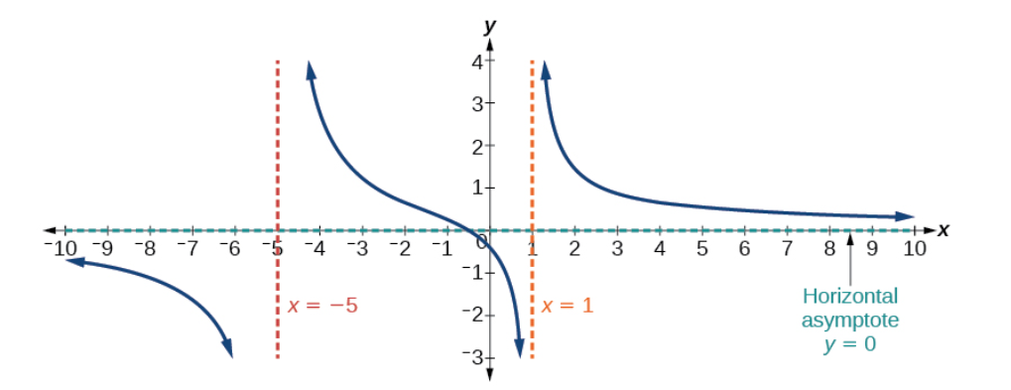

Slide 26
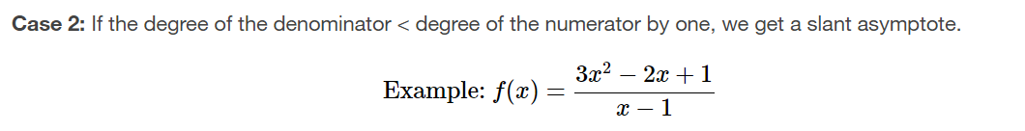
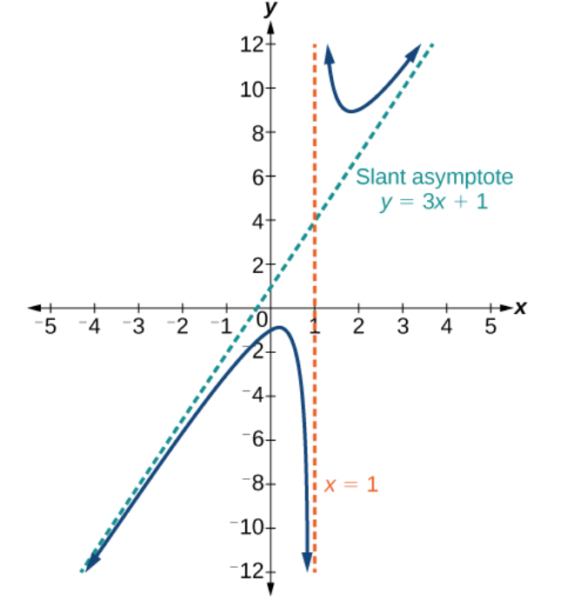

Slide 27
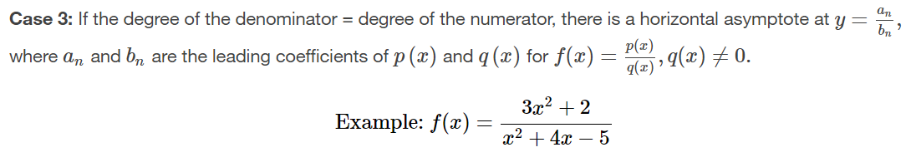
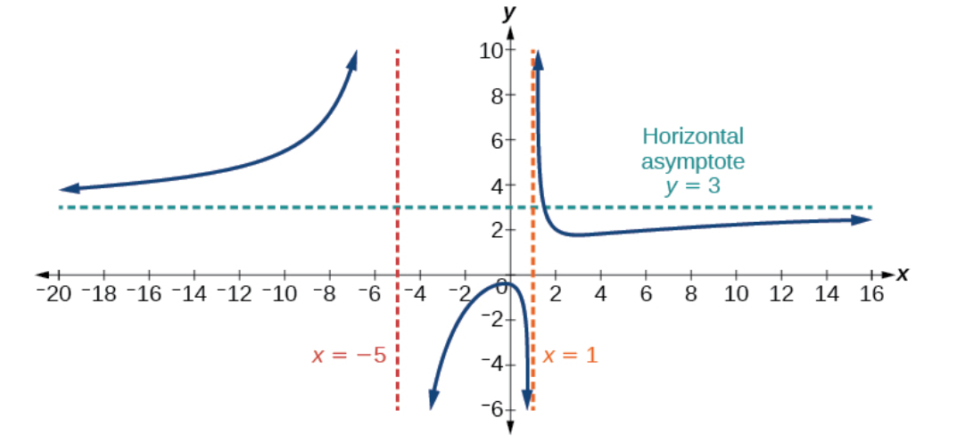

Slide 28
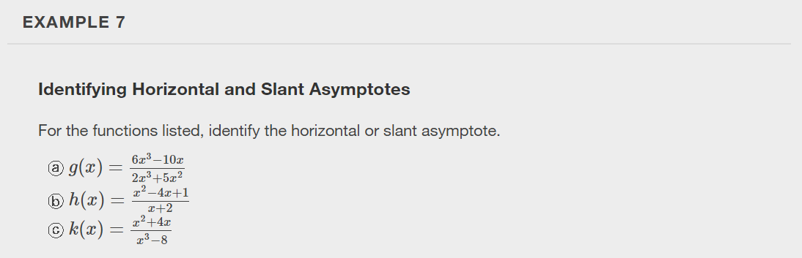

Slide 29
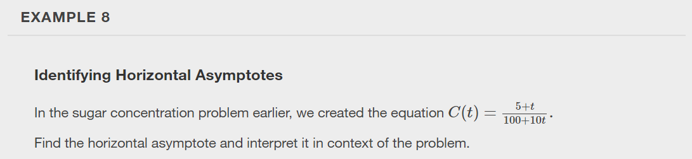

Slide 30
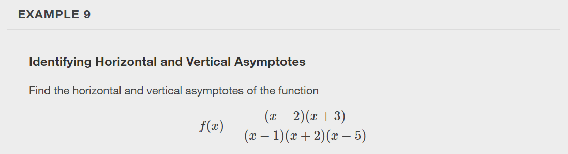

Slide 31
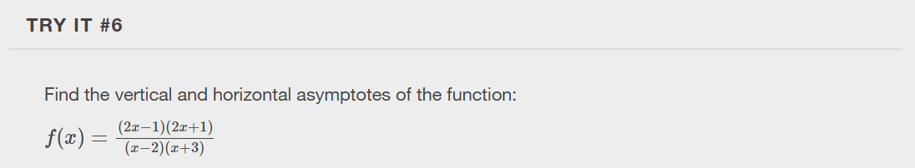

Slide 32
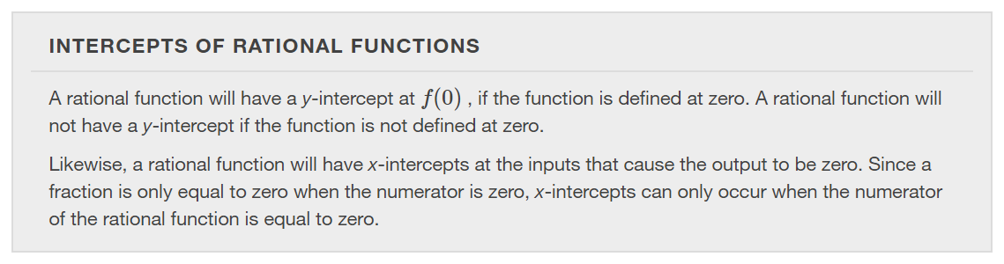

Slide 33
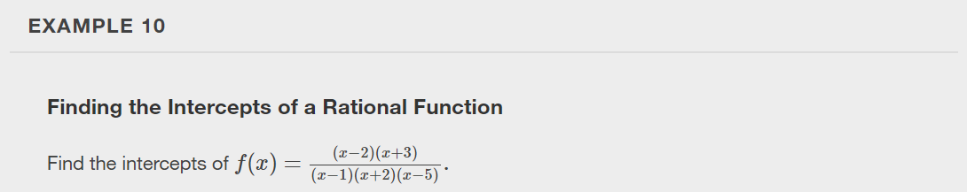

Slide 34
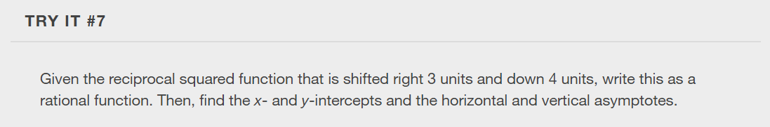

Slide 35
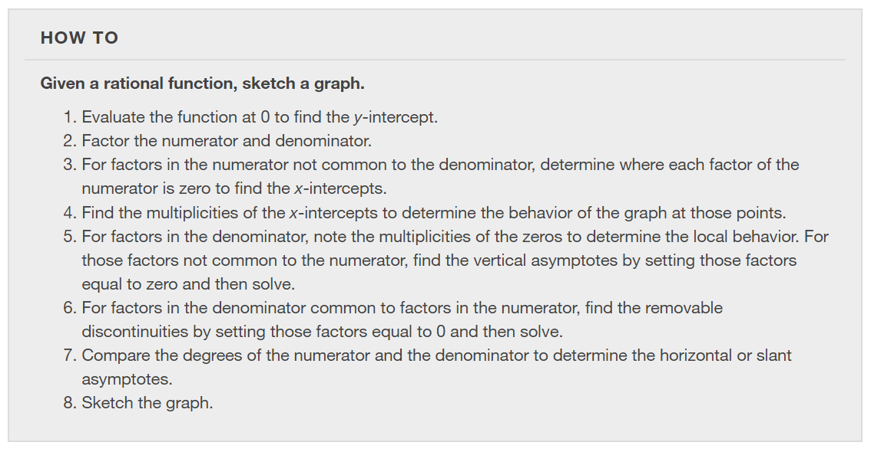

Slide 36
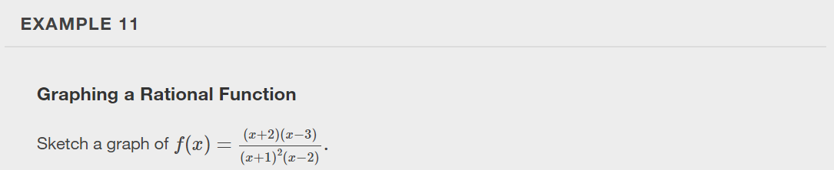

Slide 37
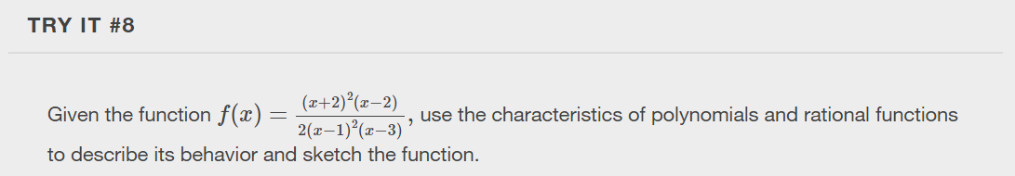

Slide 38
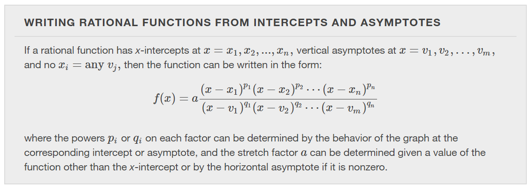

Slide 39
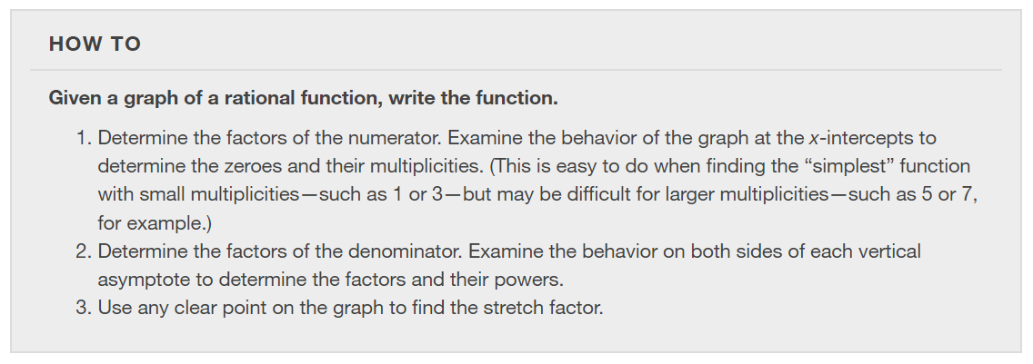

Slide 40
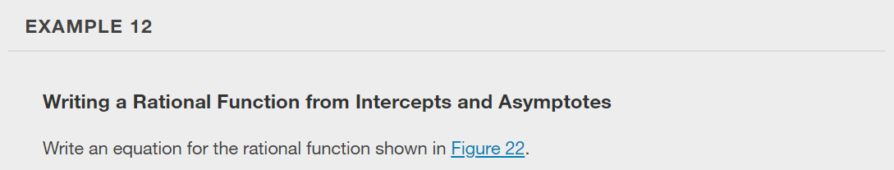
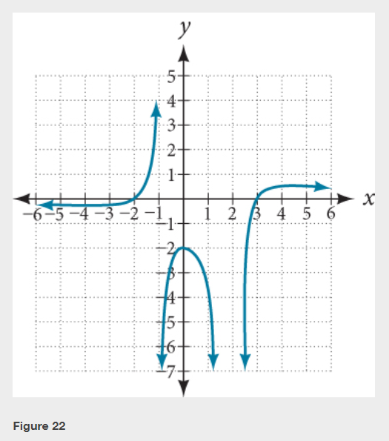

Slide 41
What did you learn in this section?
Use arrow notation.
Solve applied problems involving rational functions.
Find the domains of rational functions.
Identify vertical asymptotes.
Identify horizontal asymptotes.
Graph rational functions.
Notes:
Do you have any questions?

Slide 42
This resource is an adaptation of the OpenStax Algebra and Trigonometry 2e open textbook and is © Susan Aydelotte under a CC BY-NC-SA 4.0 International license; it may be reproduced or modified for noncommercial purposes only but must be attributed to OpenStax, Rice University and any changes must be noted. Any adaptation must be shared under the same type of license.

