Slide 1
Polynomial and Rational Functions
Chapter 5
Algebra and Trigonometry 2e, OpenStax, Jay Abramson
Notes:
Images and notes within these slides are from the OpenStax textbook Algebra and Trigonometry 2e

Slide 2
5.5 Zeros of Polynomial Functions
Notes:
Images and notes within these slides are from the OpenStax textbook Algebra and Trigonometry 2e

Slide 3
What are the learning objectives for this section?
Evaluate a polynomial using the Remainder Theorem.
Use the Factor Theorem to solve a polynomial equation.
Use the Rational Zero Theorem to find rational zeros.
Find zeros of a polynomial function.
Use the Linear Factorization Theorem to find polynomials with given zeros.
Use Descartes’ Rule of Signs.
Solve real-world applications of polynomial equations

Slide 5
Proof of the Remainder Theorem

Slide 13
Using the Rational Zero Theorem to Find Rational Zeros
Another use for the Remainder Theorem is to test whether a rational number is a zero for a given polynomial. But first we need a pool of rational numbers to test.
The Rational Zero Theorem helps us to narrow down the number of possible rational zeros using the ratio of the factors of the constant term and factors of the leading coefficient of the polynomial.

Slide 15
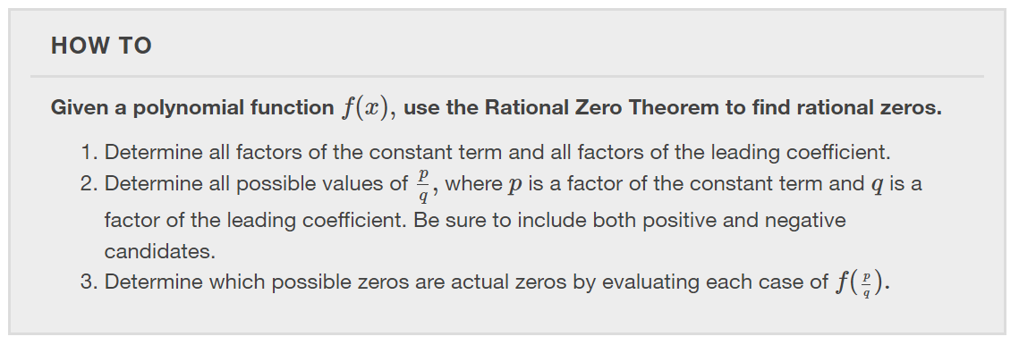

Slide 21
Using the Fundamental Theorem of Algebra
Now that we can find rational zeros for a polynomial function, we will look at a theorem that discusses the number of complex zeros of a polynomial function.
The Fundamental Theorem of Algebra tells us that every polynomial function has at least one complex zero. This theorem forms the foundation for solving polynomial equations.

Slide 29
Using Descartes’ Rule of Signs
There is a straightforward way to determine the possible numbers of positive and negative real zeros for any polynomial function.
If the polynomial is written in descending order, Descartes’ Rule of Signs tells us of a relationship between the number of sign changes in $f(x)$ and the number of positive real zeros.

Slide 34
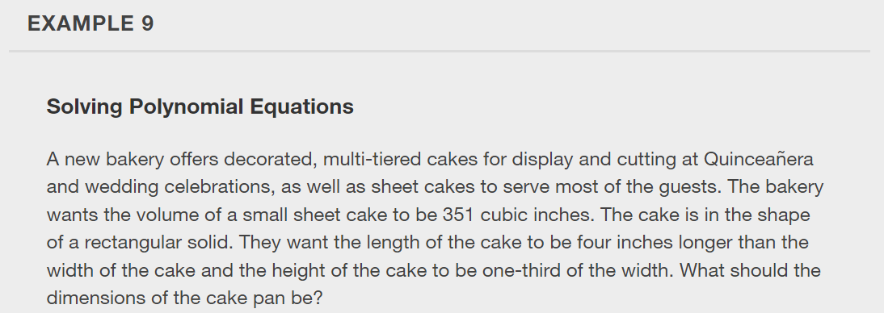

Slide 36
What did you learn in this section?
Evaluate a polynomial using the Remainder Theorem.
Use the Factor Theorem to solve a polynomial equation.
Use the Rational Zero Theorem to find rational zeros.
Find zeros of a polynomial function.
Use the Linear Factorization Theorem to find polynomials with given zeros.
Use Descartes’ Rule of Signs.
Solve real-world applications of polynomial equations
Notes:
Do you have any questions?

Slide 37
This resource is an adaptation of the OpenStax Algebra and Trigonometry 2e open textbook and is © Susan Aydelotte under a CC BY-NC-SA 4.0 International license; it may be reproduced or modified for noncommercial purposes only but must be attributed to OpenStax, Rice University and any changes must be noted. Any adaptation must be shared under the same type of license.

