Slide 1
Polynomial and Rational Functions
Chapter 5
Algebra and Trigonometry 2e, OpenStax, Jay Abramson
Notes:
Images and notes within these slides are from the OpenStax textbook Algebra and Trigonometry 2e

Slide 2
5.4 Dividing Polynomials
Notes:
Images and notes within these slides are from the OpenStax textbook Algebra and Trigonometry 2e

Slide 3
What are the learning objectives for this section?
Use long division to divide polynomials.
Use synthetic division to divide polynomials.

Slide 4
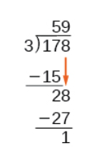
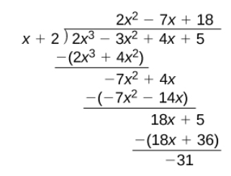
Using Long Division to Divide Polynomials
We are familiar with the long division algorithm for ordinary arithmetic. We begin by dividing into the digits of the dividend that have the greatest place value. We divide, multiply, subtract, include the digit in the next place value position, and repeat. For example, divide 178 by 3 using long division.
We will explore a similar process for dividing polynomials.

Slide 10
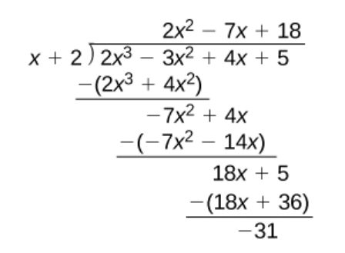
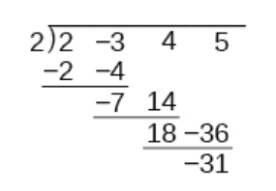
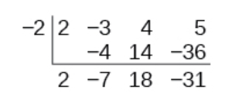
Using Synthetic Division to Divide Polynomials
As we’ve seen, long division of polynomials can involve many steps and be quite cumbersome.
Synthetic division is a shorthand method of dividing polynomials for the special case of dividing by a linear factor whose leading coefficient is 1.

Slide 19
What did you learn in this section?
Use long division to divide polynomials.
Use synthetic division to divide polynomials.
Notes:
Do you have any questions?

Slide 20
This resource is an adaptation of the OpenStax Algebra and Trigonometry 2e open textbook and is © Susan Aydelotte under a CC BY-NC-SA 4.0 International license; it may be reproduced or modified for noncommercial purposes only but must be attributed to OpenStax, Rice University and any changes must be noted. Any adaptation must be shared under the same type of license.

