Slide 1

Polynomial and Rational Functions
Chapter 5
Algebra and Trigonometry 2e, OpenStax, Jay Abramson
Notes:
Images and notes within these slides are from the OpenStax textbook Algebra and Trigonometry 2e

Slide 2
5.3 Graphs of Polynomial Functions
Notes:
Images and notes within these slides are from the OpenStax textbook Algebra and Trigonometry 2e

Slide 3
What are the learning objectives for this section?
Recognize characteristics of graphs of polynomial functions.
Use factoring to ﬁnd zeros of polynomial functions.
Identify zeros and their multiplicities.
Determine end behavior.
Understand the relationship between degree and turning points.
Graph polynomial functions.
Use the Intermediate Value Theorem.

Slide 4
Recognizing Characteristics of Graphs of Polynomial Functions
Polynomial functions of degree 2 or more have graphs that do not have sharp corners; recall that these types of graphs are called smooth curves.
Polynomial functions also display graphs that have no breaks.
Curves with no breaks are called continuous.

Slide 5
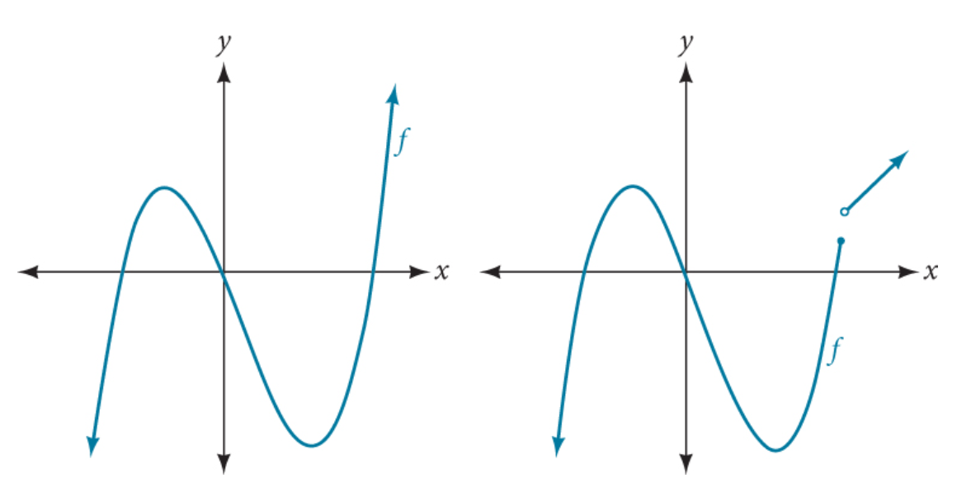
Which of these graphs represents a polynomial function?

Slide 6
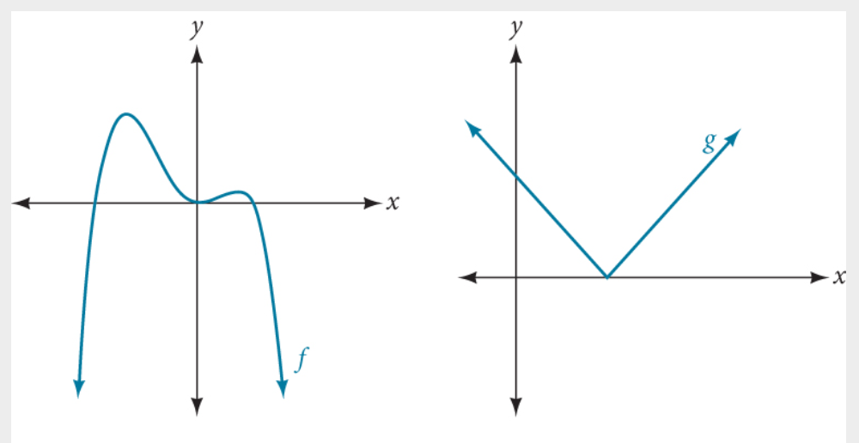
Which of these graphs represents a polynomial function?

Slide 7
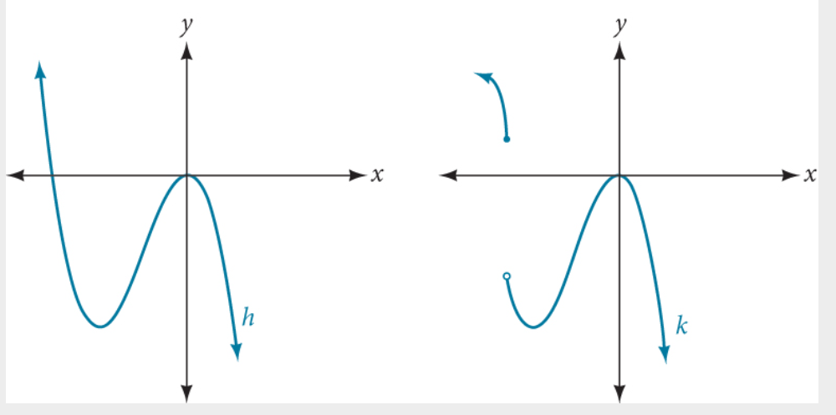
Which of these graphs represents a polynomial function?

Slide 8
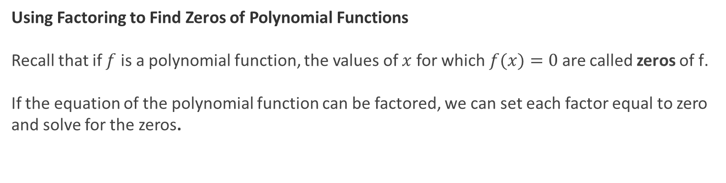
Using Factoring to Find Zeros of Polynomial Functions
Recall that if $f$ is a polynomial function, the values of $x$ for which $f(x)=0$are called zeros of f.
If the equation of the polynomial function can be factored, we can set each factor equal to zero and solve for the zeros.

Slide 9
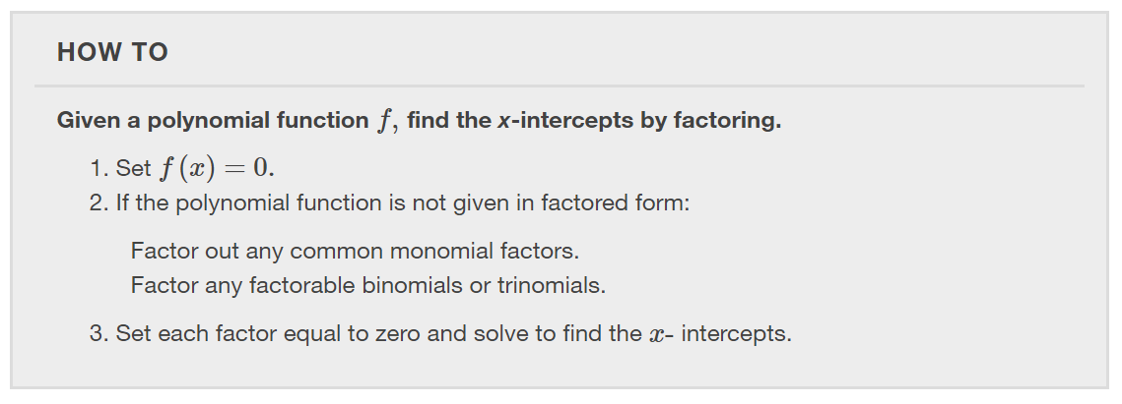

Slide 10
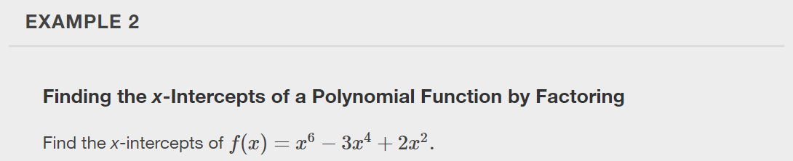

Slide 11
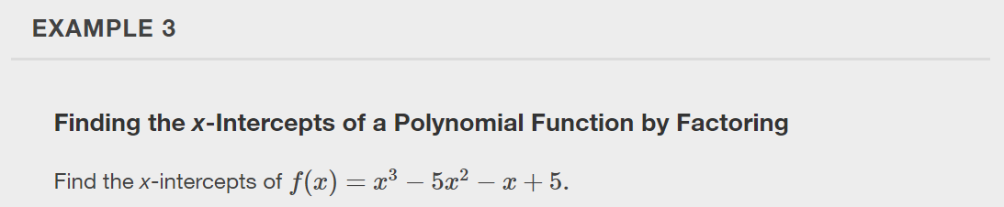

Slide 12
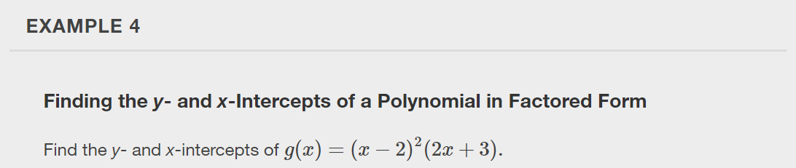

Slide 13
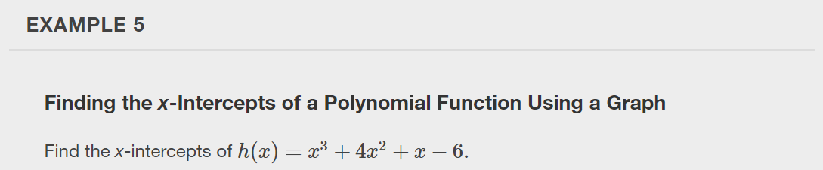

Slide 14
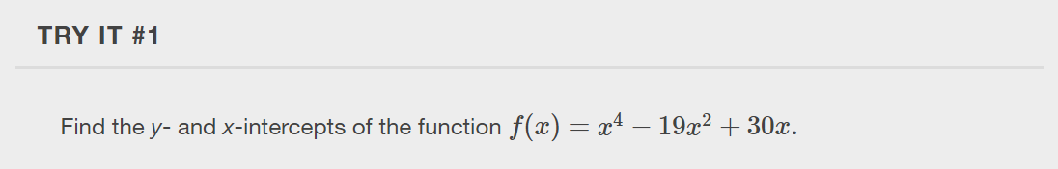

Slide 15
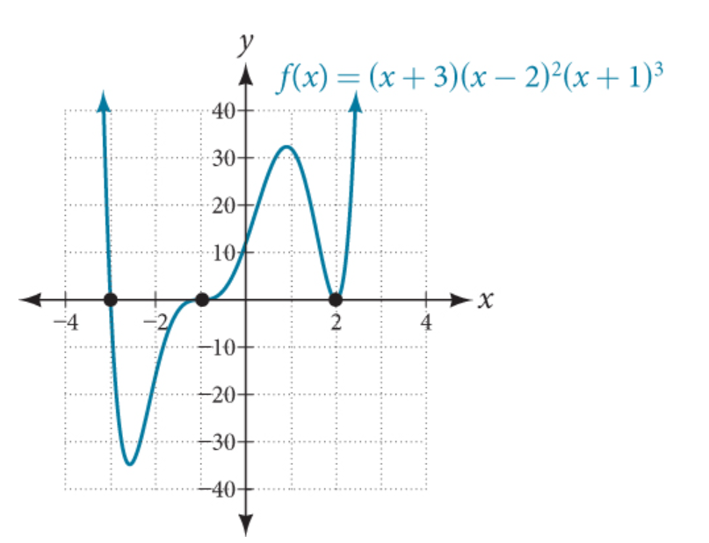
Identifying Zeros and Their Multiplicities
Graphs behave differently at various x-intercepts.
Sometimes, the graph will cross over the horizontal axis at an intercept.
Other times, the graph will touch the horizontal axis and "bounce" off.

Slide 16
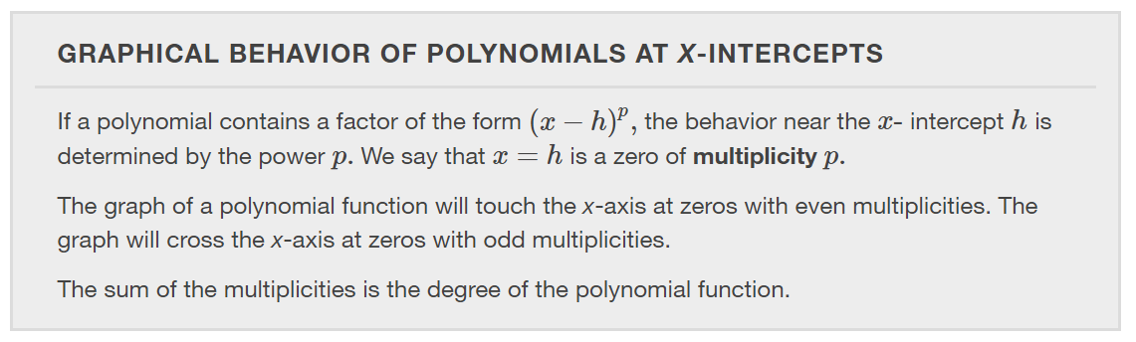

Slide 17
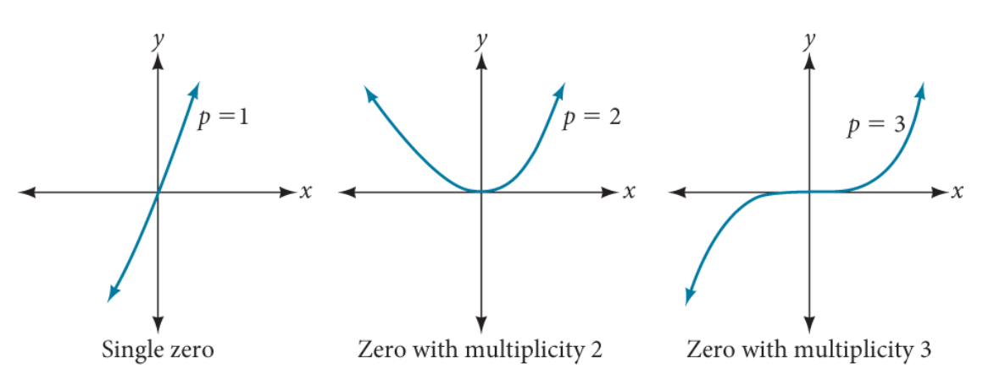

Slide 18
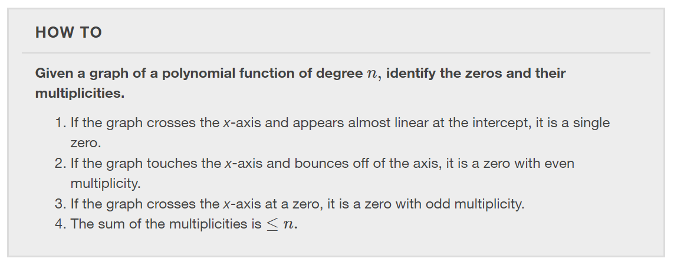

Slide 19
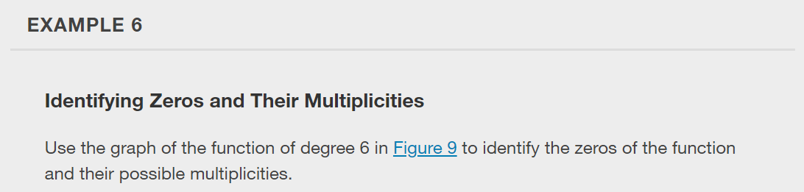
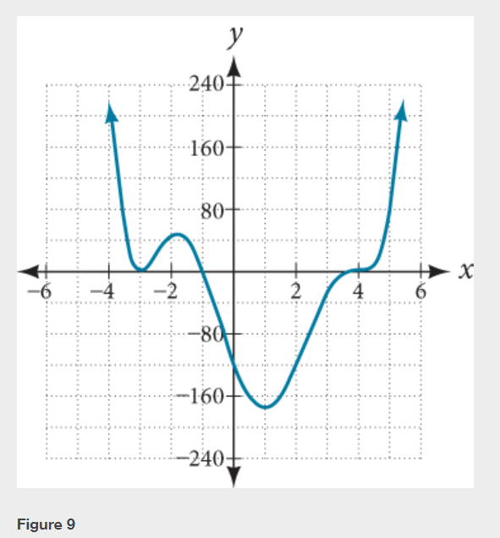

Slide 20
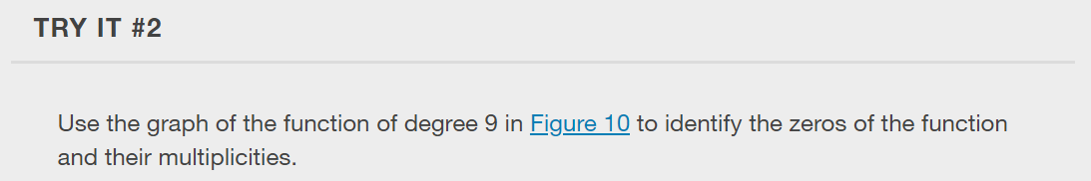
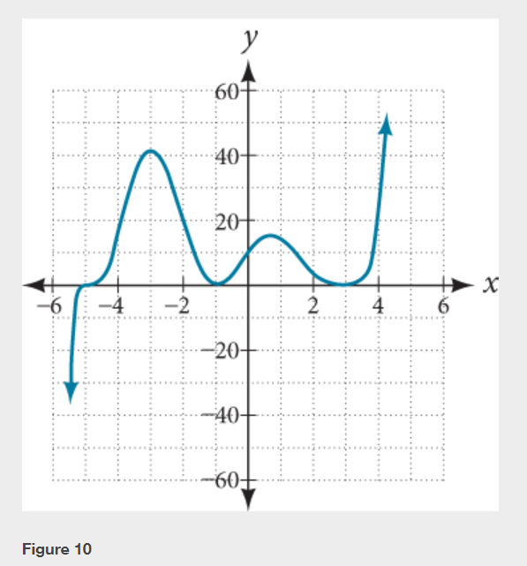

Slide 21
Determining End Behavior
As we have already learned, the behavior of a graph of a polynomial function will either ultimately rise or fall as x increases without bound and will either rise or fall as x decreases without bound.
This is because for very large inputs, say 100 or 1,000, the leading term dominates the size of the output. The same is true for very small inputs, say –100 or –1,000.
Recall that we call this behavior the end behavior of a function.

Slide 22
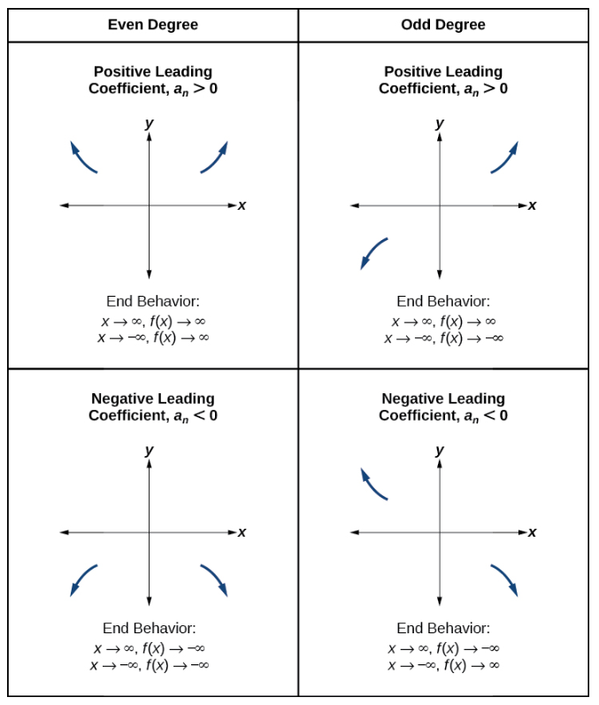

Slide 23
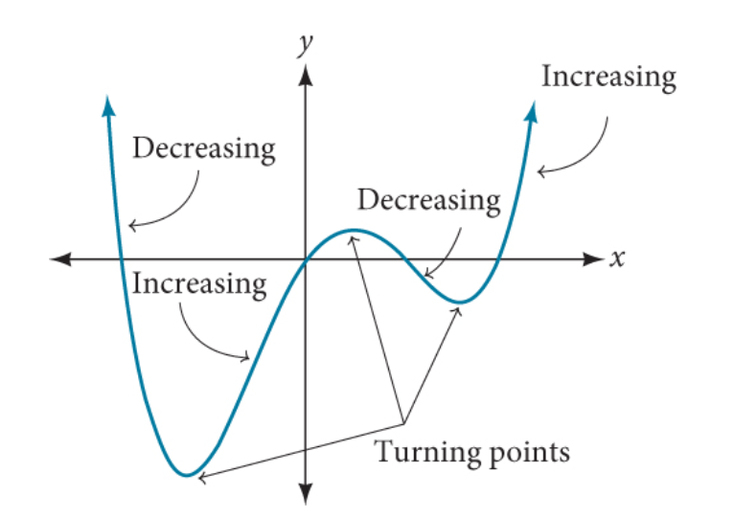

Understanding the Relationship between Degree and Turning Points
In addition to the end behavior, recall that we can analyze a polynomial function’s local behavior. It may have a turning point where the graph changes from increasing to decreasing (rising to falling) or decreasing to increasing (falling to rising).
$$f\left(x\right)=x^{4}−x^{3}−4x^{2}+4x$$

Slide 24
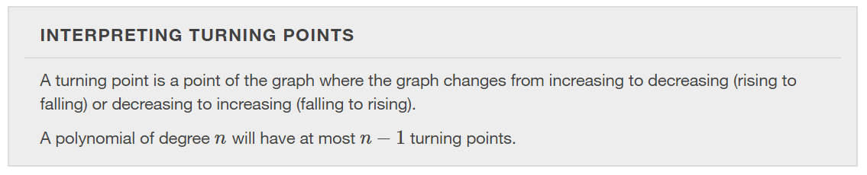

Slide 25
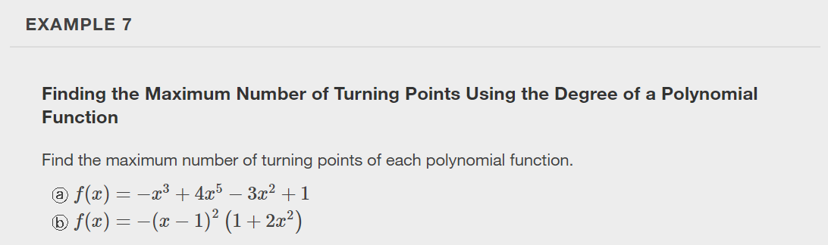

Slide 26
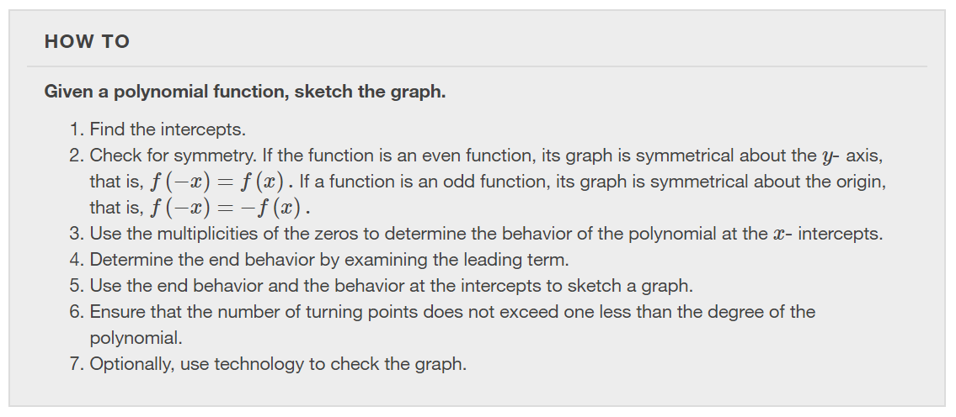

Slide 27
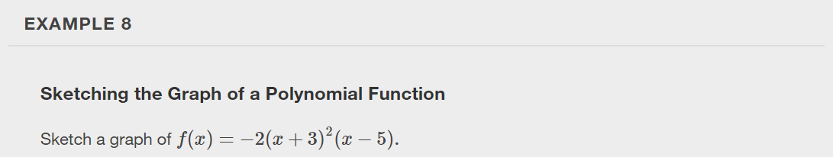

Slide 28
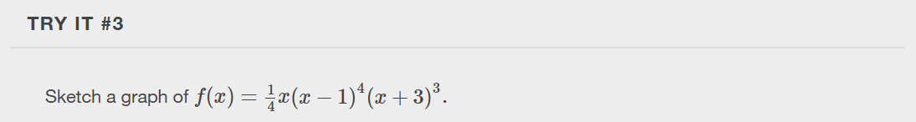

Slide 29
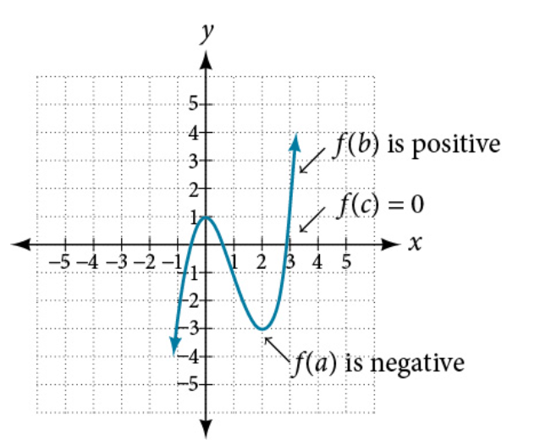
Using the Intermediate Value Theorem
In some situations, we may know two points on a graph but not the zeros. If those two points are on opposite sides of the x-axis, we can confirm that there is a zero between them if the function is continuous.

Slide 30
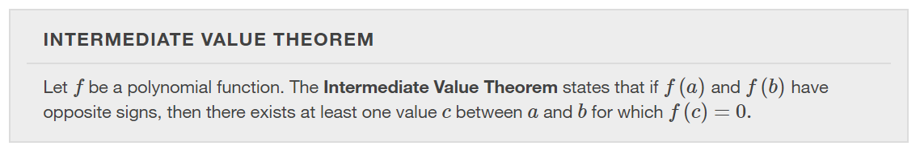

Slide 31
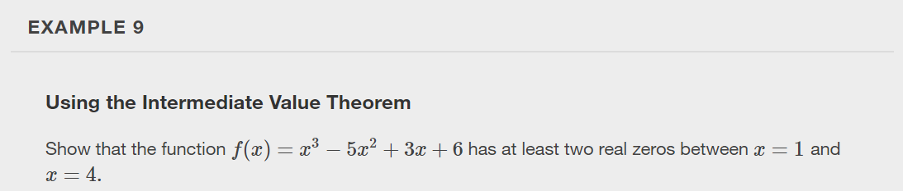

Slide 32
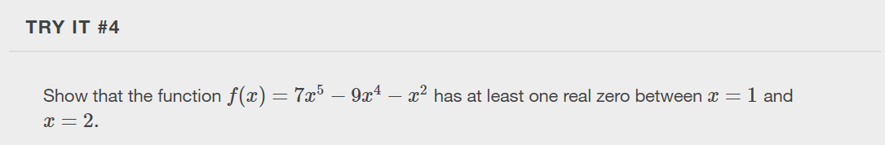

Slide 33
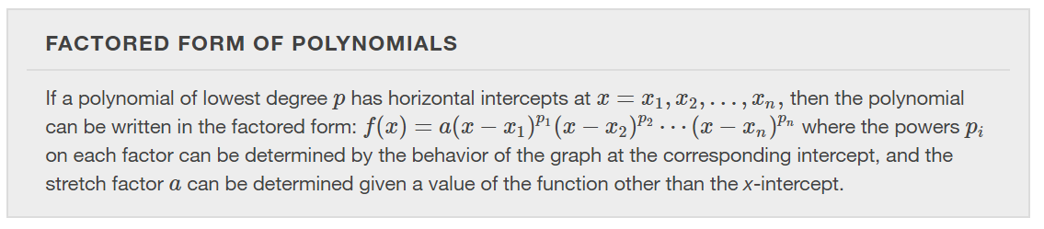

Slide 34
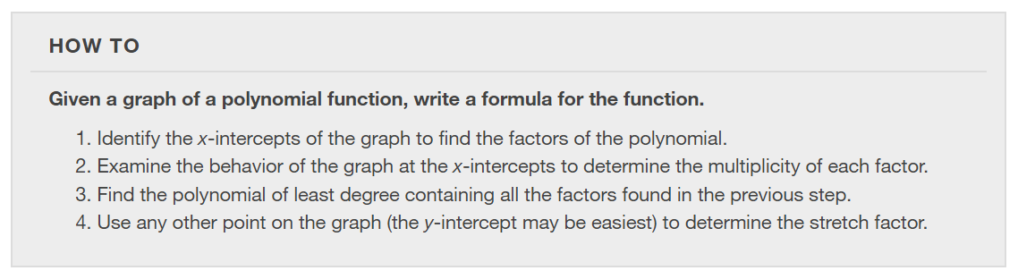

Slide 35
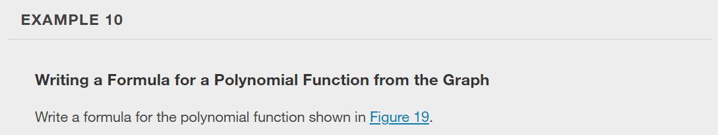
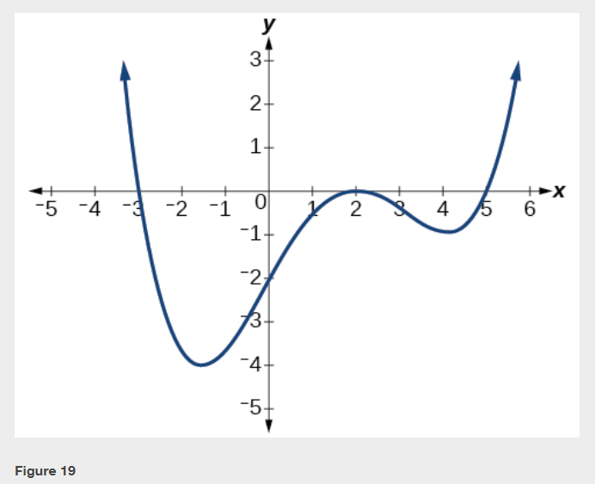

Slide 36
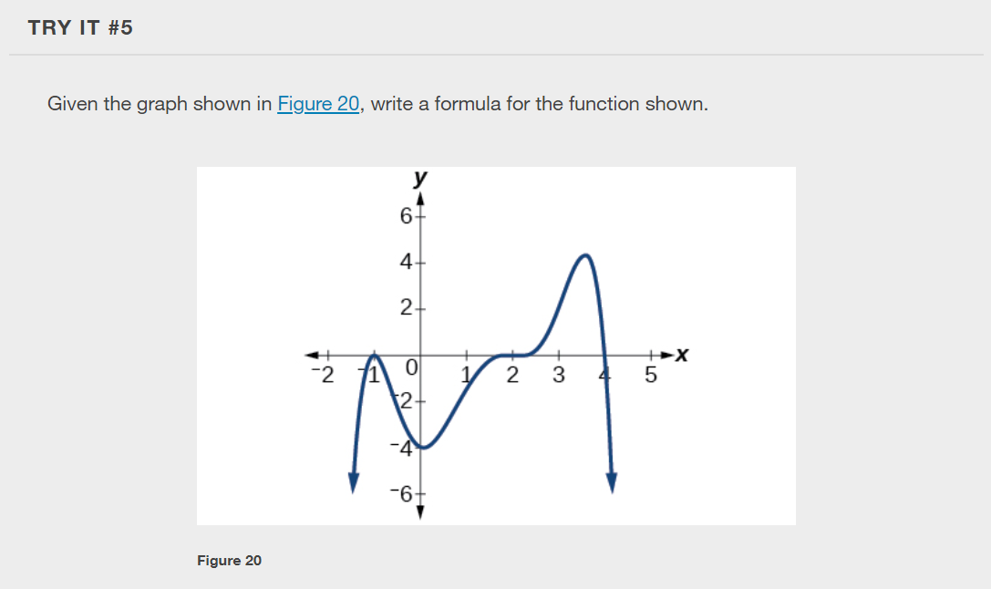

Slide 37
Using Local and Global Extrema
With quadratics, we were able to algebraically find the maximum or minimum value of the function by finding the vertex.
For general polynomials, finding these turning points is not possible without more advanced techniques from calculus. Even then, finding where extrema occur can still be algebraically challenging.
For now, we will estimate the locations of turning points using technology to generate a graph.
Each turning point represents a local minimum or maximum. Sometimes, a turning point is the highest or lowest point on the entire graph. In these cases, we say that the turning point is a global maximum or a global minimum. These are also referred to as the absolute maximum and absolute minimum values of the function.

Slide 38
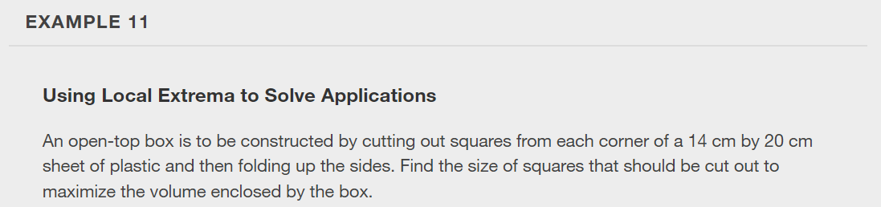

Slide 39
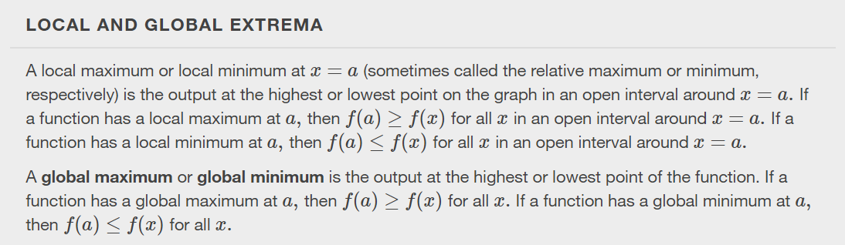
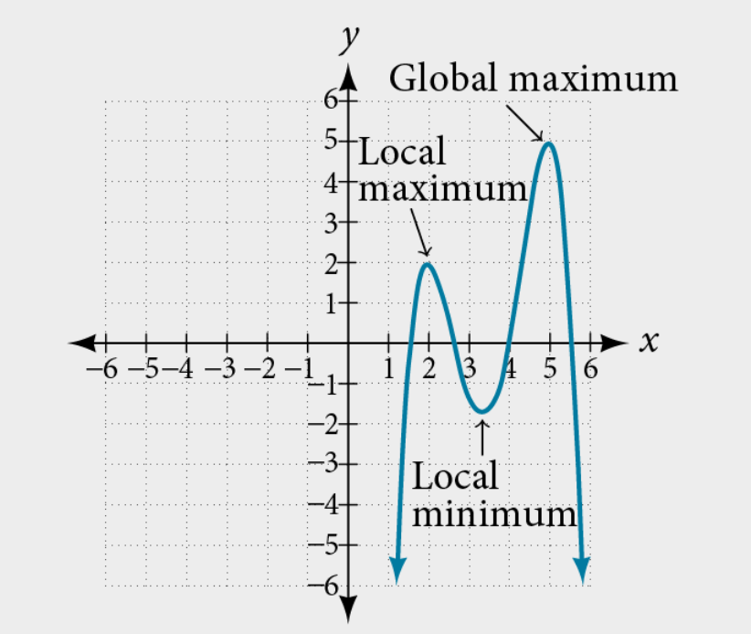

Slide 40
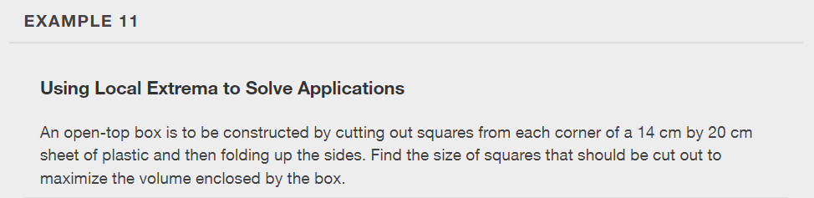

Slide 41
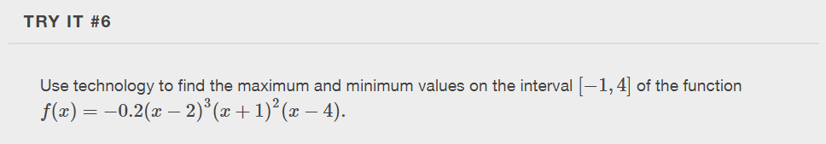

Slide 42
What did you learn in this section?
Recognize characteristics of graphs of polynomial functions.
Use factoring to ﬁnd zeros of polynomial functions.
Identify zeros and their multiplicities.
Determine end behavior.
Understand the relationship between degree and turning points.
Graph polynomial functions.
Use the Intermediate Value Theorem.
Notes:
Do you have any questions?

Slide 43
This resource is an adaptation of the OpenStax Algebra and Trigonometry 2e open textbook and is © Susan Aydelotte under a CC BY-NC-SA 4.0 International license; it may be reproduced or modified for noncommercial purposes only but must be attributed to OpenStax, Rice University and any changes must be noted. Any adaptation must be shared under the same type of license.

