Slide 1

Polynomial and Rational Functions
Chapter 5
Algebra and Trigonometry 2e, OpenStax, Jay Abramson
Notes:
Images and notes within these slides are from the OpenStax textbook Algebra and Trigonometry 2e

Slide 2
5.2 Power Functions and Polynomial Functions
Notes:
Images and notes within these slides are from the OpenStax textbook Algebra and Trigonometry 2e

Slide 3
What are the learning objectives for this section?
Identify power functions.
Identify end behavior of power functions.
Identify polynomial functions.
Identify the degree and leading coefficient of polynomial functions.
Use intercepts and turning points to describe local behavior of polynomial functions.

Slide 4
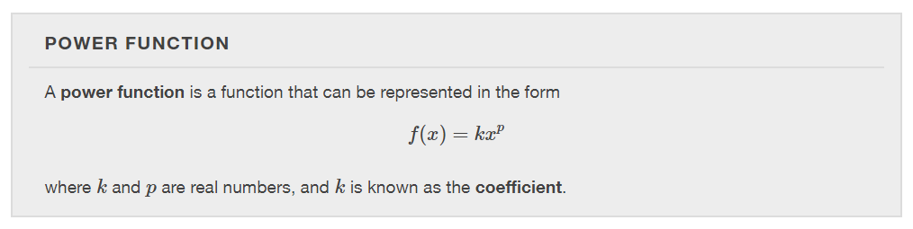

Slide 5
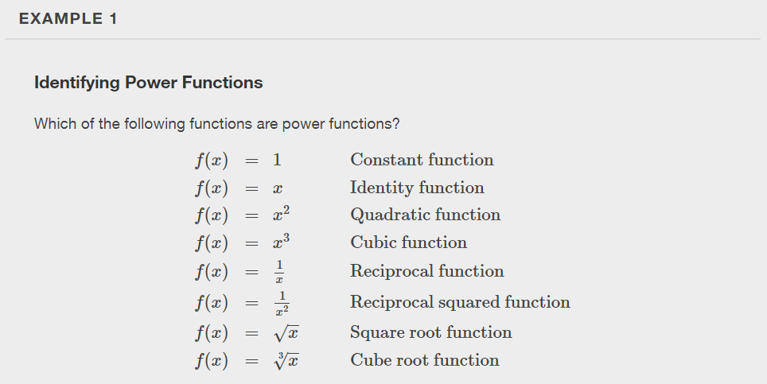

Slide 6
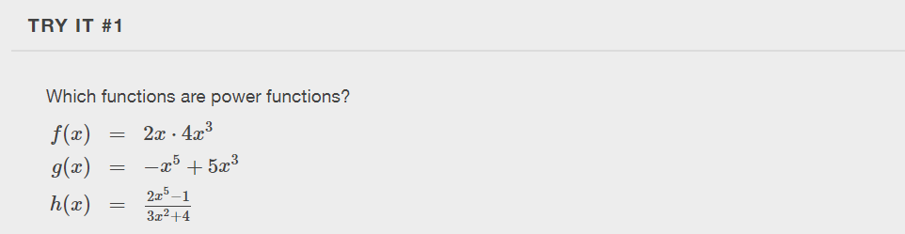

Slide 7
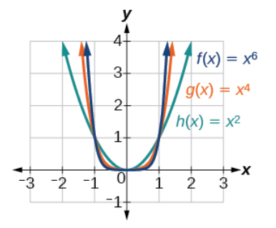
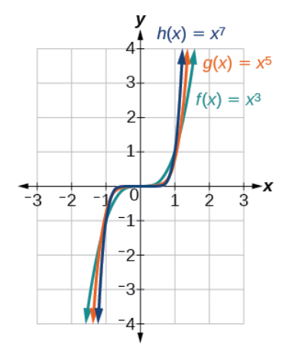
Identifying End Behavior of Power Functions

Slide 8
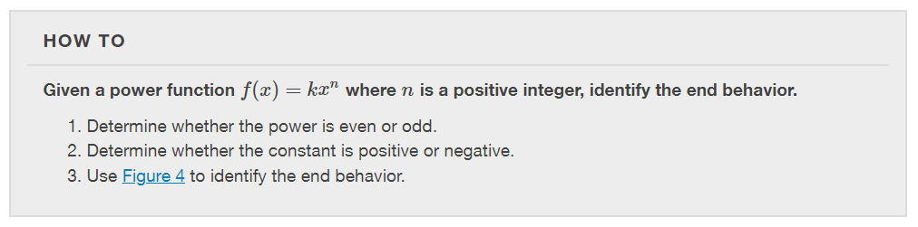

Slide 9
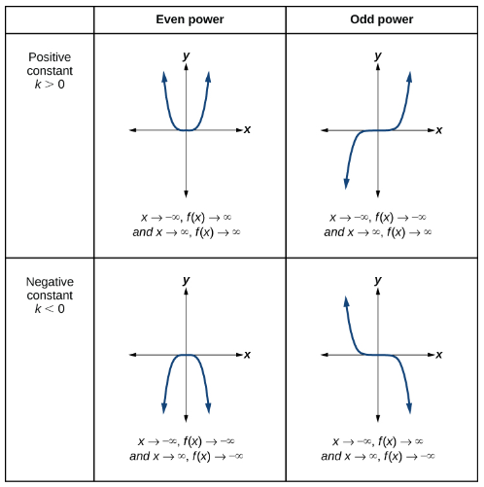

Slide 10
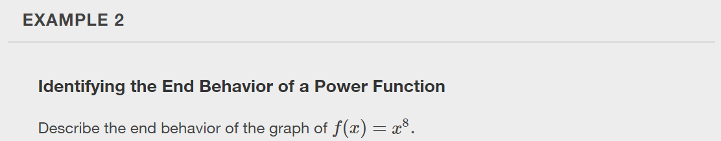

Slide 11
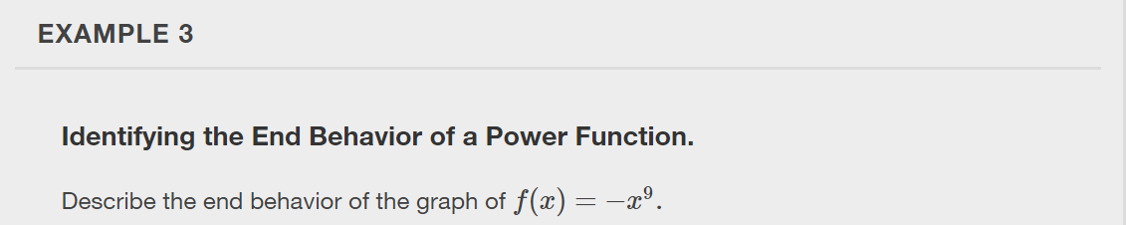

Slide 12


Slide 13
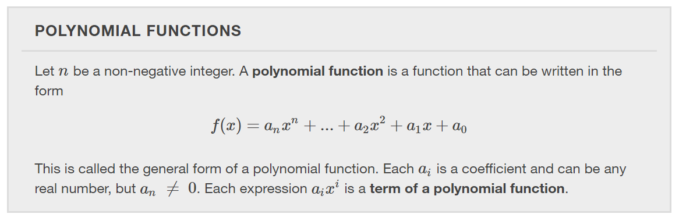

Slide 14
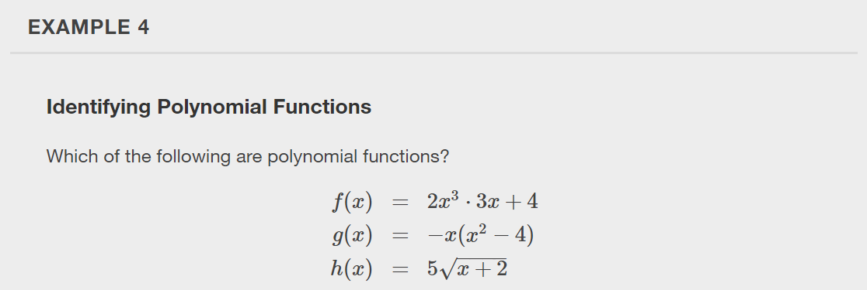

Slide 15
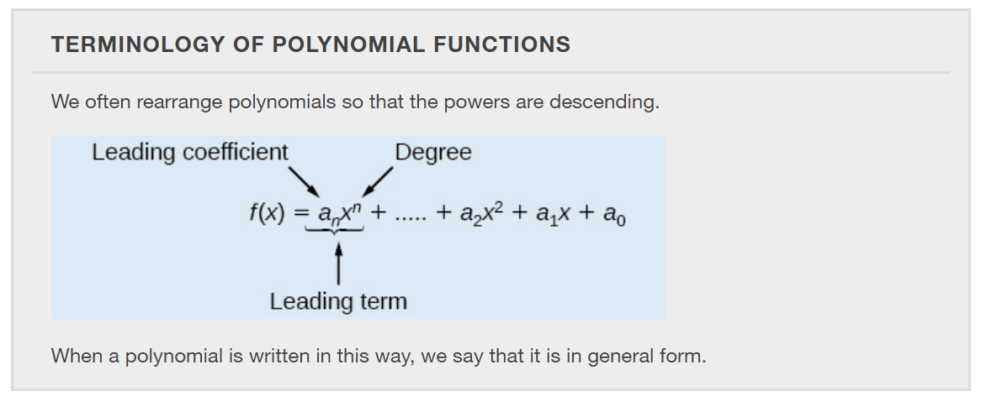

Slide 16
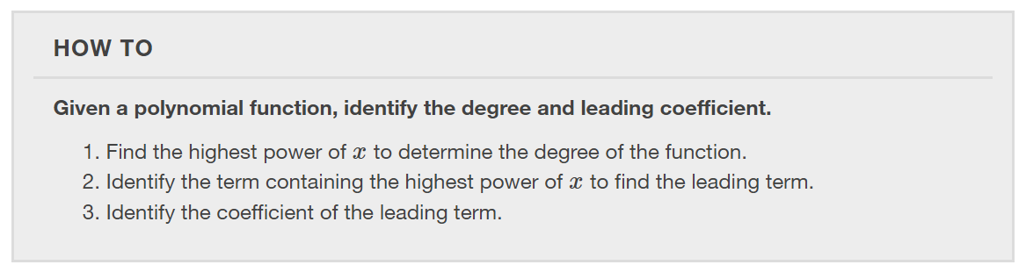

Slide 17
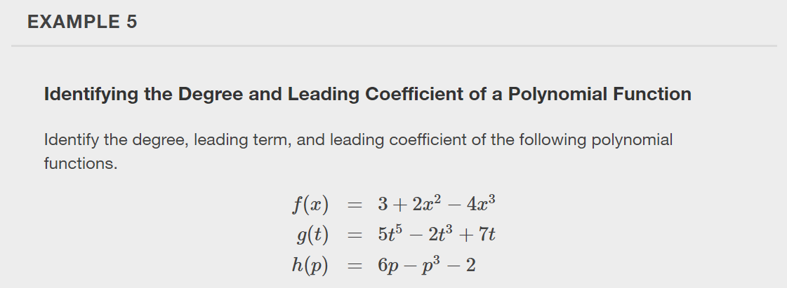

Slide 18
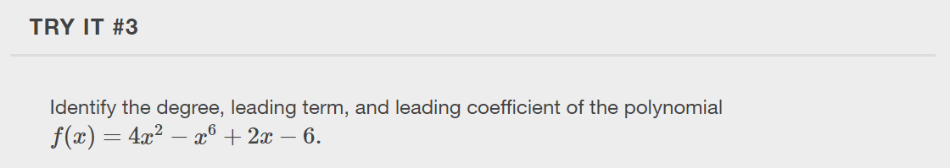

Slide 19
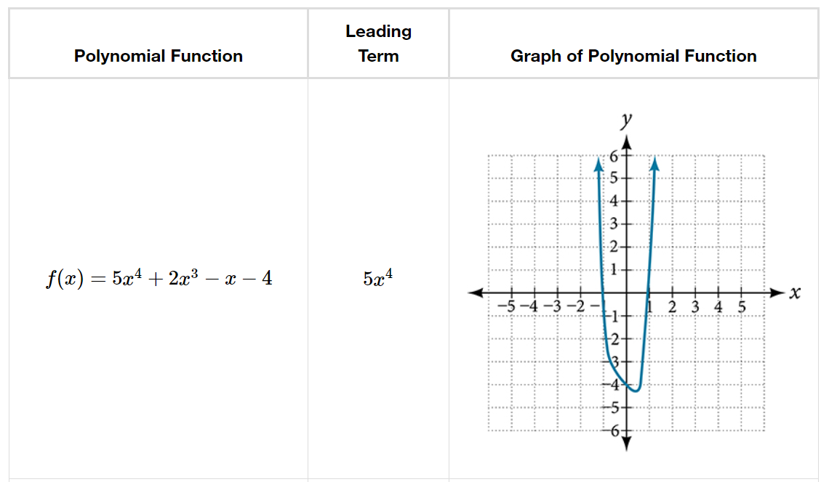
Identifying End Behavior of Polynomial Functions
For any polynomial, the end behavior of the polynomial will match the end behavior of the power function consisting of the leading term.

Slide 20
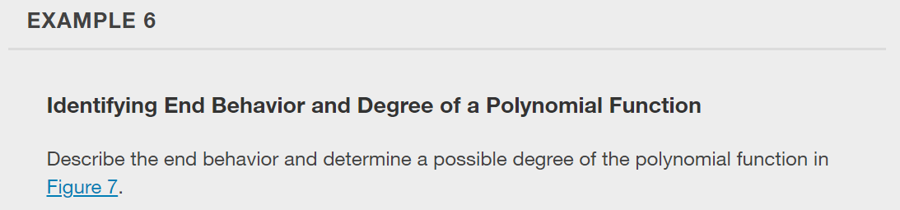
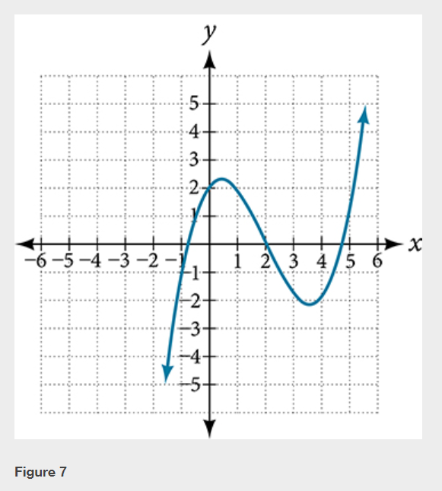

Slide 21
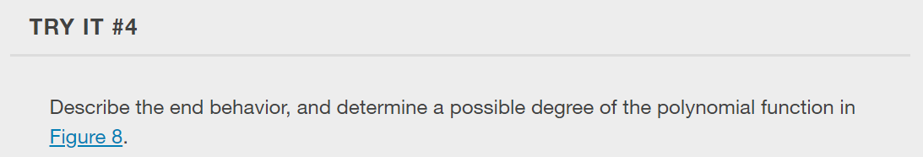
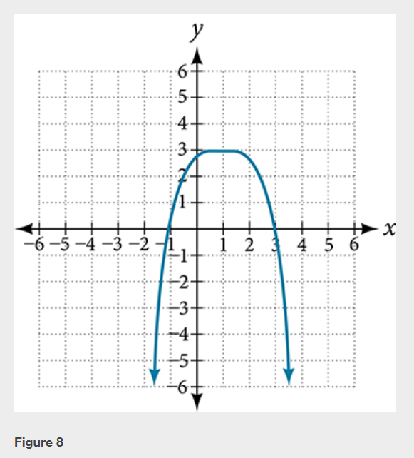

Slide 22
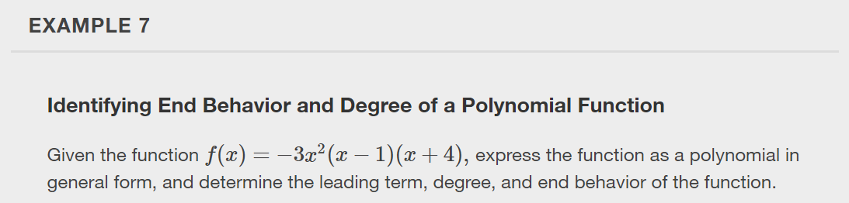

Slide 23
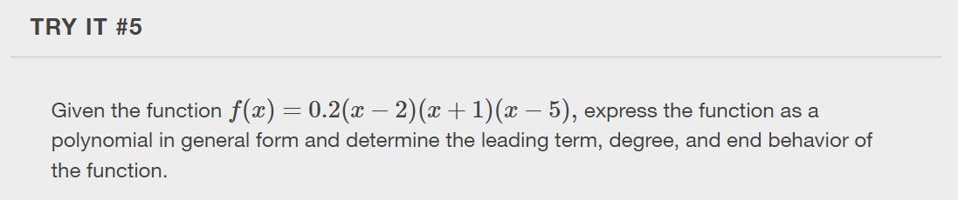

Slide 24
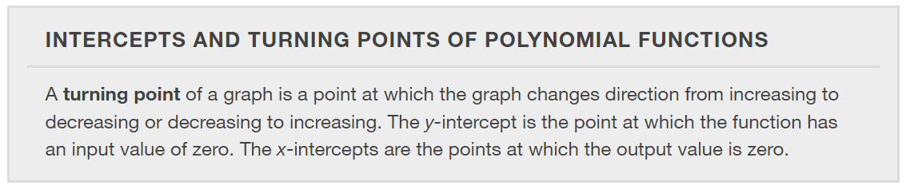

Slide 25
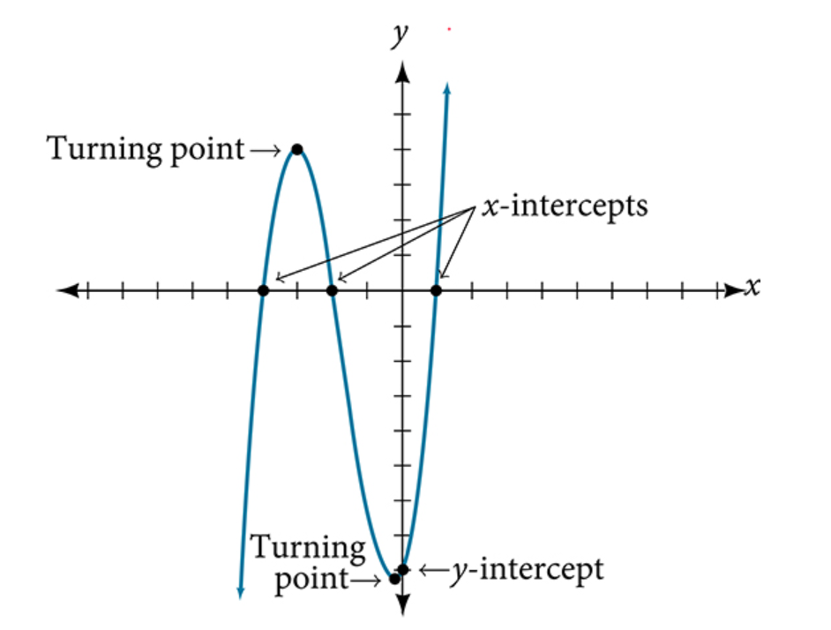

Slide 26
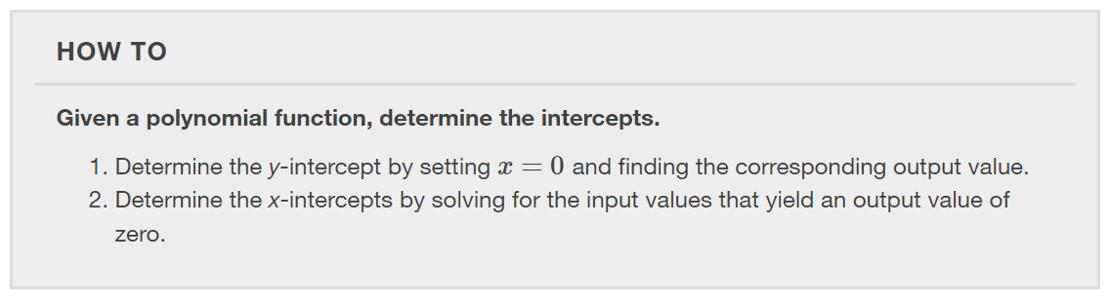

Slide 27
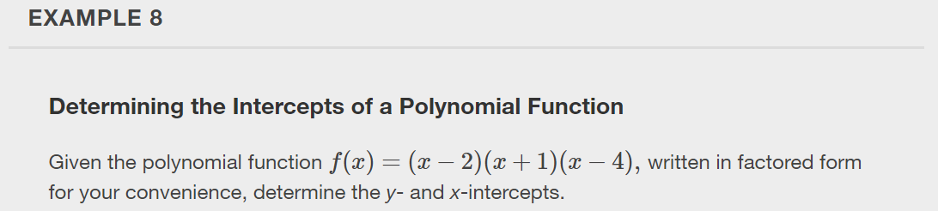

Slide 28
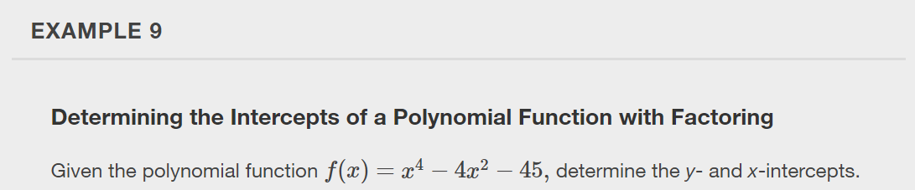

Slide 29
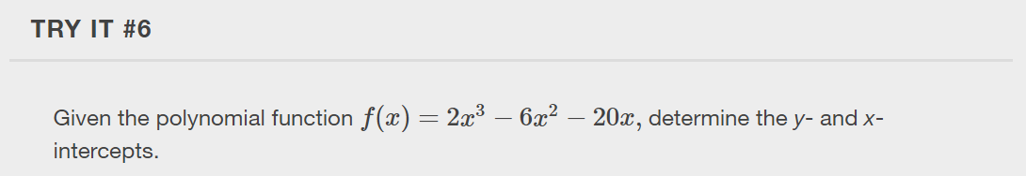

Slide 30
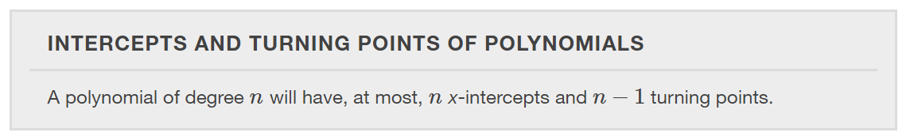

Slide 31
Characteristics of Polynomial Functions
A continuous function has no breaks in its graph: the graph can be drawn without lifting the pen from the paper.
A smooth curve is a graph that has no sharp corners. The turning points of a smooth graph must always occur at rounded curves.
The graphs of polynomial functions are both continuous and smooth.

Slide 32
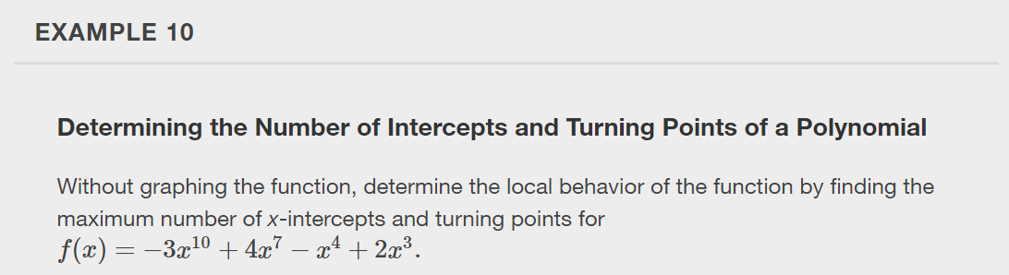

Slide 33
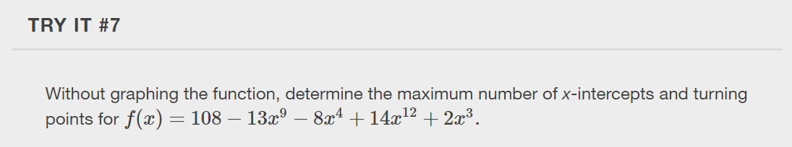

Slide 34
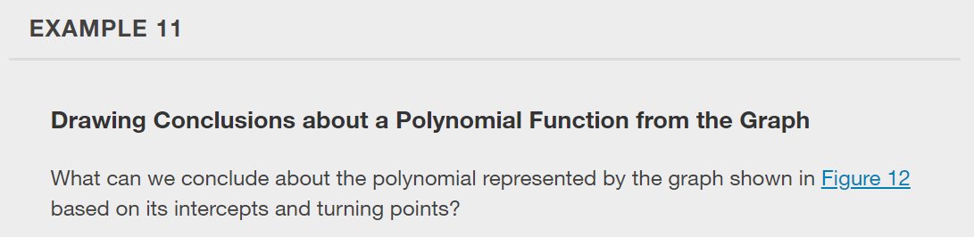
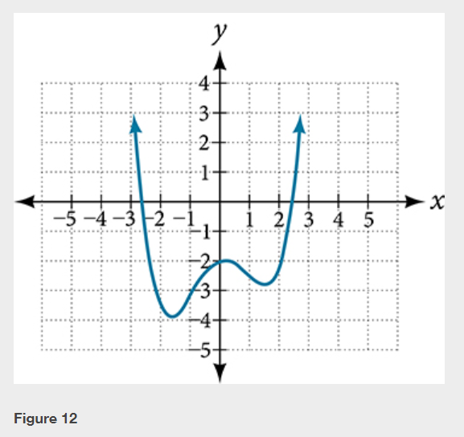

Slide 35
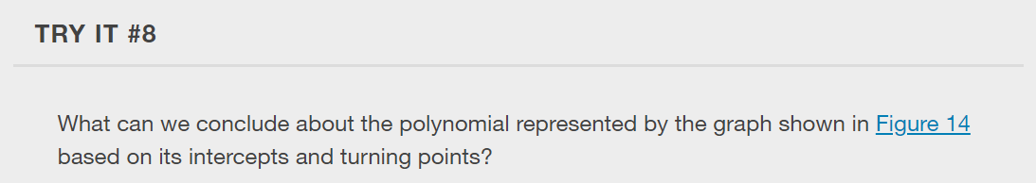
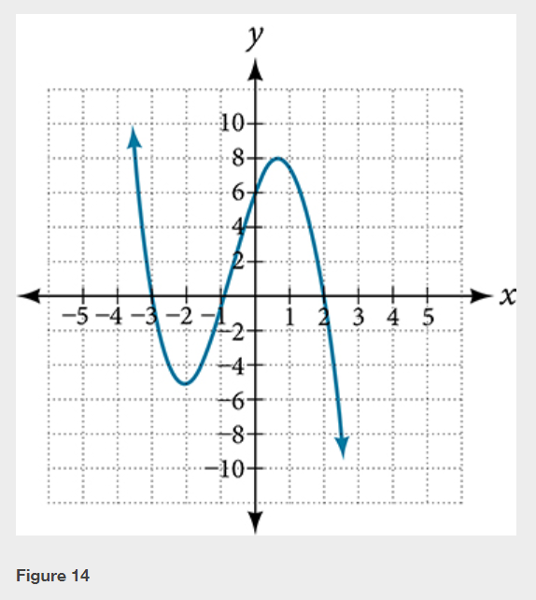

Slide 36
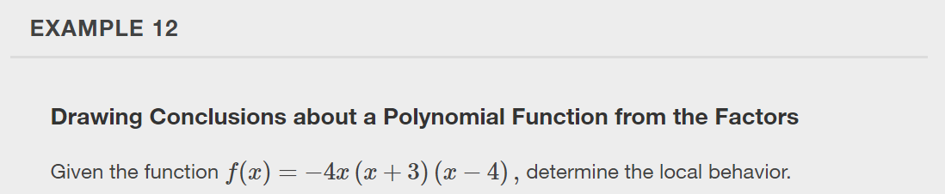

Slide 37
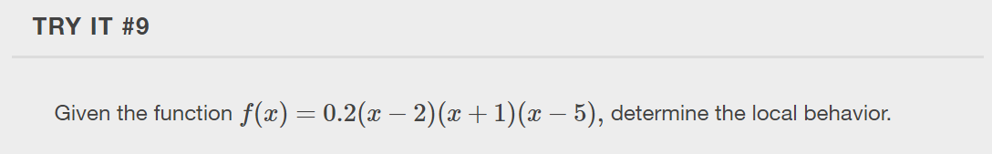

Slide 38
What did you learn in this section?
Identify power functions.
Identify end behavior of power functions.
Identify polynomial functions.
Identify the degree and leading coefficient of polynomial functions.
Use intercepts and turning points to describe local behavior of polynomial functions.
Notes:
Do you have any questions?

Slide 39
This resource is an adaptation of the OpenStax Algebra and Trigonometry 2e open textbook and is © Susan Aydelotte under a CC BY-NC-SA 4.0 International license; it may be reproduced or modified for noncommercial purposes only but must be attributed to OpenStax, Rice University and any changes must be noted. Any adaptation must be shared under the same type of license.

