Slide 1

Polynomial and Rational Functions
Chapter 5
Algebra and Trigonometry 2e, OpenStax, Jay Abramson
Notes:
Images and notes within these slides are from the OpenStax textbook Algebra and Trigonometry 2e

Slide 2
5.1 Quadratic Functions
Notes:
Images and notes within these slides are from the OpenStax textbook Algebra and Trigonometry 2e

Slide 3
What are the learning objectives for this section?
Recognize characteristics of parabolas.
Understand how the graph of a parabola is related to its quadratic function.
Determine a quadratic function’s minimum or maximum value.
Solve problems involving a quadratic function’s minimum or maximum value.

Slide 4
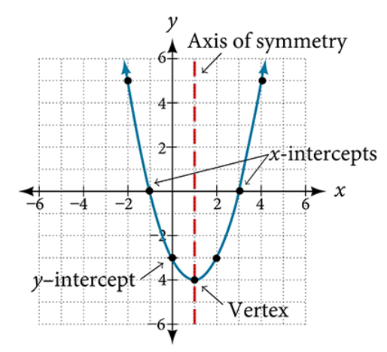
Recognizing Characteristics of Parabolas
The graph of a quadratic function is a U-shaped curve called a parabola. One important feature of the graph is that it has an extreme point, called the vertex.
If the parabola opens up, the vertex represents the lowest point on the graph, or the minimum value of the quadratic function.
If the parabola opens down, the vertex represents the highest point on the graph, or the maximum value.
In either case, the vertex is a turning point on the graph.
The graph is also symmetric with a vertical line drawn through the vertex, called the axis of symmetry.

Slide 5
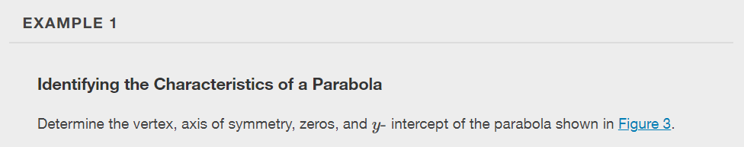
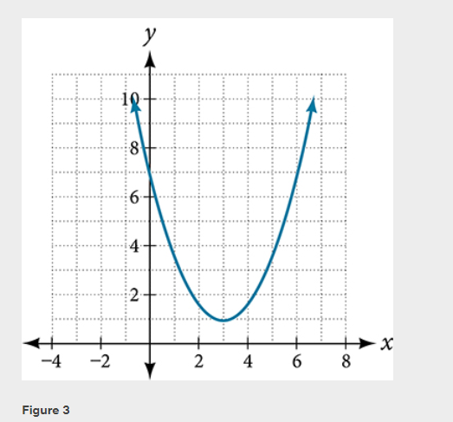

Slide 6
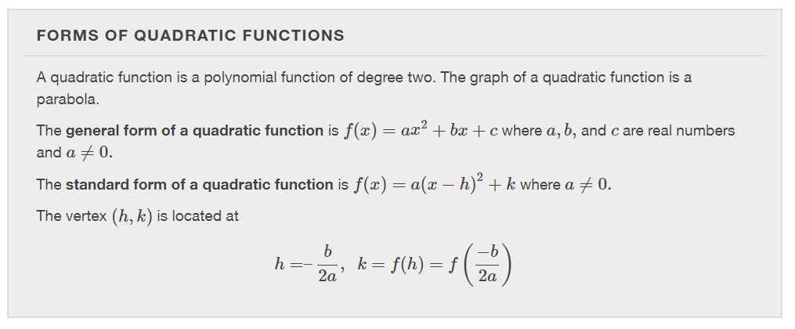

Slide 7
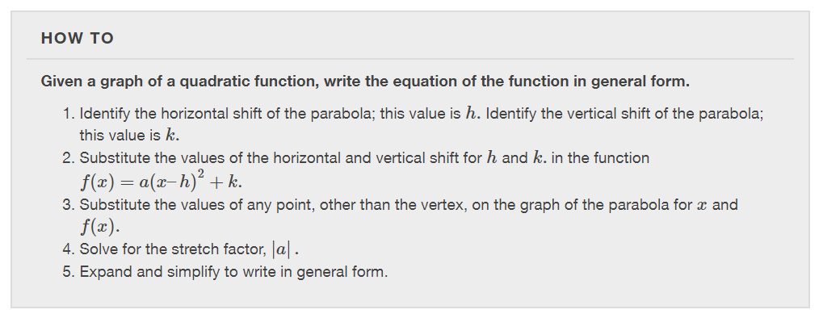

Slide 8
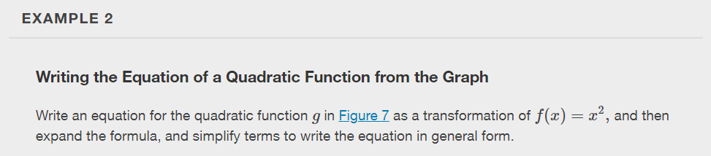
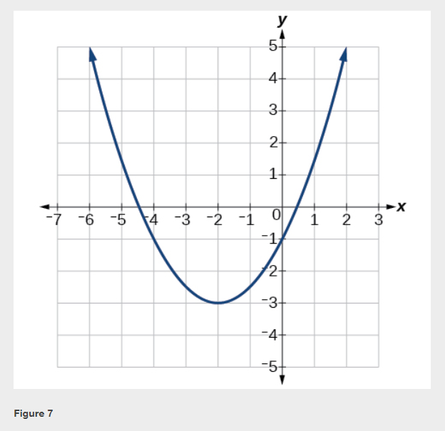

Slide 9
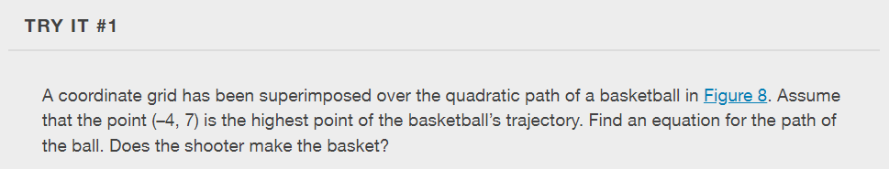
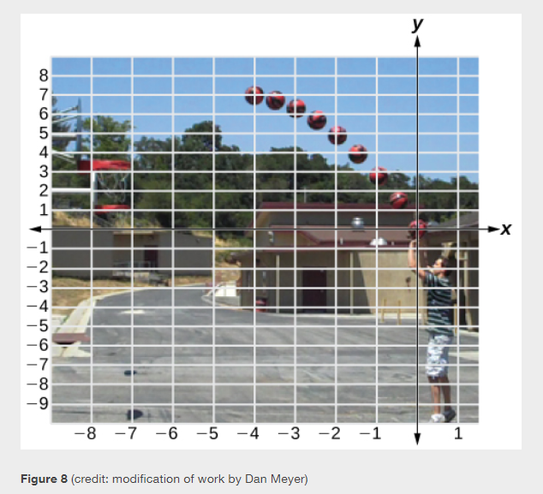

Slide 10
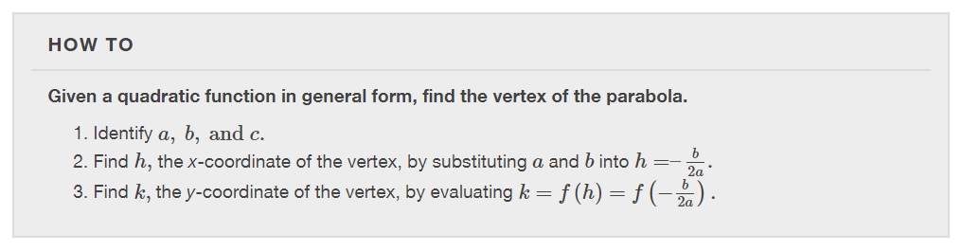

Slide 11
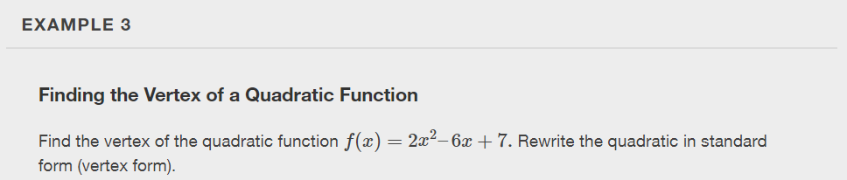

Slide 12
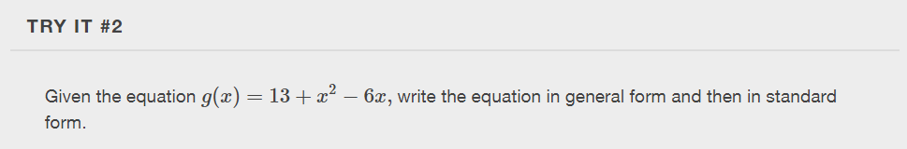

Slide 13
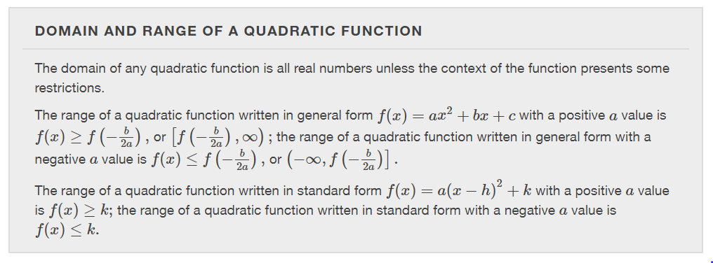

Slide 14
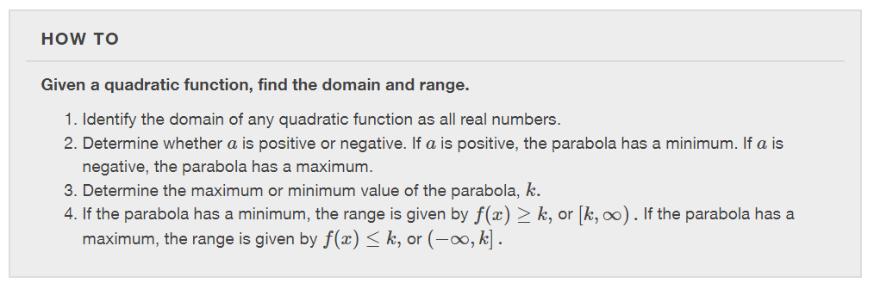

Slide 15
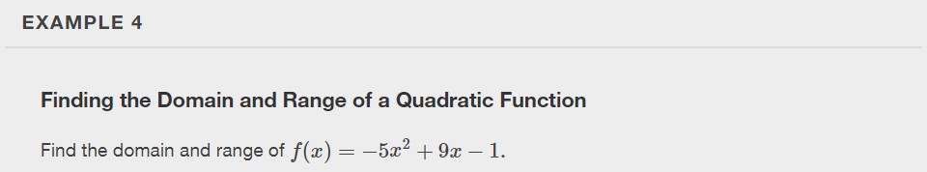

Slide 16
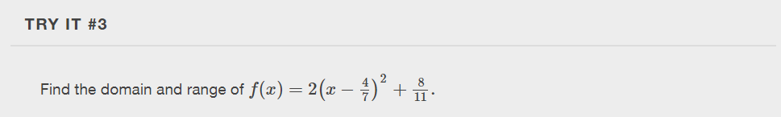

Slide 17
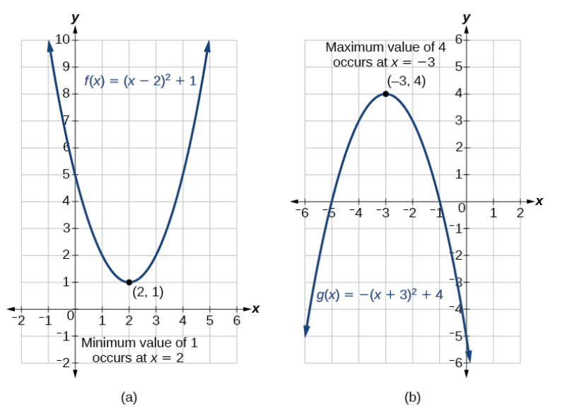
Determining the Maximum and Minimum Values of Quadratic Functions
The output of the quadratic function at the vertex is the maximum or minimum value of the function, depending on the orientation of the parabola.

Slide 18
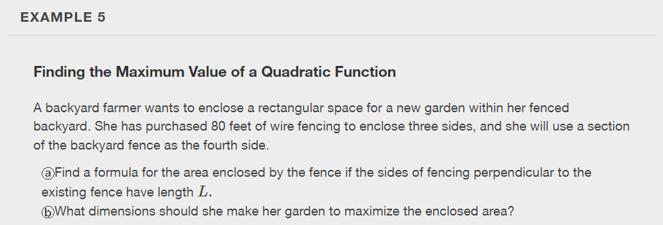

Slide 19
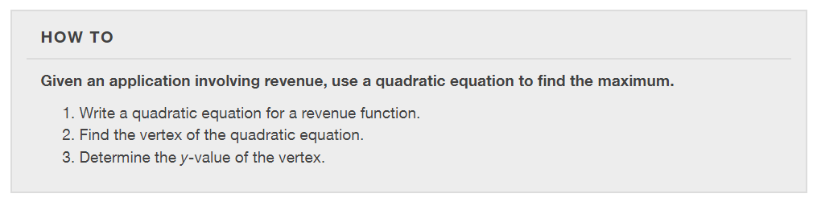

Slide 20
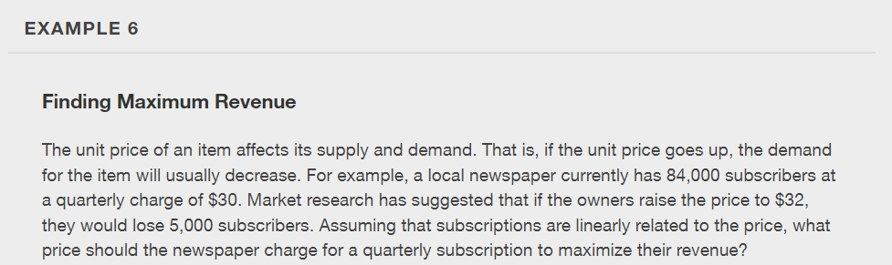

Slide 21
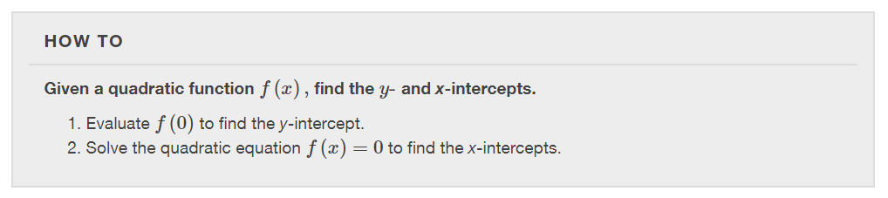

Slide 22
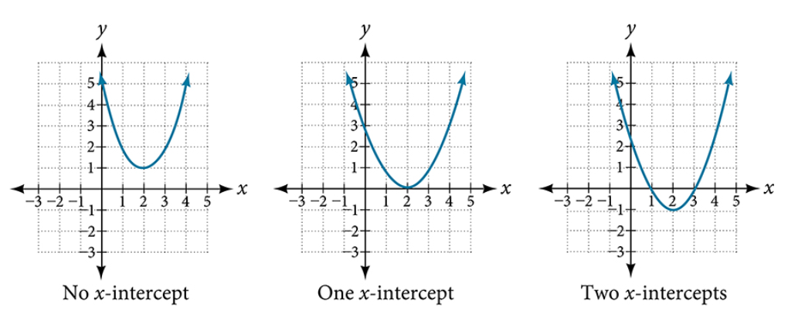

Slide 23
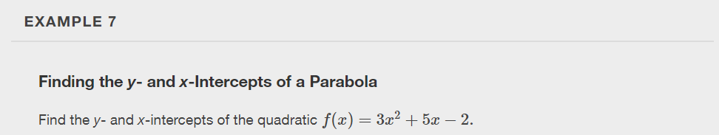

Slide 24
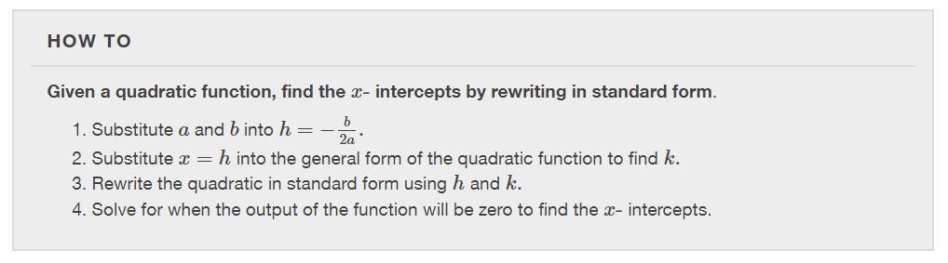

Slide 25
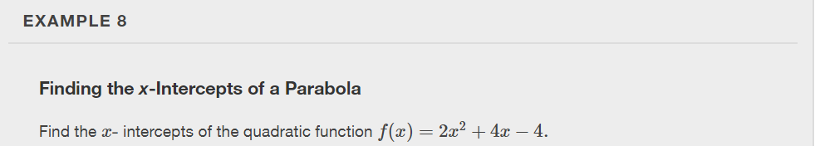

Slide 26
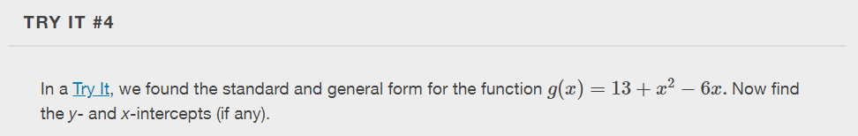

Slide 27
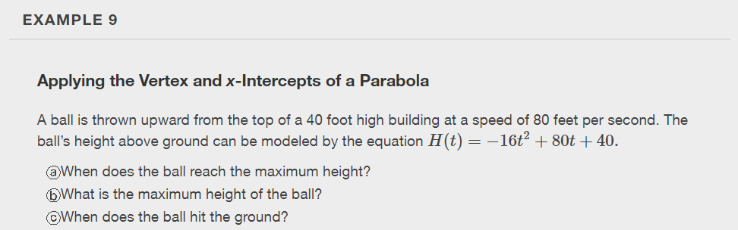

Slide 28
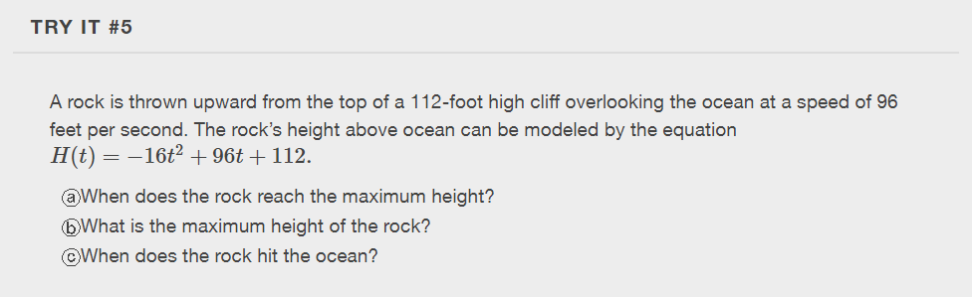

Slide 29
What did you learn in this section?
Recognize characteristics of parabolas.
Understand how the graph of a parabola is related to its quadratic function.
Determine a quadratic function’s minimum or maximum value.
Solve problems involving a quadratic function’s minimum or maximum value.
Notes:
Do you have any questions?

Slide 30
This resource is an adaptation of the OpenStax Algebra and Trigonometry 2e open textbook and is © Susan Aydelotte under a CC BY-NC-SA 4.0 International license; it may be reproduced or modified for noncommercial purposes only but must be attributed to OpenStax, Rice University and any changes must be noted. Any adaptation must be shared under the same type of license.

