Slide 1
Linear Functions
Chapter 4
Algebra and Trigonometry 2e
OpenStax
Jay Abramson
Notes:
Images and notes within these slides are from the OpenStax textbook Algebra and Trigonometry 2e

Slide 2
Fitting Linear Models to Data
Section 4.3

Slide 3
What are the skills discussed in this section?
Draw and interpret scatter diagrams.
Use a graphing utility to find the line of best fit.
Distinguish between linear and nonlinear relations.
Fit a regression line to a set of data and use the linear model to make predictions.

Slide 4
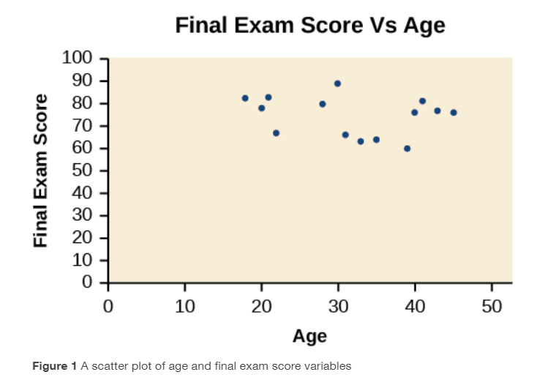
Drawing and Interpreting Scatter Plots
A scatter plot is a graph of plotted points that may show a relationship between two sets of data.
If the relationship is from a linear model, or a model that is nearly linear, we can draw conclusions using our knowledge of linear functions.
Figure 1 shows a sample scatter plot.

Slide 5
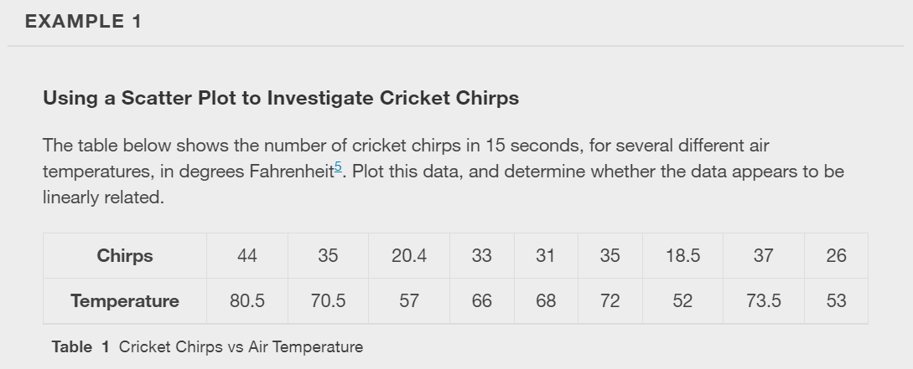

Slide 6
Finding the Line of Best Fit
Once we recognize a need for a linear function to model that data, the natural follow-up question is “what is that linear function?”
One way to approximate our linear function is to sketch the line that seems to best fit the data.
Then we can extend the line until we can verify the y-intercept.
We can approximate the slope of the line by extending it until we can estimate the rise and the run.

Slide 11
Finding the Line of Best Fit Using a Graphing Utility
While eyeballing a line works reasonably well, there are statistical techniques for fitting a line to data that minimize the differences between the line and data values⁶.
One such technique is called least squares regression and can be computed by many graphing calculators, spreadsheet software, statistical software, and many web-based calculators⁷.
Least squares regression is one means to determine the line that best fits the data, and here we will refer to this method as linear regression.

Slide 14
Distinguishing Between Linear and Nonlinear Models
Some data exhibit strong linear trends, but other data, like the final exam scores plotted by age, are clearly nonlinear.
Most calculators and computer software can also provide us with the correlation coefficient, which is a measure of how closely the line fits the data.
Many graphing calculators require the user to turn a "diagnostic on" selection to find the correlation coefficient, which mathematicians label as $r.$ The correlation coefficient provides an easy way to get an idea of how close to a line the data falls.

Slide 16
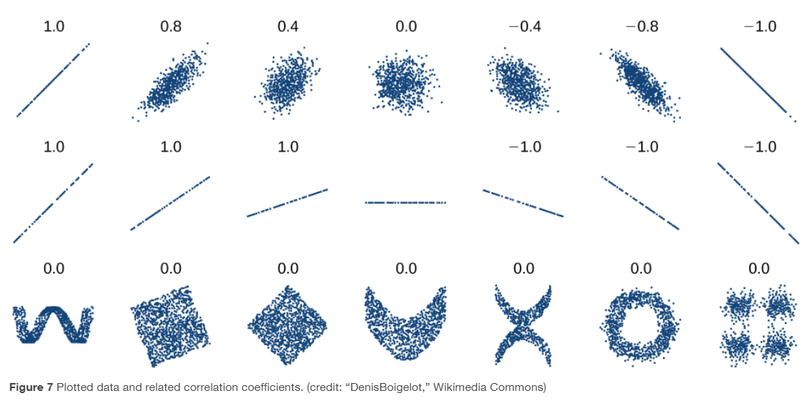

Slide 20
What did you learn in this section?
Draw and interpret scatter diagrams.
Use a graphing utility to find the line of best fit.
Distinguish between linear and nonlinear relations.
Fit a regression line to a set of data and use the linear model to make predictions.

Slide 21
This resource is an adaptation of the OpenStax Algebra and Trigonometry 2e open textbook and is © Susan Aydelotte under a CC BY-NC-SA 4.0 International license; it may be reproduced or modified for noncommercial purposes only but must be attributed to OpenStax, Rice University and any changes must be noted. Any adaptation must be shared under the same type of license.

