Slide 1

Linear Functions
Chapter 4
Algebra and Trigonometry 2e
OpenStax
Jay Abramson
Notes:
Images and notes within these slides are from the OpenStax textbook Algebra and Trigonometry 2e

Slide 2
Modeling with
Linear Functions
Section 4.2

Slide 3
What are the skills discussed in this section?
Build linear models from verbal descriptions.
Model a set of data with a linear function.

Slide 4
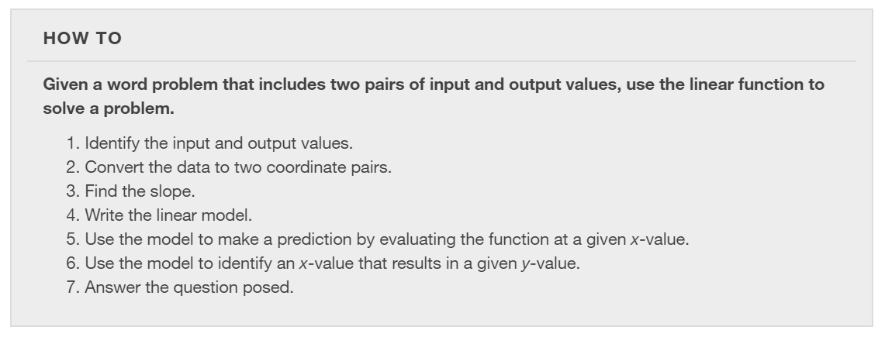

Slide 5
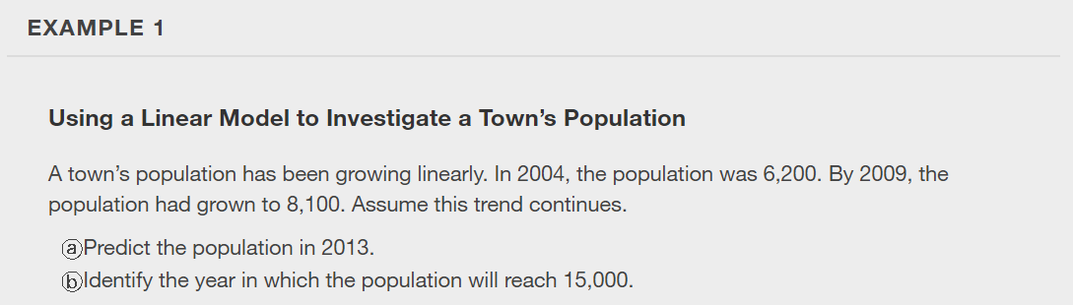

Slide 6
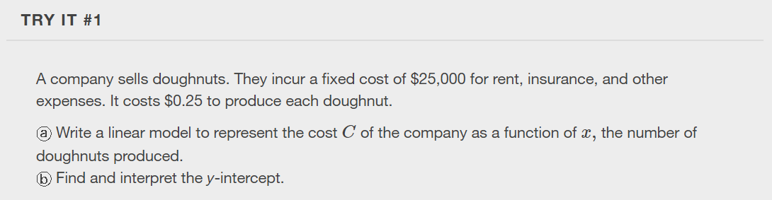

Slide 7
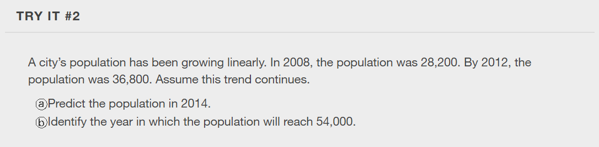

Slide 8
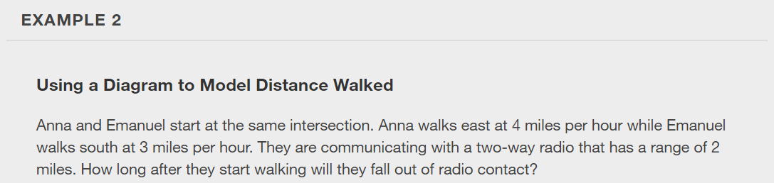

Slide 9
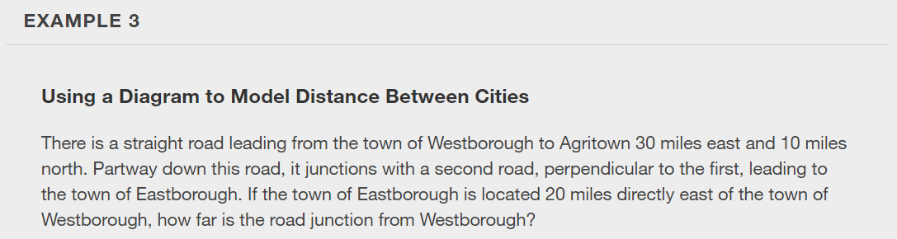

Slide 10
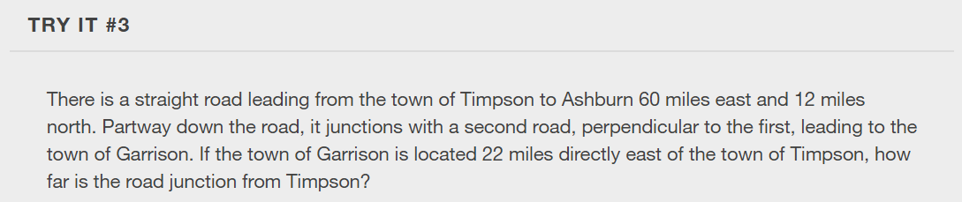

Slide 11
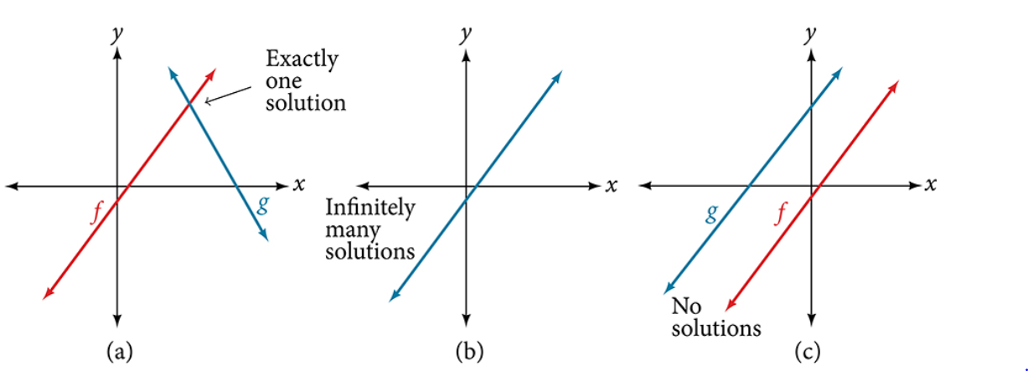

Slide 12
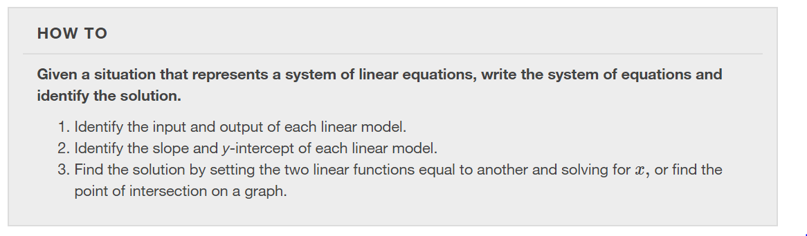

Slide 13
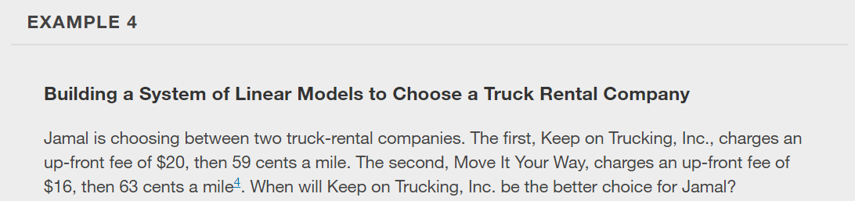

Slide 14
What did you learn in this section?
Build linear models from verbal descriptions.
Model a set of data with a linear function.

Slide 15
This resource is an adaptation of the OpenStax Algebra and Trigonometry 2e open textbook and is © Susan Aydelotte under a CC BY-NC-SA 4.0 International license; it may be reproduced or modified for noncommercial purposes only but must be attributed to OpenStax, Rice University and any changes must be noted. Any adaptation must be shared under the same type of license.

