Slide 1

Linear Functions
Chapter 4
Algebra and Trigonometry 2e
OpenStax
Jay Abramson
Notes:
Images and notes within these slides are from the OpenStax textbook Algebra and Trigonometry 2e

Slide 2
Linear Functions
Section 4.1

Slide 3
What are the skills discussed in this section?
Represent a linear function.
Determine whether a linear function is increasing, decreasing, or constant.
Interpret slope as a rate of change.
Write and interpret an equation for a linear function.
Graph linear functions.
Determine whether lines are parallel or perpendicular.
Write the equation of a line parallel or perpendicular to a given line.

Slide 4
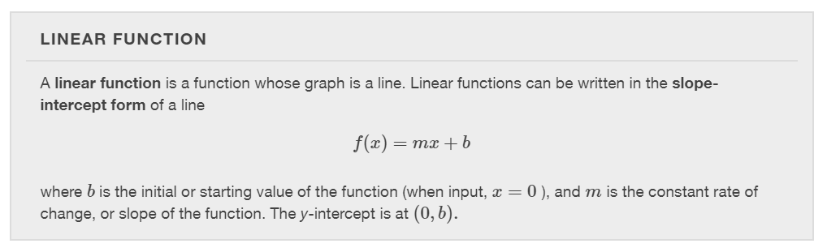

Slide 5
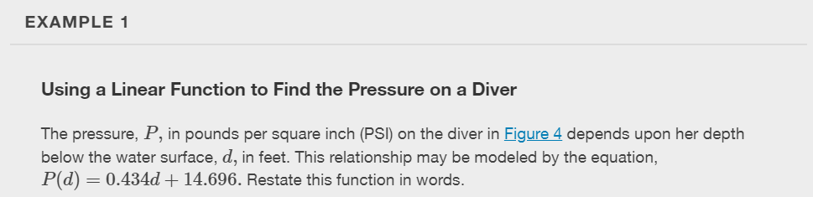


Slide 6
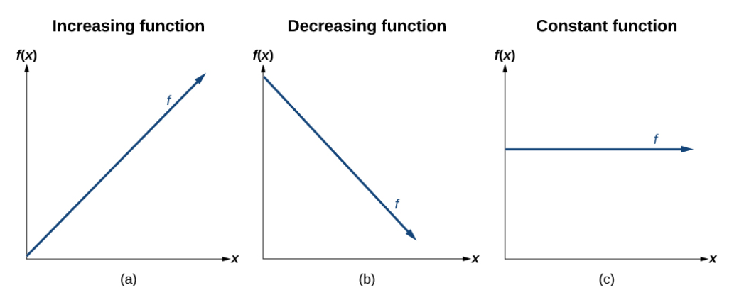
What do you notice about the slopes of each of these lines?

Slide 7
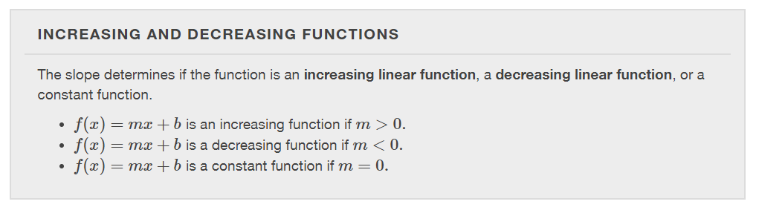

Slide 8
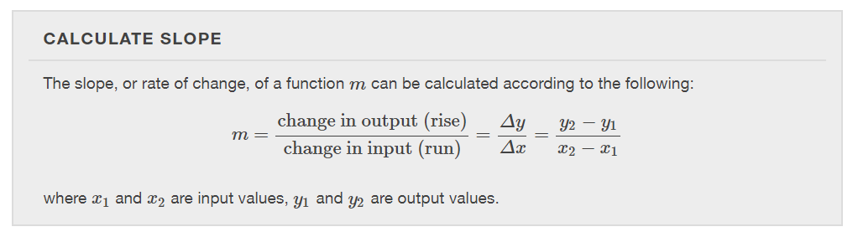

Slide 9
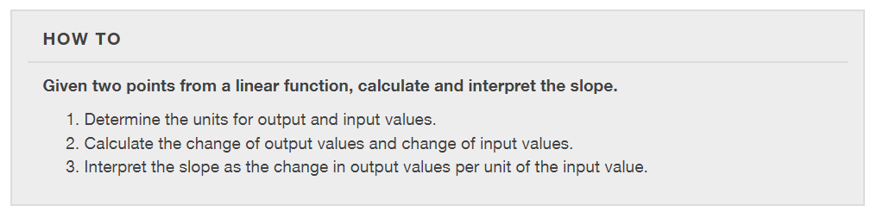

Slide 10
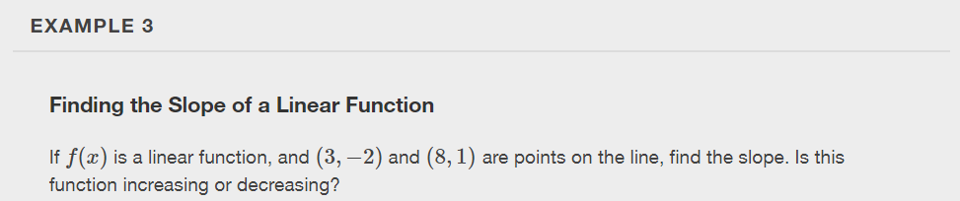

Slide 11
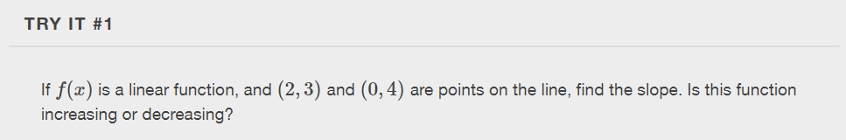

Slide 12
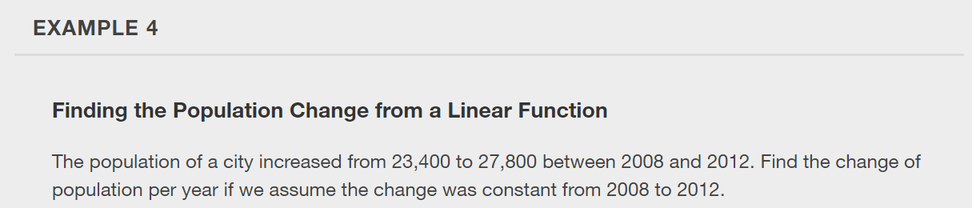

Slide 13
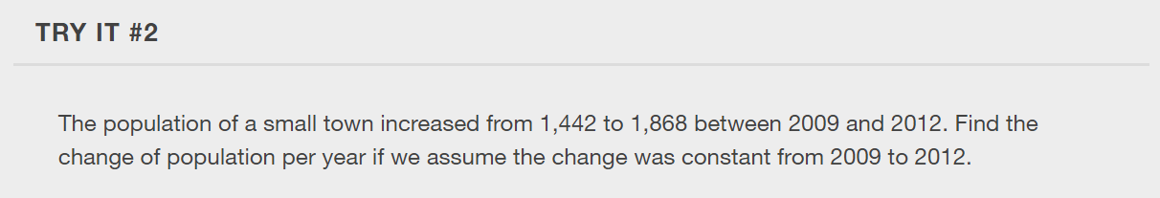

Slide 14
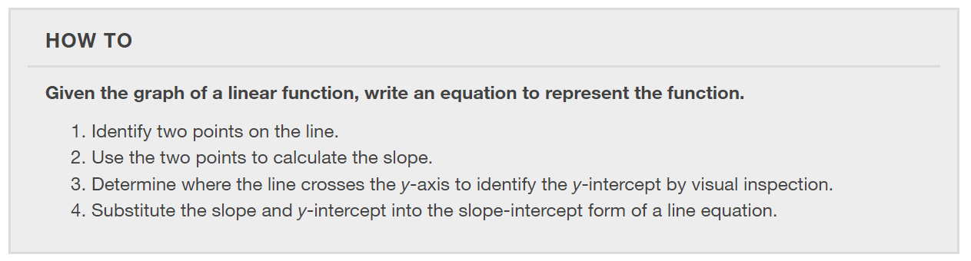

Slide 15
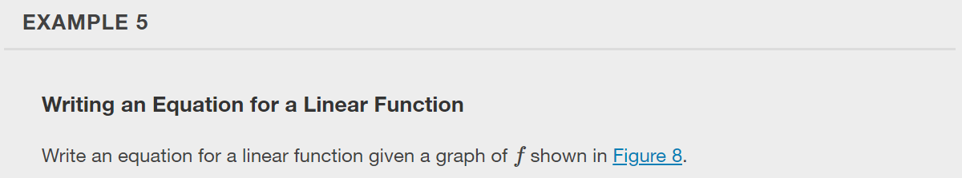
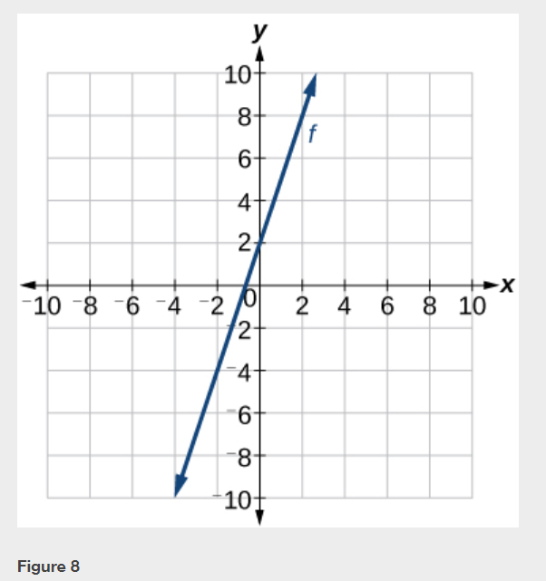

Slide 16
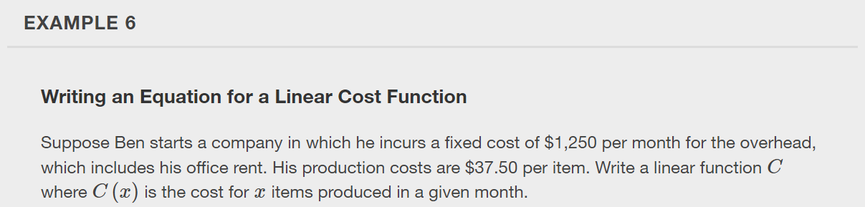

Slide 17
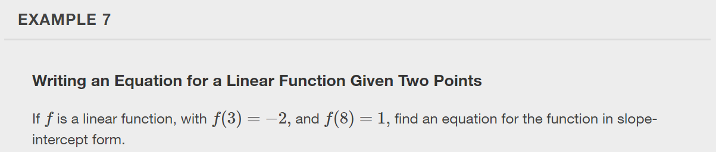

Slide 18
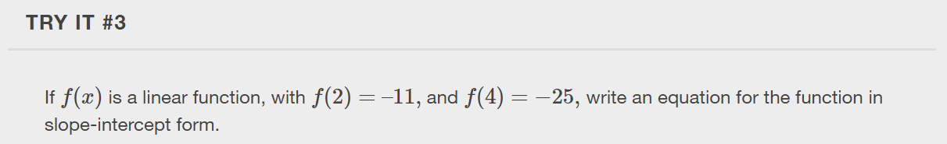

Slide 19
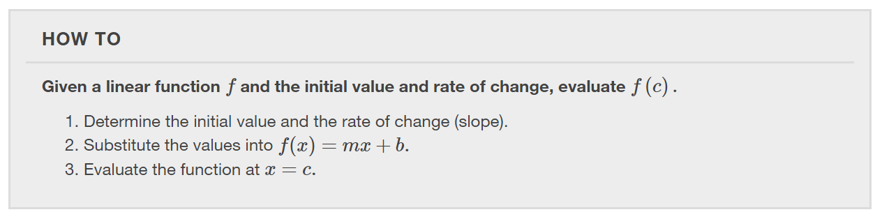
Modeling Real-World Problems with Linear Functions
In the real world, problems are not always explicitly stated in terms of a function or represented with a graph. Fortunately, we can analyze the problem by first representing it as a linear function and then interpreting the components of the function. As long as we know, or can figure out, the initial value and the rate of change of a linear function, we can solve many different kinds of real-world problems.

Slide 20
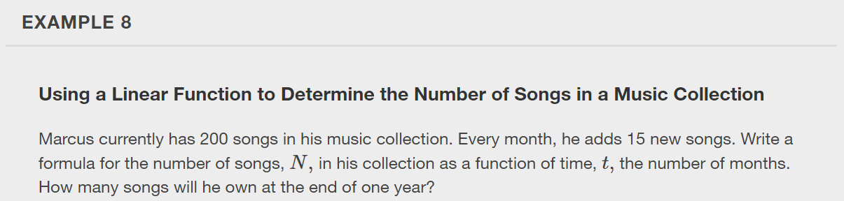

Slide 21
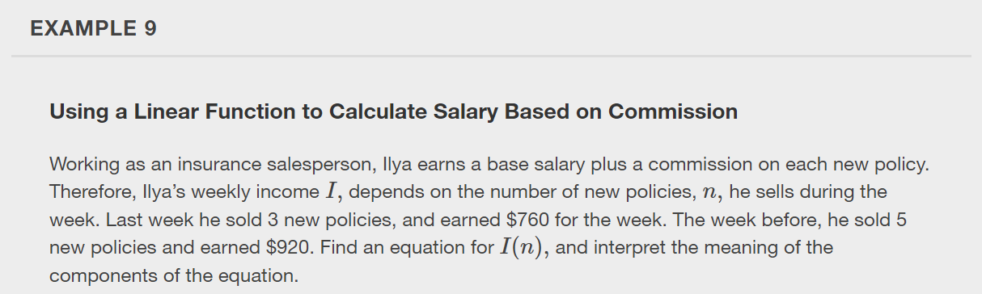

Slide 22
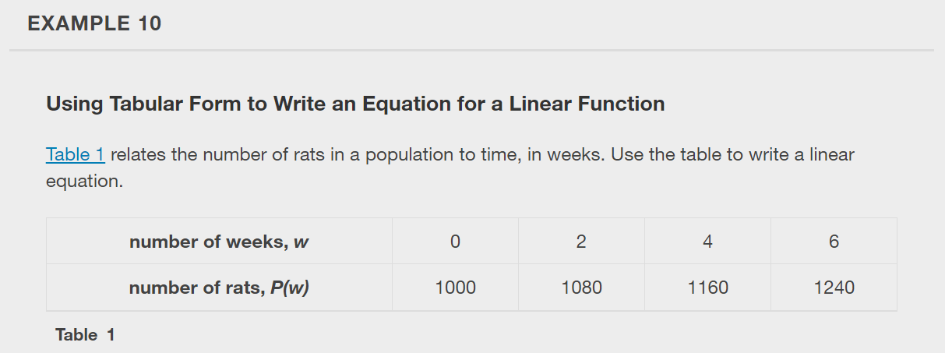

Slide 23
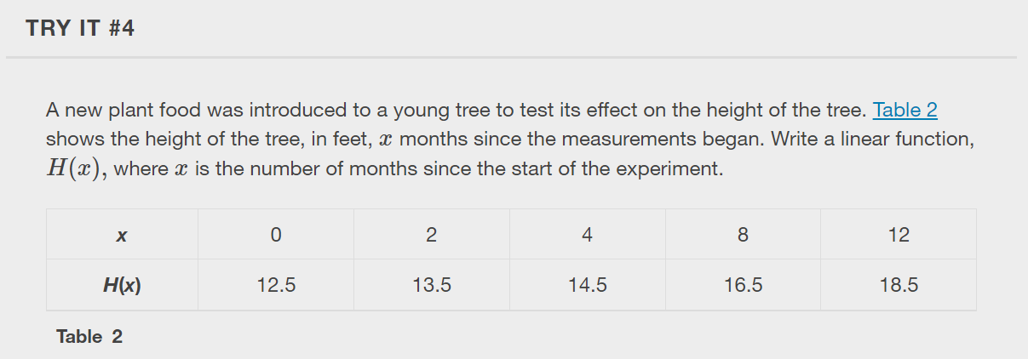

Slide 24
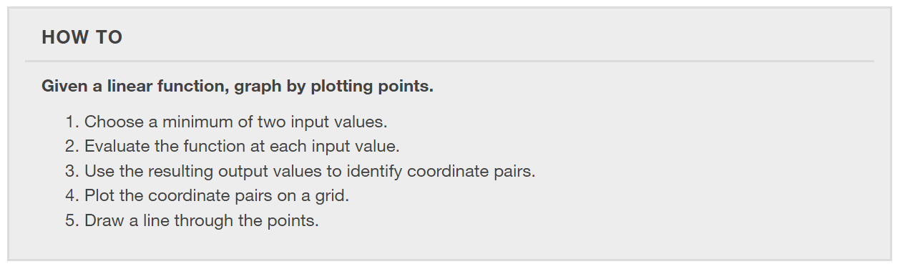
Graphing a Linear Function by Plotting Points
To find points of a function, we can choose input values, evaluate the function at these input values, and calculate output values. The input values and corresponding output values form coordinate pairs. We then plot the coordinate pairs on a grid.

Slide 25
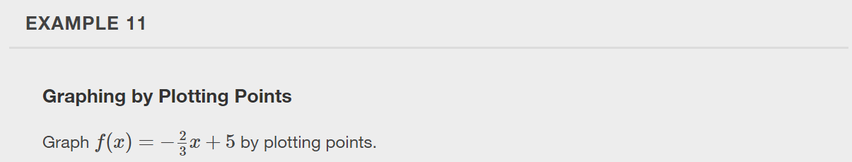

Slide 26
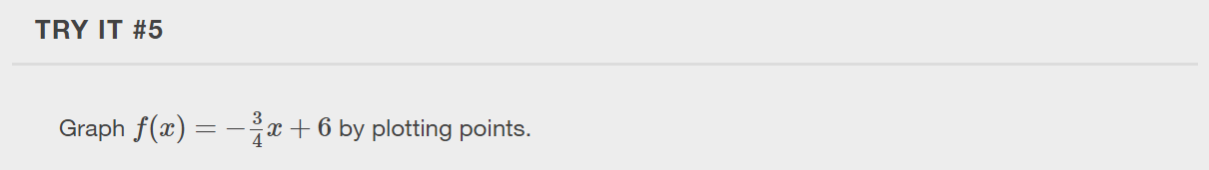

Slide 27
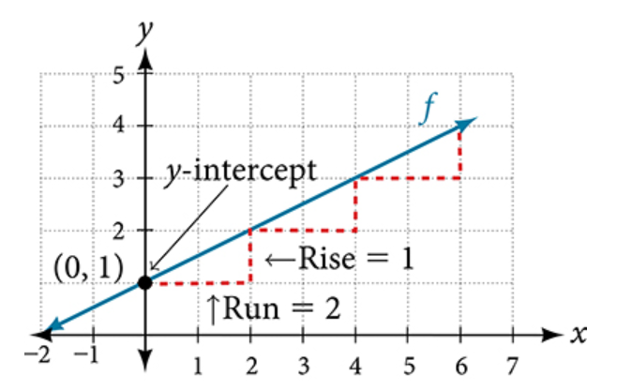
Graphing a Function Using y-intercept and Slope
Another way to graph linear functions is by using specific characteristics of the function rather than plotting points. The first characteristic is its y-intercept, which is the point at which the input value is zero.

Slide 28
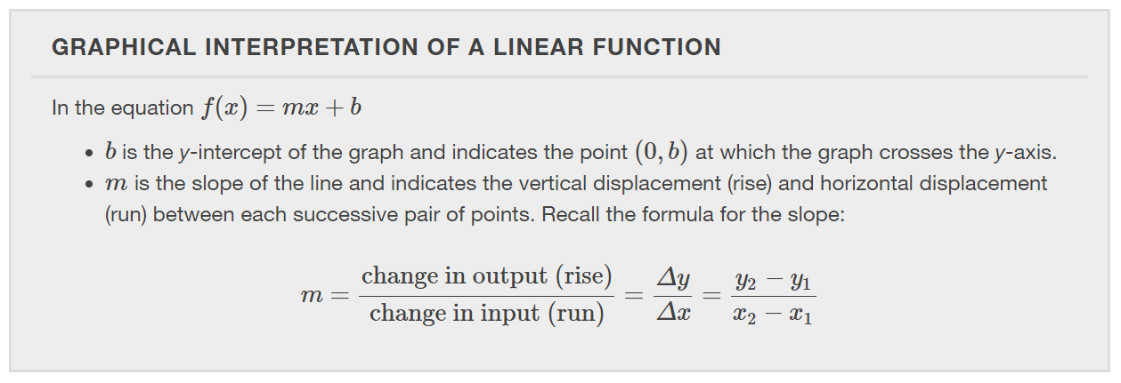

Slide 29
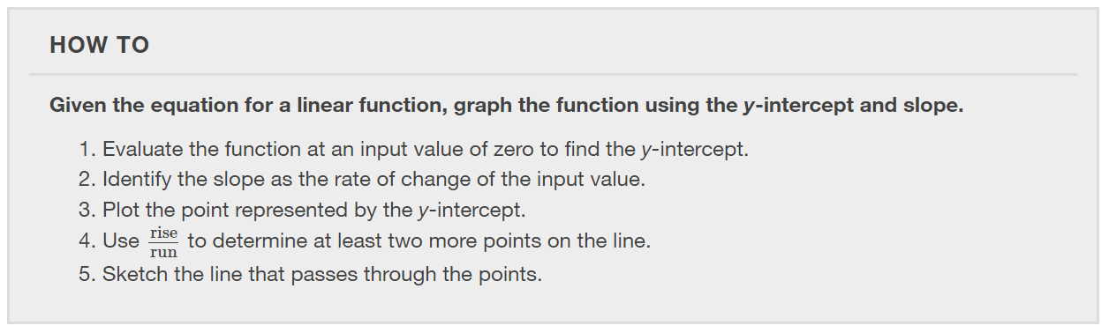

Slide 30
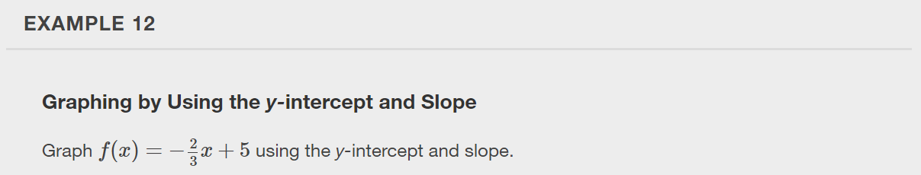

Slide 31
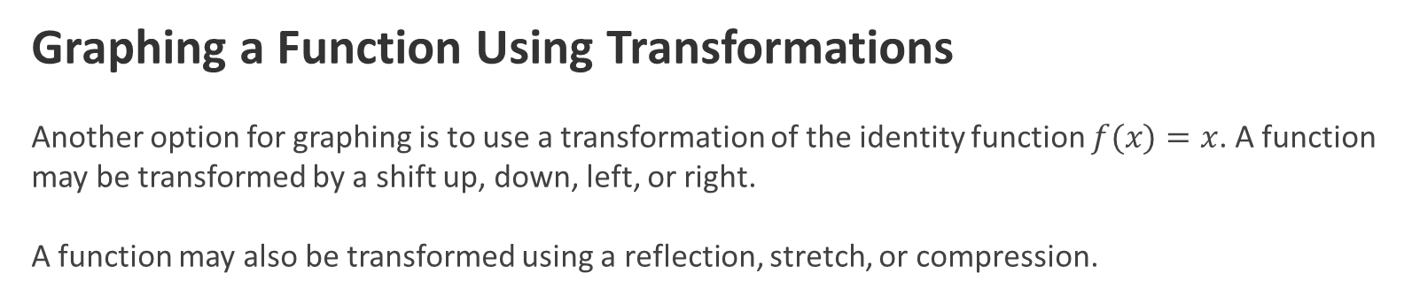
Graphing a Function Using Transformations
Another option for graphing is to use a transformation of the identity function $f(x)=x$. A function may be transformed by a shift up, down, left, or right.
A function may also be transformed using a reflection, stretch, or compression.

Slide 32
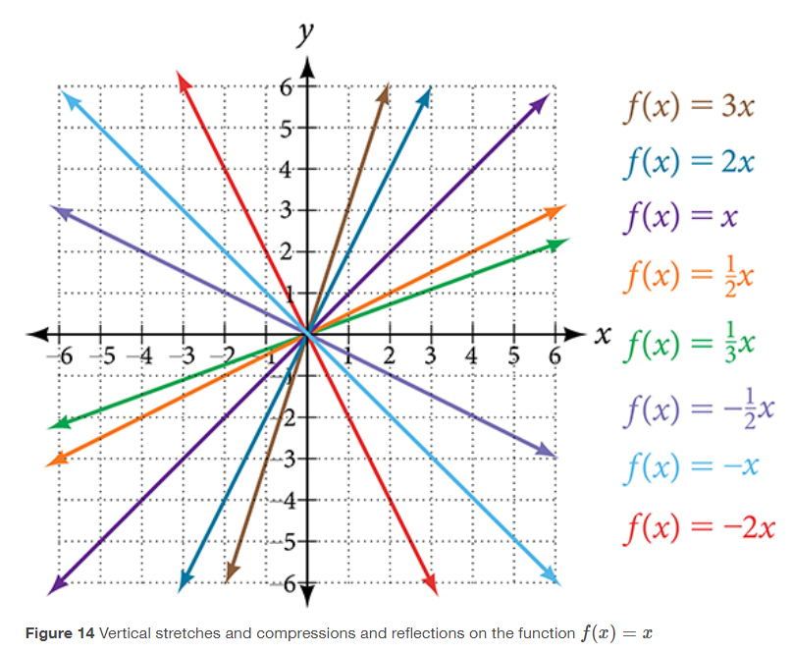
Vertical Stretch or Compression
Notes:
Vertical Stretch or Compression
In the equation f(x)=mx, the m is acting as the vertical stretch or compression of the identity function. When m is negative, there is also a vertical reflection of the graph. Notice in Figure 14 that multiplying the equation of f(x)=x by m stretches the graph of f by a factor of m units if m>1 and compresses the graph of f by a factor of m units if 0<m<1. This means the larger the absolute value of m, the steeper the slope.

Slide 33
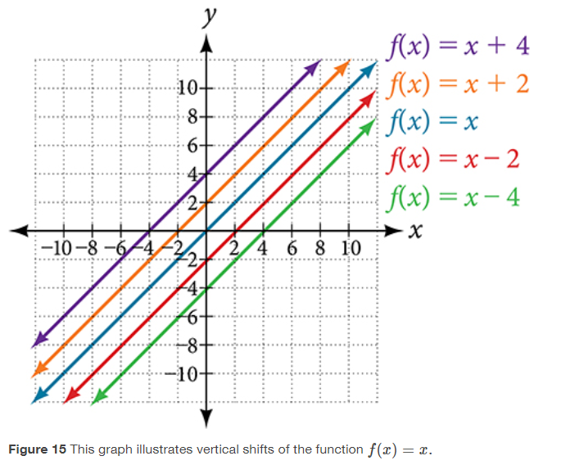
Vertical Shift
Notes:
Vertical Shift
In f(x)=mx+b, the b acts as the vertical shift, moving the graph up and down without affecting the slope of the line. Notice in Figure 15 that adding a value of b to the equation of f(x)=x shifts the graph of f a total of b units up if b is positive and |b| units down if b is negative.

Slide 34
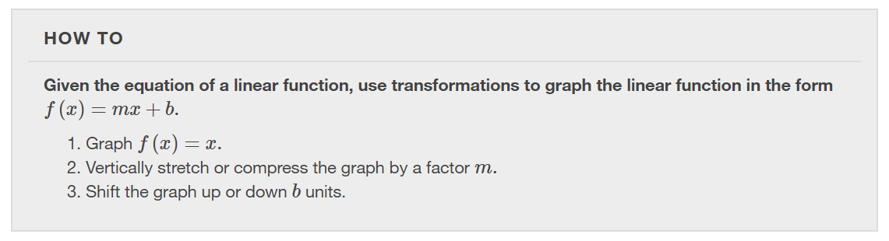

Slide 35
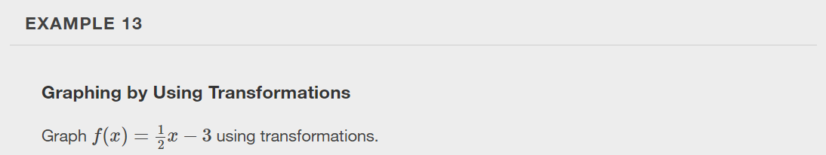

Slide 36
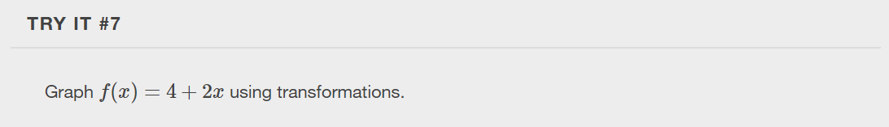

Slide 37
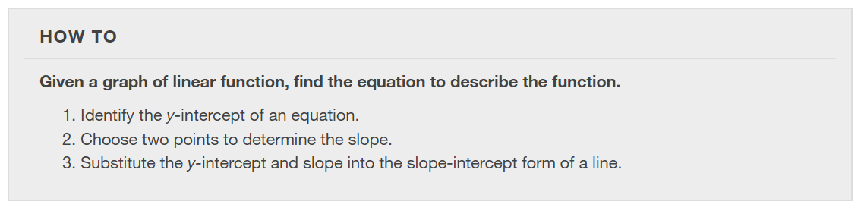

Slide 38
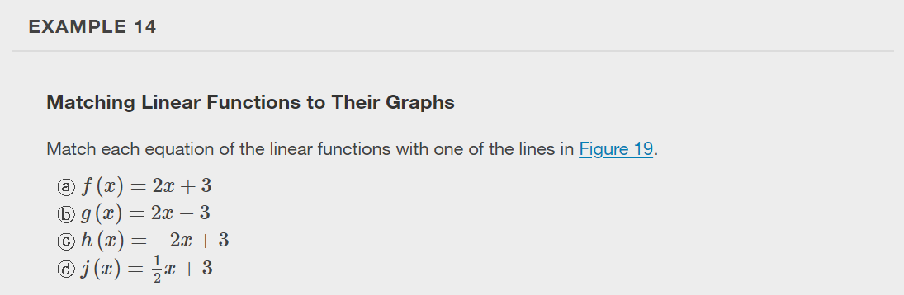

Slide 39
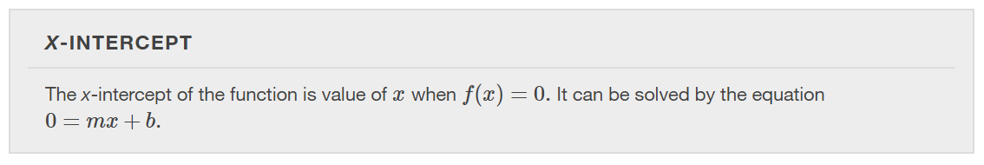

Slide 40
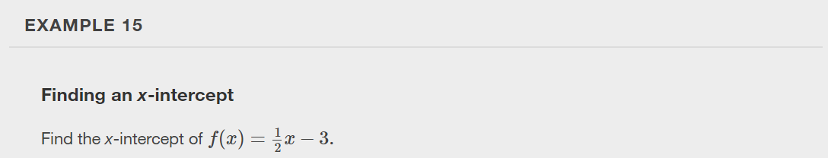

Slide 41


Slide 42
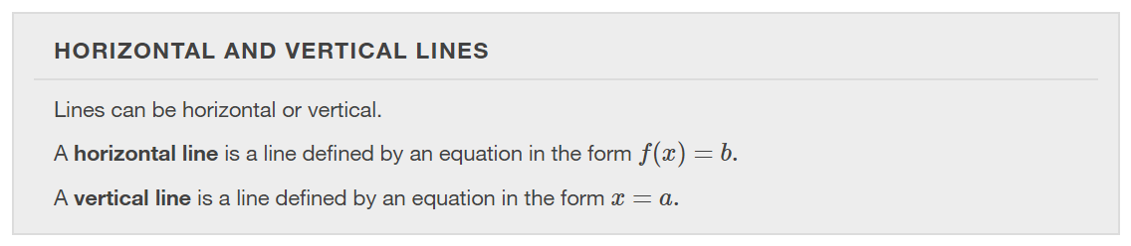

Slide 43
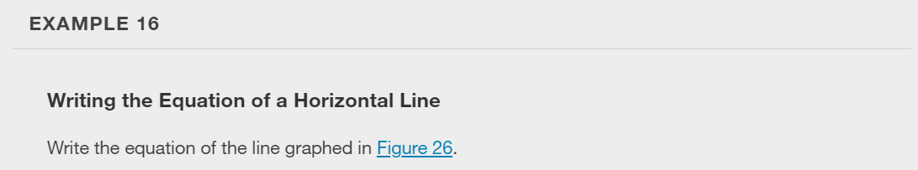
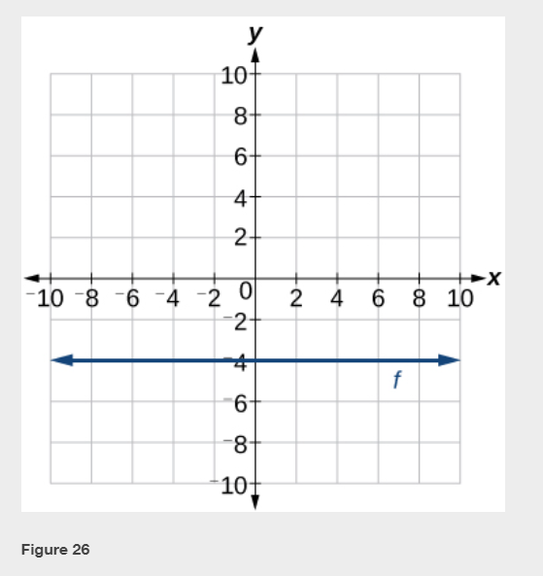

Slide 44
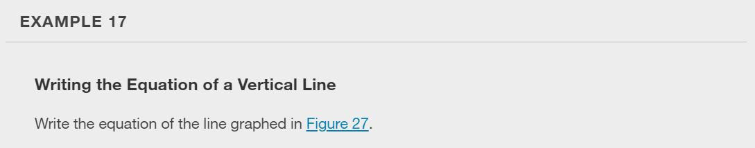
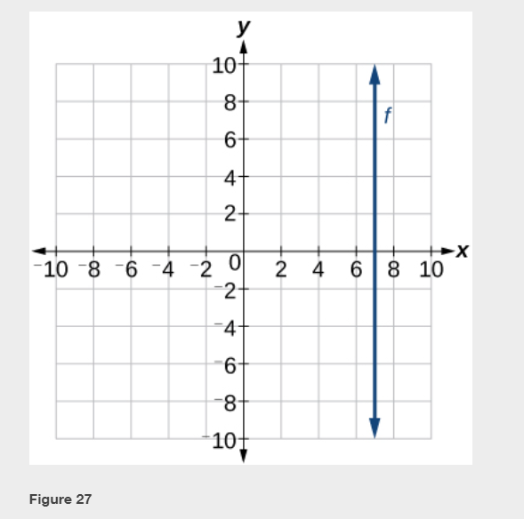

Slide 45
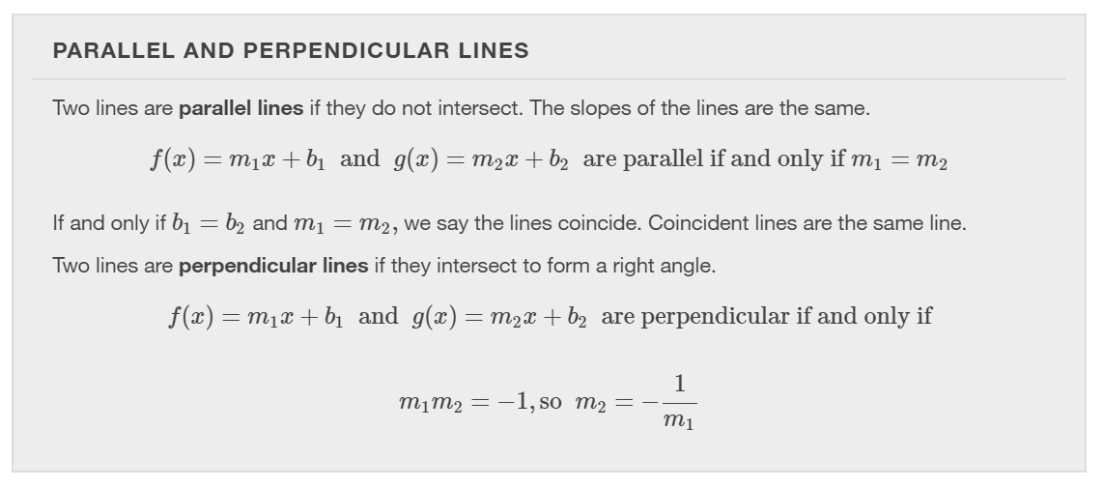

Slide 46
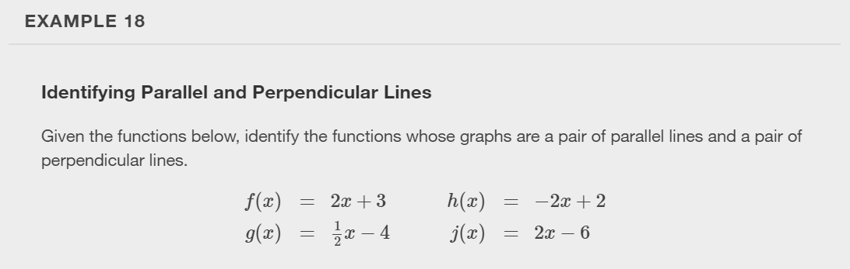

Slide 47
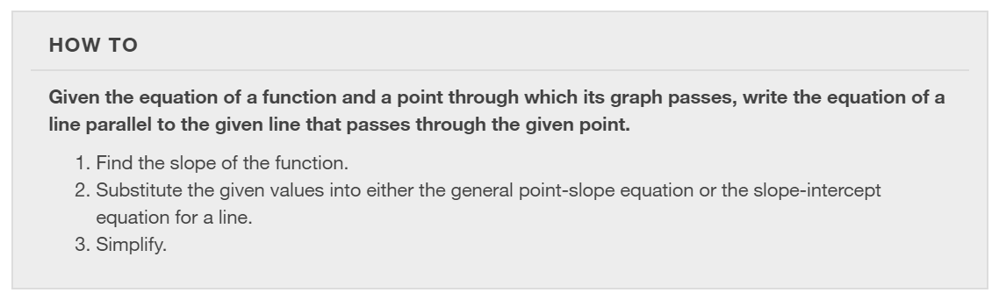

Slide 48
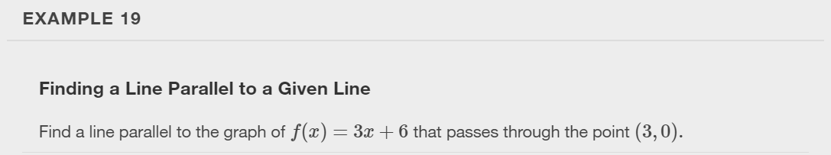

Slide 49
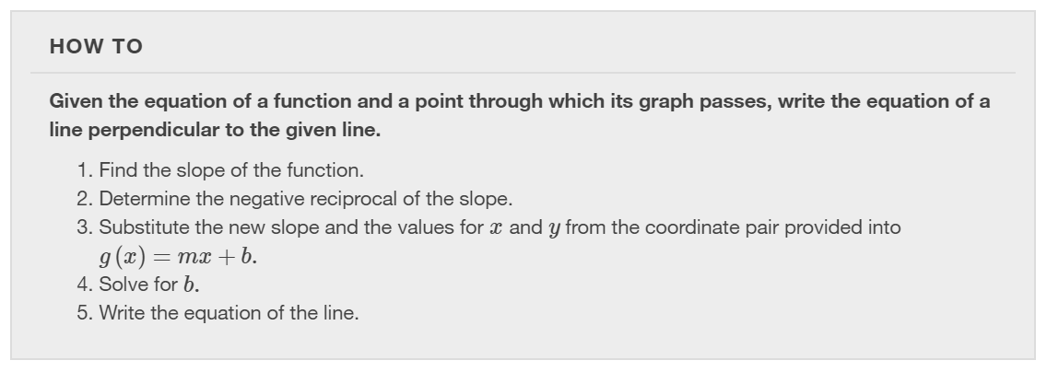

Slide 50
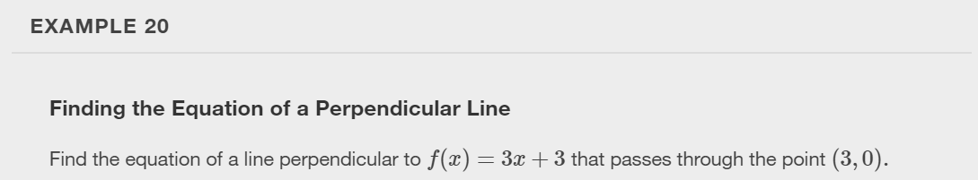

Slide 51
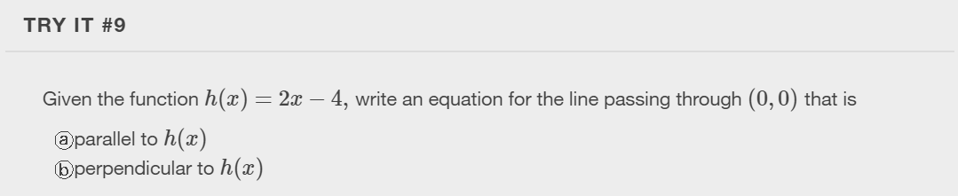

Slide 52


Slide 53


Slide 54


Slide 55
What did you learn in this section?
Represent a linear function.
Determine whether a linear function is increasing, decreasing, or constant.
Interpret slope as a rate of change.
Write and interpret an equation for a linear function.
Graph linear functions.
Determine whether lines are parallel or perpendicular.
Write the equation of a line parallel or perpendicular to a given line.
Notes:
Do you have any questions?

Slide 56
This resource is an adaptation of the OpenStax Algebra and Trigonometry 2e open textbook and is © Susan Aydelotte under a CC BY-NC-SA 4.0 International license; it may be reproduced or modified for noncommercial purposes only but must be attributed to OpenStax, Rice University and any changes must be noted. Any adaptation must be shared under the same type of license.

