Slide 1

Functions
Chapter 3
Algebra and Trigonometry 2e
OpenStax
Jay Abramson
Notes:
Images and notes within these slides are from the OpenStax textbook Algebra and Trigonometry 2e

Slide 2
Inverse Functions
Section 3.7

Slide 3
What are the skills discussed in this section?
Verify inverse functions.
Determine the domain and range of an inverse function and restrict the domain of a function to make it one-to-one.
Find or evaluate the inverse of a function.
Use the graph of a one-to-one function to graph its inverse function on the same axes.
Notes:
In this section, we will practice determining domains and ranges for specific functions. We can write the domain and range in interval notation, which uses values within brackets to describe a set of numbers.

Slide 4
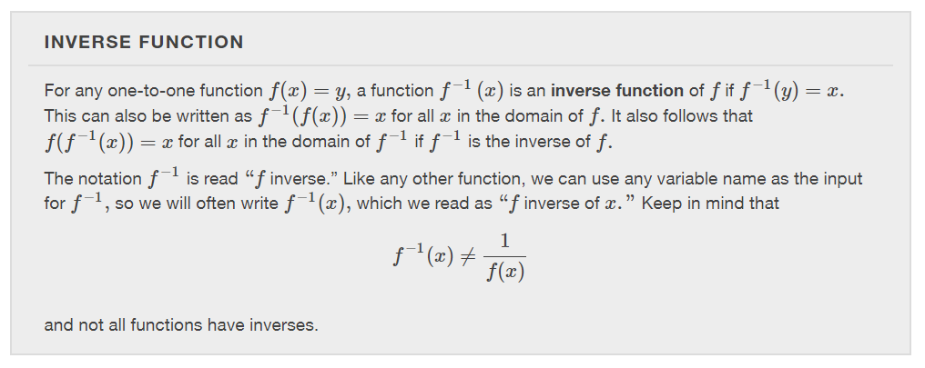

Slide 5
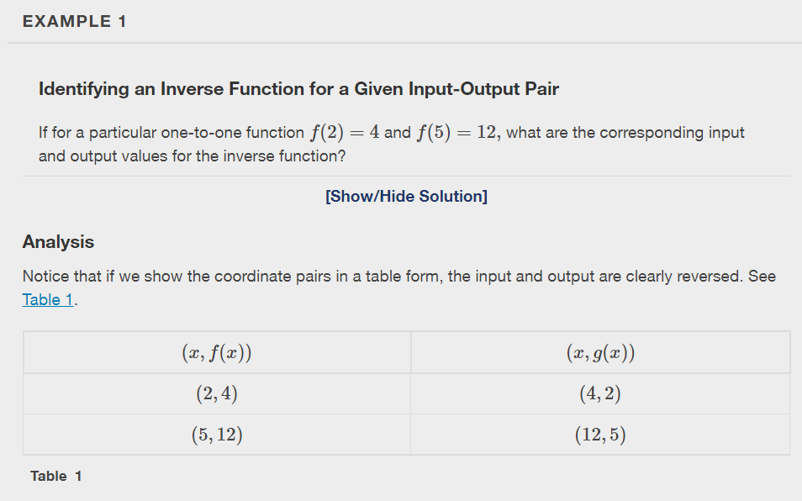

Slide 6
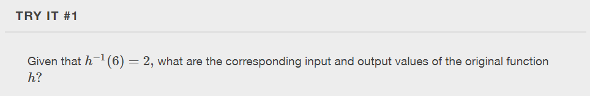

Slide 7
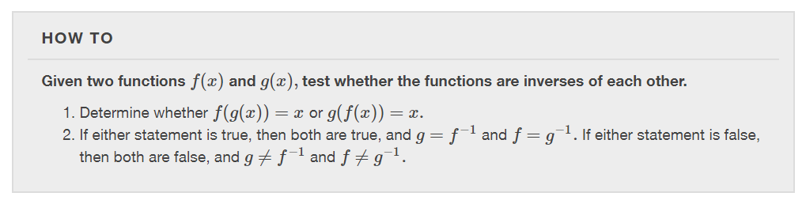

Slide 8
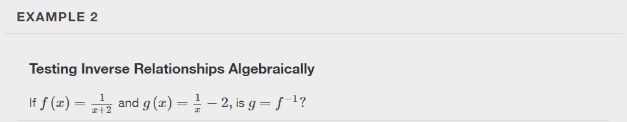

Slide 9
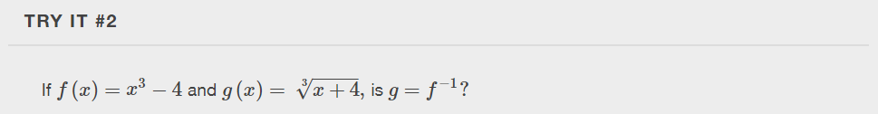

Slide 10
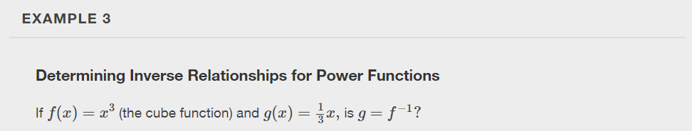

Slide 11
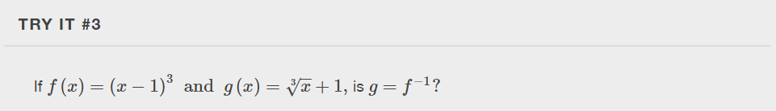

Slide 12
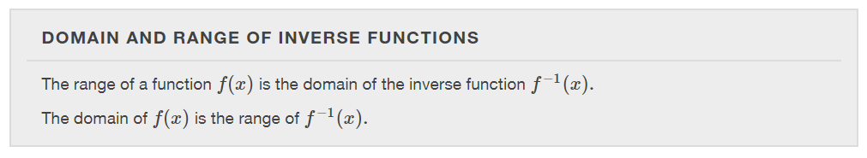

Slide 13
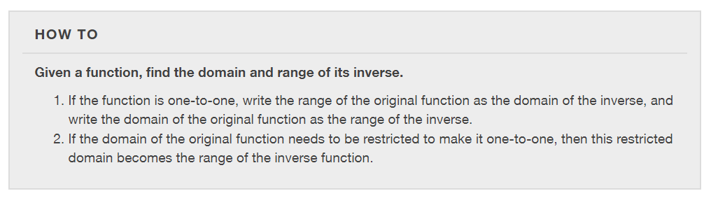

Slide 14
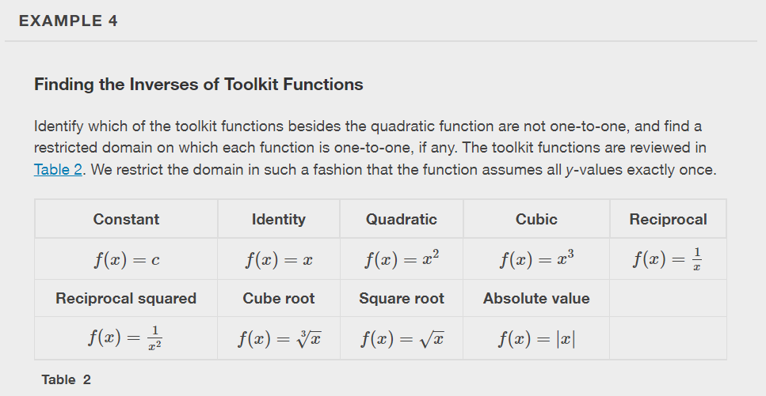

Slide 15
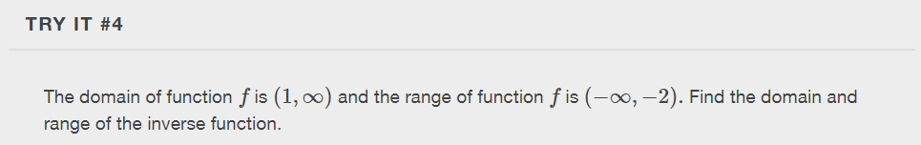

Slide 16
Finding and Evaluating Inverse Functions
Once we have a one-to-one function, we can evaluate its inverse at specific inverse function inputs or construct a complete representation of the inverse function in many cases.
Inverting Tabular Functions
Suppose we want to find the inverse of a function represented in table form. Remember that the domain of a function is the range of the inverse and the range of the function is the domain of the inverse. So we need to interchange the domain and range.
Each row (or column) of inputs becomes the row (or column) of outputs for the inverse function. Similarly, each row (or column) of outputs becomes the row (or column) of inputs for the inverse function.

Slide 17
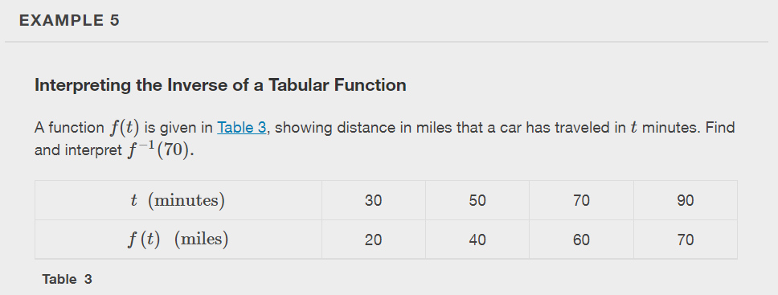

Slide 18
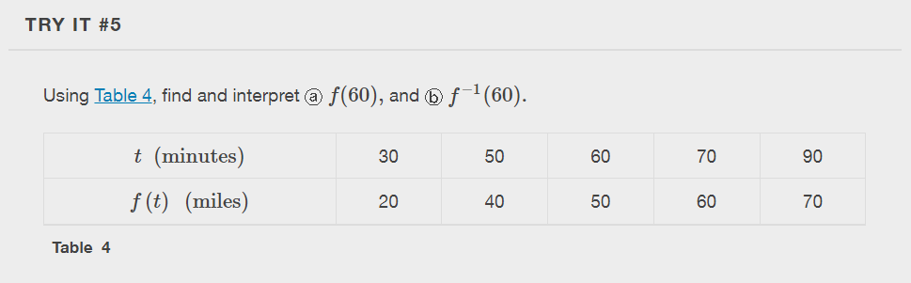

Slide 19
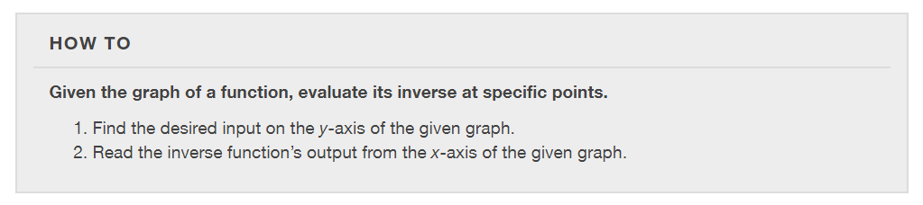

Slide 20
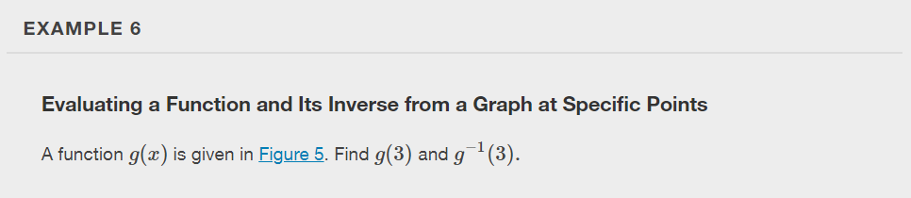
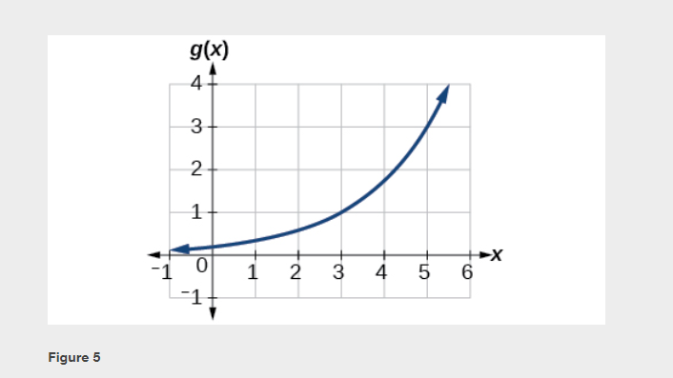

Slide 21
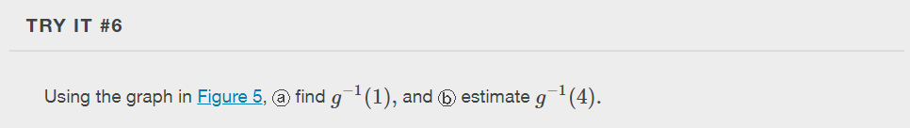
Notes:
Use a graphing calculator to graph.

Slide 22
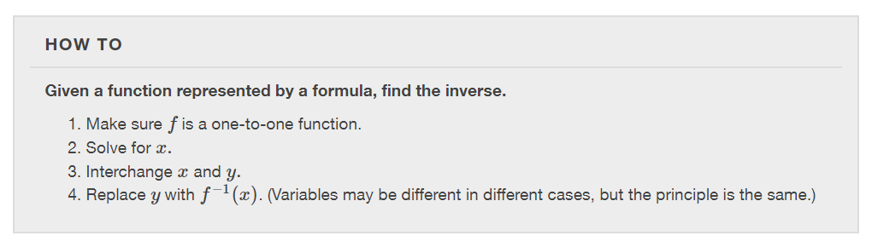

Slide 23
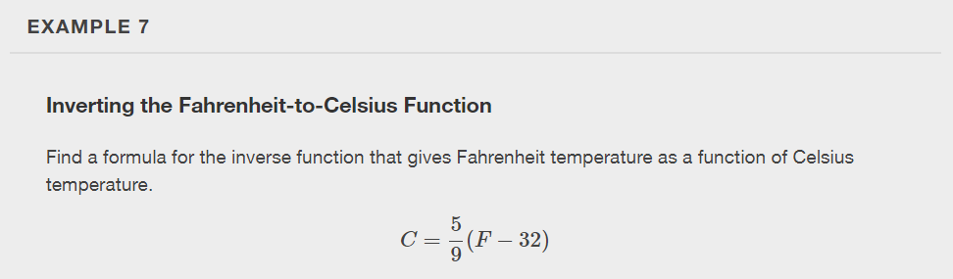

Slide 24
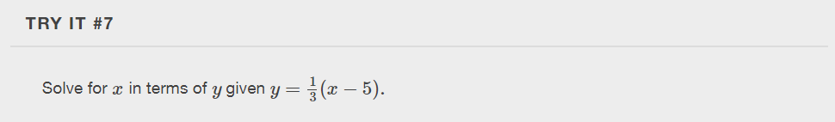

Slide 25
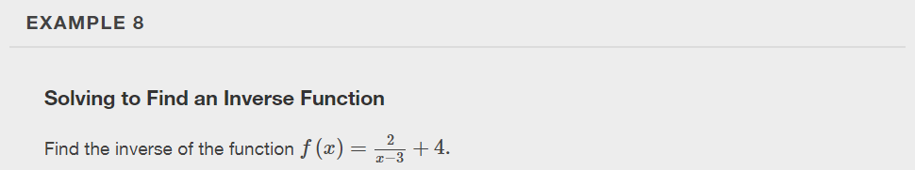

Slide 26
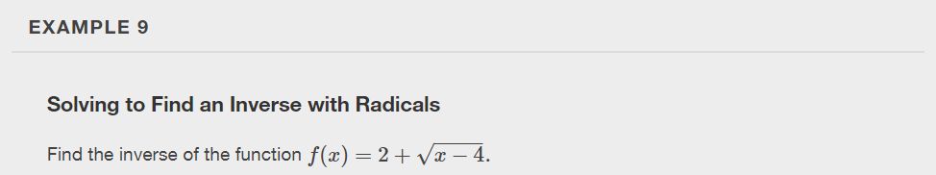

Slide 27
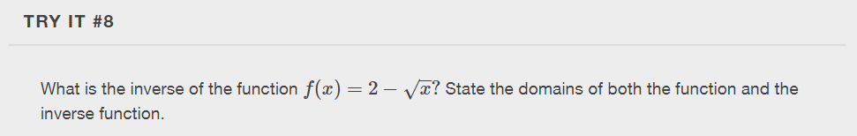

Slide 28
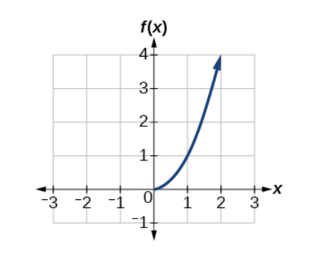
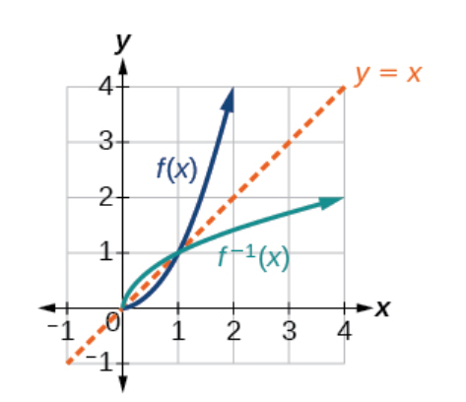
Finding Inverse Functions and Their Graphs
Now that we can find the inverse of a function, we will explore the graphs of functions and their inverses.

Slide 29
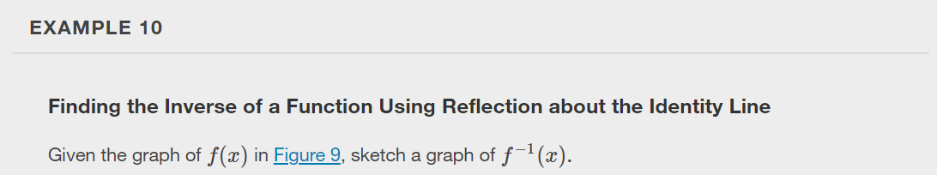
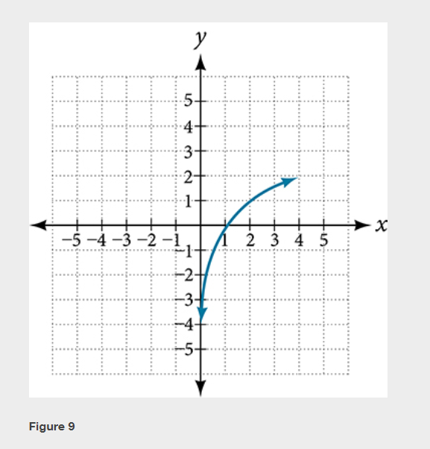

Slide 30
What did you learn in this section?
Graph functions using vertical and horizontal shifts.
Graph functions using reflections about the x-axis and the y-axis.
Determine whether a function is even, odd, or neither from its graph.
Graph functions using compressions and stretches.
Combine transformations.
Notes:
Do you have any questions?

Slide 31
This resource is an adaptation of the OpenStax Algebra and Trigonometry 2e open textbook and is © Susan Aydelotte under a CC BY-NC-SA 4.0 International license; it may be reproduced or modified for noncommercial purposes only but must be attributed to OpenStax, Rice University and any changes must be noted. Any adaptation must be shared under the same type of license.

