Slide 1

Functions
Chapter 3
Algebra and Trigonometry 2e
OpenStax
Jay Abramson
Notes:
Images and notes within these slides are from the OpenStax textbook Algebra and Trigonometry 2e

Slide 2
Absolute Value Functions
Section 3.6

Slide 3
What are the skills discussed in this section?
Graph an absolute value function.
Solve an absolute value equation.
Notes:
In this section, we will practice determining domains and ranges for specific functions. We can write the domain and range in interval notation, which uses values within brackets to describe a set of numbers.

Slide 4
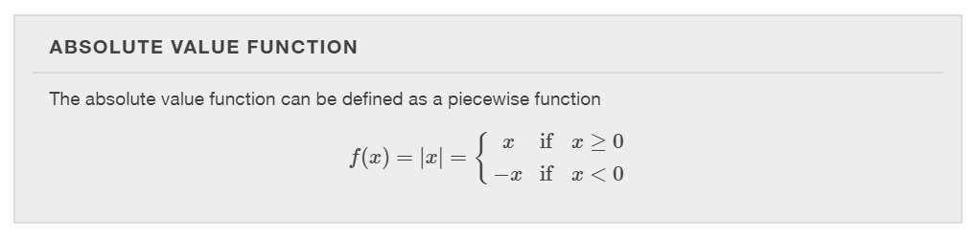
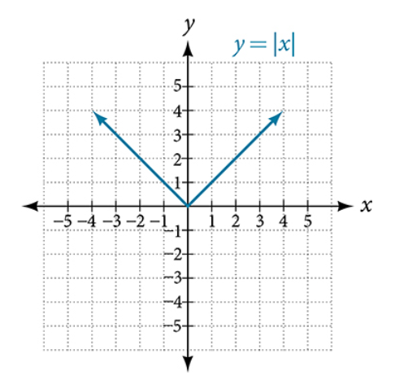

Slide 5
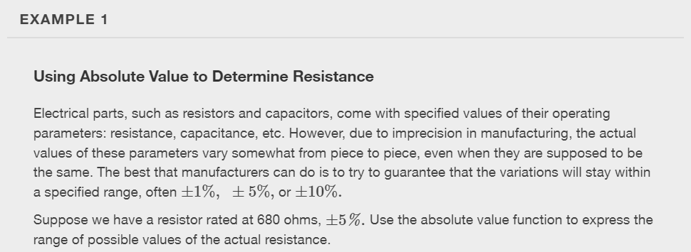

Slide 6
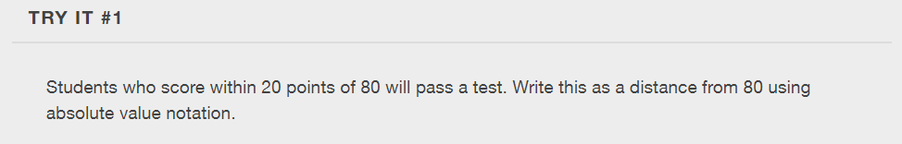

Slide 7
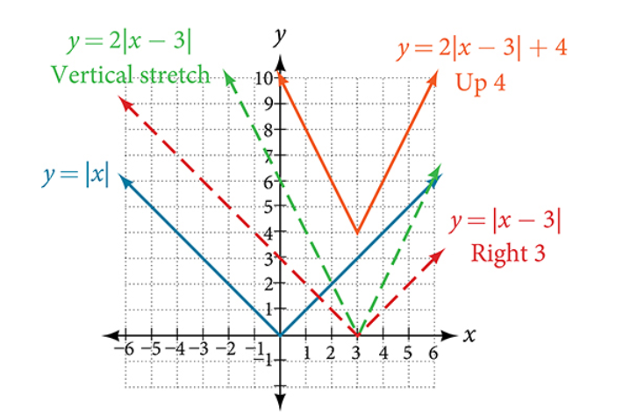
Graphing an Absolute Value Function
The most significant feature of the absolute value graph is the corner point at which the graph changes direction.

Slide 8
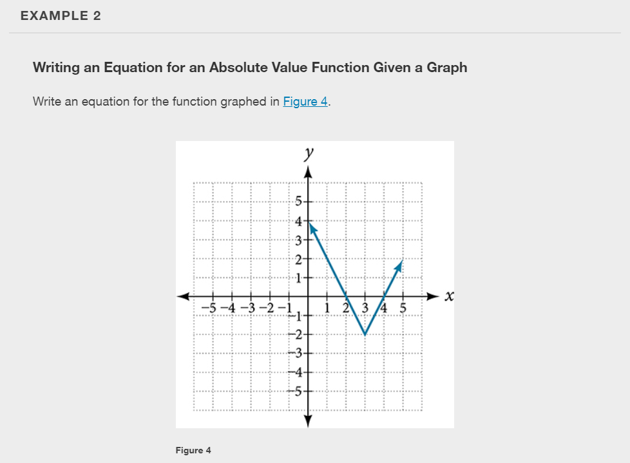

Slide 9
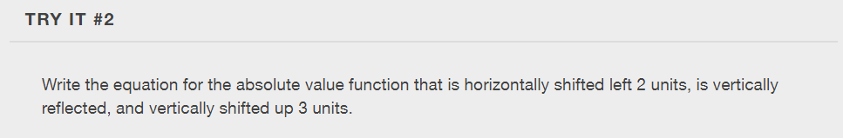

Slide 10
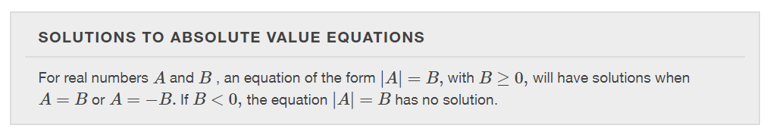
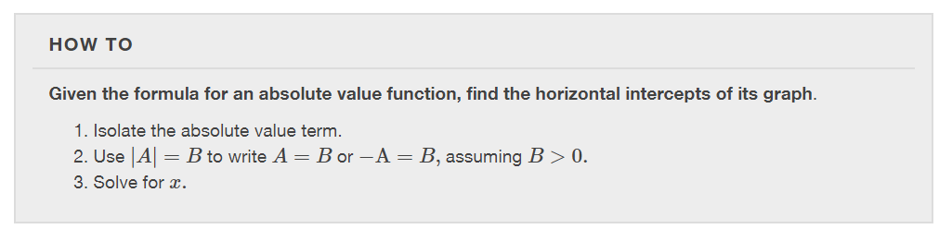

Slide 11
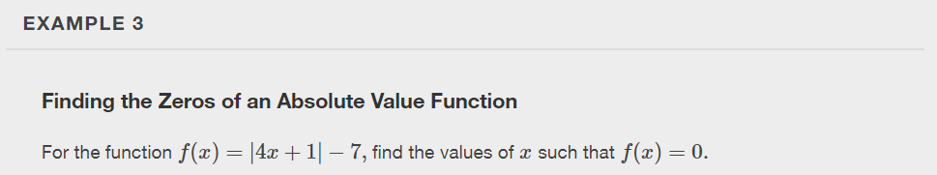

Slide 12
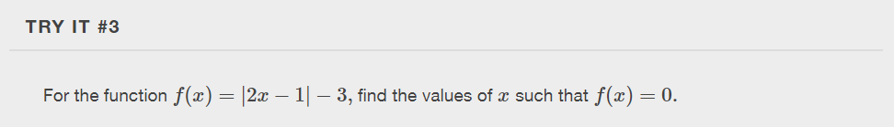

Slide 13
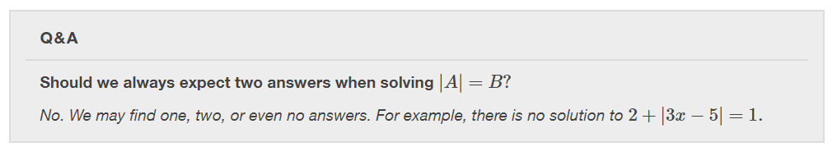
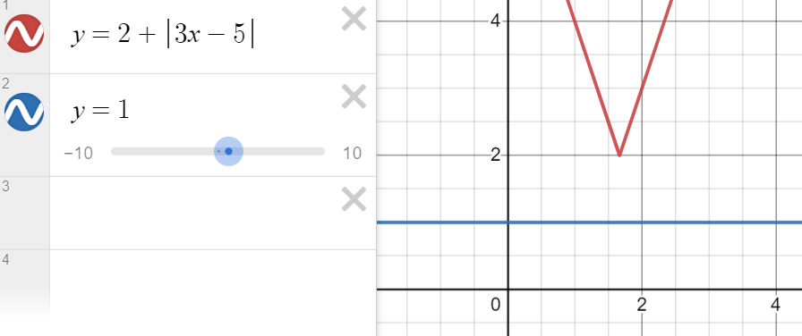

Slide 14
What did you learn in this section?
Graph an absolute value function.
Solve an absolute value equation.
Notes:
Do you have any questions?

Slide 15
This resource is an adaptation of the OpenStax Algebra and Trigonometry 2e open textbook and is © Susan Aydelotte under a CC BY-NC-SA 4.0 International license; it may be reproduced or modified for noncommercial purposes only but must be attributed to OpenStax, Rice University and any changes must be noted. Any adaptation must be shared under the same type of license.

