Slide 1

Functions
Chapter 3
Algebra and Trigonometry 2e
OpenStax
Jay Abramson
Notes:
Images and notes within these slides are from the OpenStax textbook Algebra and Trigonometry 2e

Slide 2
Transformation of Functions
Section 3.5

Slide 3
What are the skills discussed in this section?
Graph functions using vertical and horizontal shifts.
Graph functions using reflections about the x-axis and the y-axis.
Determine whether a function is even, odd, or neither from its graph.
Graph functions using compressions and stretches.
Combine transformations.
Notes:
In this section, we will practice determining domains and ranges for specific functions. We can write the domain and range in interval notation, which uses values within brackets to describe a set of numbers.

Slide 4
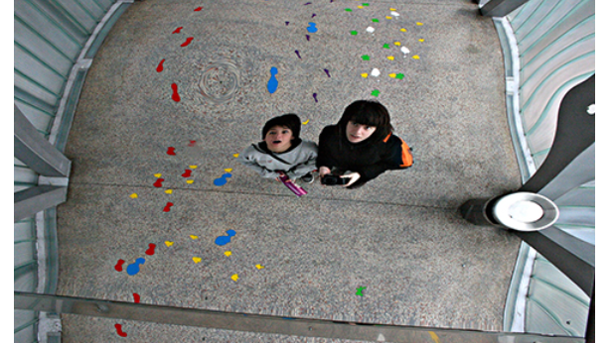
Notes:
A flat mirror enables us to see an accurate image of ourselves and whatever is behind us. When we tilt the mirror, the images we see may shift horizontally or vertically. But what happens when we bend a flexible mirror? Like a carnival funhouse mirror, it presents us with a distorted image of ourselves, stretched or compressed horizontally or vertically. In a similar way, we can distort or transform mathematical functions to better adapt them to describing objects or processes in the real world. In this section, we will take a look at several kinds of transformations.

Slide 5
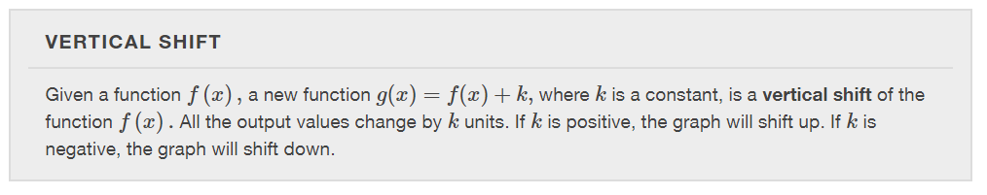

Slide 6
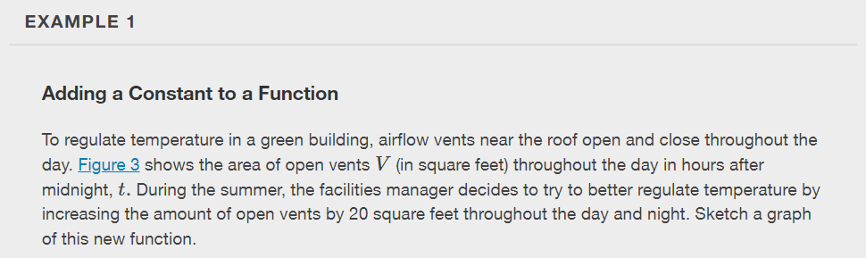
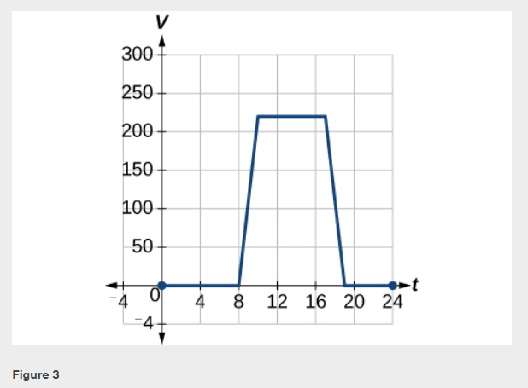

Slide 7
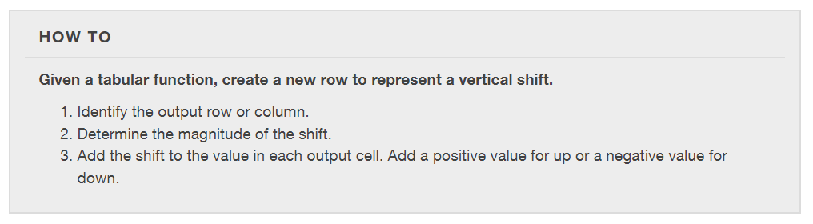

Slide 8
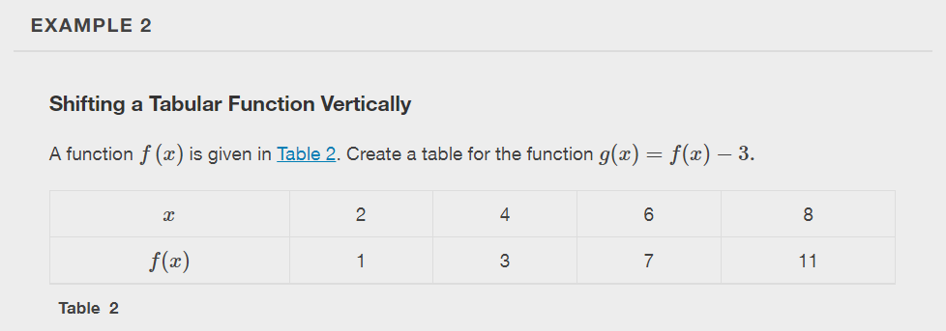

Slide 9
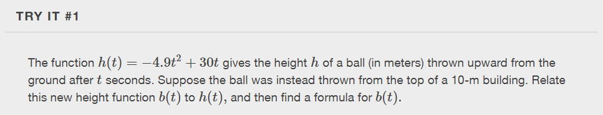

Slide 10
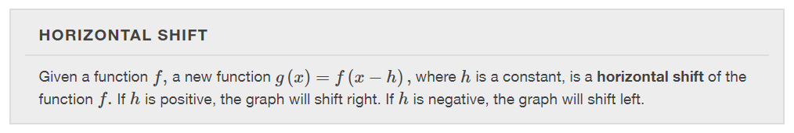

Slide 11
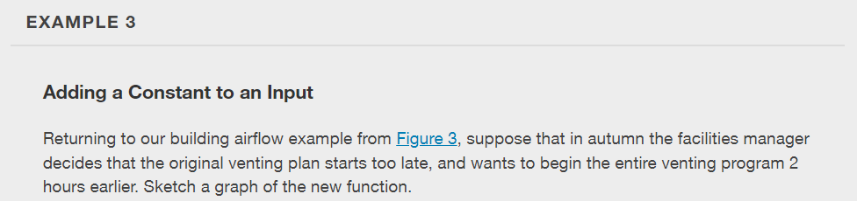

Slide 12
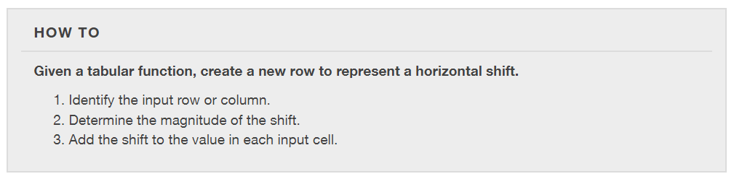

Slide 13
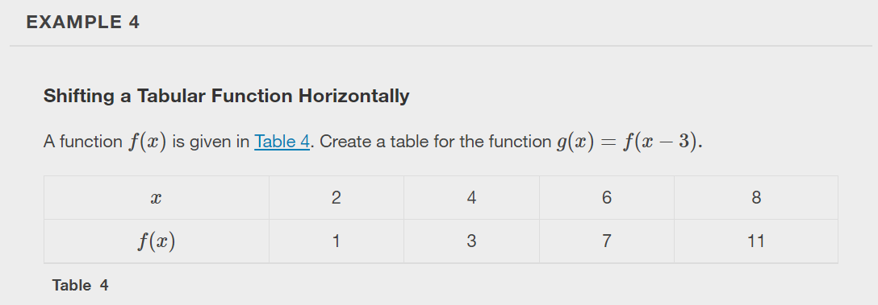

Slide 14
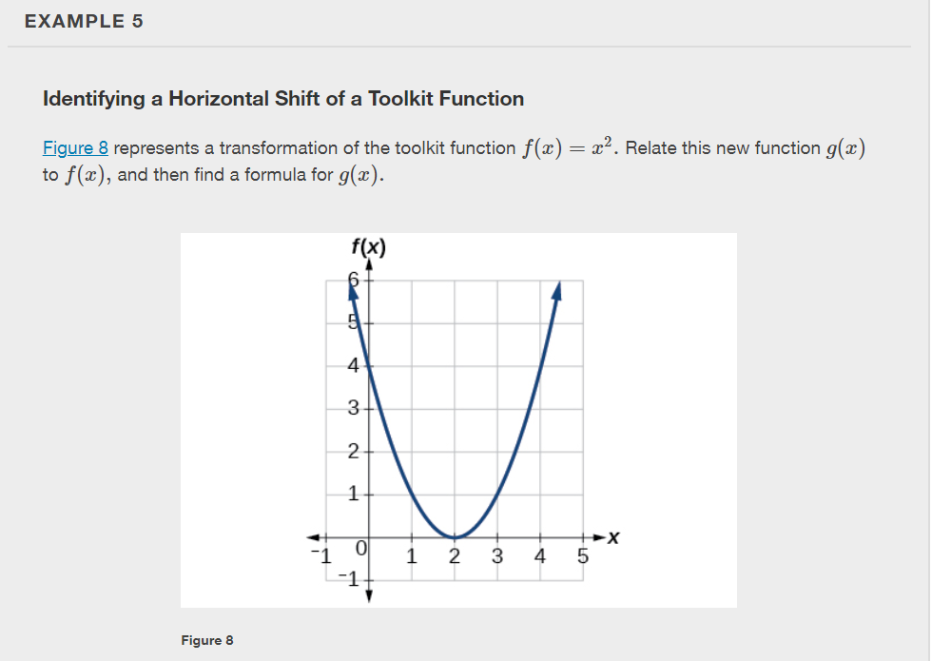

Slide 15
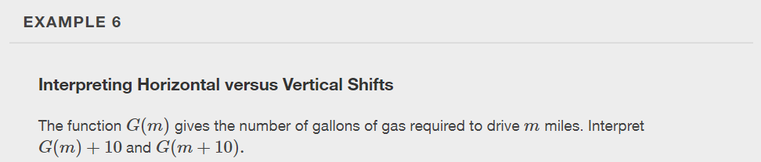

Slide 16
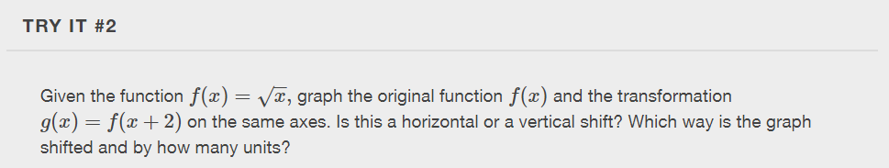

Slide 17
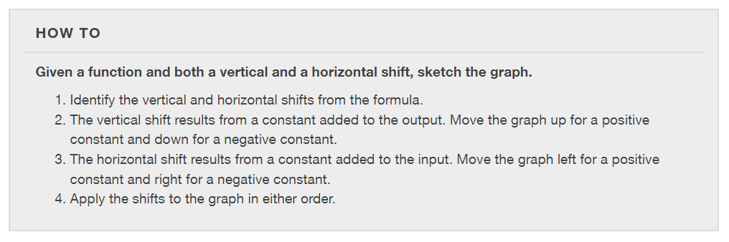

Slide 18
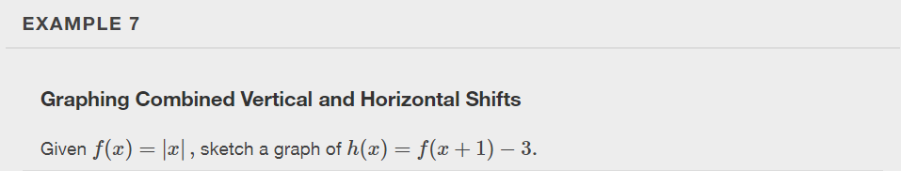

Slide 19
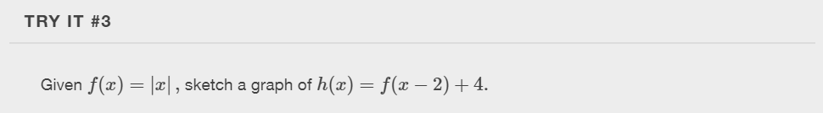

Slide 20
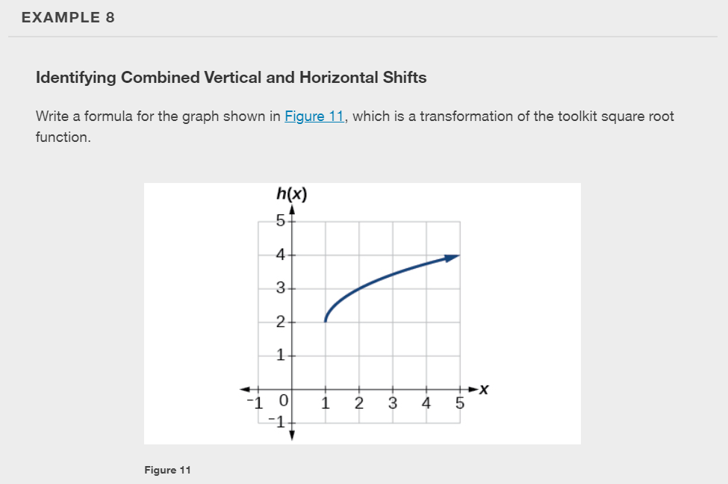

Slide 21
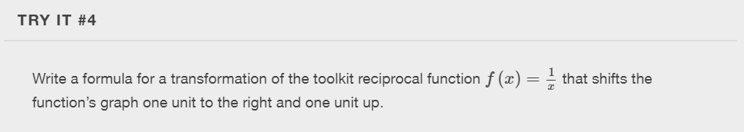
Notes:
Use a graphing calculator to graph.

Slide 22
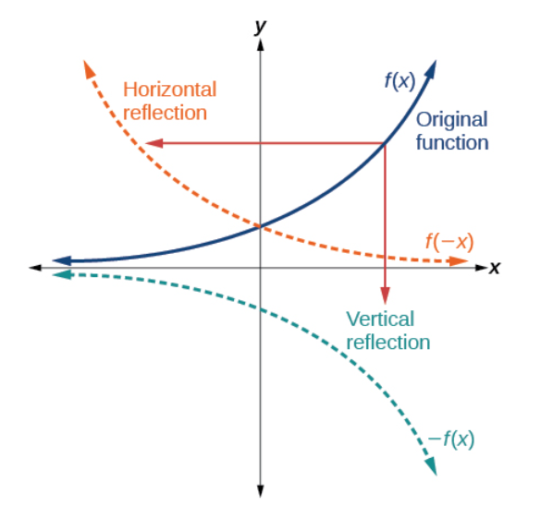
Graphing Functions Using Reflections about the Axes
Another transformation that can be applied to a function is a reflection over the x- or y-axis. A vertical reflection reflects a graph vertically across the x-axis, while a horizontal reflection reflects a graph horizontally across the y-axis.

Slide 23
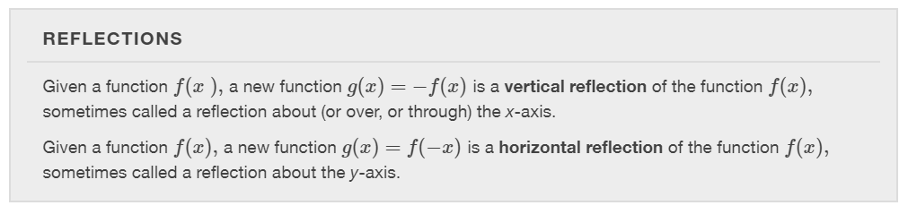

Slide 24
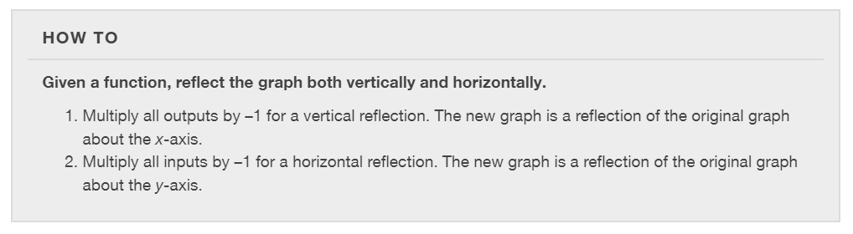

Slide 25
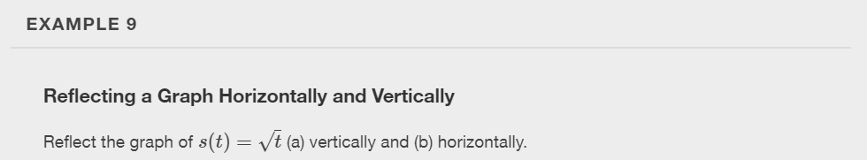

Slide 26


Slide 27
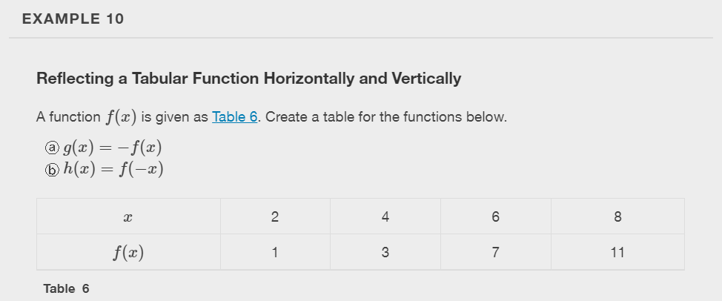

Slide 28
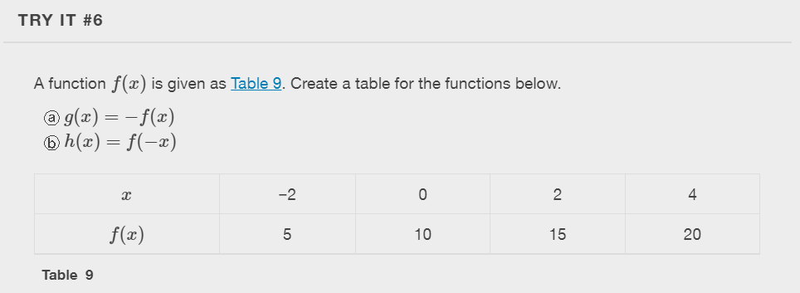

Slide 29
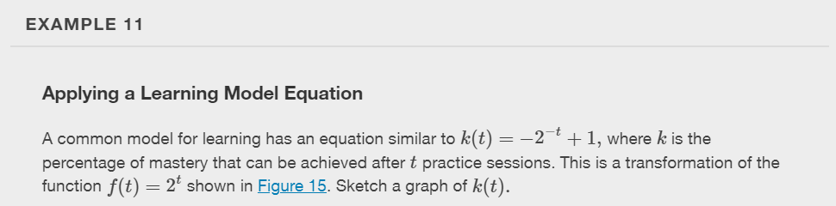
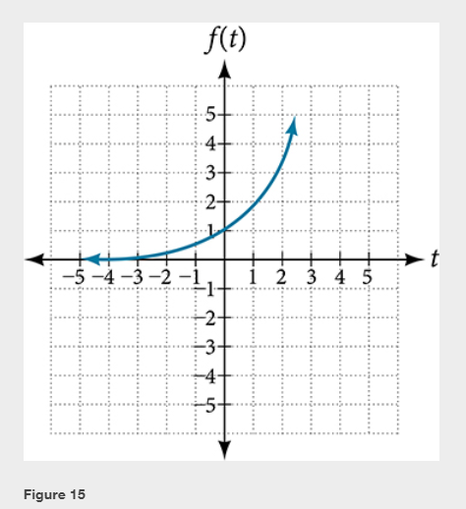

Slide 30
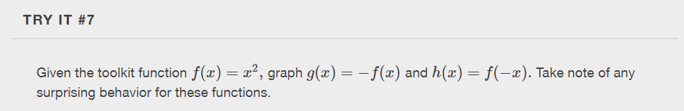

Slide 31
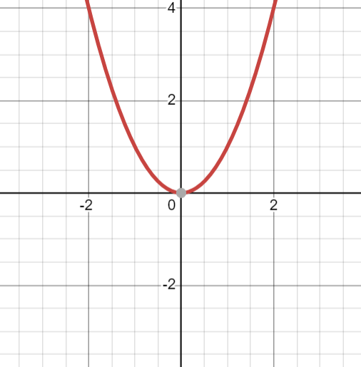
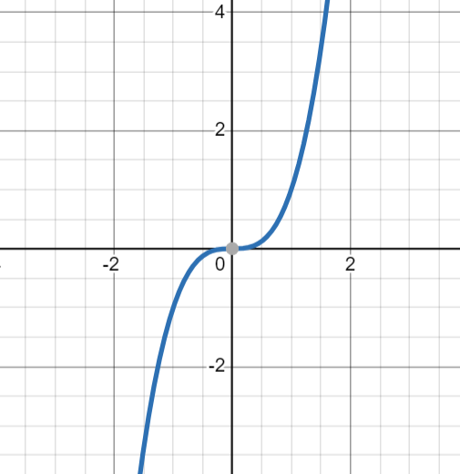


Determining Even and Odd Functions
Some functions exhibit symmetry so that reflections result in the original graph.
A function whose graph is symmetric about the y-axis is called an even function.
A function with a graph that is symmetric about the origin is called an odd function.
$$f(x)=x^{2}$$
$$f(x)=x^{3}$$

Slide 32
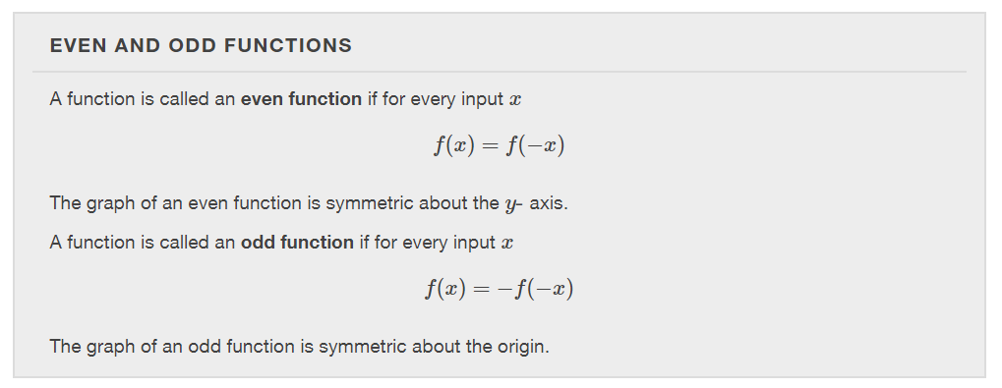

Slide 33
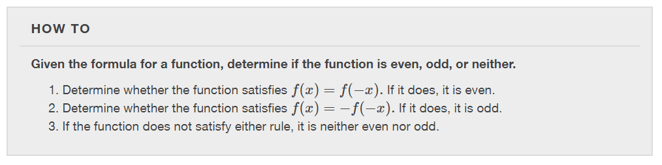

Slide 34
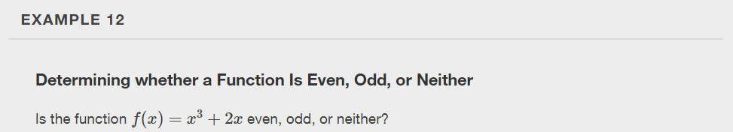

Slide 35


Slide 36
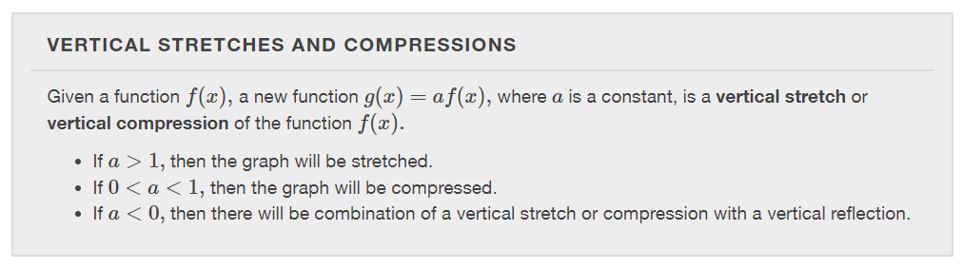
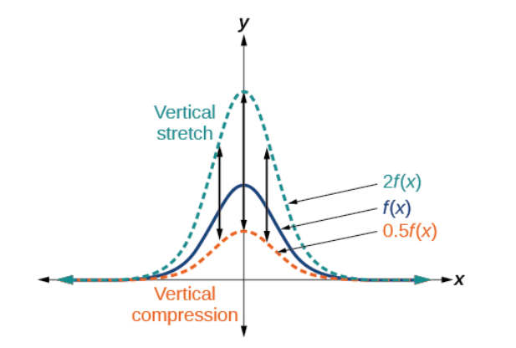

Slide 37
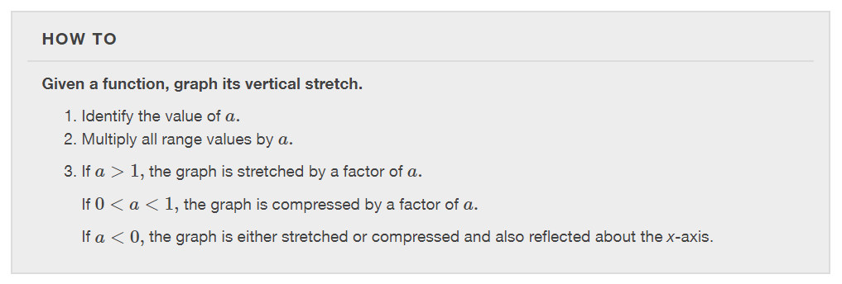

Slide 38
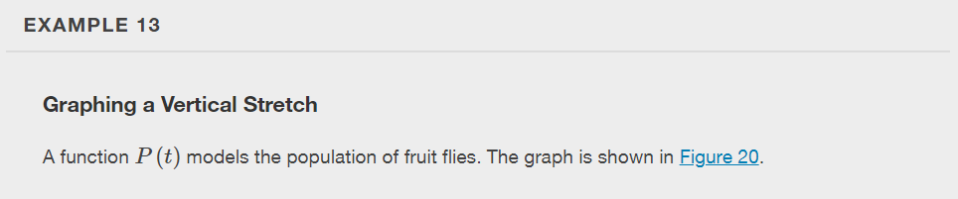
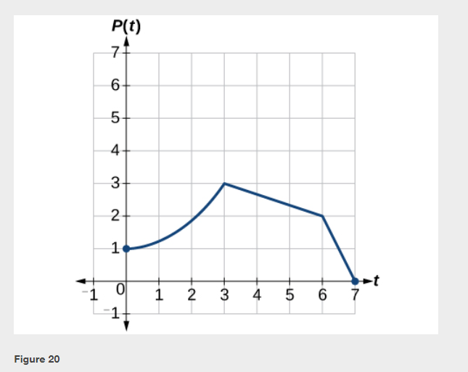

Slide 39
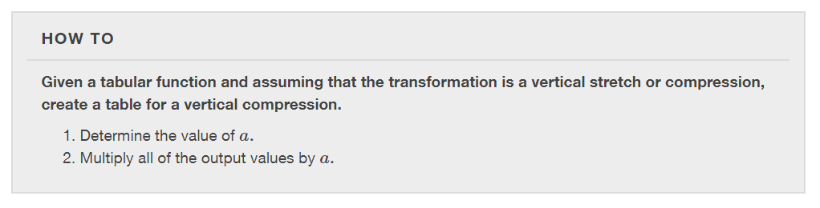

Slide 40
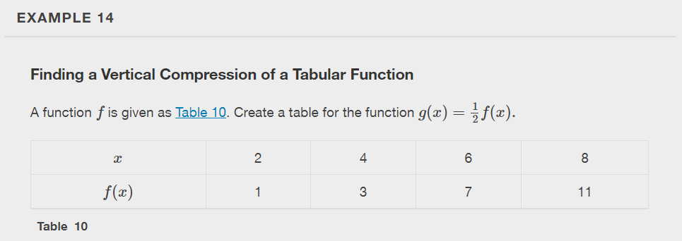

Slide 41
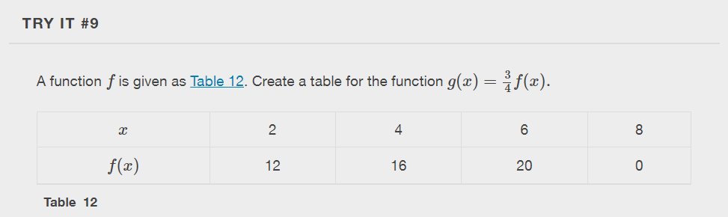

Slide 42
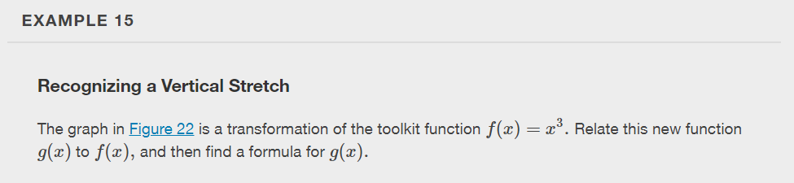
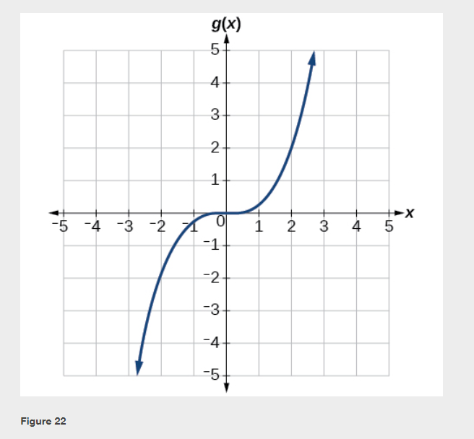

Slide 43
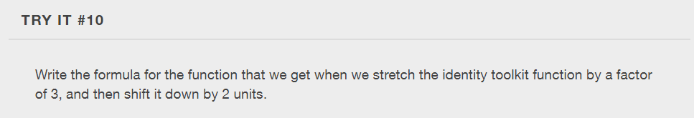

Slide 44
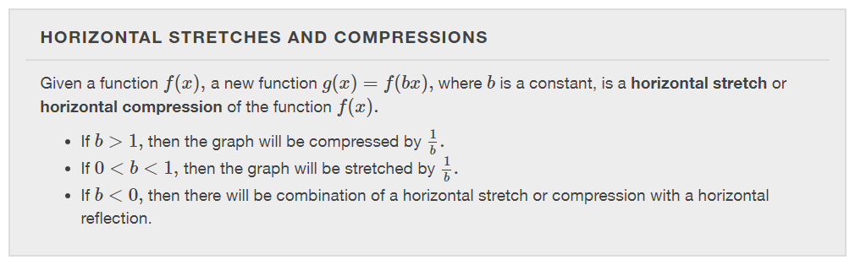
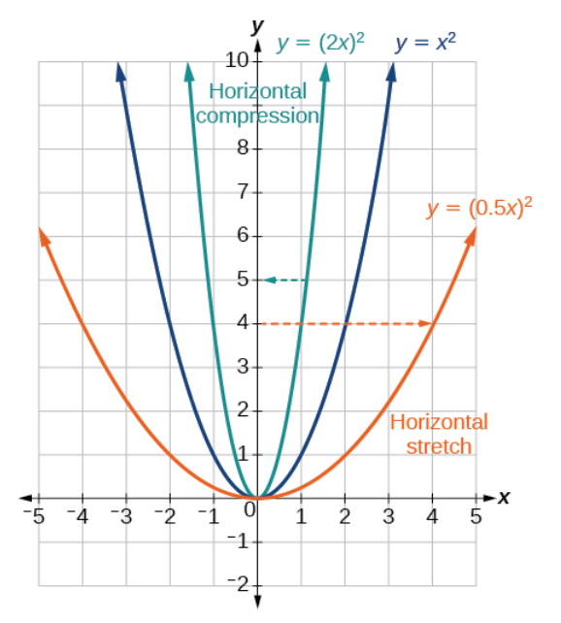

Slide 45
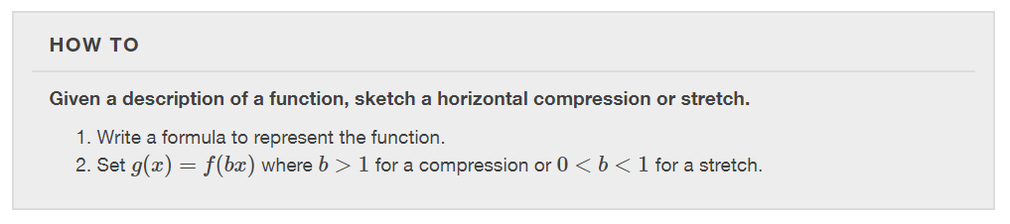

Slide 46
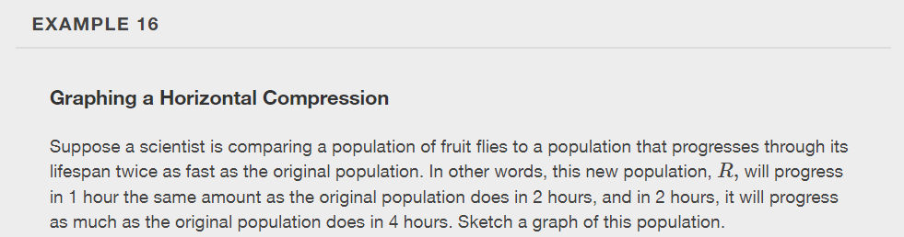

Slide 47
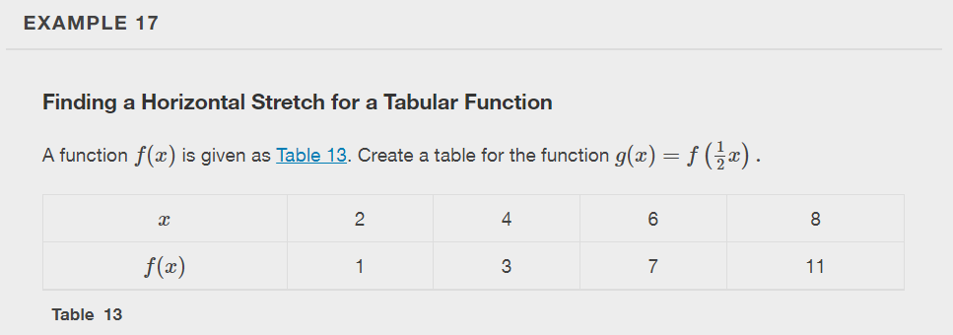

Slide 48
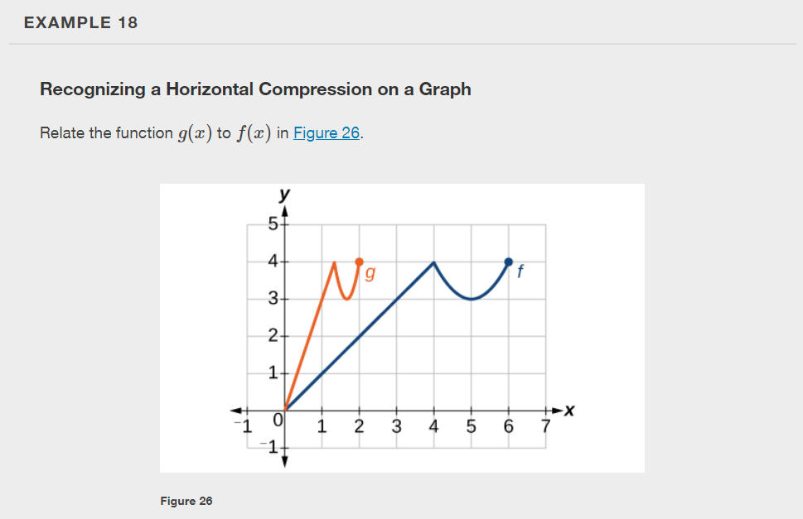

Slide 49


Slide 50


Slide 51


Slide 52


Slide 53
What did you learn in this section?
Graph functions using vertical and horizontal shifts.
Graph functions using reflections about the x-axis and the y-axis.
Determine whether a function is even, odd, or neither from its graph.
Graph functions using compressions and stretches.
Combine transformations.
Notes:
Do you have any questions?

Slide 54
This resource is an adaptation of the OpenStax Algebra and Trigonometry 2e open textbook and is © Susan Aydelotte under a CC BY-NC-SA 4.0 International license; it may be reproduced or modified for noncommercial purposes only but must be attributed to OpenStax, Rice University and any changes must be noted. Any adaptation must be shared under the same type of license.

