Slide 1
Functions
Chapter 3
Algebra and Trigonometry 2e
OpenStax
Jay Abramson
Notes:
Images and notes within these slides are from the OpenStax textbook Algebra and Trigonometry 2e

Slide 2
Composition of Functions
Section 3.4

Slide 3
What are the skills discussed in this section?
Combine functions using algebraic operations.
Create a new function by composition of functions.
Evaluate composite functions.
Find the domain of a composite function.
Decompose a composite function into its component functions.
Notes:
In this section, we will practice determining domains and ranges for specific functions. We can write the domain and range in interval notation, which uses values within brackets to describe a set of numbers.

Slide 4
Combining Functions Using Algebraic Operations

Slide 7
Composition of Functions
The process of combining functions so that the output of one function becomes the input of another is known as a composition of functions. The resulting function is known as a composite function. We represent this combination by the following notation:

Slide 12
Evaluating Composite Functions
Once we compose a new function from two existing functions, we need to be able to evaluate it for any input in its domain.
We will evaluate composite functions with three approaches, using:
tables
graphs
formulas
In each case, we evaluate the inner function using the starting input and then use the inner function’s output as the input for the outer function.

Slide 13
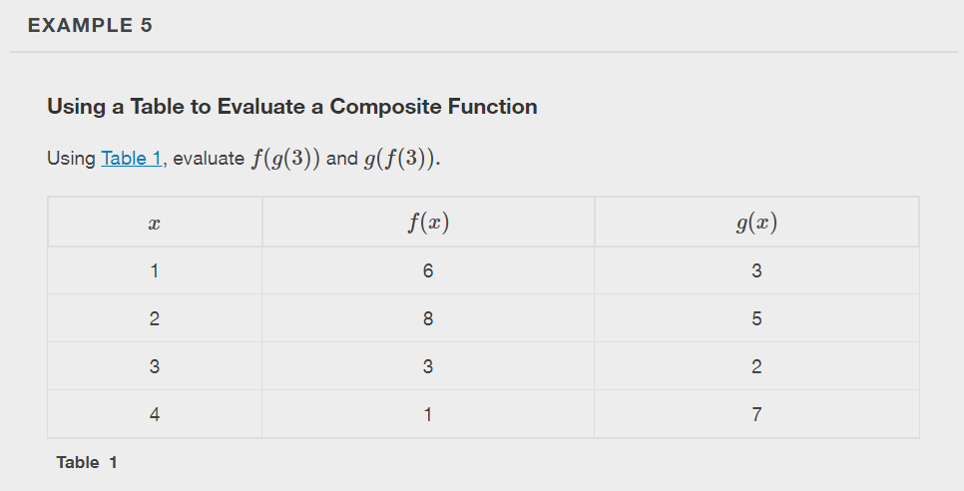

Slide 14
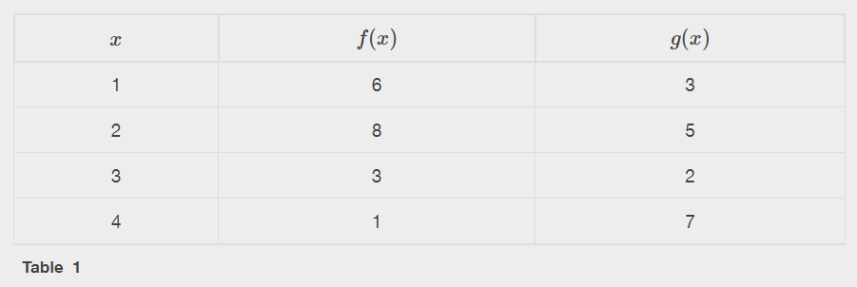

Slide 16
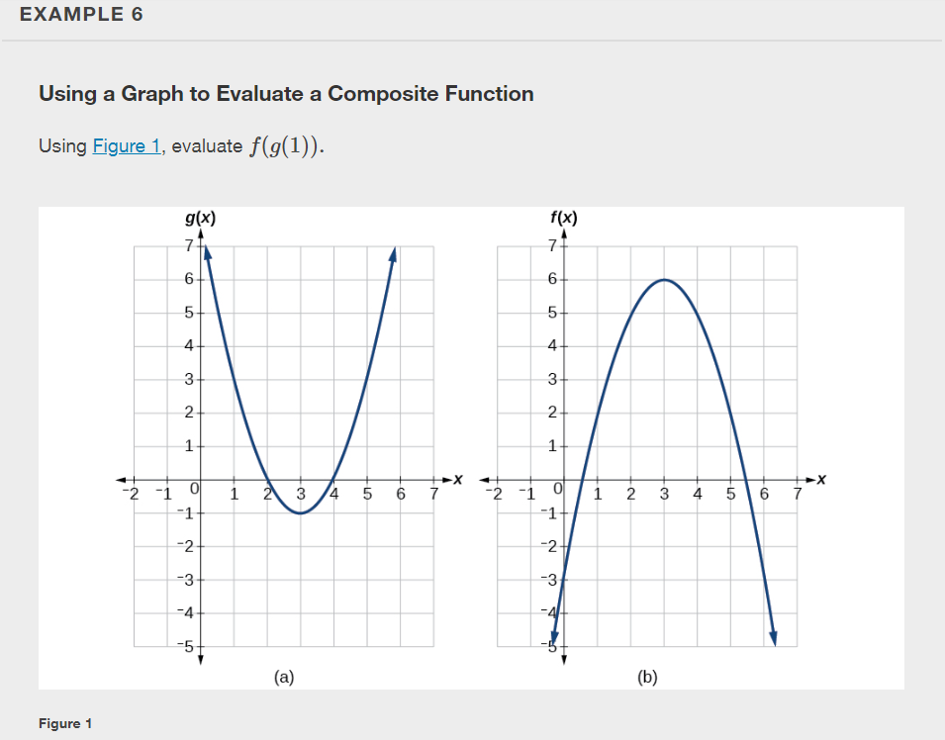

Slide 17
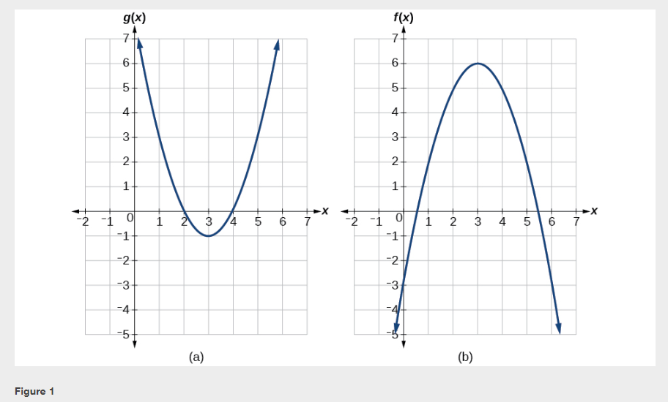

Slide 21
Notes:
Use a graphing calculator to graph.

Slide 26
Decomposing a Composite Function into its Component Functions
In some cases, it is necessary to decompose a complicated function. In other words, we can write it as a composition of two simpler functions.
There may be more than one way to decompose a composite function, so we may choose the decomposition that appears to be most expedient.

Slide 29
What did you learn in this section?
Combine functions using algebraic operations.
Create a new function by composition of functions.
Evaluate composite functions.
Find the domain of a composite function.
Decompose a composite function into its component functions.
Notes:
Do you have any questions?

Slide 30
This resource is an adaptation of the OpenStax Algebra and Trigonometry 2e open textbook and is © Susan Aydelotte under a CC BY-NC-SA 4.0 International license; it may be reproduced or modified for noncommercial purposes only but must be attributed to OpenStax, Rice University and any changes must be noted. Any adaptation must be shared under the same type of license.

