Slide 1

Functions
Chapter 3
Algebra and Trigonometry 2e
OpenStax
Jay Abramson
Notes:
Images and notes within these slides are from the OpenStax textbook Algebra and Trigonometry 2e

Slide 2
Rates of Change and
Behavior of Graphs
Section 3.3

Slide 3
What are the skills discussed in this section?
Find the average rate of change of a function.
Use a graph to determine where a function is increasing, decreasing, or constant.
Use a graph to locate local maxima and local minima.
Use a graph to locate the absolute maximum and absolute minimum.
Notes:
In this section, we will practice determining domains and ranges for specific functions. We can write the domain and range in interval notation, which uses values within brackets to describe a set of numbers.

Slide 4
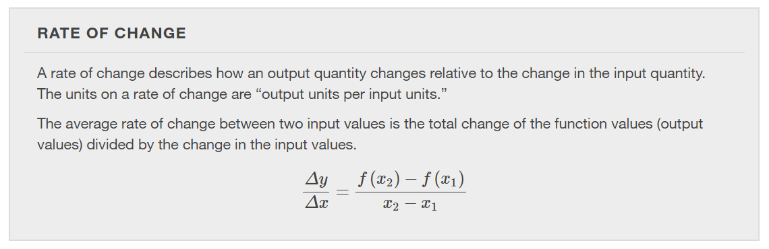

Slide 5
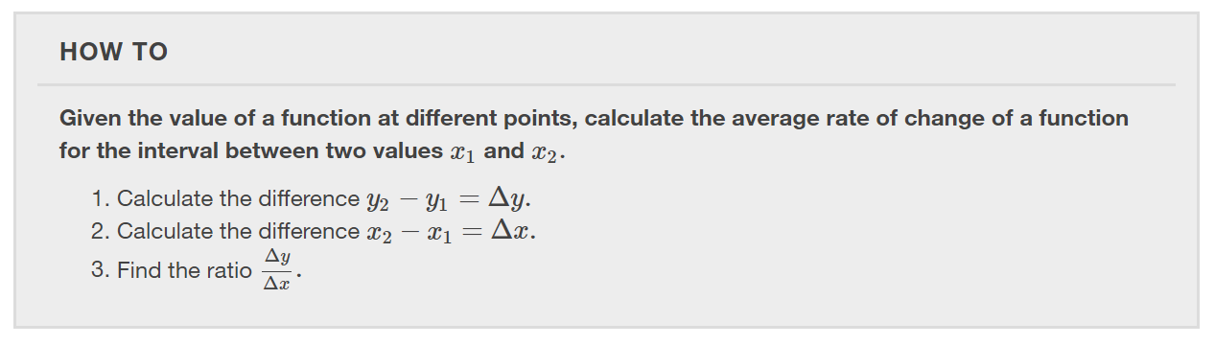

Slide 6
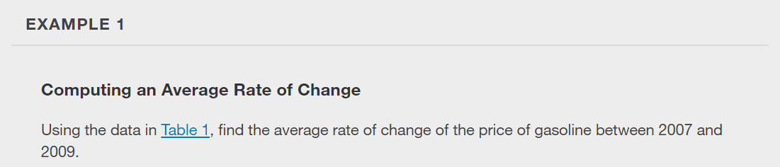
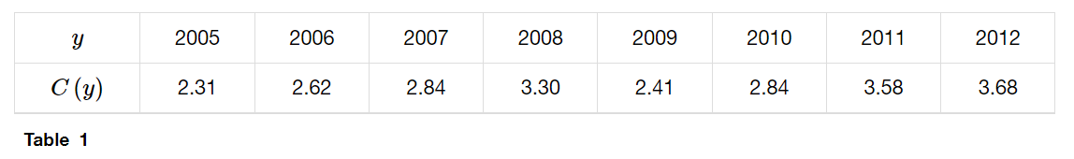

Slide 7
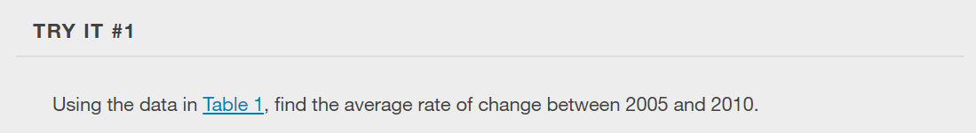

Slide 8
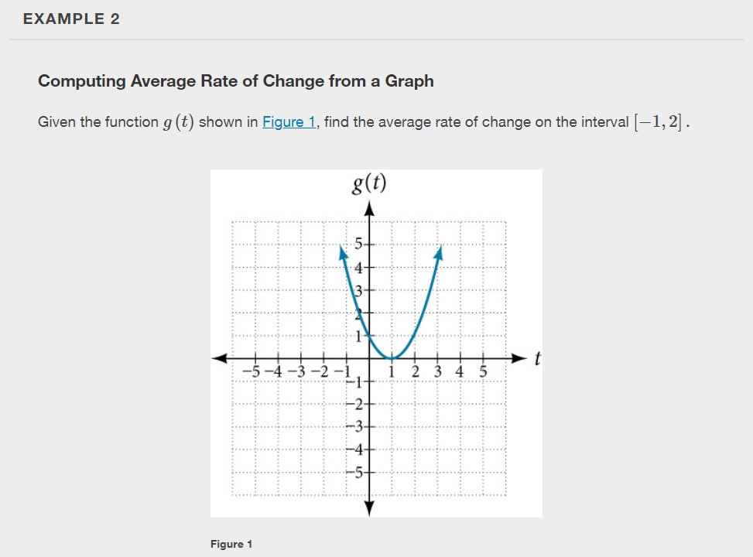

Slide 9
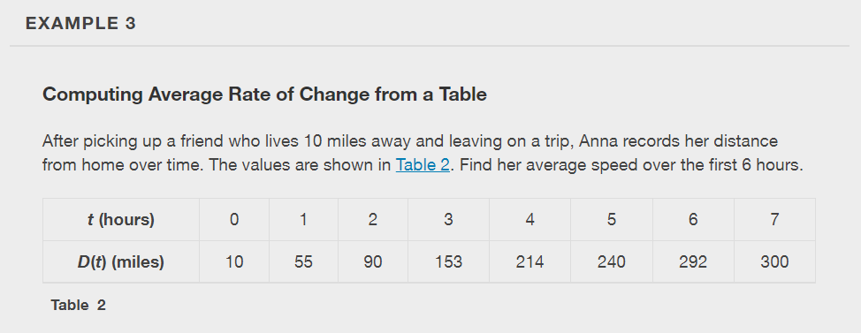

Slide 10
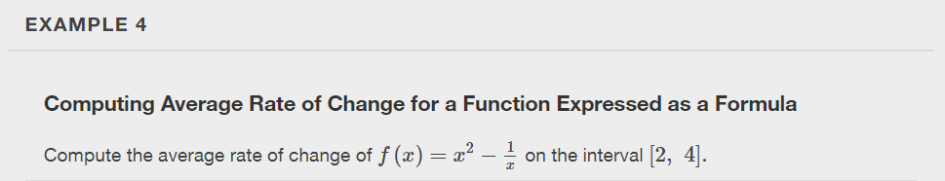

Slide 11
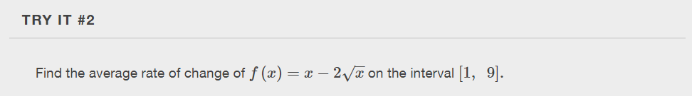

Slide 12
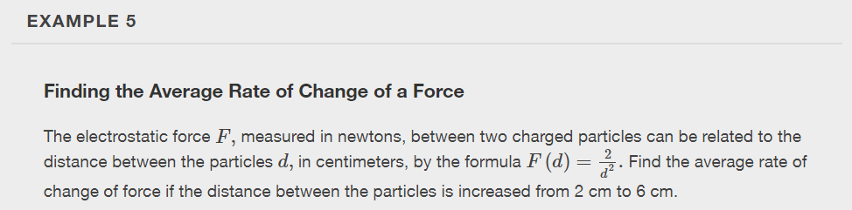

Slide 13
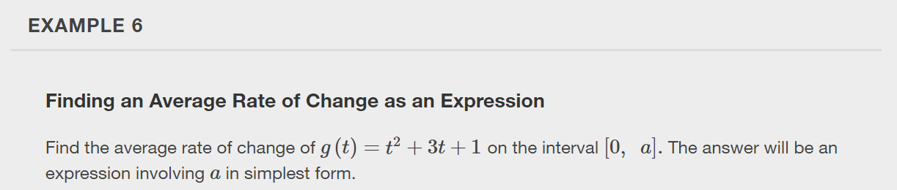

Slide 14
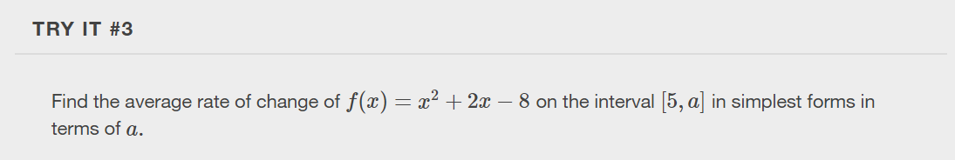

Slide 15
Using a Graph to Determine Where a Function is Increasing, Decreasing, or Constant
As part of exploring how functions change, we can identify intervals over which the function is changing in specific ways.
We say that a function is increasing on an interval if the function values increase as the input values increase within that interval.
Similarly, a function is decreasing on an interval if the function values decrease as the input values increase over that interval.
The average rate of change of an increasing function is positive, and the average rate of change of a decreasing function is negative.

Slide 16
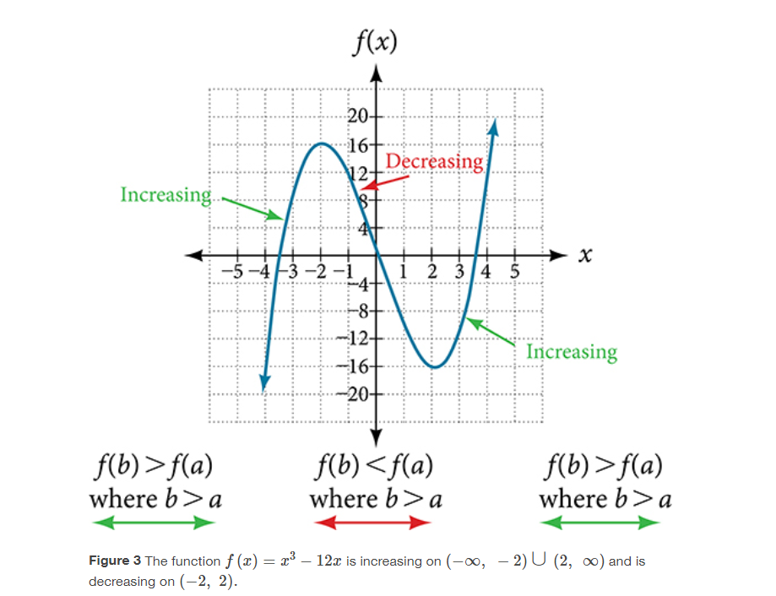

Slide 17
A value of the input where a function changes from increasing to decreasing (as we go from left to right, that is, as the input variable increases) is the location of a local maximum. The function value at that point is the local maximum. If a function has more than one, we say it has local maxima.
Similarly, a value of the input where a function changes from decreasing to increasing as the input variable increases is the location of a local minimum. The function value at that point is the local minimum. The plural form is “local minima.”
Together, local maxima and minima are called local extrema, or local extreme values, of the function. (The singular form is “extremum.”) Often, the term local is replaced by the term relative.

Slide 18
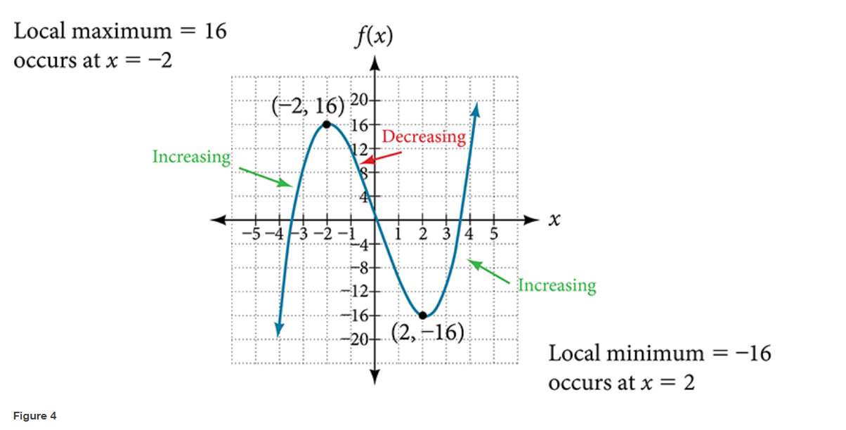

Slide 19
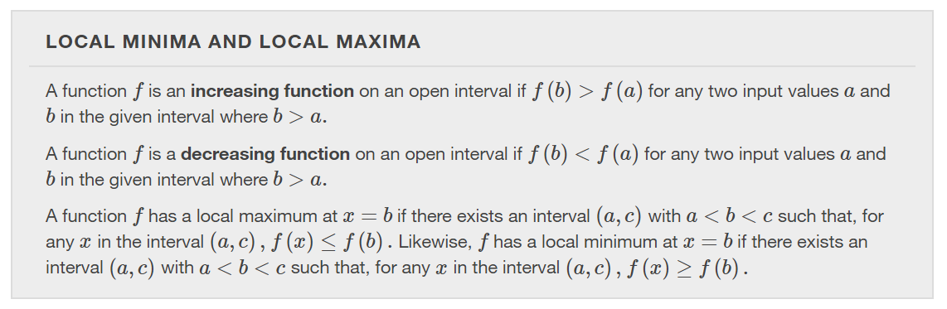

Slide 20
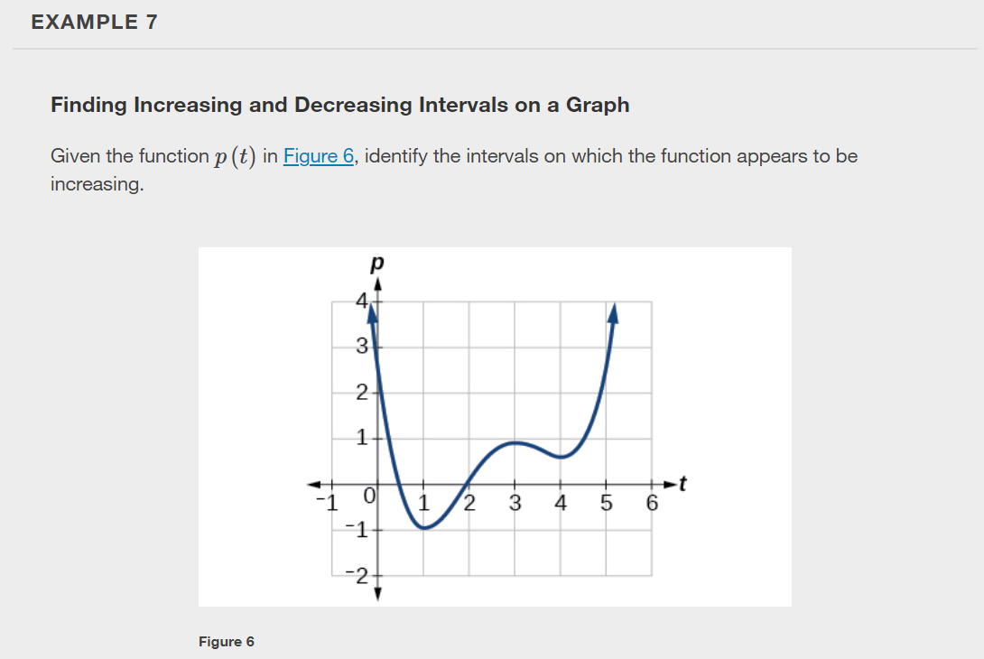

Slide 21
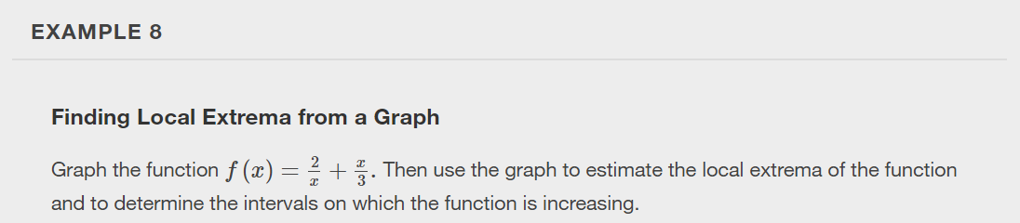
Notes:
Use a graphing calculator to graph.

Slide 22
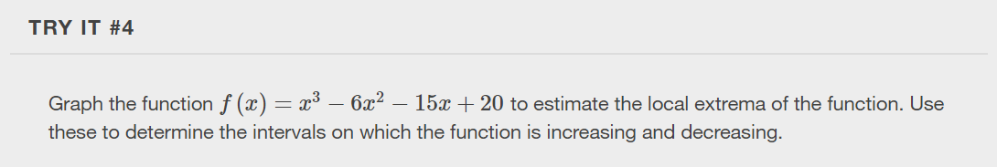

Slide 23
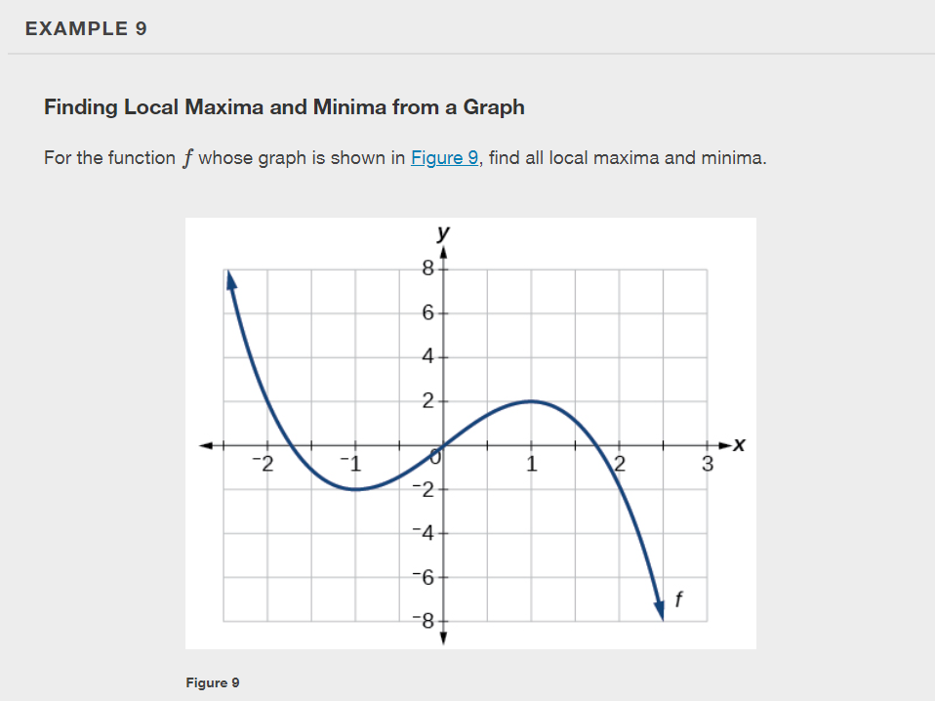

Slide 24
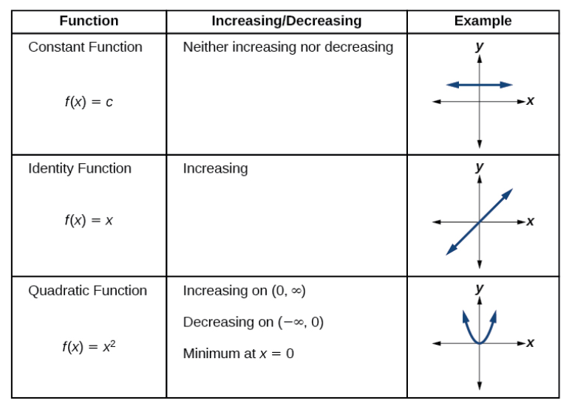
Analyzing the Toolkit Functions for Increasing or Decreasing Intervals

Slide 25
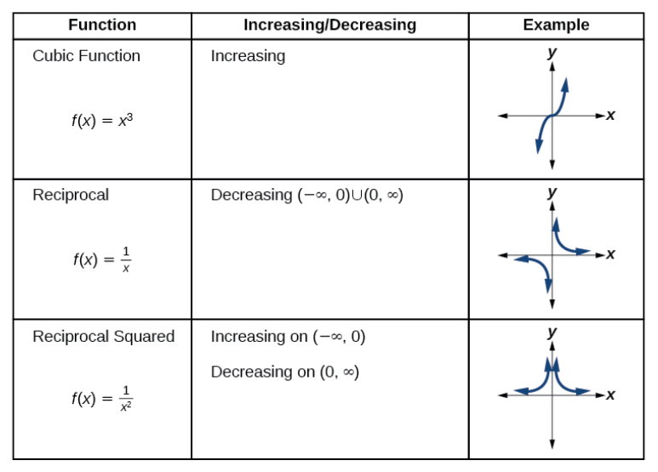
Analyzing the Toolkit Functions for Increasing or Decreasing Intervals

Slide 26
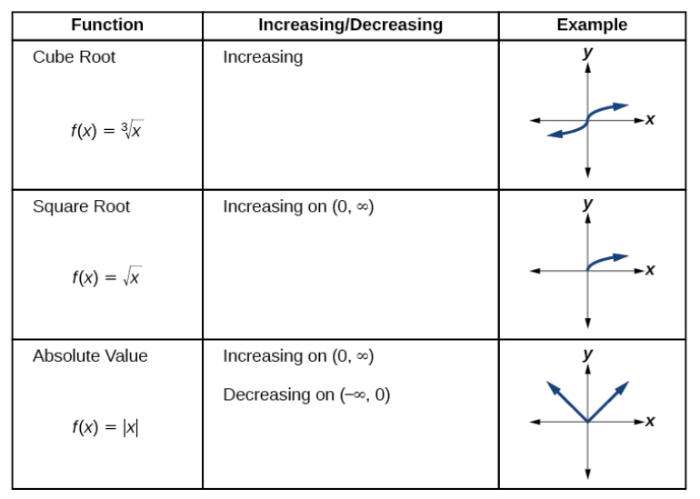
Analyzing the Toolkit Functions for Increasing or Decreasing Intervals

Slide 27
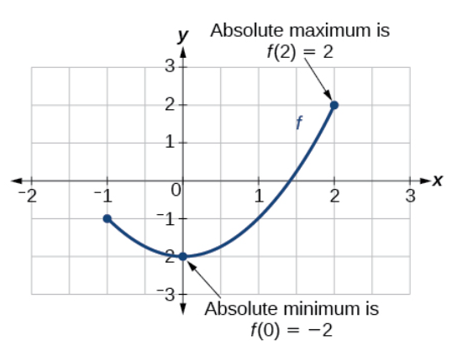
Use A Graph to Locate the Absolute Maximum and Absolute Minimum
There is a difference between locating the highest and lowest points on a graph in a region around an open interval (locally) and locating the highest and lowest points on the graph for the entire domain.
The y-coordinates (output) at the highest and lowest points over the entire domain are called the absolute maximum and absolute minimum, respectively.

Slide 28
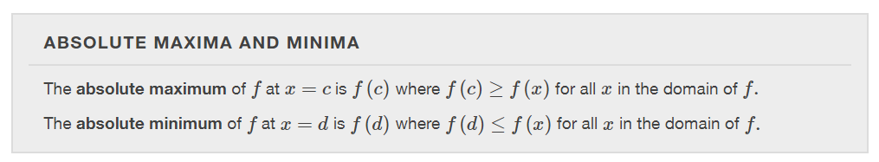

Slide 29
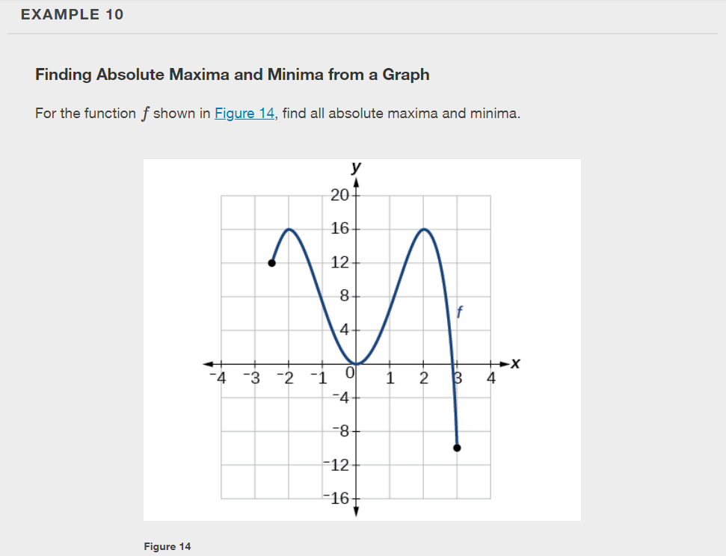

Slide 30
What did you learn in this section?
Find the average rate of change of a function.
Use a graph to determine where a function is increasing, decreasing, or constant.
Use a graph to locate local maxima and local minima.
Use a graph to locate the absolute maximum and absolute minimum.
Notes:
Do you have any questions?

Slide 31
This resource is an adaptation of the OpenStax Algebra and Trigonometry 2e open textbook and is © Susan Aydelotte under a CC BY-NC-SA 4.0 International license; it may be reproduced or modified for noncommercial purposes only but must be attributed to OpenStax, Rice University and any changes must be noted. Any adaptation must be shared under the same type of license.

