Slide 1

Functions
Chapter 3
Algebra and Trigonometry 2e
OpenStax
Jay Abramson
Notes:
Images and notes within these slides are from the OpenStax textbook Algebra and Trigonometry 2e

Slide 2
Domain and Range
Section 3.2

Slide 3
What are the skills discussed in this section?
Find the domain of a function defined by an equation.
Graph piecewise-defined functions.
Notes:
In this section, we will practice determining domains and ranges for specific functions. We can write the domain and range in interval notation, which uses values within brackets to describe a set of numbers.

Slide 4
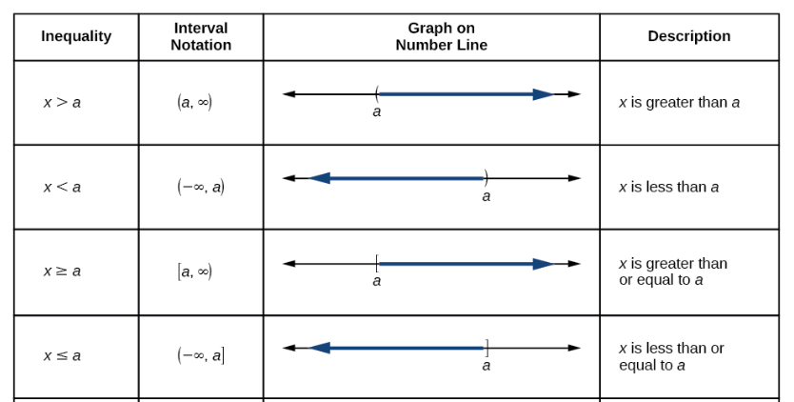
Notes:
Before we begin, let us review the conventions of interval notation:
The smallest number from the interval is written first.
The largest number in the interval is written second, following a comma.
Parentheses, ( or ), are used to signify that an endpoint value is not included, called exclusive.
Brackets, [ or ], are used to indicate that an endpoint value is included, called inclusive.

Slide 5
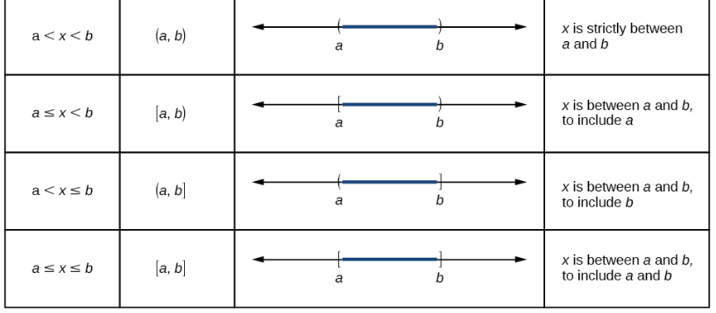

Slide 6
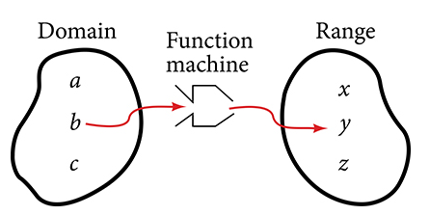
Notes:
Recall that the domain of a function is the set of input values (or independent variable).
The range is the set of output values (or dependent variable).

Slide 7
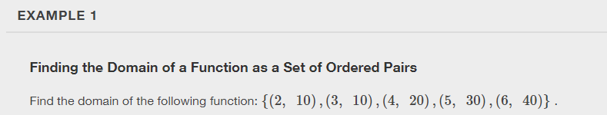

Slide 8
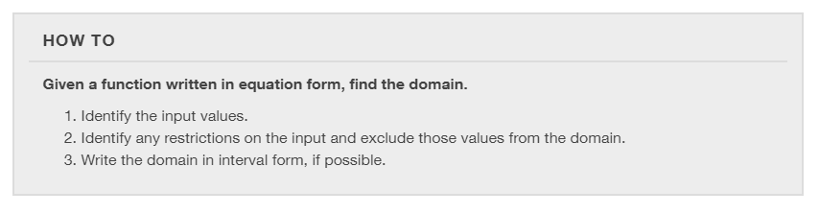

Slide 9
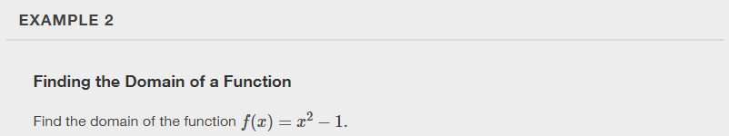

Slide 10
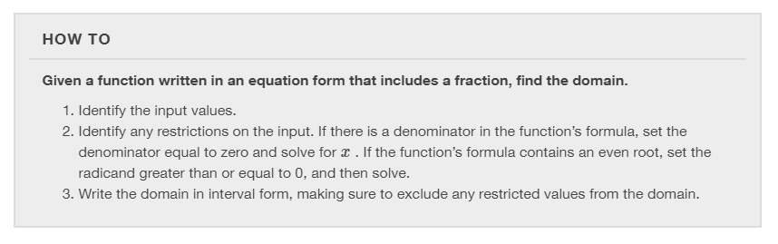

Slide 11
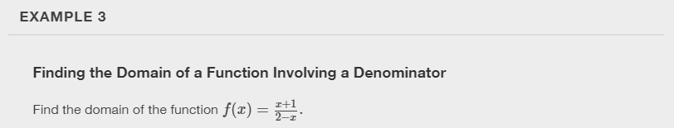

Slide 12


Slide 13
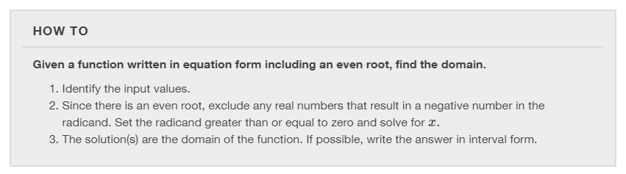

Slide 14
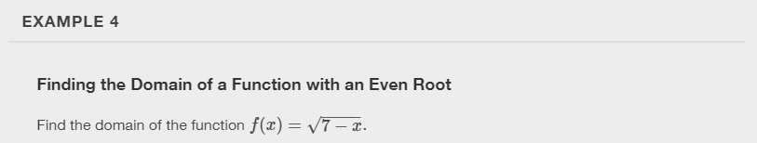

Slide 15
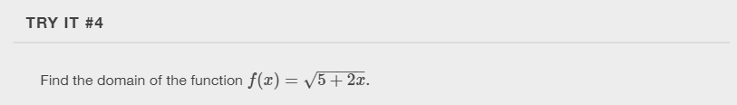

Slide 16
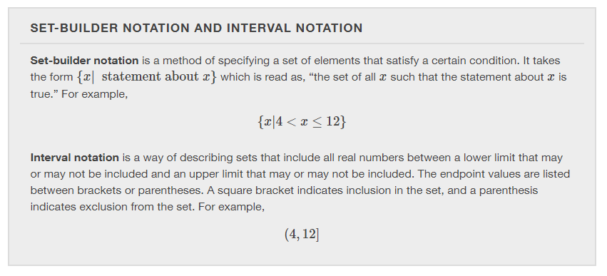

Slide 17
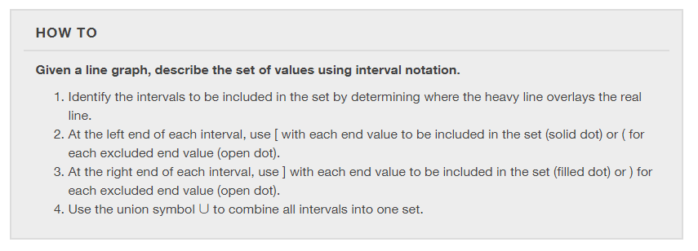

Slide 18
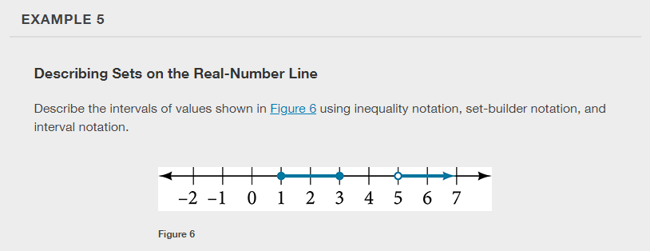

Slide 19
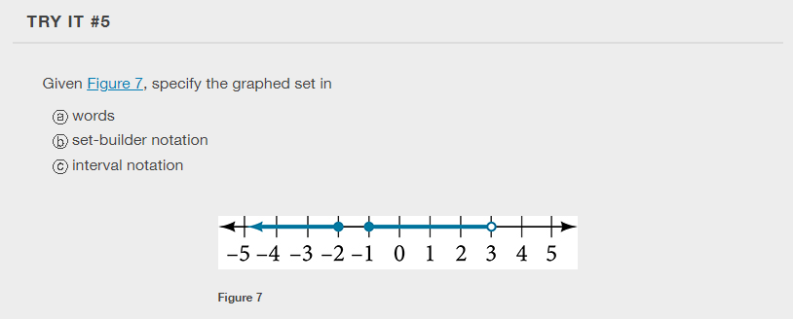

Slide 20
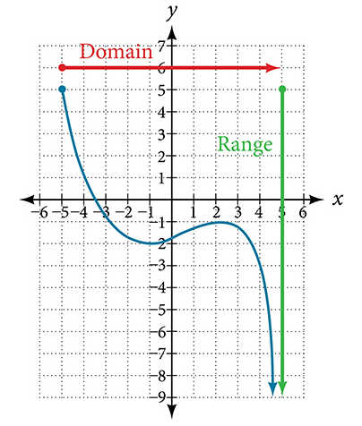
Finding Domain and Range from Graphs
Another way to identify the domain and range of functions is by using graphs.

Slide 21
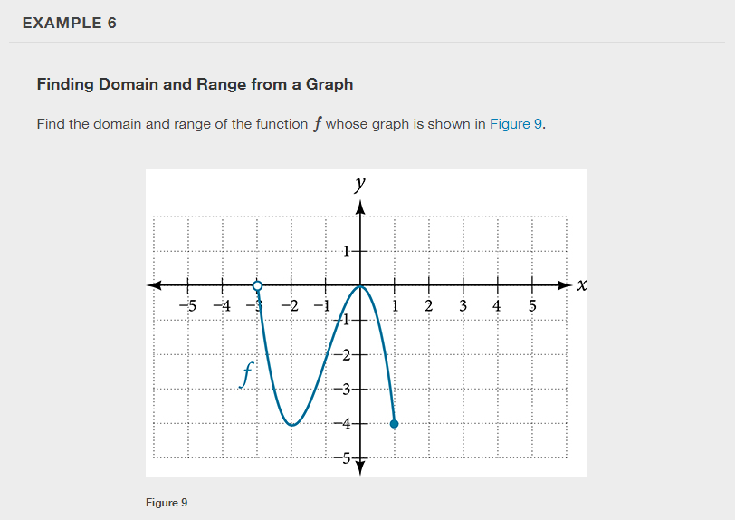

Slide 22
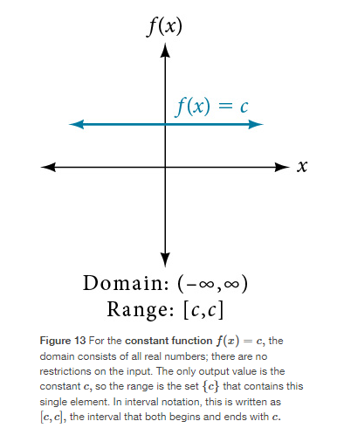
Finding Domains and Ranges of the Toolkit Functions

Slide 23
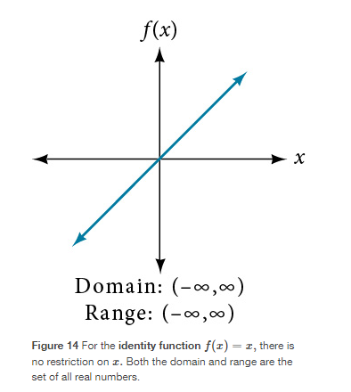
Finding Domains and Ranges of the Toolkit Functions

Slide 24
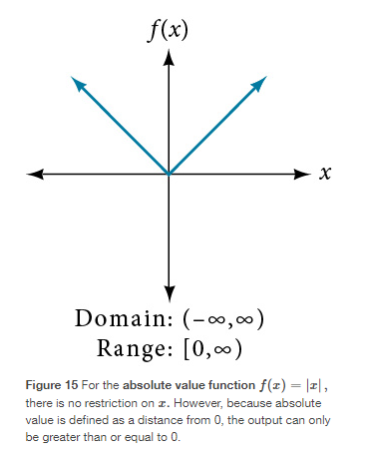
Finding Domains and Ranges of the Toolkit Functions

Slide 25
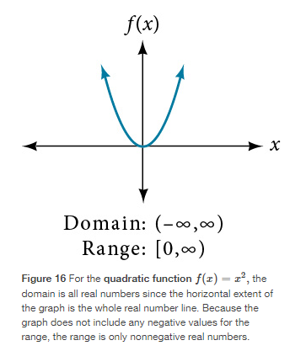
Finding Domains and Ranges of the Toolkit Functions

Slide 26
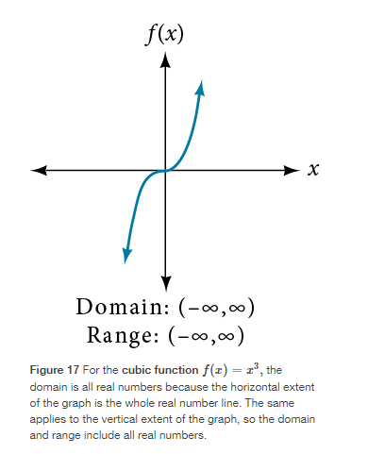
Finding Domains and Ranges of the Toolkit Functions

Slide 27
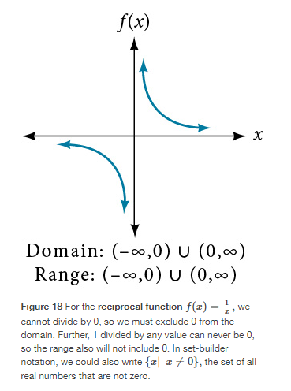
Finding Domains and Ranges of the Toolkit Functions

Slide 28
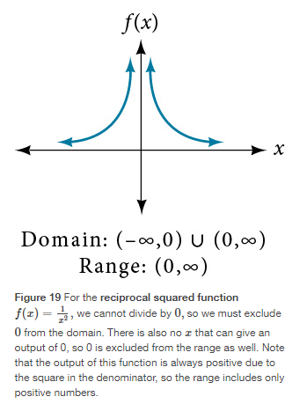
Finding Domains and Ranges of the Toolkit Functions

Slide 29
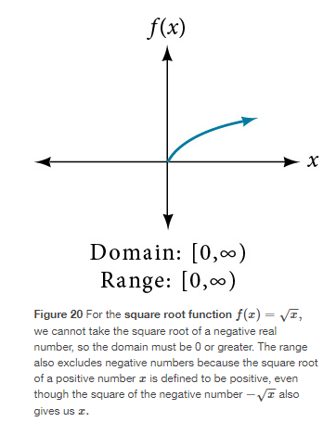
Finding Domains and Ranges of the Toolkit Functions

Slide 30
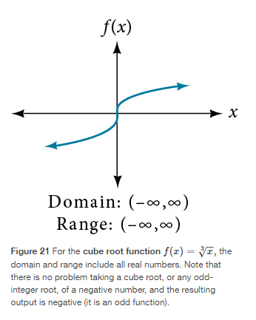
Finding Domains and Ranges of the Toolkit Functions

Slide 31
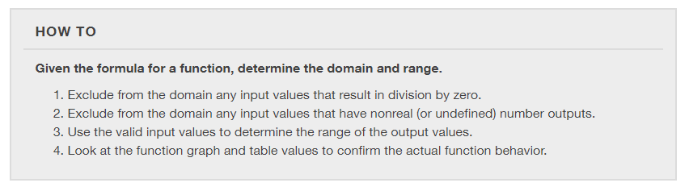

Slide 32
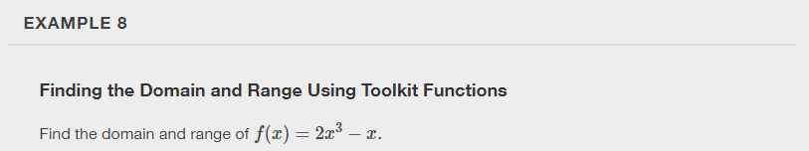

Slide 33
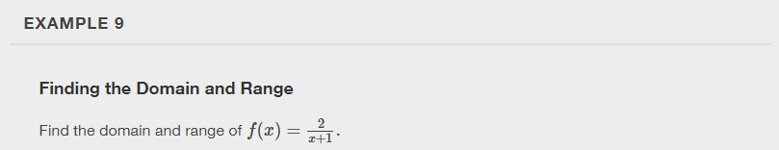

Slide 34
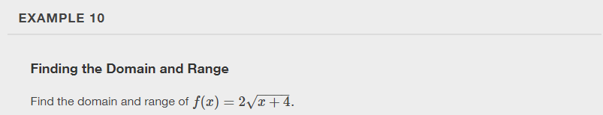

Slide 35
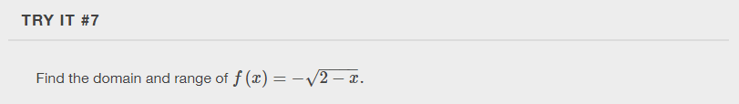

Slide 36
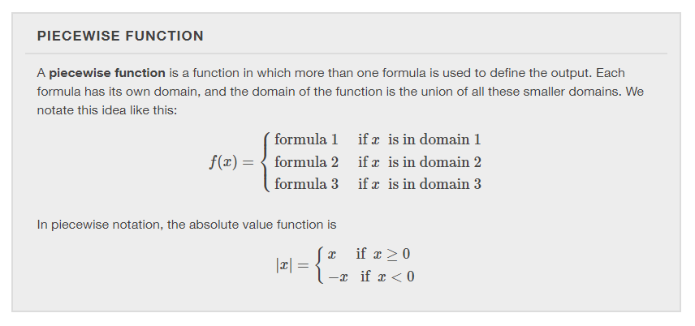

Slide 37
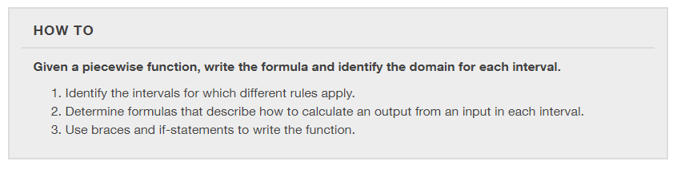

Slide 38
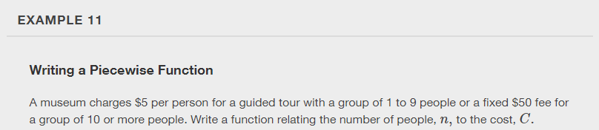

Slide 39
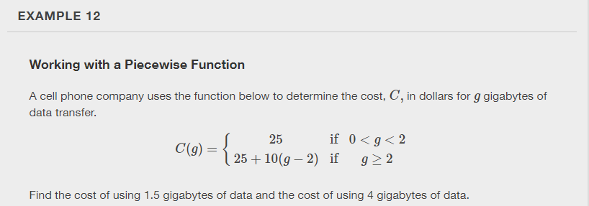

Slide 40
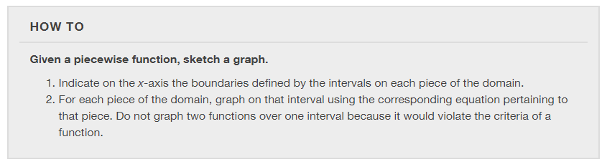

Slide 41
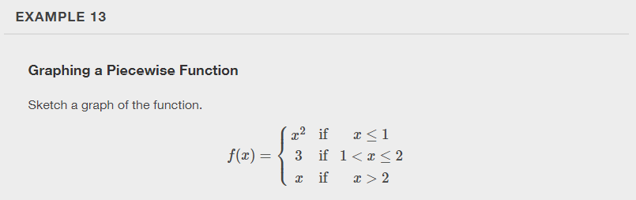

Slide 42


Slide 43
What did you learn in this section?
Find the domain of a function defined by an equation.
Graph piecewise-defined functions.
Notes:
Do you have any questions?

Slide 44
This resource is an adaptation of the OpenStax Algebra and Trigonometry 2e open textbook and is © Susan Aydelotte under a CC BY-NC-SA 4.0 International license; it may be reproduced or modified for noncommercial purposes only but must be attributed to OpenStax, Rice University and any changes must be noted. Any adaptation must be shared under the same type of license.

