Slide 1

Functions
Chapter 3
Algebra and Trigonometry 2e
OpenStax
Jay Abramson
Notes:
Images and notes within these slides are from the OpenStax textbook Algebra and Trigonometry 2e

Slide 2
Functions and
Function Notation
Section 3.1
Notes:
Solve quadratic equations by factoring.
Solve quadratic equations by the square root property.
Solve quadratic equations by completing the square.
Solve quadratic equations by using the quadratic formula.
Use the Pythagorean Theorem.

Slide 3
What are the skills discussed in this section?
Determine whether a relation represents a function.
Find the value of a function.
Determine whether a function is one-to-one.
Use the vertical line test to identify functions.
Graph the functions listed in the library of functions.

Slide 4
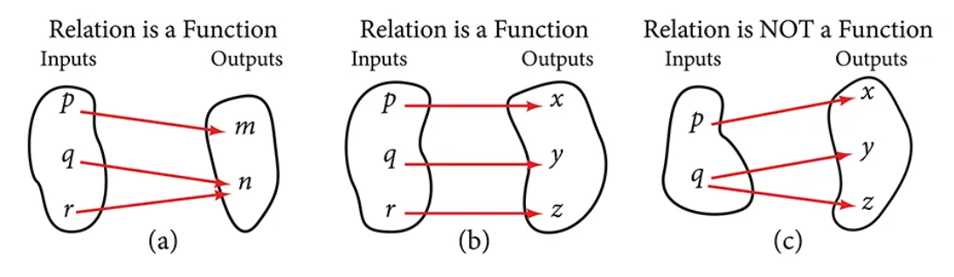
Determining Whether a Relation Represents a Function
A relation is a set of ordered pairs. The set of the first components of each ordered pair is called the domain and the set of the second components of each ordered pair is called the range.
Each value in the domain is also known as an input value, or independent variable.
Each value in the range is also known as an output value, or dependent variable.
A function is a relation that assigns a single value in the range to each value in the domain. In other words, no x-values are repeated.
Notes:
(a) This relationship is a function because each input is associated with a single output. Note that input q and r both give output n.
(b) This relationship is also a function. In this case, each input is associated with a single output.
(c) This relationship is not a function because input q is associated with two different outputs.

Slide 5
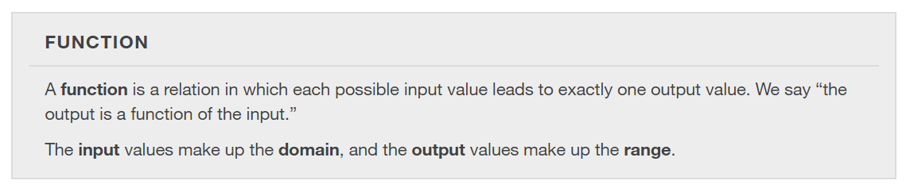

Slide 6
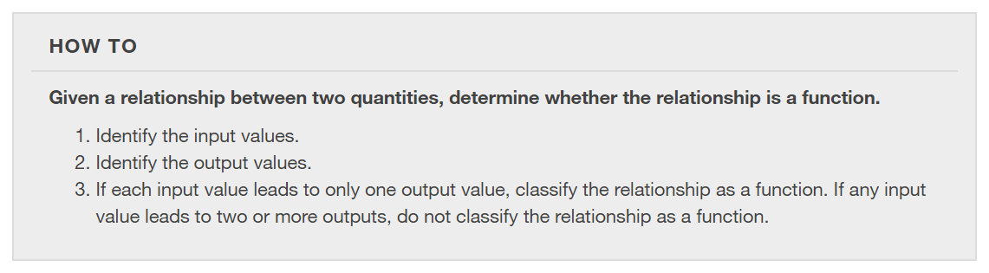

Slide 7
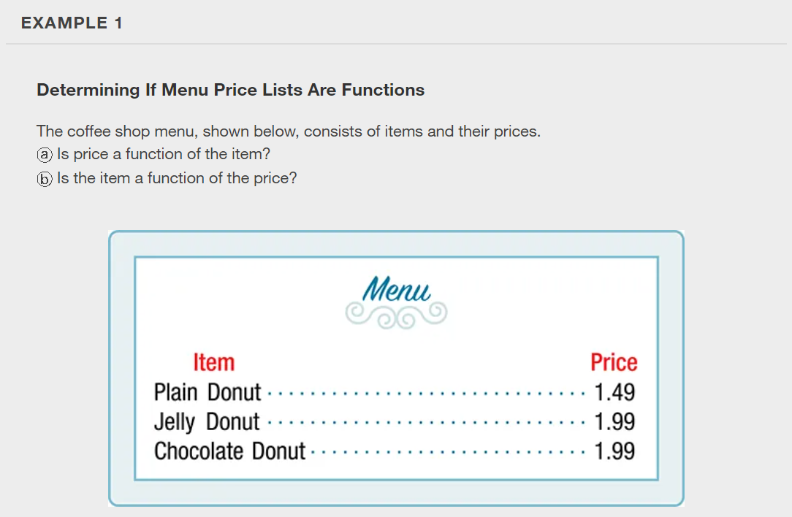

Slide 8
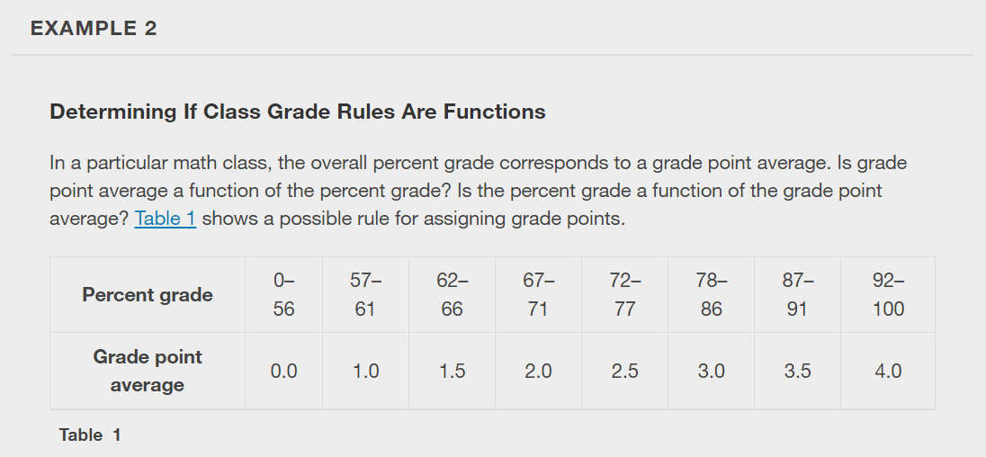

Slide 9
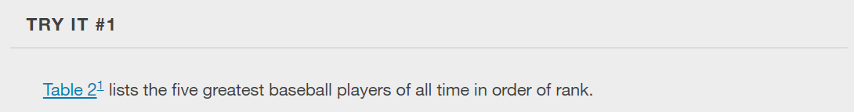
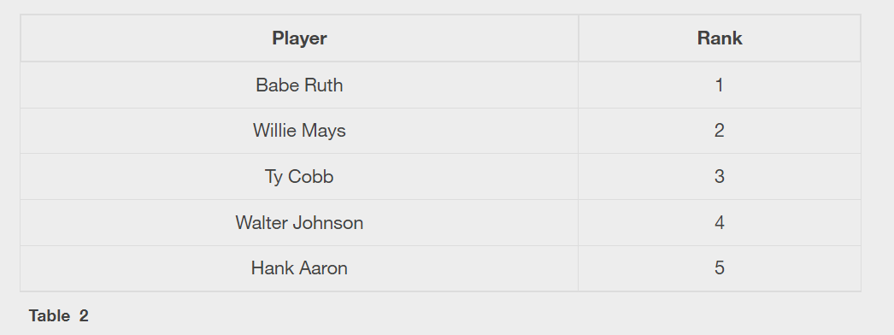
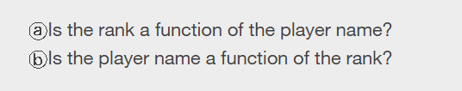

Slide 10
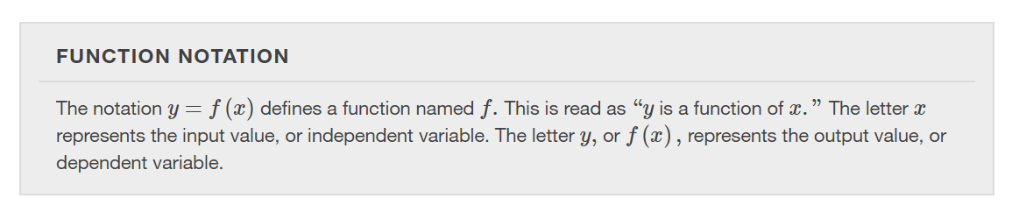

Slide 11
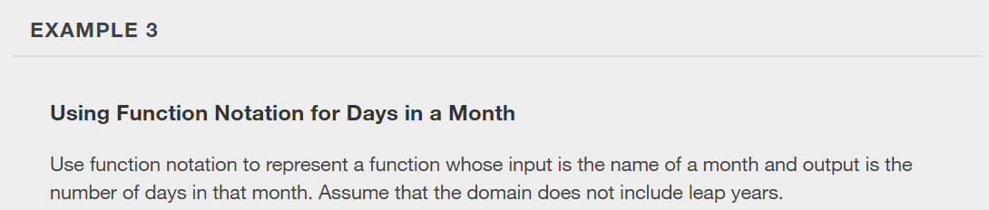

Slide 12
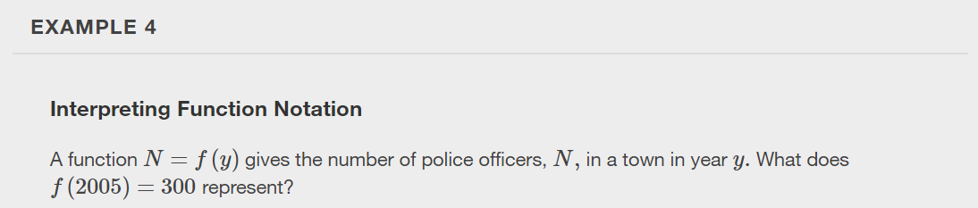

Slide 13
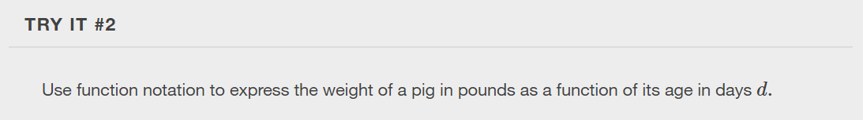

Slide 14
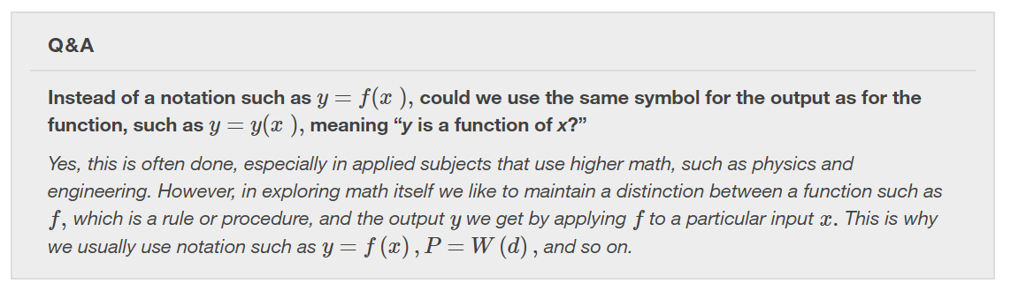

Slide 15
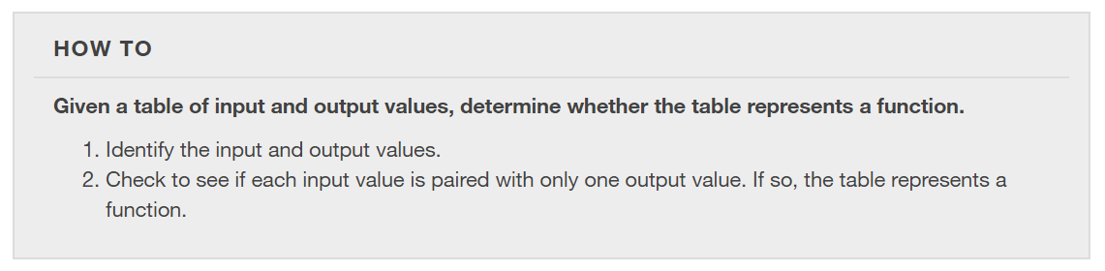
Representing Functions Using Tables
A common method of representing functions is in the form of a table. The table rows or columns display the corresponding input and output values.
In some cases, these values represent all we know about the relationship; other times, the table provides a few select examples from a more complete relationship.

Slide 16
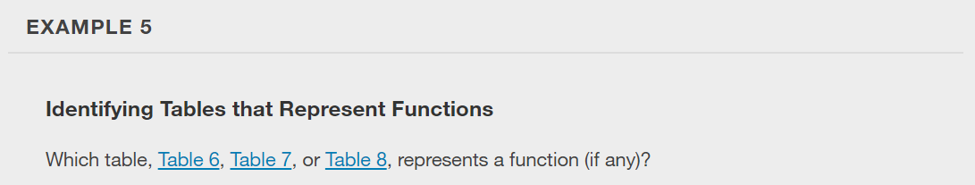
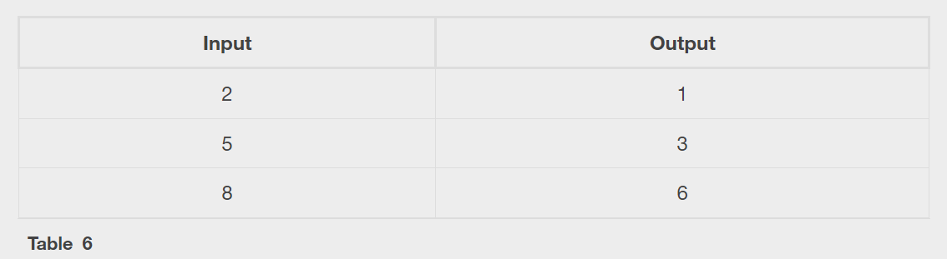
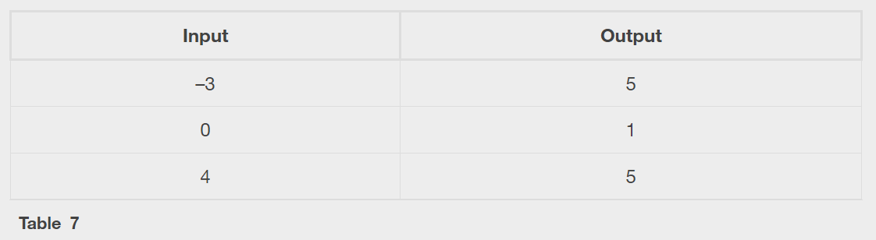
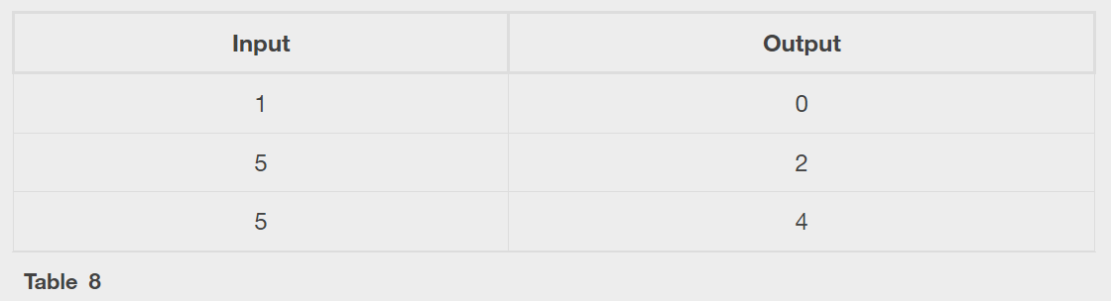

Slide 17
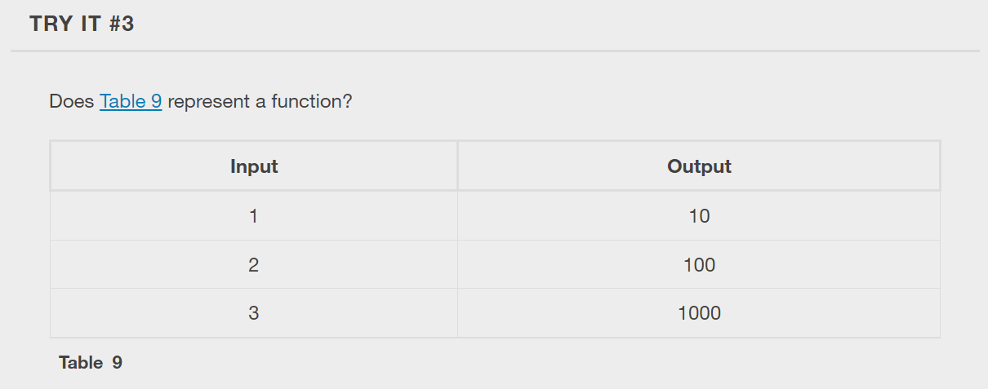

Slide 18
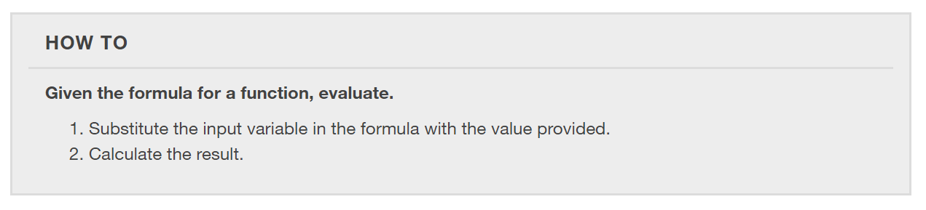
Finding Output Values of a Function
When we know an input value and want to determine the corresponding output value for a function, we evaluate the function. Evaluating will always produce one result because each input value of a function corresponds to exactly one output value.

Slide 19
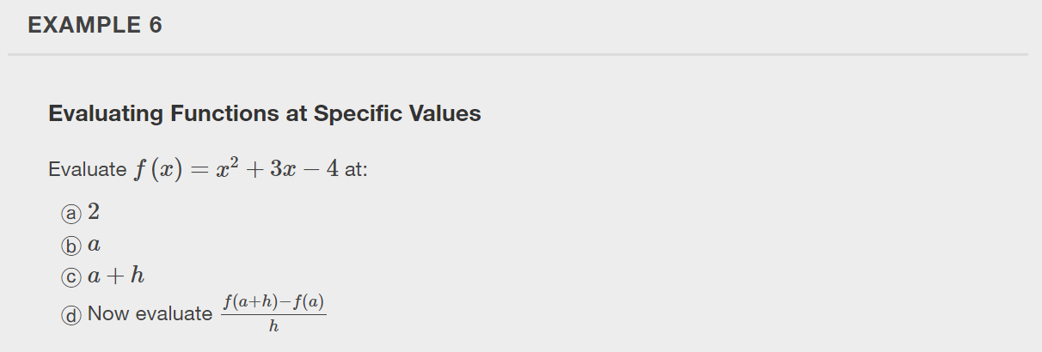

Slide 20
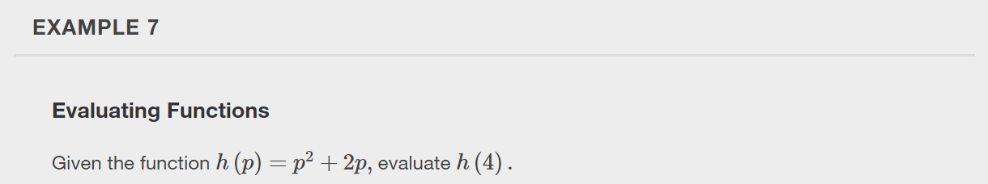

Slide 21


Slide 22
Finding Input Values of a Function
When we know an output value and want to determine the input values that would produce that output value, we set the output equal to the function’s formula and solve for the input. Solving can produce more than one solution because different input values can produce the same output value.

Slide 23
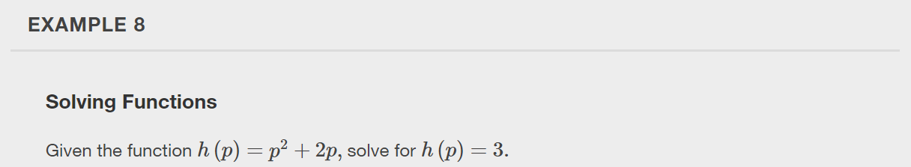

Slide 24


Slide 25
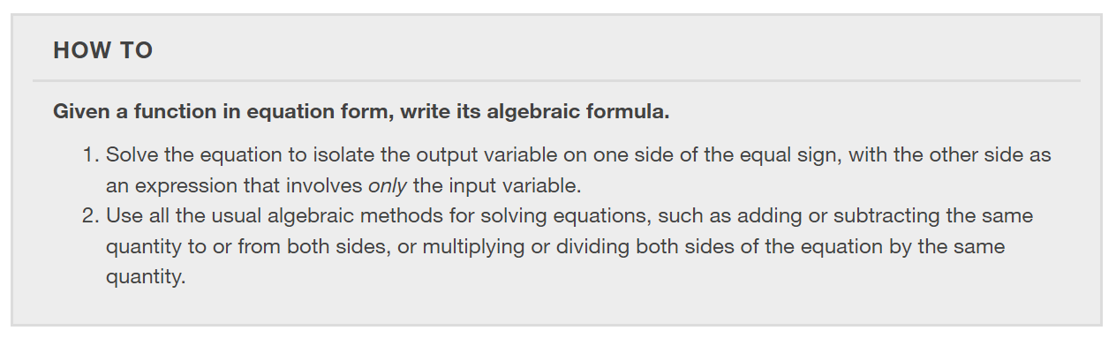
Evaluating Functions Expressed in Formulas
Some functions are defined by mathematical rules or procedures expressed in equation form. If it is possible to express the function output with a formula involving the input quantity, then we can define a function in algebraic form.

Slide 26
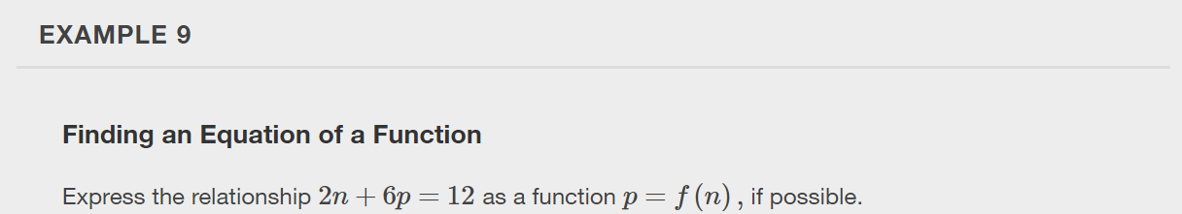

Slide 27
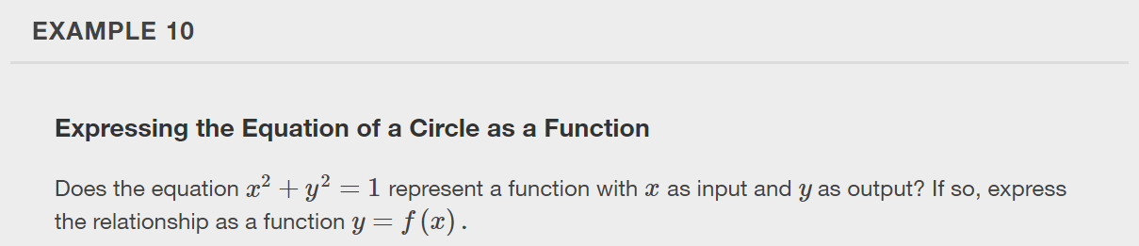

Slide 28
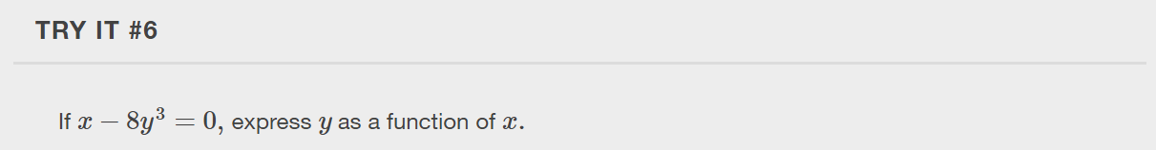

Slide 29
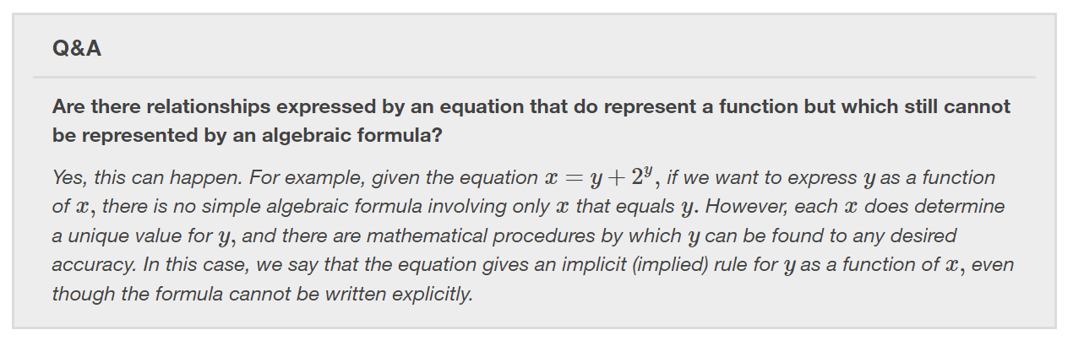

Slide 30
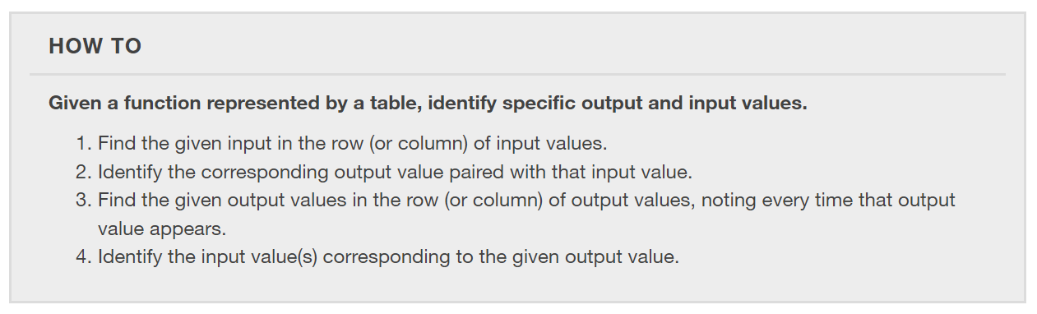

Slide 31
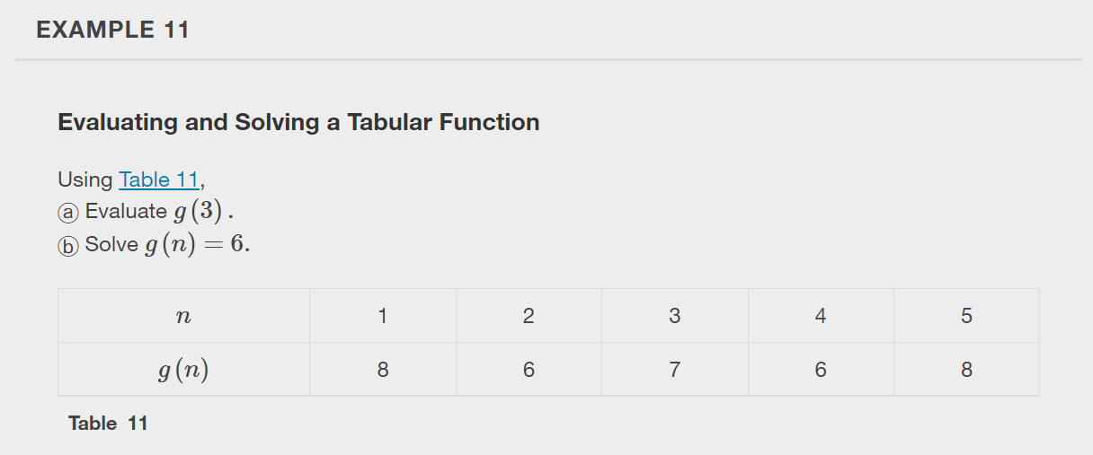

Slide 32
Finding Function Values from a Graph
Evaluating a function using a graph also requires finding the corresponding output value for a given input value, only in this case, we find the output value by looking at the graph.
Solving a function equation using a graph requires finding all instances of the given output value on the graph and observing the corresponding input value(s).

Slide 33
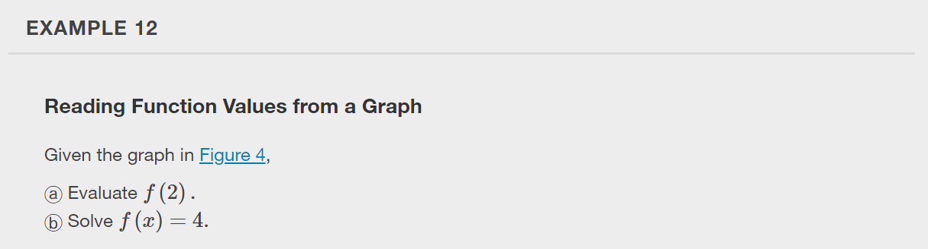
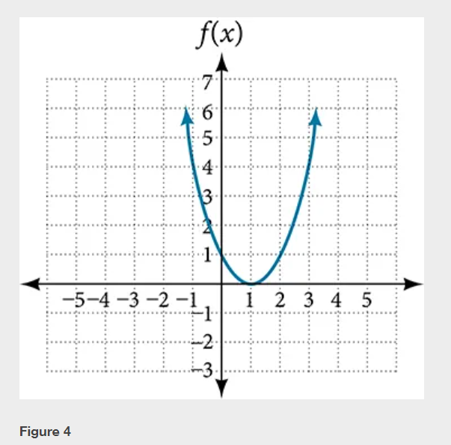

Slide 34
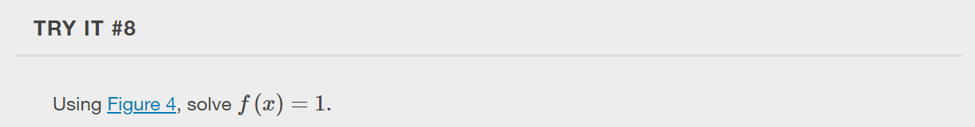

Slide 35
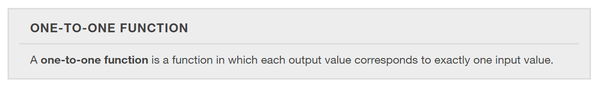
Determining Whether a Function is One-to-One
Some functions have a given output value that corresponds to two or more input values.
However, some functions have only one input value for each output value, as well as having only one output for each input. We call these functions one-to-one functions.

Slide 36
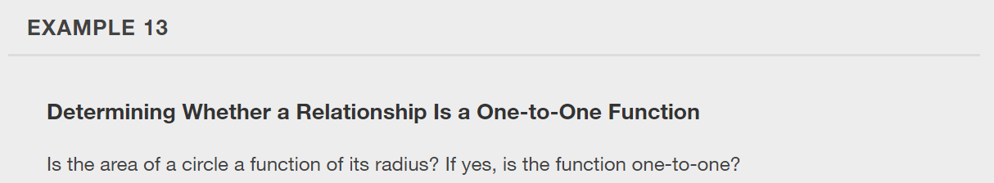

Slide 37
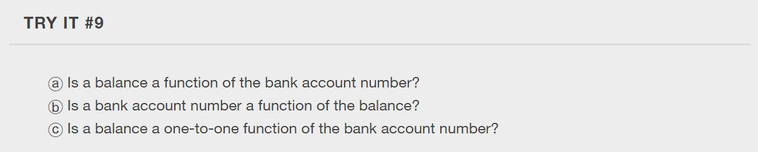

Slide 38
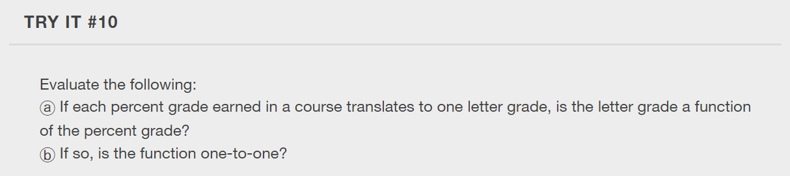

Slide 39
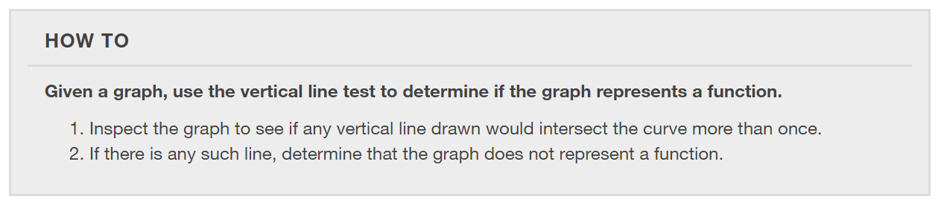
Using the Vertical Line Test
The vertical line test can be used to determine whether a graph represents a function.
If we can draw any vertical line that intersects a graph more than once, then the graph does not define a function because a function has only one output value for each input value.

Slide 40
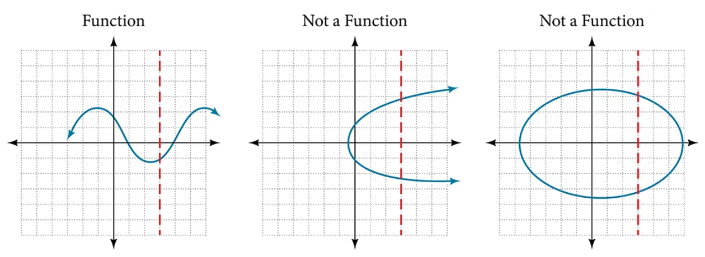

Slide 41
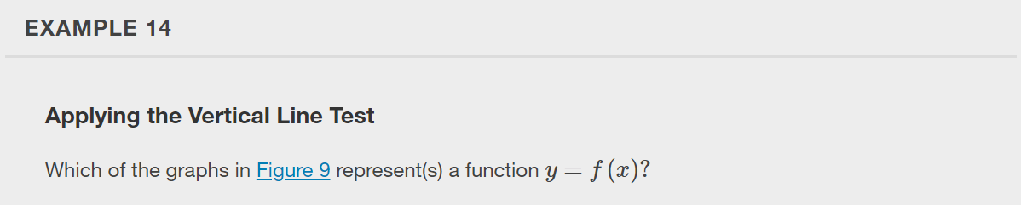
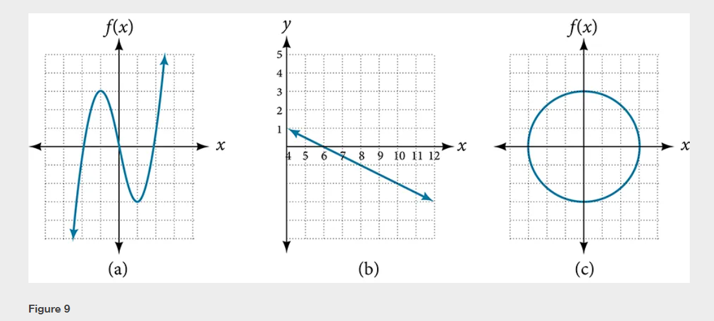

Slide 42
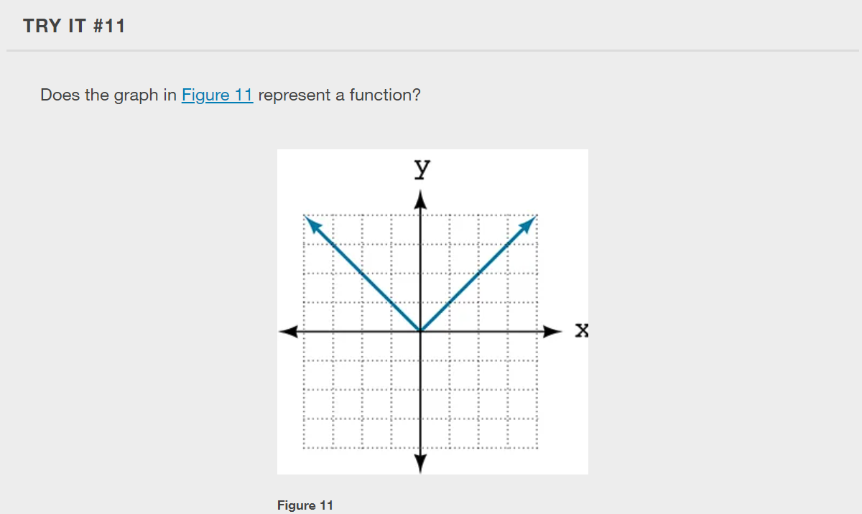

Slide 43
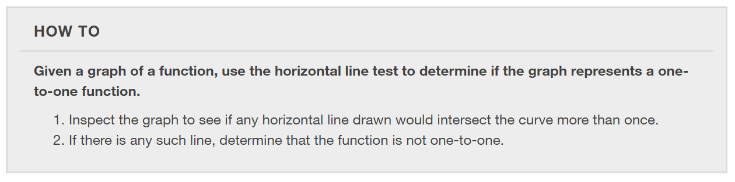
Using the Horizontal Line Test
Once we have determined that a graph defines a function, an easy way to determine if it is a one-to-one function is to use the horizontal line test. Draw horizontal lines through the graph. If any horizontal line intersects the graph more than once, then the graph does not represent a one-to-one function.

Slide 44
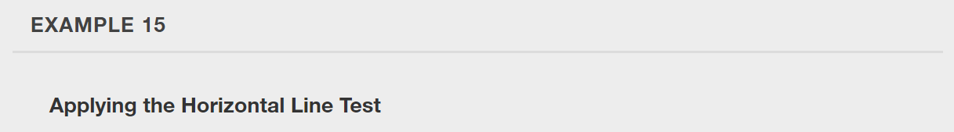

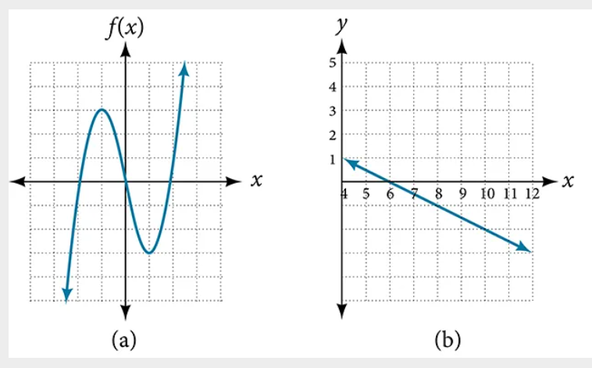

Slide 45

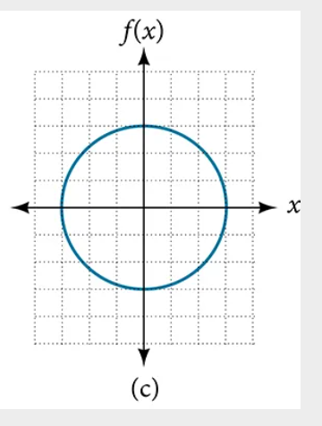

Slide 46
Identifying the Toolkit Functions
In this text, we will be exploring functions—the shapes of their graphs, their unique characteristics, their algebraic formulas, and how to solve problems with them.
The “toolkit functions” are functions for which we know the graph, formula, and special properties. These functions form the building-block elements for our library of functions.

Slide 47
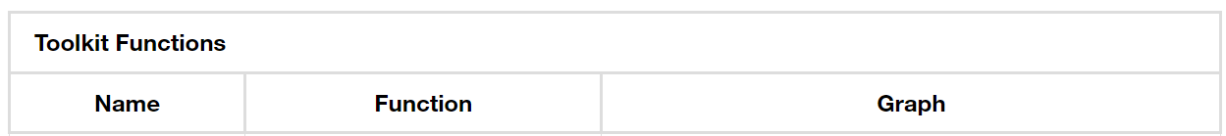
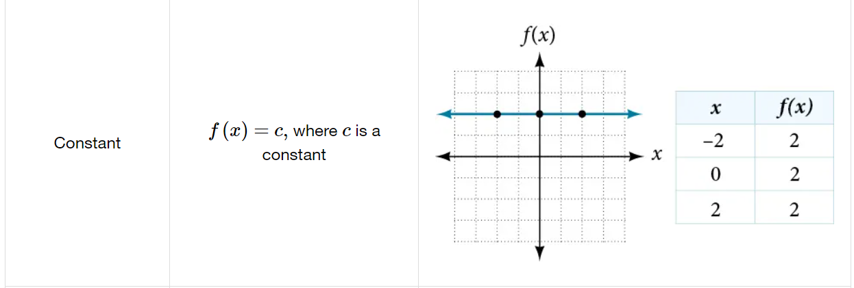

Slide 48
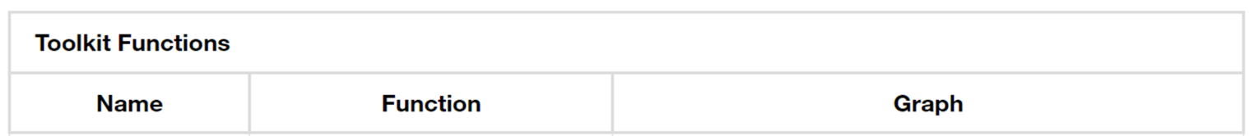
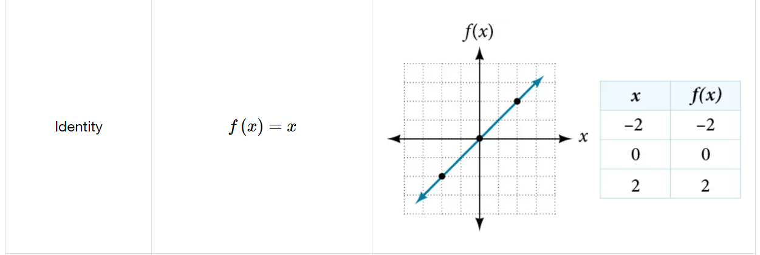

Slide 49



Slide 50


Slide 51


Slide 52


Slide 53


Slide 54


Slide 55


Slide 56
What did you learn in this section?
Determine whether a relation represents a function.
Find the value of a function.
Determine whether a function is one-to-one.
Use the vertical line test to identify functions.
Graph the functions listed in the library of functions.
Notes:
Do you have any questions?

Slide 57
This resource is an adaptation of the OpenStax Algebra and Trigonometry 2e open textbook and is © Susan Aydelotte under a CC BY-NC-SA 4.0 International license; it may be reproduced or modified for noncommercial purposes only but must be attributed to OpenStax, Rice University and any changes must be noted. Any adaptation must be shared under the same type of license.

