Slide 1
Equations and Inequalities
Chapter 2
Algebra and Trigonometry 2e
OpenStax
Jay Abramson
Notes:
Images and notes within these slides are from the OpenStax textbook Algebra and Trigonometry 2e

Slide 2
Other Types of Equations
Section 2.6
Notes:
Solve quadratic equations by factoring.
Solve quadratic equations by the square root property.
Solve quadratic equations by completing the square.
Solve quadratic equations by using the quadratic formula.
Use the Pythagorean Theorem.

Slide 3
What are the skills discussed in this section?
Solve equations involving rational exponents.
Solve equations using factoring.
Solve radical equations.
Solve absolute value equations.
Solve other types of equations.
Notes:
Do you have any questions?

Slide 4
Notes:
Do you have any questions?

Slide 5
Notes:
Do you have any questions?

Slide 6
Solving Equations Involving Rational Exponents
We can solve equations in which a variable is raised to a rational exponent by raising both sides of the equation to the reciprocal of the exponent. The reason we raise the equation to the reciprocal of the exponent is because we want to eliminate the exponent on the variable term.
Notes:
Do you have any questions?

Slide 7
Notes:
Do you have any questions?

Slide 8
Notes:
Do you have any questions?

Slide 9
Notes:
Do you have any questions?

Slide 10
Notes:
Do you have any questions?

Slide 11
Notes:
Do you have any questions?

Slide 12
Solving Equations Using Factoring
We have used factoring to solve quadratic equations, but it is a technique that we can use with many types of polynomial equations, which are equations that contain a string of terms including numerical coefficients and variables. When we are faced with an equation containing polynomials of degree higher than 2, we can often solve them by factoring.
Notes:
Do you have any questions?

Slide 13
Notes:
Do you have any questions?

Slide 14
Notes:
Do you have any questions?

Slide 15
Notes:
Do you have any questions?

Slide 16
Notes:
Do you have any questions?

Slide 17
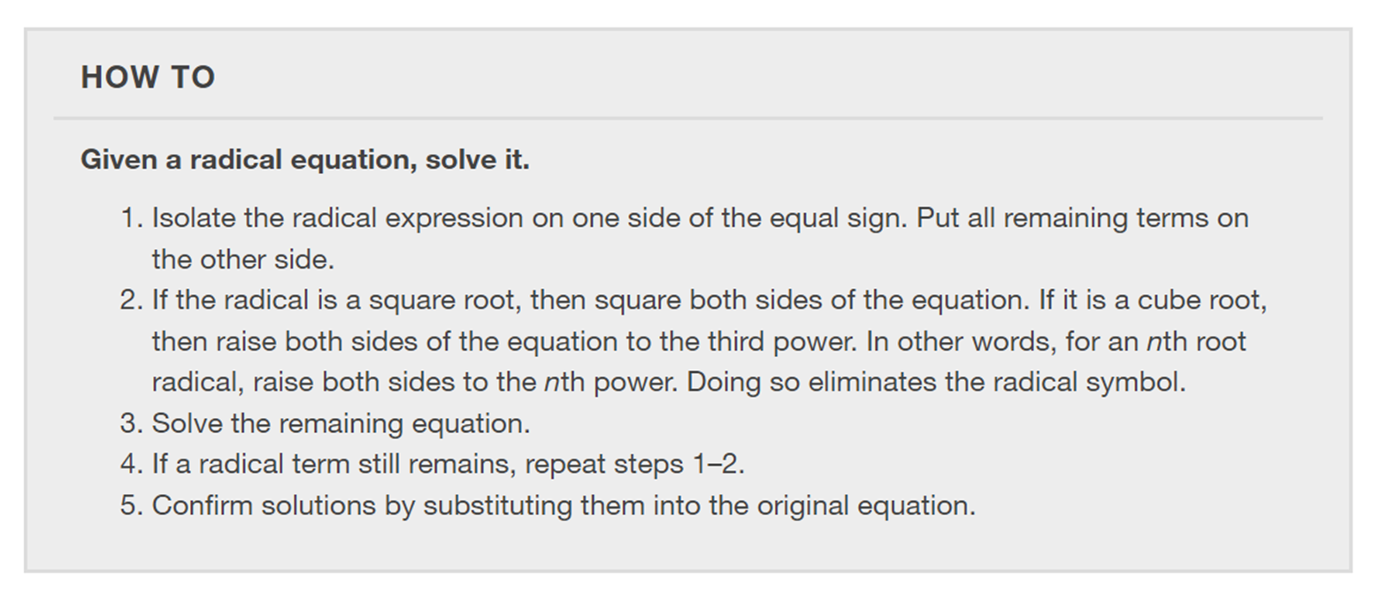
Solving Radical Equations
Radical equations may have one or more radical terms, and are solved by eliminating each radical, one at a time. We have to be careful when solving radical equations, as it is not unusual to find extraneous solutions, roots that are not, in fact, solutions to the equation. These solutions are not due to a mistake in the solving method, but result from the process of raising both sides of an equation to a power. Checking each answer in the original equation will confirm the true solutions.
Notes:
Do you have any questions?

Slide 18
Notes:
Do you have any questions?

Slide 19
Notes:
Do you have any questions?

Slide 20
Notes:
Do you have any questions?

Slide 21
Notes:
Do you have any questions?

Slide 22
Notes:
Do you have any questions?

Slide 23
Solving an Absolute Value Equation
Next, we will learn how to solve an absolute value equation. Knowing how to solve problems involving absolute value functions is useful. For example, we may need to identify numbers or points on a line that are at a specified distance from a given reference point.
Notes:
Do you have any questions?

Slide 24
Notes:
Do you have any questions?

Slide 25
Notes:
Do you have any questions?

Slide 26
Solving Equations in Quadratic Form
Equations in quadratic form are equations with three terms. The first term has a power other than 2. The middle term has an exponent that is one-half the exponent of the leading term. The third term is a constant. We can solve equations in this form as if they were quadratic.
Notes:
Do you have any questions?

Slide 27
Notes:
Do you have any questions?

Slide 28
Notes:
Do you have any questions?

Slide 29
Notes:
Do you have any questions?

Slide 30
Notes:
Do you have any questions?

Slide 31
Notes:
Do you have any questions?

Slide 32
Solving Rational Equations Resulting in a Quadratic
Earlier, we solved rational equations. Sometimes, solving a rational equation results in a quadratic. When this happens, we continue the solution by simplifying the quadratic equation by one of the methods we have seen. It may turn out that there is no solution.
Notes:
Do you have any questions?

Slide 33
Notes:
Do you have any questions?

Slide 34
Notes:
Do you have any questions?

Slide 35
What did you learn in this section?
Solve equations involving rational exponents.
Solve equations using factoring.
Solve radical equations.
Solve absolute value equations.
Solve other types of equations.
Notes:
Do you have any questions?

Slide 36
This resource is an adaptation of the OpenStax Algebra and Trigonometry 2e open textbook and is © Susan Aydelotte under a CC BY-NC-SA 4.0 International license; it may be reproduced or modified for noncommercial purposes only but must be attributed to OpenStax, Rice University and any changes must be noted. Any adaptation must be shared under the same type of license.

