Slide 1
Equations and Inequalities
Chapter 2
Algebra and Trigonometry 2e
OpenStax
Jay Abramson
Notes:
Images and notes within these slides are from the OpenStax textbook Algebra and Trigonometry 2e

Slide 2
Quadratic Equations
Section 2.5
Notes:
Solve quadratic equations by factoring.
Solve quadratic equations by the square root property.
Solve quadratic equations by completing the square.
Solve quadratic equations by using the quadratic formula.
Use the Pythagorean Theorem.

Slide 3
Story Problem
Notes:
The computer monitor on the left is a 23.6-inch model and the one on the right is a 27-inch model. Proportionally, the monitors appear very similar. If there is a limited amount of space and we desire the largest monitor possible, how do we decide which one to choose? To answer this question, we use a quadratic equation. In this section, we will learn how to solve quadratic equations using four different methods.

Slide 4
Solving Quadratic Equations by Factoring
An equation containing a second-degree polynomial is called a quadratic equation.
If a quadratic equation can be factored, it is written as a product of linear terms. Solving by factoring depends on the zero-product property, which states if the product of two numbers or two expressions equals zero, then one of the numbers or one of the expressions must equal zero because zero multiplied by anything equals zero.
Multiply two binomials with the FOIL method results in a trinomial.
Factoring is reverses this process: start with the trinomial and express it as the product of two binomials.
Notes:
Quadratic equations are used in countless ways in the fields of engineering, architecture, finance, biological science, and, of course, mathematics.
Often the easiest method of solving a quadratic equation is factoring. Factoring means finding expressions that can be multiplied together to give the expression on one side of the equation.

Slide 6
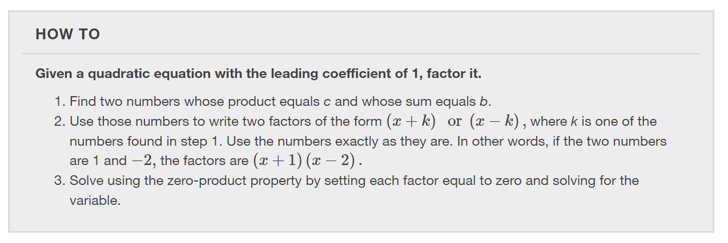

Slide 13
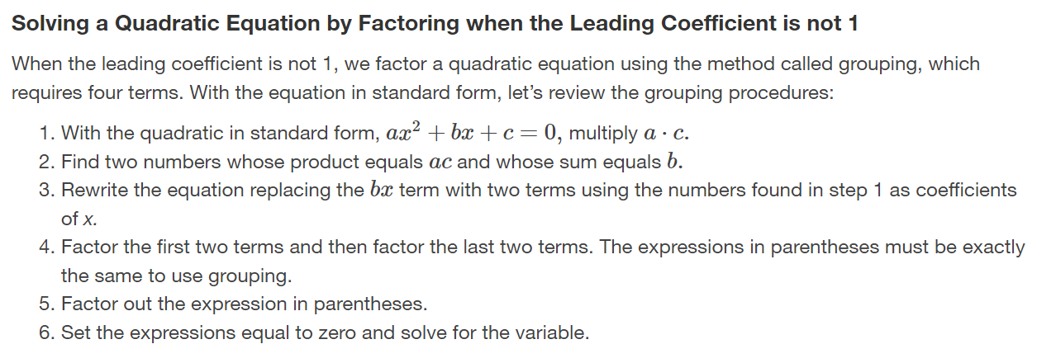

Slide 18
Using the Square Root Property
When there is no linear term in the equation, another method of solving a quadratic equation is by using the square root property.

Slide 23
Completing the Square
Not all quadratic equations can be factored or can be solved in their original form using the square root property. In these cases, we may use a method for solving a quadratic equation known as completing the square.
${a x}^{2}+b x+c=0$
If $a$ equals $1$, the follow these steps:
1. add ${(b/2)}^{2}$to both sides of the equation to obtain a perfect square trinomial
2. factor the trinomial as a perfect square binomial
3. apply the square root property
4. solve for the variable $x$
If $a$ does not equal $1$, then divide the equation by $a$ and proceed as described above to complete the square.

Slide 26
Notes:
The fourth method of solving a quadratic equation is by using the quadratic formula, a formula that will solve all quadratic equations. Although the quadratic formula works on any quadratic equation in standard form, it is easy to make errors in substituting the values into the formula. Pay close attention when substituting, and use parentheses when inserting a negative number. We can derive the quadratic formula by completing the square.

Slide 33
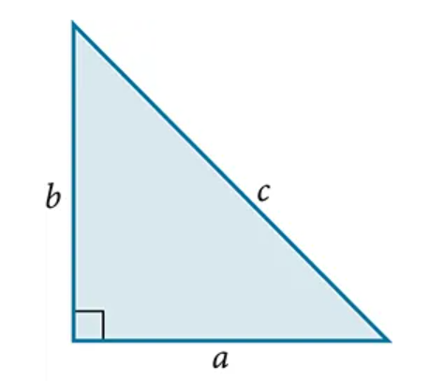
Using the Pythagorean Theorem
One of the most famous formulas in mathematics is the Pythagorean Theorem.
The Pythagorean Theorem is given as
where $a$ and $b$ refer to the legs of a right triangle adjacent to the $90$-degree angle, and $c$ refers to the hypotenuse.

Slide 34
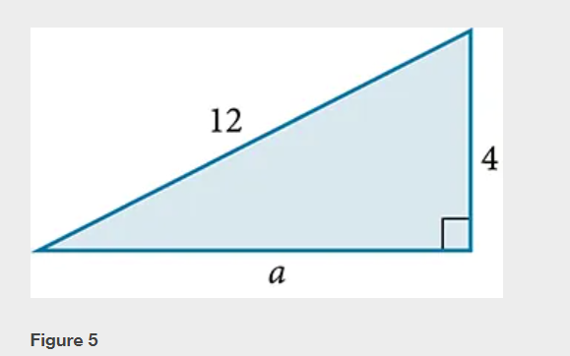

Slide 36
What did you learn in this section?
Solve quadratic equations by factoring.
Solve quadratic equations by the square root property.
Solve quadratic equations by completing the square.
Solve quadratic equations by using the quadratic formula.
Use the Pythagorean Theorem.
Notes:
Do you have any questions?

Slide 37
This resource is an adaptation of the OpenStax Algebra and Trigonometry 2e open textbook and is © Susan Aydelotte under a CC BY-NC-SA 4.0 International license; it may be reproduced or modified for noncommercial purposes only but must be attributed to OpenStax, Rice University and any changes must be noted. Any adaptation must be shared under the same type of license.

