Slide 1
Equations and Inequalities
Chapter 2
Algebra and Trigonometry 2e
OpenStax
Jay Abramson
Notes:
Images and notes within these slides are from the OpenStax textbook Algebra and Trigonometry 2e

Slide 2
Models and Applications
Section 2.3
Notes:
Set up a linear equation to solve a real-world application.
Use a formula to solve a real-world application.

Slide 3
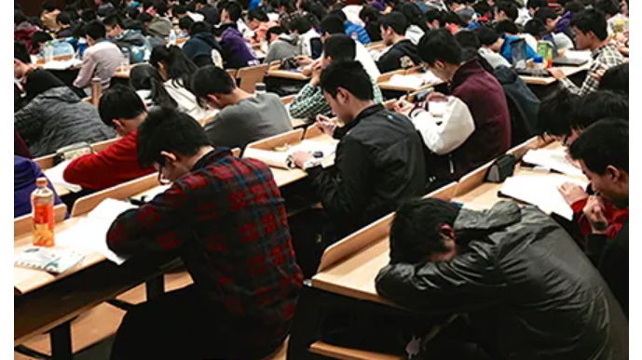
Story Problem
Notes:
A student is hoping to get an A in his math class. He has scores of 75, 82, 95, 91, and 94 on his first five tests. Only the final exam remains, and the maximum number of points that can be earned is 100. Is it possible for the student to end the course with an A? We can use mathematical models to answer this question.

Slide 4
Setting up a Linear Equation to Solve a Real-World Application

Slide 7
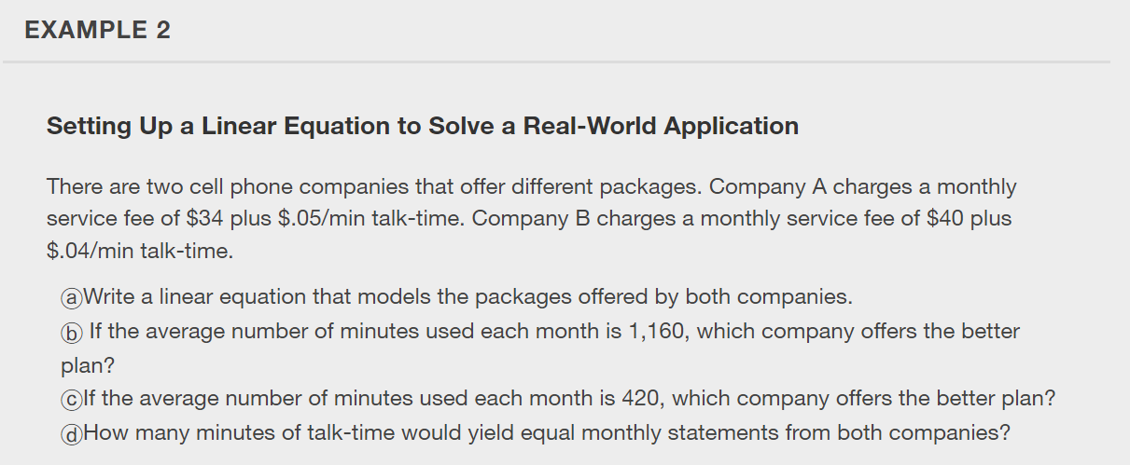

Slide 16
What did you learn in this section?
Set up a linear equation to solve a real-world application.
Use a formula to solve a real-world application.
Notes:
Do you have any questions?

Slide 17
This resource is an adaptation of the OpenStax Algebra and Trigonometry 2e open textbook and is © Susan Aydelotte under a CC BY-NC-SA 4.0 International license; it may be reproduced or modified for noncommercial purposes only but must be attributed to OpenStax, Rice University and any changes must be noted. Any adaptation must be shared under the same type of license.

