Slide 1

Equations and Inequalities
Chapter 2
Algebra and Trigonometry 2e
OpenStax
Jay Abramson
Notes:
Images and notes within these slides are from the OpenStax textbook Algebra and Trigonometry 2e

Slide 2
Linear Equations in One Variable
Section 2.2
Notes:
Solve equations in one variable algebraically.
Solve a rational equation.
Find a linear equation.
Given the equations of two lines, determine whether their graphs are parallel or perpendicular.
Write the equation of a line parallel or perpendicular to a given line.

Slide 3
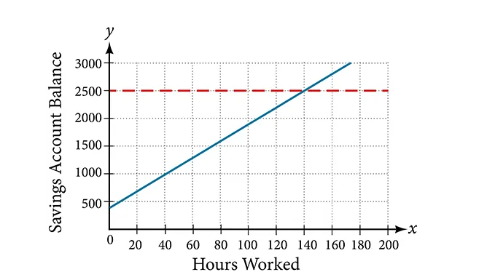
Story Problem
Notes:
Caroline is a full-time college student planning a spring break vacation. To earn enough money for the trip, she has taken a part-time job at the local bank that pays $15.00/hr, and she opened a savings account with an initial deposit of $400 on January 15. She arranged for direct deposit of her payroll checks. If spring break begins March 20 and the trip will cost approximately $2,500, how many hours will she have to work to earn enough to pay for her vacation? If she can only work 4 hours per day, how many days per week will she have to work? How many weeks will it take? In this section, we will investigate problems like this and others,

Slide 4
Solving Linear Equations in One Variable
A linear equation is an equation of a straight line, written in one variable. The only power of the variable is 1.
There are three types of linear equations: identity, conditional, or inconsistent.
  An identity equation is true for all values of the variable.
  A conditional equation is true for only some values of the variable.
  An inconsistent equation results in a false statement.

Slide 5
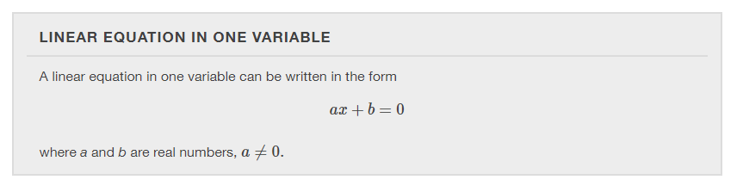

Slide 6
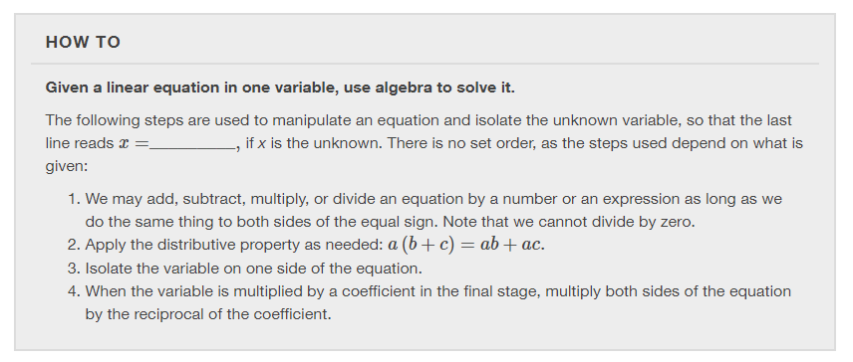

Slide 7
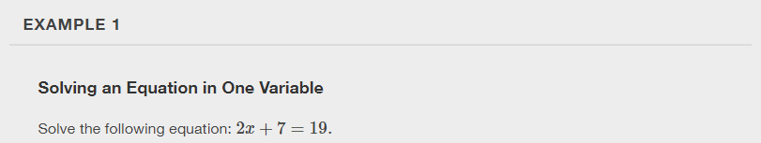

Slide 8


Slide 9
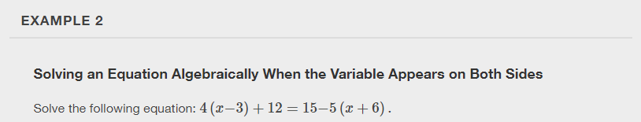

Slide 10


Slide 11
Solving a Rational Equation
In this section, we look at rational equations that, after some manipulation, result in a linear equation.
If an equation contains at least one rational expression, it is a considered a rational equation.
A rational expression is the ratio, or quotient, of two polynomials.
Rational equations have a variable in the denominator in at least one of the terms. Our goal is to perform algebraic operations so that the variables appear in the numerator. In fact, we will eliminate all denominators by multiplying both sides of the equation by the least common denominator (LCD).
Finding the LCD is identifying an expression that contains the highest power of all of the factors in all of the denominators. We do this because when the equation is multiplied by the LCD, the common factors in the LCD and in each denominator will equal one and will cancel out.

Slide 12
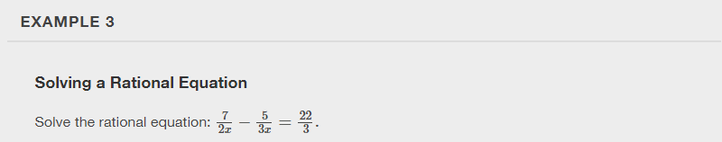

Slide 13
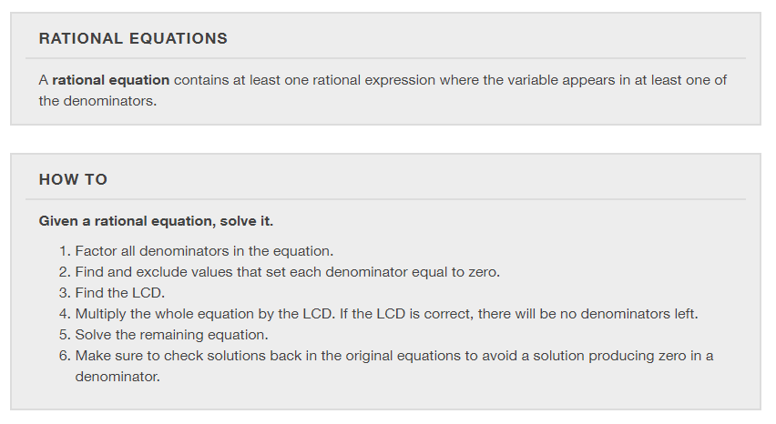

Slide 14
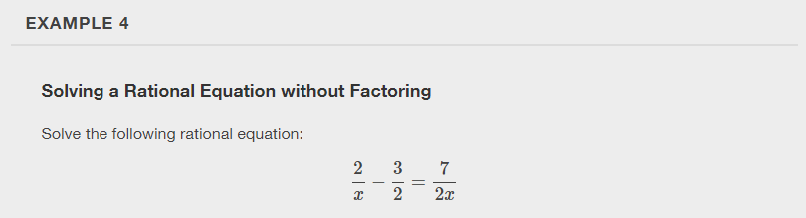

Slide 15


Slide 16
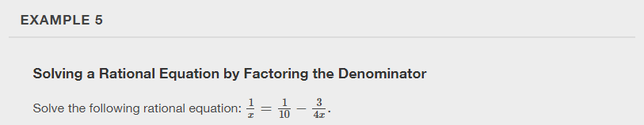

Slide 17


Slide 18
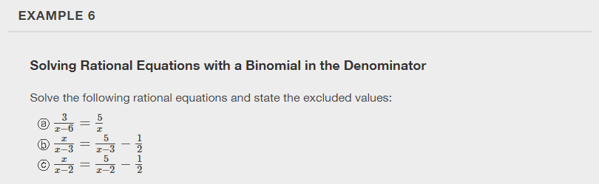

Slide 19
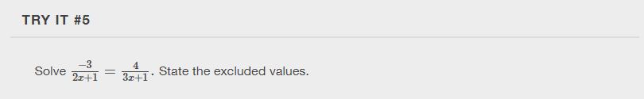

Slide 20
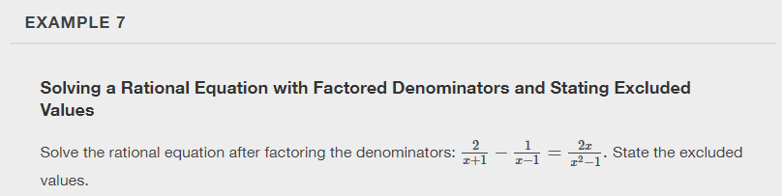

Slide 21


Slide 22
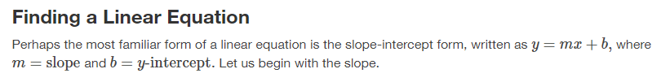
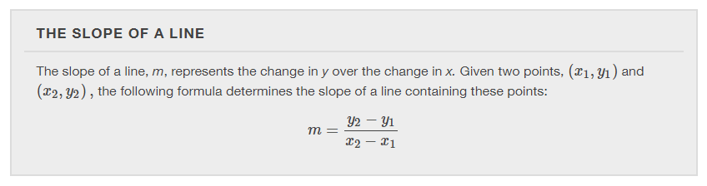

Slide 23
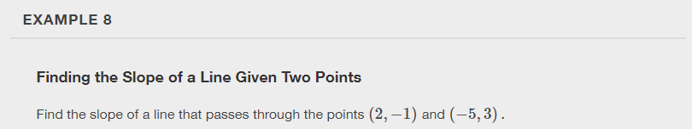

Slide 24


Slide 25
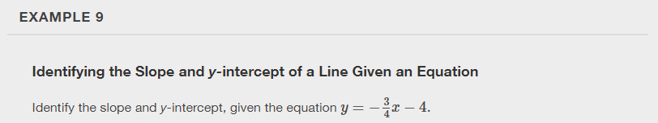

Slide 26
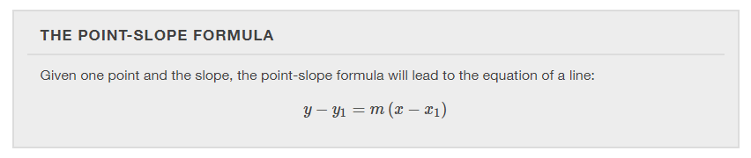

Slide 27
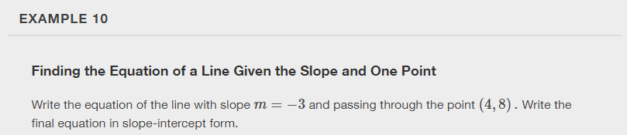

Slide 28
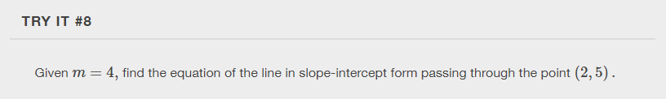

Slide 29
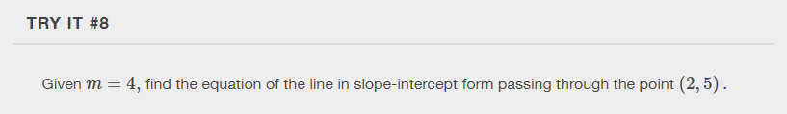

Slide 30
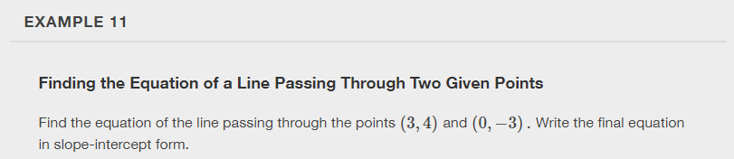

Slide 31
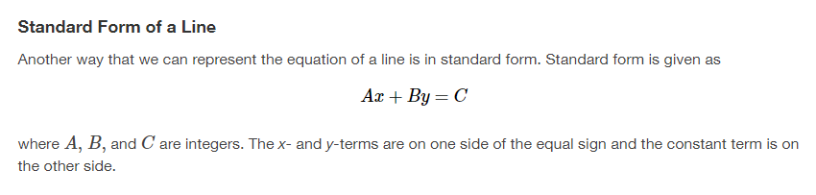

Slide 32
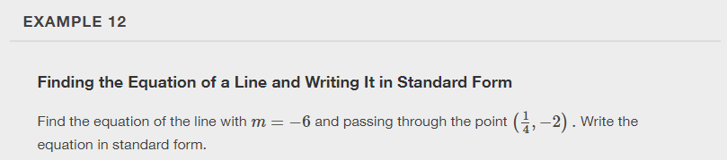

Slide 33
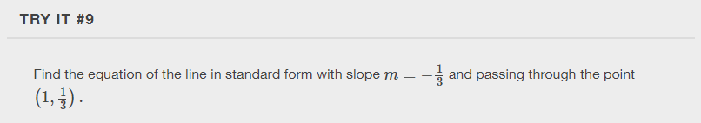

Slide 34
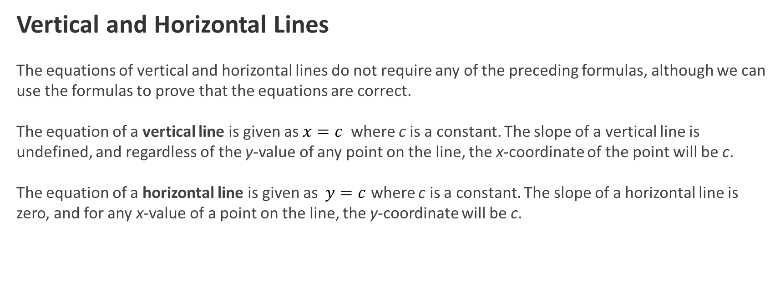
Vertical and Horizontal Lines
The equations of vertical and horizontal lines do not require any of the preceding formulas, although we can use the formulas to prove that the equations are correct.
The equation of a vertical line is given as $x=c$ where c is a constant. The slope of a vertical line is undefined, and regardless of the y-value of any point on the line, the x-coordinate of the point will be c.
The equation of a horizontal line is given as $y=c$ where c is a constant. The slope of a horizontal line is zero, and for any x-value of a point on the line, the y-coordinate will be c.

Slide 35
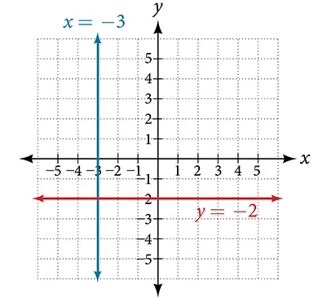
Vertical and Horizontal Lines

Slide 36
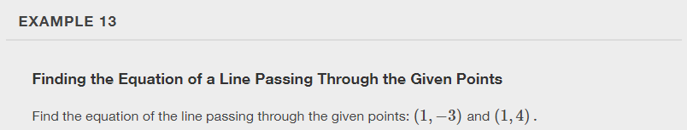

Slide 37


Slide 38
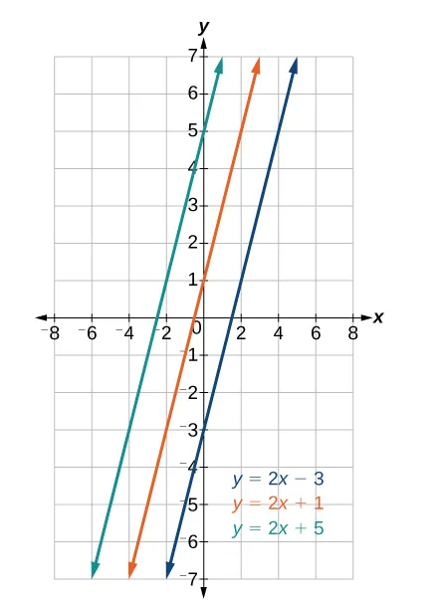
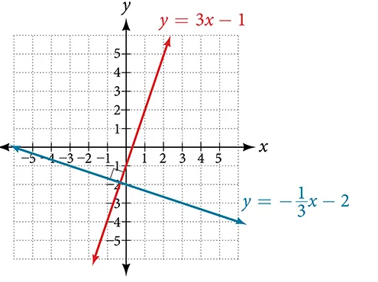
Determining Whether Graphs of Lines are Parallel or Perpendicular
Parallel lines have the same slope and different y-intercepts. Lines that are parallel to each other will never intersect.
Lines that are perpendicular intersect to form a 90-degree angle. The slope of one line is the negative reciprocal of the other. We can show that two lines are perpendicular if the product of the two slopes is -1.

Slide 39
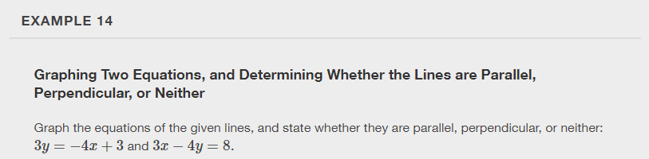

Slide 40
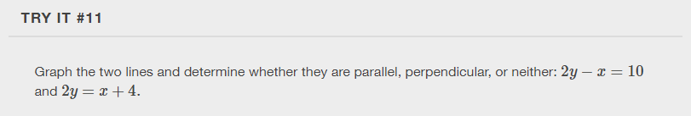

Slide 41
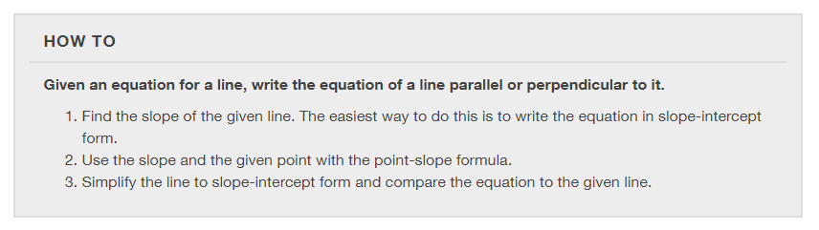
Writing the Equations of Lines Parallel or Perpendicular to a Given Line

Slide 42
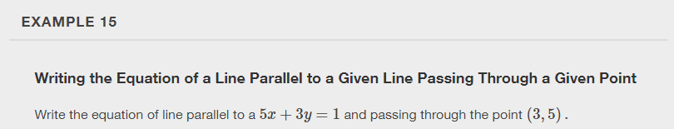

Slide 43


Slide 44
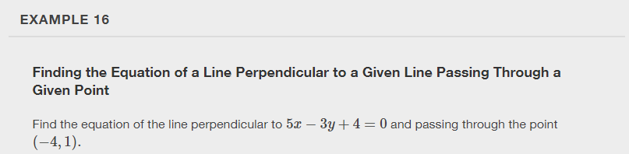

Slide 45
What did you learn in this section?
Solve equations in one variable algebraically.
Solve a rational equation.
Find a linear equation.
Given the equations of two lines, determine whether their graphs are parallel or perpendicular.
Write the equation of a line parallel or perpendicular to a given line.
Notes:
Do you have any questions?

Slide 46
This resource is an adaptation of the OpenStax Algebra and Trigonometry 2e open textbook and is © Susan Aydelotte under a CC BY-NC-SA 4.0 International license; it may be reproduced or modified for noncommercial purposes only but must be attributed to OpenStax, Rice University and any changes must be noted. Any adaptation must be shared under the same type of license.

